Slide 1
LIT 3023 Modernism
T.S. Eliot
The Waste Land (2)

Slide 2
Overview
Recap on last lecture
A poem of allusion
Structure
Close reading

Slide 3
The Waste Land
Sources - myth and romance (see Jessie Weston, James Frazer)
European literature in general
Very broad range of reference - some perhaps unintentional, e.g. Marie
Dialogic (Bakhtin)
“The past should be altered by the present as much as the present is directed by the past." (Eliot, “Tradition and the Individual Talent”)
“He do the police in different voices”
Notes:
Bakhtin: The dialogic work carries on a continual dialogue with other works of literature and other authors. It does not merely answer, correct, silence, or extend a previous work, but informs and is continually informed by the previous work.
"You mightn't think it, but Sloppy is a beautiful reader of a newspaper. He do the Police in different voices." Betty Higden in Our Mutual Friend.
Lodge, Small World – Persse’ s thesis

Slide 4
Impact of allusion
Density
Intertextuality - imports other connotations, and implies a comparison, for instance
“April is the cruellest month…”
“Sweet Thames, run softly…”
Eliot: “In art there should be interpenetration and metamorphosis” (review of Le Sacre de Printemps, 1921

Slide 5
April
Spring - fertility, growth, renewal; object of many rituals
Celebrated in literature and art
Obvious evocation of Chaucer’s Prologue
By extension, other celebrations of growth / life

Slide 6
Chaucer: General Prologue
Whan that Aprill with his shoures soote
the droghte of March hath perced to the roote,
And bathed every veyne in swich licour
Of which vertu engendred is the flour;
Whan Zephirus eek with his sweete breeth
Inspired hath in every holt and heeth
The tendre croppes, and the yonge sonne
Hath in the Ram his halve cours yronne,
And smale foweles maken melodye,
That slepen al the nyght with open ye
(So priketh hem nature in hir corages);
Thanne longen folk to goon on pilgrimages,
And palmeres for to seken straunge strondes,
To ferne halwes, kowthe in sondry londes;
And specially from every shires ende
Of Engelond to Caunterbury they wende,
The hooly blisful martir for to seke,
That hem hath holpen whan that they were seeke.

Slide 7
Brooke
The Old Vicarage, Grantchester
(Café des Westens, Berlin, May 1912)
Just now the lilac is in bloom,
All before my little room;
And in my flower-beds, I think,
Smile the carnation and the pink;
And down the borders, well I know, 5
The poppy and the pansy blow…

Slide 8
Brooke, Cont’d
Oh! there the chestnuts, summer through,
Beside the river make for you
A tunnel of green gloom, and sleep
Deeply above; and green and deep 10
The stream mysterious glides beneath,
Green as a dream and deep as death.

Slide 9
Brooke…
—Oh, damn! I know it! and I know
How the May fields all golden show,
And when the day is young and sweet, 15
Gild gloriously the bare feet
That run to bathe…
Du lieber Gott!

Slide 10
..and
Here am I, sweating, sick, and hot,
And there the shadowed waters fresh 20
Lean up to embrace the naked flesh.
Temperamentvoll German Jews
Drink beer around;—and there the dews
Are soft beneath a morn of gold.

Slide 11
So…
Opening can evoke ideas of the beauty and promise of spring, but…
…contain notions of doubt, frustration and decay as well
Intertextuality works by bringing the contrasting ideas into juxtaposition

Slide 12
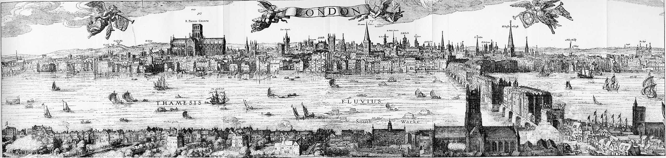
Spenser’s Thames

Slide 13
Spenser’s Prothalamion
Calme was the day, and through the trembling ayre,
Sweete breathing Zephyrus did softly play
A gentle spirit, that lightly did delay
Hot Titans beames, which then did glyster fayre:
When I whom sullein care,
Through discontent of my long fruitlesse stay
In Princes Court, and expectation vayne
Of idle hopes, which still doe fly away,
Like empty shaddowes, did aflict my brayne,
Walkt forth to ease my payne

Slide 14
Cont’d
Along the shoare of siluer streaming Themmes,
Whose rutty Bancke, the which his Riuer hemmes,
Was paynted all with variable flowers,
And all the meades adornd with daintie gemmes,
Fit to decke maydens bowres,
And crowne their Paramours,
Against the Brydale day, which is not long:
Sweete Themmes runne softly, till I end my Song.

Slide 15
Eliot’s nymphs
The wind
Crosses the brown land, unheard. The nymphs are departed.
Sweet Thames, run softly, till I end my song.
The river bears no empty bottles, sandwich papers,
Silk handkerchiefs, cardboard boxes, cigarette ends
Or other testimony of summer nights. The nymphs are departed.
And their friends, the loitering heirs of city directors;
Departed, have left no addresses.
By the waters of Leman I sat down and wept...
Sweet Thames, run softly till I end my song,
Sweet Thames, run softly, for I speak not loud or long.

Slide 16
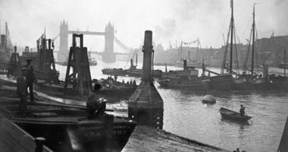
Eliot’s Thames
Notes:
The river sweats /Oil and tar /The barges drift /With the turning tide /Red sails /Wide /To leeward, swing on the heavy spar. /The barges wash /Drifting logs /Down Greenwich reach /Past the Isle of Dogs.

Slide 17
The Fire Sermon
Buddha’s sermon against lust
“River’s tent is broken” - literal and metaphorical meanings
Religious and moral decay
Comparison of idyllic certainties of Spenser with sordid twentieth-century realities
Notes:
Tent – can = tabernacle, so religious connotations.

Slide 18
Structure?
“These fragments I have shored against my ruins”
Suggests broken, fractured, disorganised structure
Echoed in the collage of voices at the end
Resonances rebound from one section to another
Spatial, not linear

Slide 19
Conclusions
Cooper: The Waste Land does not merely reflect the breakdown of an historical, social, and cultural order battered by violent forces operating under the name of modernity. For Eliot the disaster that characterized modernity was not an overturning, but the unavoidable, and ironic, culmination of that very order so lovingly celebrated in Victoria's last decade on the throne. Unlike the older generation, who saw in events like the Great War the passing of a golden age, Eliot saw only that the golden age was itself a heap of absurd sociopolitical axioms and perverse misreadings of the cultural past that had proved in the last instance to be made of the meanest alloy.
Notes:
From Cooper, J.X., T.S. Eliot and the Politics of Voice: The Argument of "The Waste Land." (Ann Arbor: UMI Research Press, 1987) p. 85

Slide 20
…or…
Untermeyer: “Mr Eliot’s poetic variations on a theme of a super-refined futility.”
although “a pompous parade of erudition,” as “an echo of contemporary despair, as a picture of dissolution, of the breaking down of the very structures on which life has modeled itself, The Waste Land has definite authenticity.”
Lowell: “A piece of tripe.”
Notes:
Untermeyer: ‘Disillusion and Dogma’, review in The Freeman, January 1923 p. 453
Lowell, quoted by Jay Martin in his introduction to The Waste Land: A Collection of Critical Essays (Englewood Cliffs, N.J., 1968), p. 5.

