Slide 2
PLAY / PAUSE
VOLUME
NAVIGATION
Before you begin…
Navigating through this e-Session could not be simpler. You will find at the bottom of each screen a navigation bar.
This navigation bar contains a play / pause button which allows you to stop and start the audio commentary for each page, along with any videos or animations.
Additionally, you also have two page navigation buttons which allow you to move forwards and backwards through the content pages.
The navigation bar, also includes an audio control, which allows you to change the audio and video sound level by left clicking and moving your mouse to change the volume to a desired level.
Notes:
Navigating through this e-Session could not be simpler. You will find at the bottom of each screen a navigation bar.
This navigation bar contains a play / pause button which allows you to stop and start the audio commentary for each page, along with any videos or animations.
Additionally, you also have two page navigation buttons which allow you to move forwards and backwards through the content pages.
The navigation bar, also includes an audio control, which allows you to change the audio and video sound level by left clicking and moving your mouse to change the volume to a desired level.

Slide 3
NAVIGATION
DOCUMENTS
Before you begin…
The navigation tool also includes a progress slide bar, which shows you the time remaining for each page. You can left click and drag your mouse within this bar to quickly shift to a particular time.
Access the acknowledgement and reference material for the e session by clicking on the resource button, top right of the page.
If at any time you require help in using this e-session please contact your help desk facilities.
PROGRESS BAR
REPLAY
Notes:
Before you begin…
The navigation tool also includes a progress slide bar, which shows you the time remaining for each page. You can left click and drag your mouse within this bar to quickly shift to a particular time.
Access the acknowledgement and reference material for the e session by clicking on the resource button, top right of the page.
If at any time you require help in using this e-session please contact your help desk facilities.

Slide 4
Welcome to the diabetes foot screening online e session
Diabetic foot check is aimed at highlighting patients at risk of developing foot ulceration and amputation
This is in accordance with NICE guidelines ‘Prevention & Management of foot problems’ – clinical guideline 10 (2004)

Slide 5
Background Prevalence of diabetes
There are 2.9 million people diagnosed with diabetes in the UK (2011)¹

Slide 6
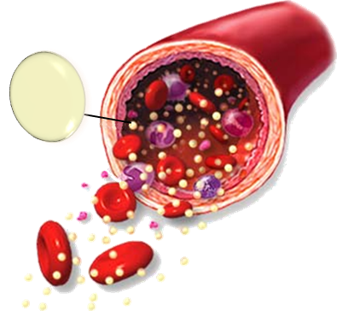
Background Diabetes effect on the foot
Hyperglycaemia over a long period increases risk of complications.
(UKPDS 1998;DCCT 1993)
Glucose
High Levels of Glucose
Hyperglycaemia
Notes:
Search The Lancet for The UK Prospective Diabetes study
http://www.thelancet.com/journals/lancet/article/PIIS0140-6736(98)07037-8/fulltext

Slide 7
Variation of amputations in the england
Amputation rates in some areas are too high, says the Department of Health.
Diabetes amputation rates show huge regional variation
BBC News Health March 2012
Diabetes foot care ‘Appalling’.
BBC News Health July 2012
The interactive online version of the Atlas can be accessed on the next screen.
Notes:
Read more http://www.rightcare.nhs.uk/ search Atlas of Variation
Link http://www.sepho.org.uk/extras/maps/NHSatlas2011/atlas.html
http://www.rightcare.nhs.uk/index.php/atlas/atlas-of-variation-2011/

Slide 8
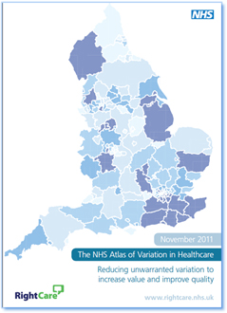
Atlas of Variation 2011
Rate of urgent GP referrals for suspected cancer per 100,000 population by PCT, 2010/11
The interactive online version of the Atlas can be accessed here.
SELECT TO VIEW
Notes:
http://www.sepho.org.uk/extras/maps/NHSatlas2011/atlas.html

Slide 9
Cost of poor diabetic foot care to NHS
In 2010 – 2011 the NHS England spent an estimated £639 – 662 million on diabetic foot ulcers and amputations.
This is equal to 0.6 – 0.7 of the NHS budget or 1.75 – 1.8 million pounds per day.
Diabetes: cases and costs predicted to rise
LEARN MORE
In order to try and prevent this from happening annual diabetic foot assessment are required.
Notes:
Diabetes: cases and costs predicted to rise
http://www.nhs.uk/news/2012/04april/Pages/nhs-diabetes-costs-cases-rising.aspx
Foot care for people with diabetes in the NHS
in England: The economic case for change
http://www.diabetes.org.uk/upload/News/Factsheet%20Footcare%20for%20people%20with%20diabetes.pdf

Slide 10
Diabetic foot assessment
Regular, accurate & reliable screening is essential to be able to focus on those most at risk
(Foster & Edmonds 2001, St Vincent Workgroup Report 1996; SIGN 2001; NICE 2004)
The NICE clinical guideline on type 2 diabetes recommend.
Test foot sensations using 10g monofilament or vibration
Palpate foot pulses
Inspect for any deformity
Inspect for significant callus
Check for signs of ulceration
Ask about any previous ulceration
Inspect footwear
Type 2 diabetes foot problems: Prevention and management of foot problems
LEARN MORE
Notes:
Learn more..Type 2 diabetes foot problems: Prevention and management of foot problems
http://publications.nice.org.uk/type-2-diabetes-foot-problems-cg10
Search http://www.nice.org.uk/
Type 2 diabetes foot problems: Prevention and management of foot problems (CG10)

Slide 11
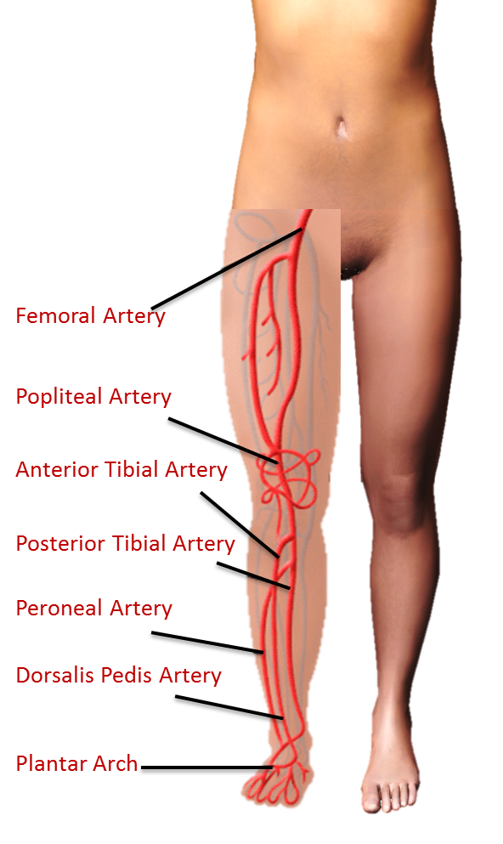
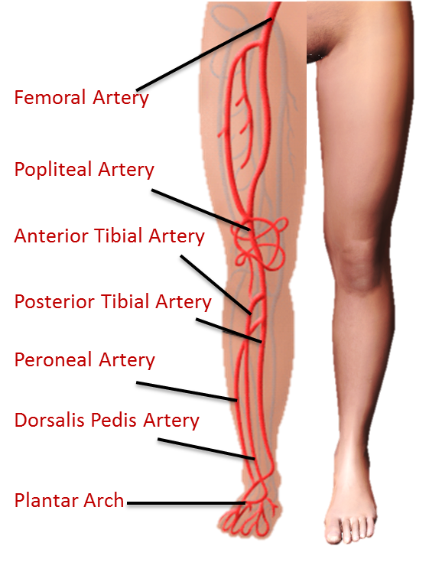
Foot pulses
Dorsalis Pedis
Palpate the top of the foot between the first and second metatarsal. (Note whether present or absent).
Posterior Tibial
Palpate the area behind the medial malleolus (ankle bone). (Note whether present or absent).
If either pulse can be felt then it is unlikely that there is significant ischaemia.
Femoral Artery
Popliteal Artery
Anterior Tibial Artery
Posterior Tibial Artery
Peroneal Artery
Dorsalis Pedis Artery
Plantar Arch
Femoral Artery
Popliteal Artery
Anterior Tibial Artery
Posterior Tibial Artery
Peroneal Artery
Dorsalis Pedis Artery
Plantar Arch

Slide 12
Foot pulses
Accurate pulse palpation requires practice.
Select play to view an example video on Accurate pulse palpation
Both posterior tibial and dorsalis pedis pulses are assessed and any one absent pulse may indicate peripheral arterial disease should be referred on

Slide 13
Foot pulses
Both posterior tibial and dorsalis pedis pulses are assessed and any one absent pulse may indicate peripheral arterial disease should be referred on

Slide 14
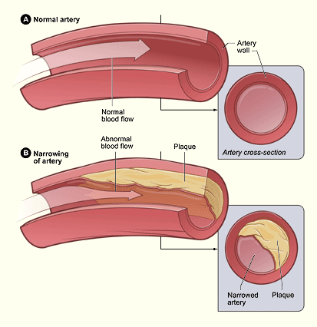
Foot Pulses - peripheral arterial disease
Peripheral arterial disease (PAD) occurs when there is significant narrowing of arteries, most often due to atherosclerosis.
Poor circulation in diabetes can present as either macrovascular or micro vascular disease (- type 1 diabetes usually presents with microvascular changes, - type 2 diabetes usually present with macrovascular.)
Peripheral arterial disease occurs 2 - 3 times more in the diabetes population and usually presents below knee.
SELECT TO ZOOM
Notes:
Peripheral arterial disease (PAD) occurs when there is significant narrowing of arteries, most often due to atherosclerosis.
Poor circulation in diabetes can present as either macrovascular or micro vascular disease (- type 1 diabetes usually presents with microvascular changes, - type 2 diabetes usually present with macrovascular.)
Peripheral arterial disease occurs 2 - 3 times more in the diabetes population and usually presents below knee.
Accurate pulse palpation requires practice.

Slide 15
Foot Pulses - peripheral arterial disease

Slide 16
Foot Pulses - peripheral arterial disease
Signs and symptoms
Amputation
Gangrene
Rest Pain
Ischaemic ulcer
Claudication
Absent pulse
Critical limb ischaemia

Slide 17
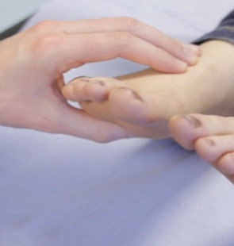
Foot Pulses - peripheral arterial disease
Absent Pulse
Absent pulses - any one absent
pulse may indicate arterial disease (ischaemia) and requires further investigation
Section
1 of ?

Slide 18
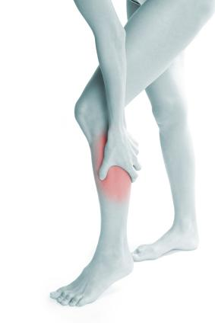
Foot Pulses - peripheral arterial disease
Claudication
Claudication - muscular leg pain on exercise that is relieved by a short rest of less than 10 minutes
Section
1 of ?

Slide 19
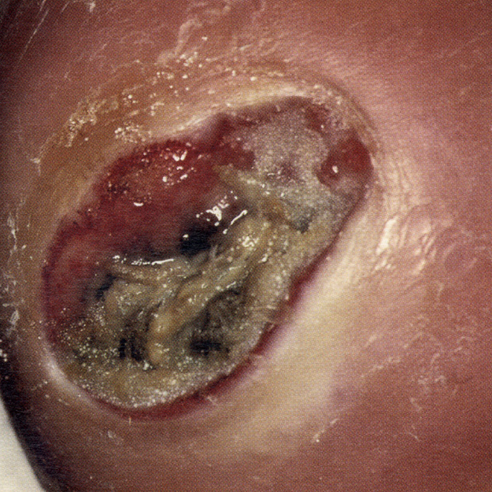
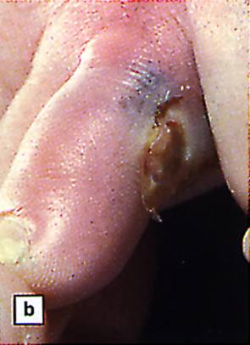
Foot Pulses - peripheral arterial disease
Ischaemic ulcer
An ischemic ulcer is a break in the integrity of the skin brought about by a significant reduction of blood supply to the area. They may have a punched out appearance with necrotic eschar.
Section
1 of ?

Slide 20
Foot Pulses - peripheral arterial disease
Rest Pain
Rest pain - a severe form of claudication brought about whilst resting without any exercise, this is a symptom of critical limb ischaemia
Section
1 of ?

Slide 21
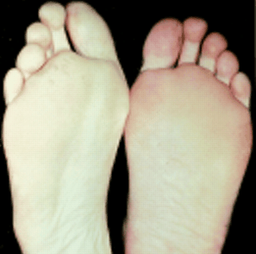
Foot Pulses - peripheral arterial disease
Critical limb ischaemia
Rest pain - a severe form of claudication brought about whilst resting without any exercise, this is a symptom of critical limb ischaemia
Section
1 of ?

Slide 22
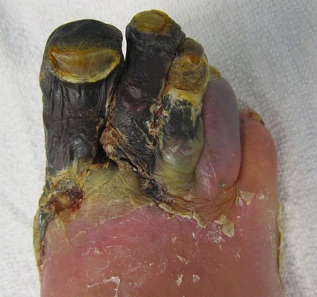
Foot Pulses - peripheral arterial disease
Gangrene
Gangrene - Localized death and decomposition of body tissue, resulting from either obstructed circulation or bacterial infection
Section
1 of ?

Slide 23
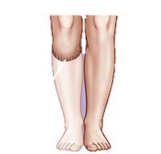
Foot Pulses - peripheral arterial disease
Rest Pain
Rest pain - a severe form of claudication brought about whilst resting without any exercise, this is a symptom of critical limb ischaemia
Section
1 of ?

