Slide 1
Learning Technology Development

Slide 2
Online Submission Workshop
How to create an assignment dropbox?
  Assignment Template
  Dates
Grade Centre
  Hide Columns
  Grading Schemas (Some Revision, Pass, Merit, Distinction)
Marking assignments
  Downloading Assignment (Zip File)
  Feedback ( Rename File)
  Uploading Assignments (Upload Zip)
  Releasing Feedback
Releasing Feedback
  Un-Hide Column
Smart Views
Downloading Reports
edgehill.ac.uk

Slide 3
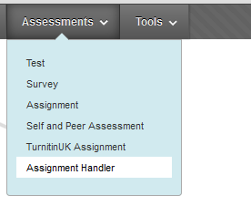
How to create an assignment dropbox
Assessment – Assignment Handler

Slide 4
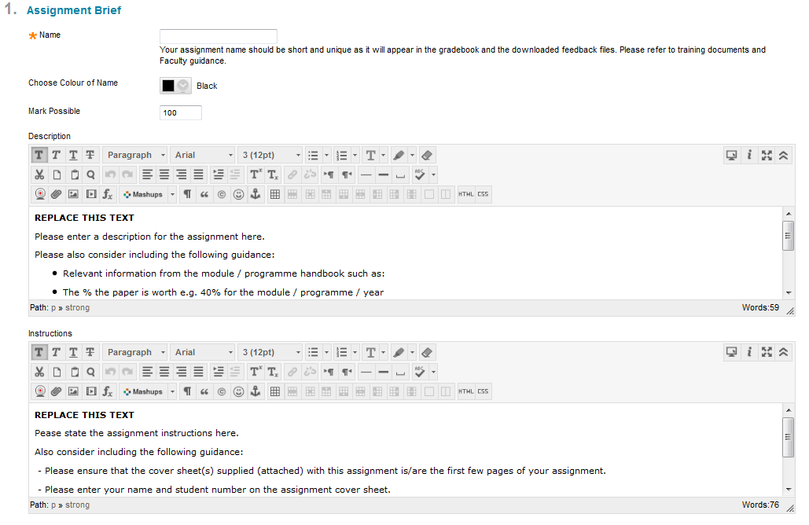
How to create an assignment dropbox
Enter Assignment Name
Enter Assignment Description
Enter Assignment Instruction

Slide 5
Assignment Description
Description for the assignment.
Please also consider including the following guidance:
Relevant information from the module / programme handbook such as:
The % the paper is worth e.g. 40% for the module / programme / year
Word count e.g. 1500 words
Learning outcomes this assignment addresses
Assignment structure
... perhaps refer the student back to the handbook.

Slide 6
Assignment Instructions
Assignment instructions.
Also consider including the following guidance:
- Please ensure that the cover sheet(s) supplied (attached) with this assignment is/are the first few pages of your assignment.
- Please enter your name and student number on the assignment cover sheet.
- Please ensure that your assignment fulfils the requirements laid out in the module / programme handbook.
- Please keep a copy of your assignment and the receipt you receive for your records.

Slide 7
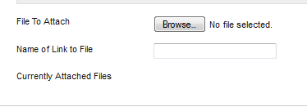
How to create an assignment dropbox
Assignment Template
Add an Assignment Template

Slide 8
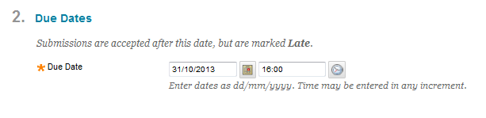
How to create an assignment dropbox
Due Date

Slide 9
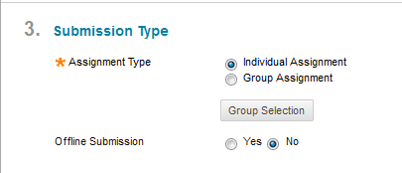
How to create an assignment dropbox
Submission Type

Slide 10
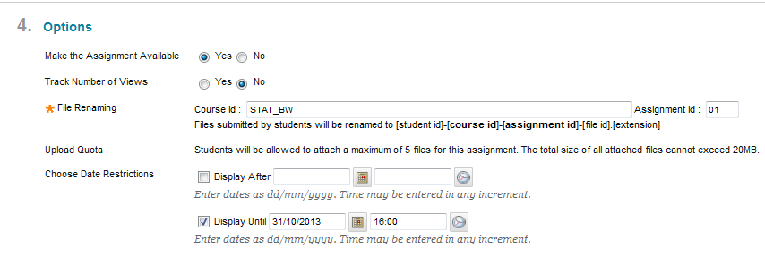
How to create an assignment dropbox
Availability

Slide 11
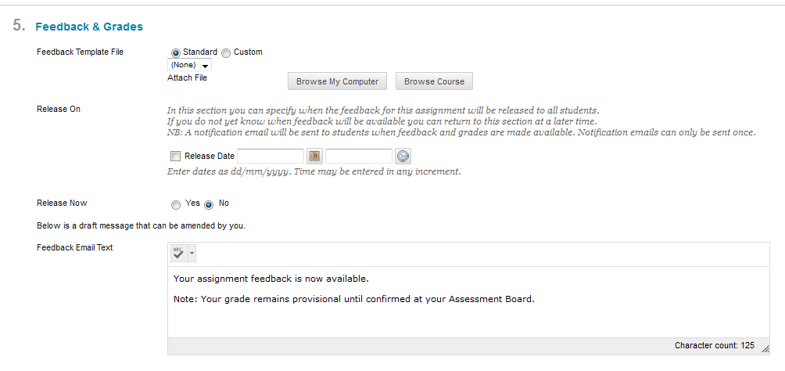
How to create an assignment dropbox
Feedback & Grades

Slide 12
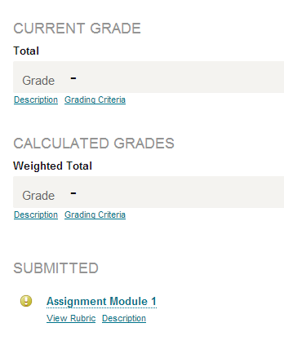
Grade Centre –
Hide Column Student View
Hide

Slide 13
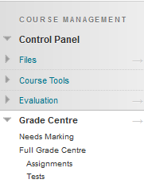
Grade Centre – Hide Column
Full Grade Centre

Slide 14
Grade Centre – Hide Column
Hide Column from Students
Hide Column in Grade Centre

Slide 15
Grade Centre – Hide Column
Hide Column from Students
Hide Column in Grade Centre
Hide Column from Students

Slide 16
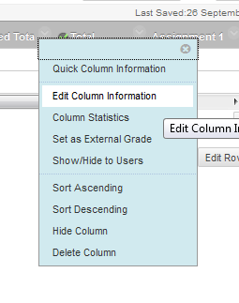
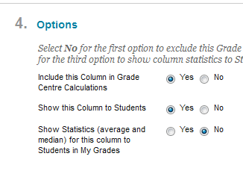
Grade Centre –
Hide Column from students
This is done for all the columns in the grade centre including submission dropbox’s

Slide 17

Grade Centre – Hide Column
Indicates Column is hidden from Students

Slide 18
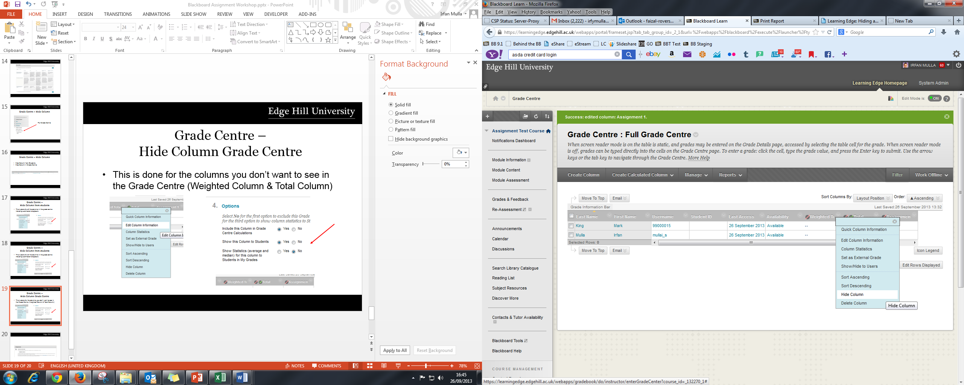
Grade Centre –
Hide Column Grade Centre
This is done for the columns you don’t want to see in the Grade Centre (Weighted Column & Total Column)

Slide 19
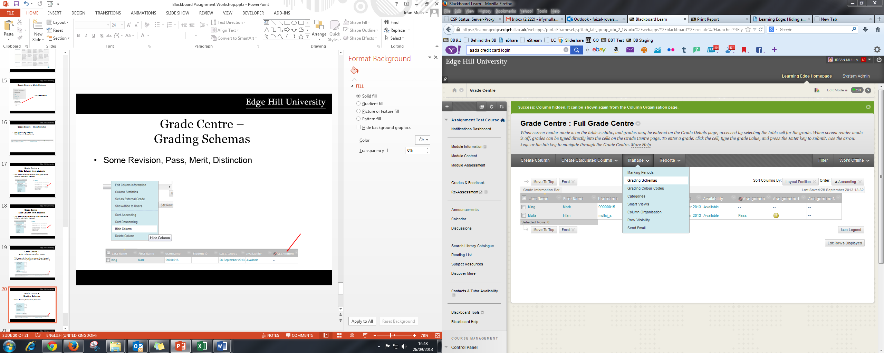
Grade Centre –
Grading Schemas
Some Revision, Pass, Merit, Distinction

Slide 20
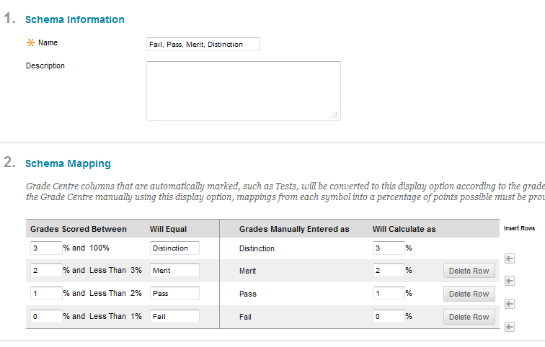
Grade Centre –
Grading Schemas
Enter Name
Enter Description
Create Schema Mapping

Slide 21
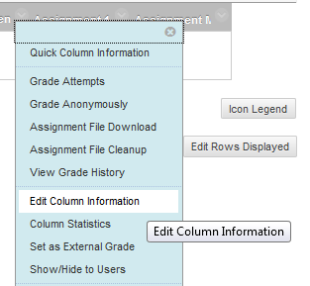
Add Grading Schemas to Grade Centre Column

Slide 22

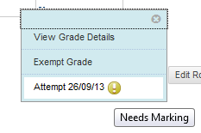
Marking Assignment – In Line Grading Tool

Slide 23
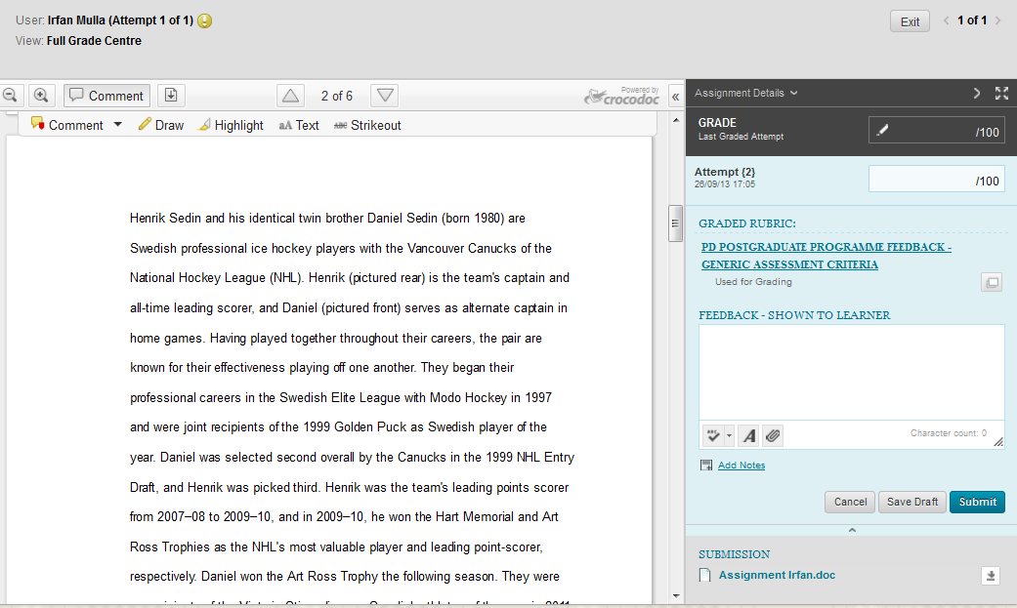
Marking Assignment – In Line Grading Tool
Grade Entry
Formatting Toolbar
Rubric
Feedback Sheet

Slide 24

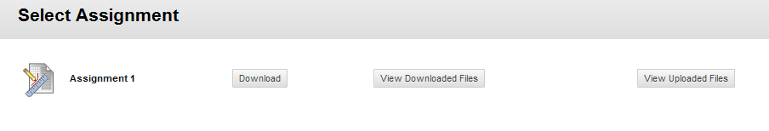
Marking Assignment – Offline Marking
Downloading Zip File

Slide 25
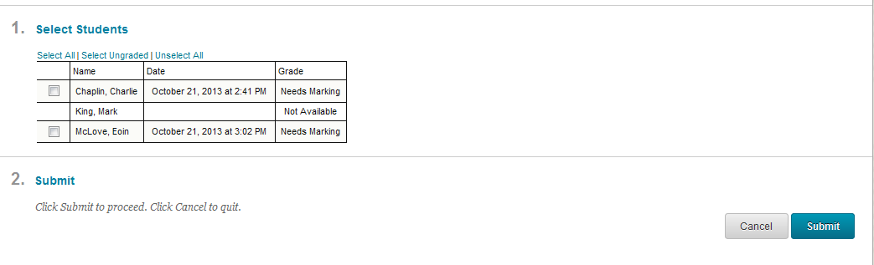
Marking Assignment – Offline Marking
Select Student Assignment and Submit

Slide 26
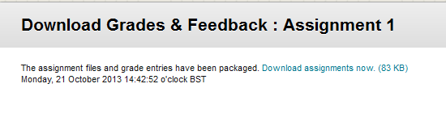
Marking Assignment – Offline Marking
Right Click Download Assignment now

Slide 27
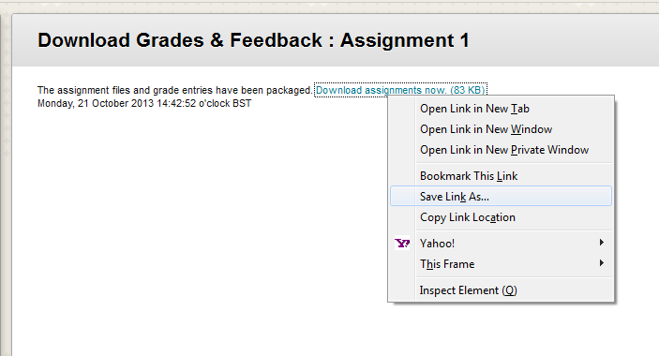
Marking Assignment – Offline Marking
Select Save Link As and save the zip file to your location

Slide 28
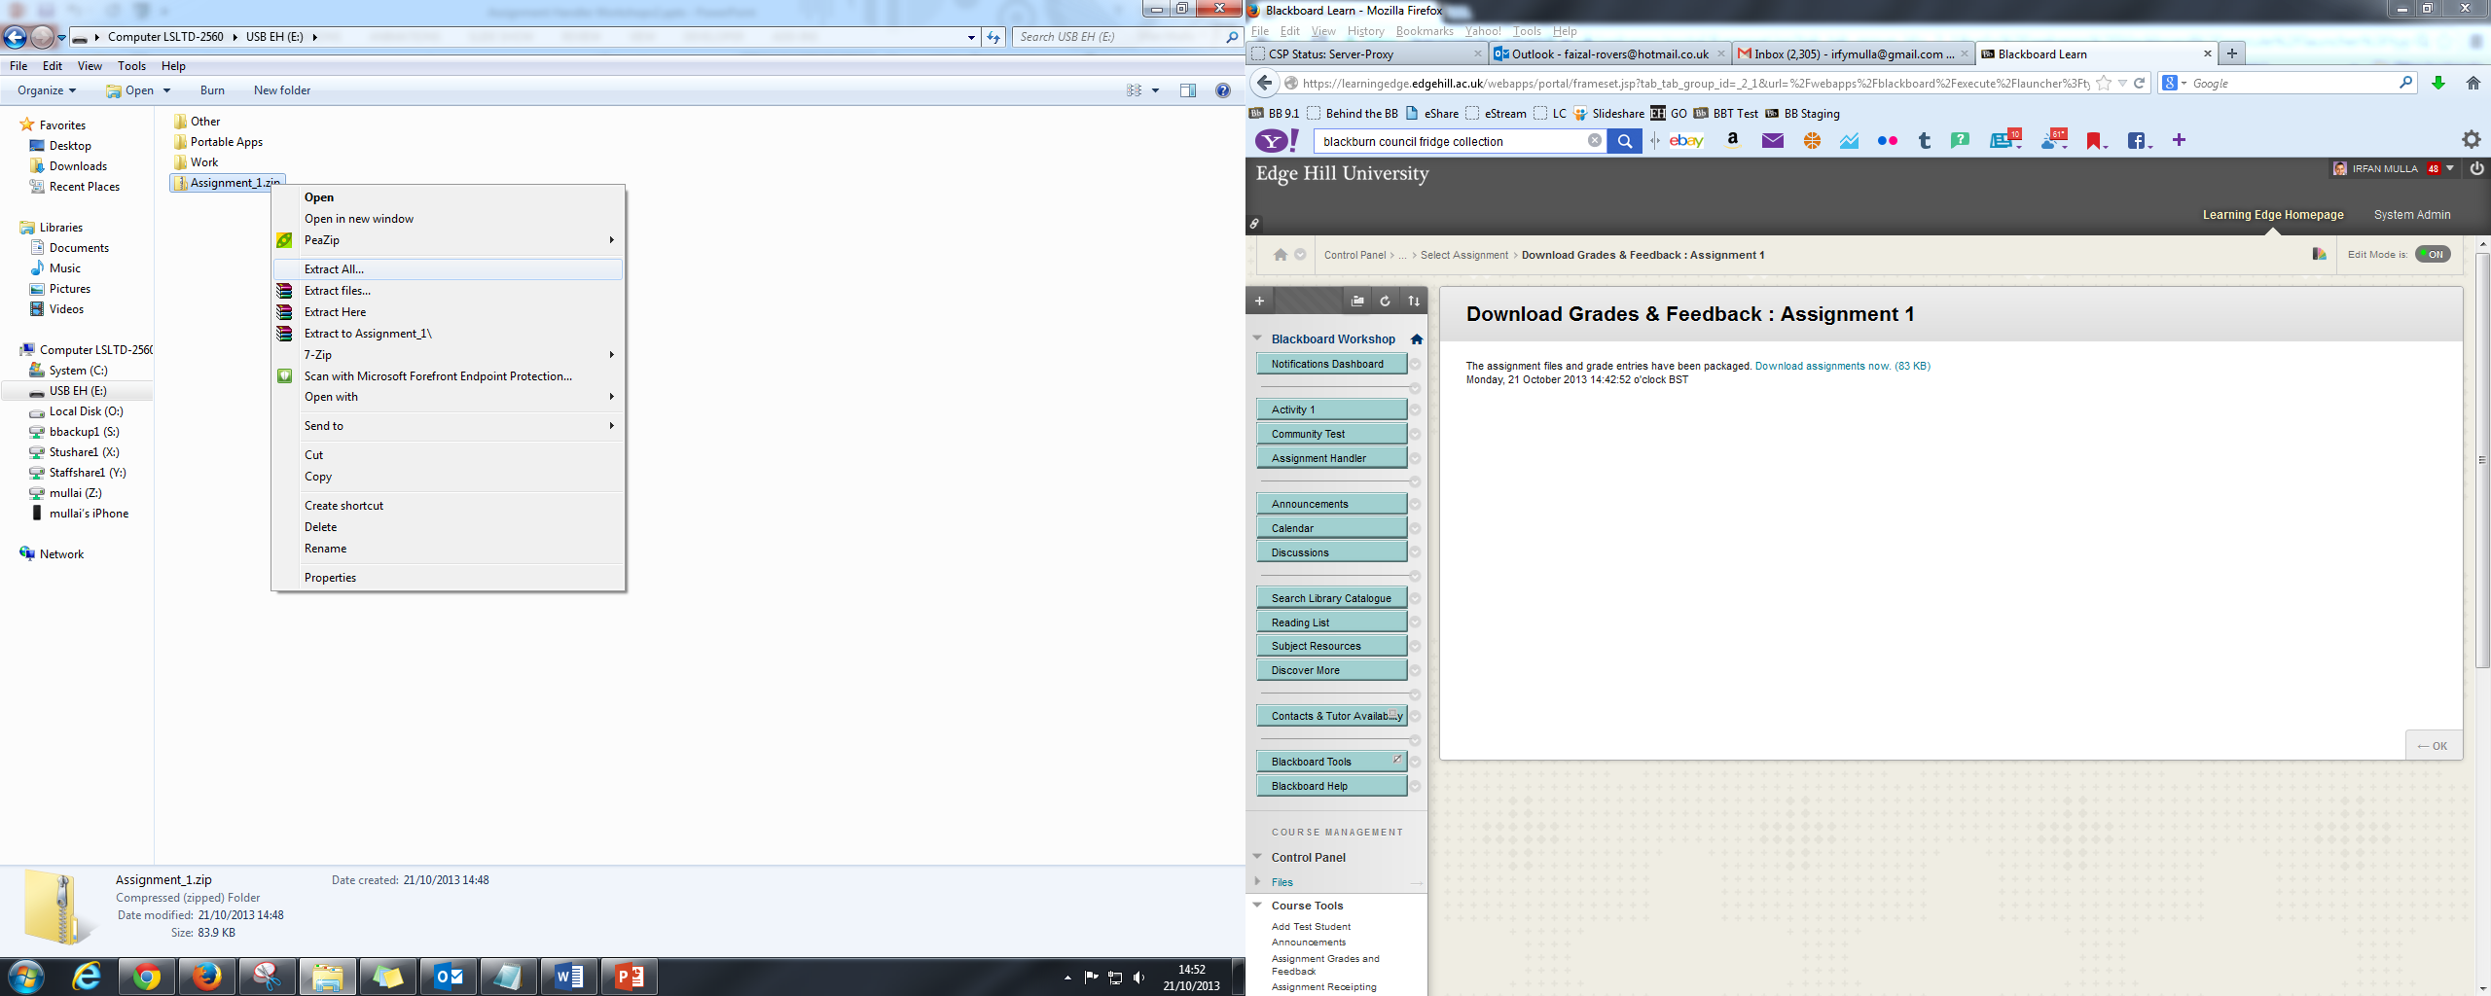
Marking Assignment – Offline Marking
Extract Zip File

Slide 29
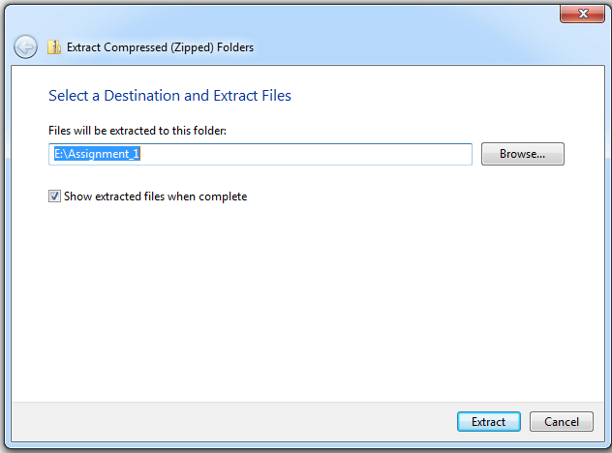
Marking Assignment – Offline Marking

Slide 30
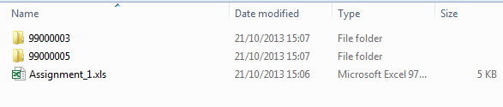
Marking Assignment – Offline Marking
Extracted Zip File
Folders containing student submissions
Spreadsheet File to Enter Student Grades

Slide 31


Marking Assignment – Offline Marking
Rename feedback file
Original Student Submission
Rename Annotated Student Submission

Slide 32
Marking Assignment – Offline Marking
The annotated assignment must be renamed as following at the beginning
feedback_studentid
i.e. feedback_20088160

Slide 33
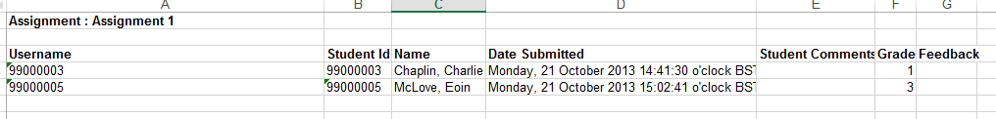
Marking Assignment – Offline Marking
Grade Entry
Student Grade is entered in the spreadsheet as setup in the grading schema

Slide 34
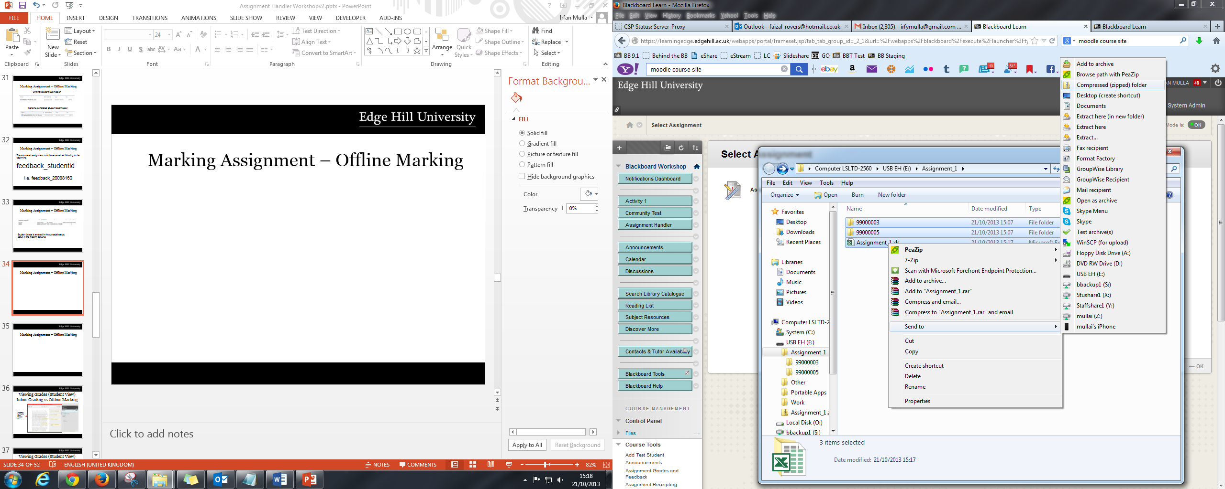
Marking Assignment – Offline Marking
Select All – Right Click on Spreadsheet File and send to Compressed (Zipped) Folder
* Zip file must be called the same name as the Assignment

Slide 35
Marking Assignment – Offline Marking
Check List before Uploading
Feedback file renamed correctly feedback_studentid i.e feedback_20088160
Grades entered correctly in spreadsheet
Completed Zip file has the same name as the assignment title

Slide 36
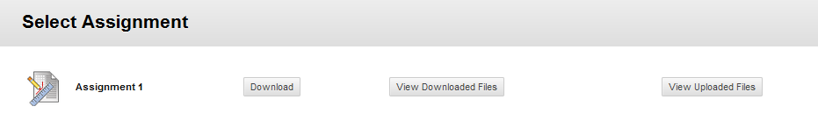
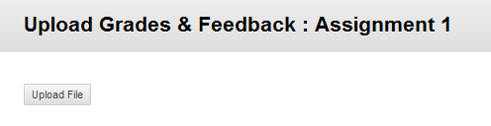
Marking Assignment – Offline Marking
Upload Zip File
1. Select View Uploaded Files
2. Upload File

Slide 37
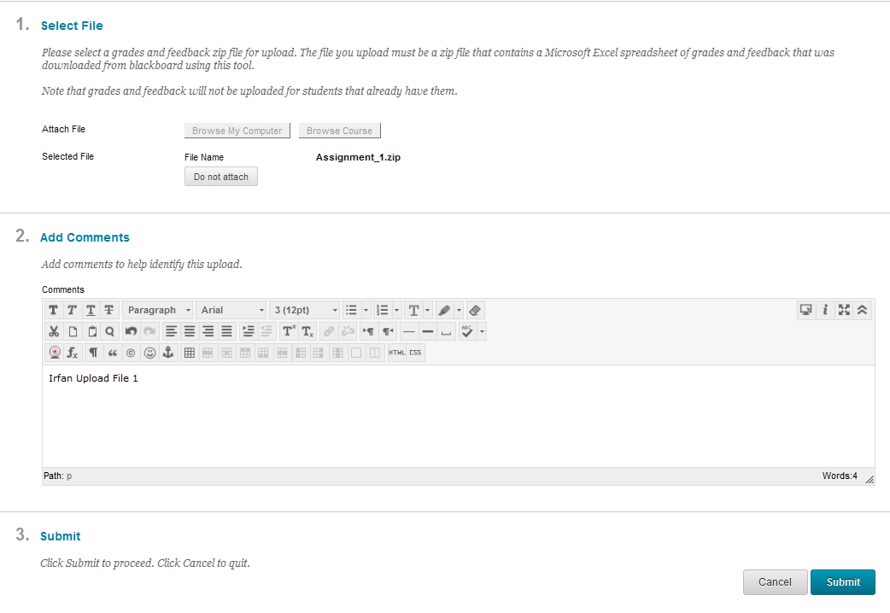
Marking Assignment – Offline Marking
Upload Zip File
1. Select Completed Zip File
2. Insert Comments
3. Submit

Slide 38
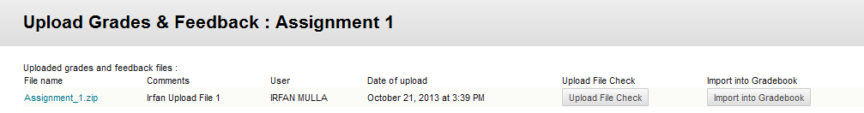
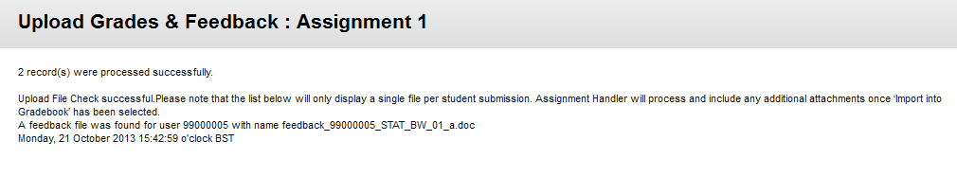
Marking Assignment – Offline Marking
Upload Zip File
1.Select upload file check to make sure all file are correct in the zip file.
2.If there are no errors then the submissions has correctly been uploaded and can now be imported into Gradebook
3. Select Import into Gradebook

Slide 39
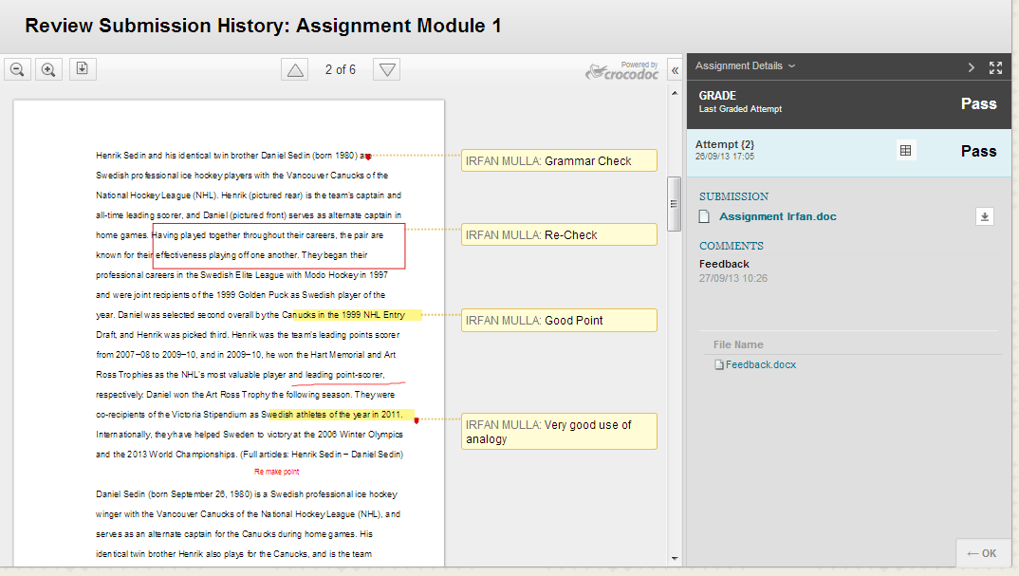
Viewing Grades (Student View) Inline Grading vs Offline Marking
Annotated Comments within Crocdoc view

Slide 40
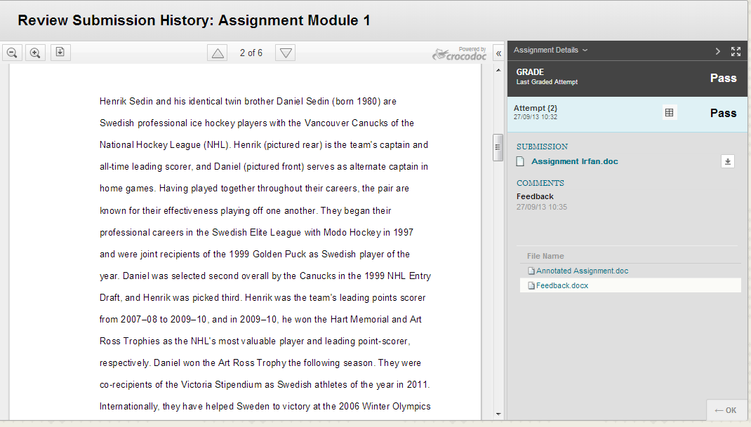
Viewing Grades (Student View) Inline Grading vs Offline Marking
Attached Feedback Files

Slide 41
Viewing Grades (Student View) Inline Grading vs Offline Marking
Inline Grading has annotated comments in crocdoc view
Must be online to mark assignments and connected to the internet.
Offline marking uses attachments to give feedback to students.
Can be downloaded and marked offline

Slide 42
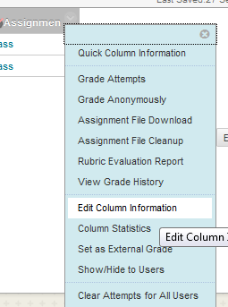
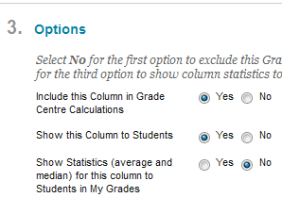
Step 1 - Releasing Feedback –
Un-Hide Column Grade Centre

Slide 43
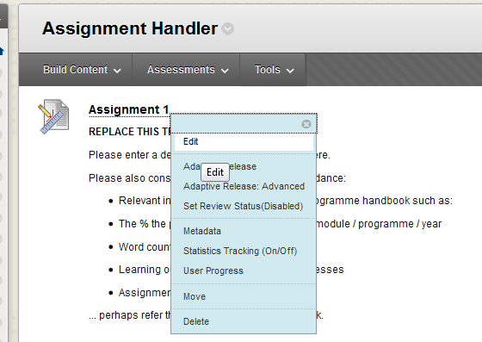
Step 2 - Release Feedback
Select the dropbox you are releasing grades for

Slide 44
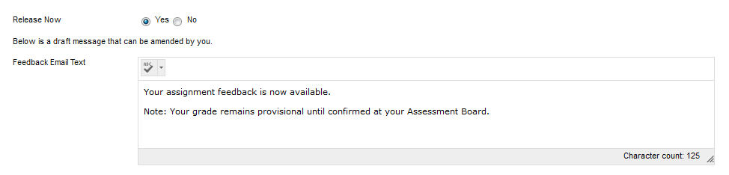
Step 2 - Release Feedback
Select the ‘Yes’ Release Now and Submit
* This will automatically send an email to students notifying their grade and feedback is available

Slide 45
Smart Views
What is Smart View
Allows you to view specific students you are marking in Grade Centre rather than the full list.
Example 300 students. In charge of 20 students only.
Create a smart view to display your 20 students in Grade Centre only. Much easier to manage.

Slide 46
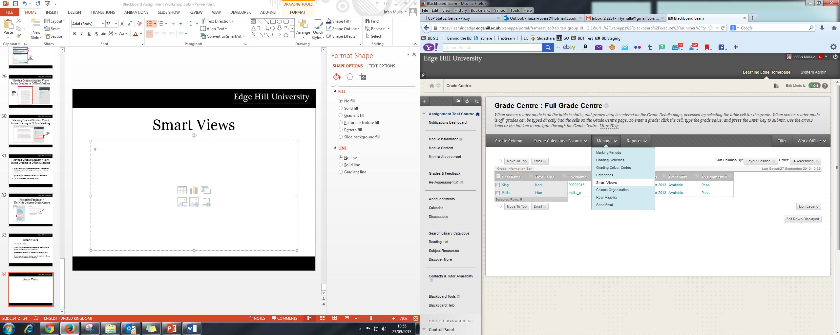
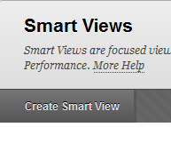
Smart Views

Slide 47
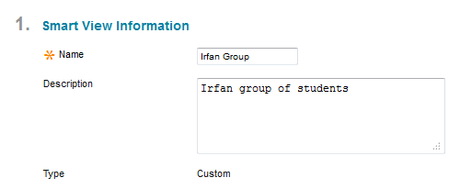
Smart Views
Enter Name
Enter Description

Slide 48
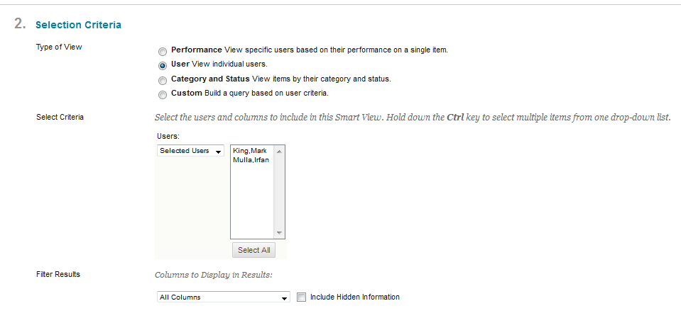
Smart Views
Select the users you wish to add to your smart view.
Select the column you wish to add to your smart view.

Slide 49
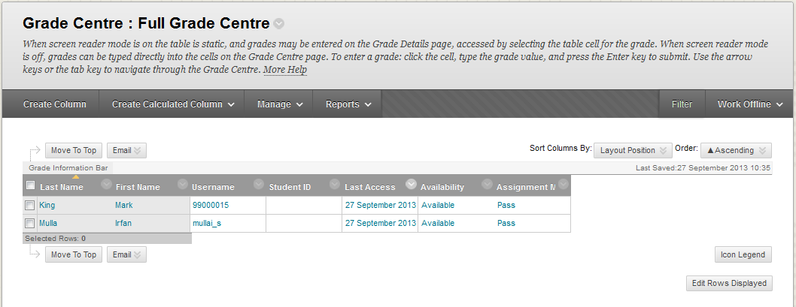
Smart Views

Slide 50
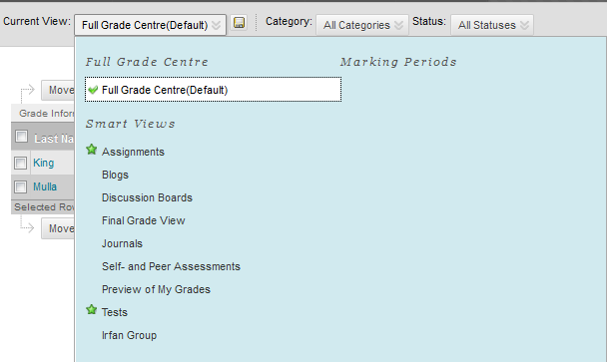
Smart Views
Select your Smart View Group

Slide 51
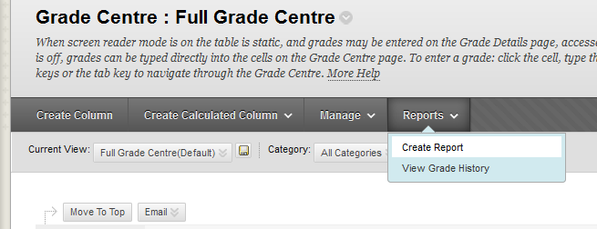
Downloading Reports
Create Report

Slide 52
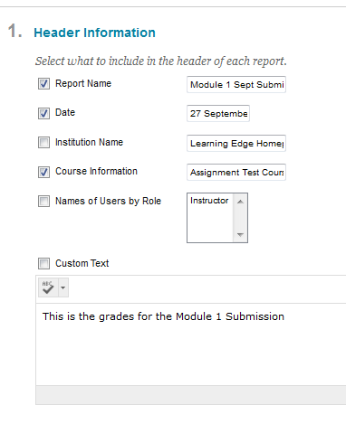
Downloading Reports

Slide 53
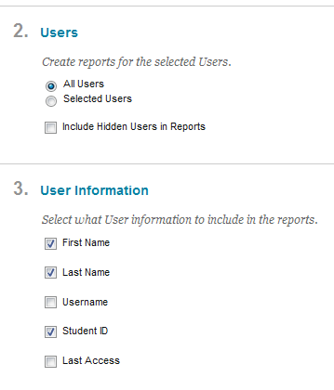
Downloading Reports

Slide 54
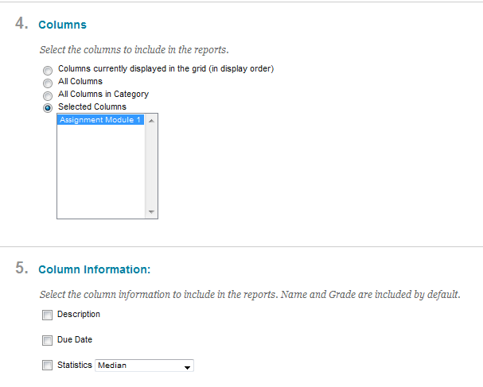
Downloading Reports

Slide 55
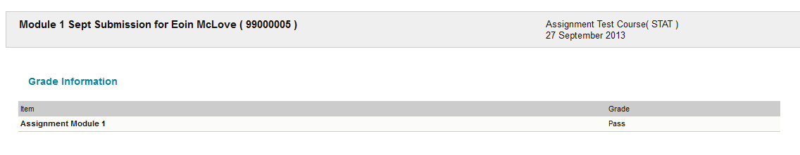
Downloading Reports

Slide 56
Links
Assignment Handler - Bible
  http://www.eshare.edgehill.ac.uk/2238/
Assignment Handler – Brief Overview
  http://www.eshare.edgehill.ac.uk/2332/
Presentation Assignment Workshop
  http://www.eshare.edgehill.ac.uk/4102/

Slide 57
End

