Slide 1
Learning Technology Development

Slide 2
Online Submission Workshop
How to create an assignment dropbox?
Assignment Template
Dates
Rubrics
Grade Centre
Hide Columns
Grading Schemas (Some Revision, Pass, Merit, Distinction)
Marking assignments
Online using Crocdoc
Offline marking
Releasing Feedback
Un-Hide Column
Smart Views
Downloading Reports
edgehill.ac.uk

Slide 3
How to create an assignment dropbox
Assessment - Assignment

Slide 4
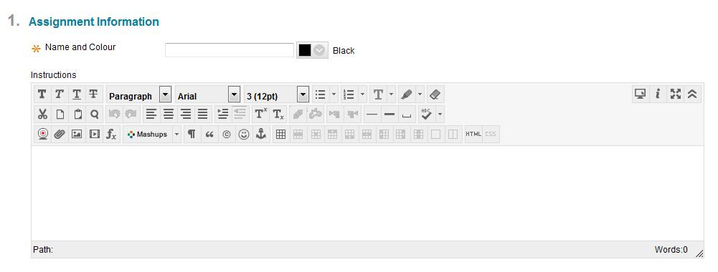
How to create an assignment dropbox
Enter Assignment Name
Enter Assignment Description
Learning Outcomes
Instructions

Slide 5
Assignment Description
Description for the assignment.
Please also consider including the following guidance:
Relevant information from the module / programme handbook such as:
The % the paper is worth e.g. 40% for the module / programme / year
Word count e.g. 1500 words
Learning outcomes this assignment addresses
Assignment structure
... perhaps refer the student back to the handbook.

Slide 6
Assignment Instructions
Assignment instructions.
Also consider including the following guidance:
- Please ensure that the cover sheet(s) supplied (attached) with this assignment is/are the first few pages of your assignment.
- Please enter your name and student number on the assignment cover sheet.
- Please ensure that your assignment fulfils the requirements laid out in the module / programme handbook.
- Please keep a copy of your assignment and the receipt you receive for your records.

Slide 7
How to create an assignment dropbox
Assignment Template
Add an Assignment Template

Slide 8
How to create an assignment dropbox
Rubric

Slide 9
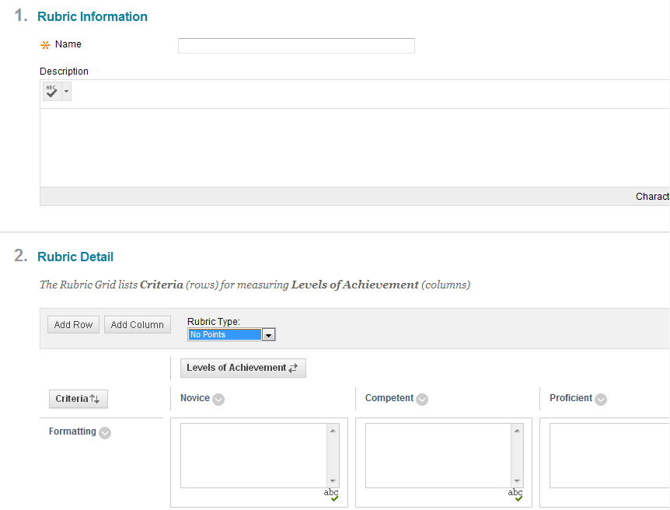
How to create an assignment dropbox
Rubric
Enter name and Description
Add rows and columns of the rubric

Slide 10
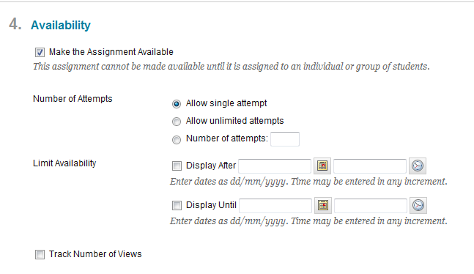
How to create an assignment dropbox
Availability
Select Attempts
Select Availability

Slide 11
How to create an assignment dropbox
Due Dates
Enter Due Date and Time

Slide 12
How to create an assignment dropbox

Slide 13
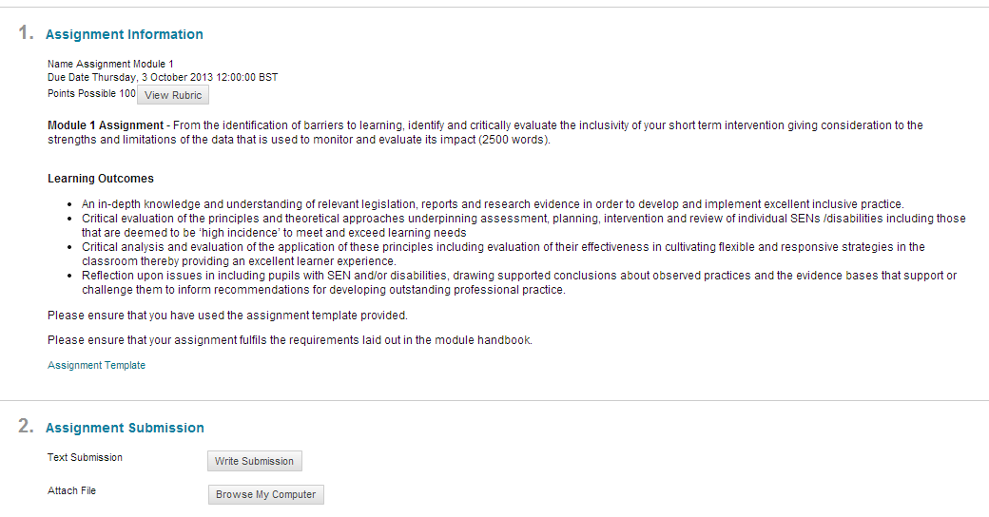
How to create an assignment dropbox

Slide 14
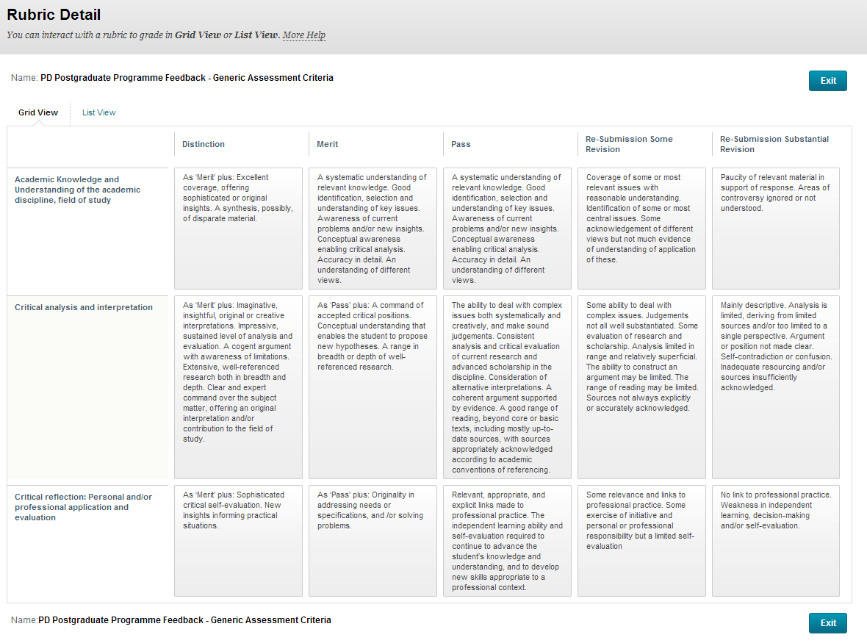

Slide 15
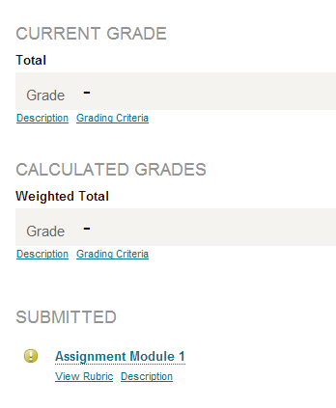
Grade Centre – Hide Column Student View
Hide

Slide 16
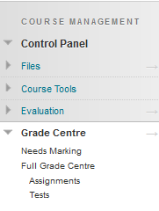
Grade Centre – Hide Column
Full Grade Centre

Slide 17
Grade Centre – Hide Column
Hide Column from Students
Hide Column in Grade Centre

Slide 18
Grade Centre – Hide Column
Hide Column from Students
Hide Column in Grade Centre
Hide Column from Students

Slide 19
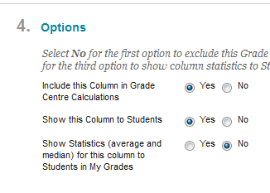
Grade Centre –
Hide Column from students
This is done for all the columns in the grade centre including submission dropbox’s

Slide 20
Grade Centre – Hide Column
Indicates Column is hidden from Students

Slide 21
Grade Centre –
Hide Column Grade Centre
This is done for the columns you don’t want to see in the Grade Centre (Weighted Column & Total Column)

Slide 22
Grade Centre –
Grading Schemas
Some Revision, Pass, Merit, Distinction

Slide 23
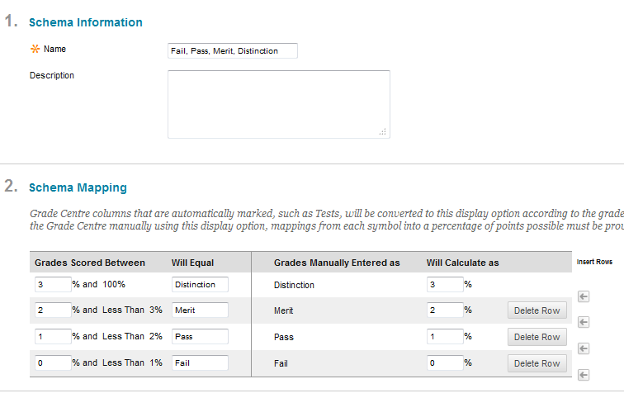
Grade Centre –
Grading Schemas
Enter Name
Enter Description
Create Schema Mapping

Slide 24
Add Grading Schemas to Grade Centre Column

Slide 25
Marking Assignment – In Line Grading Tool

Slide 26
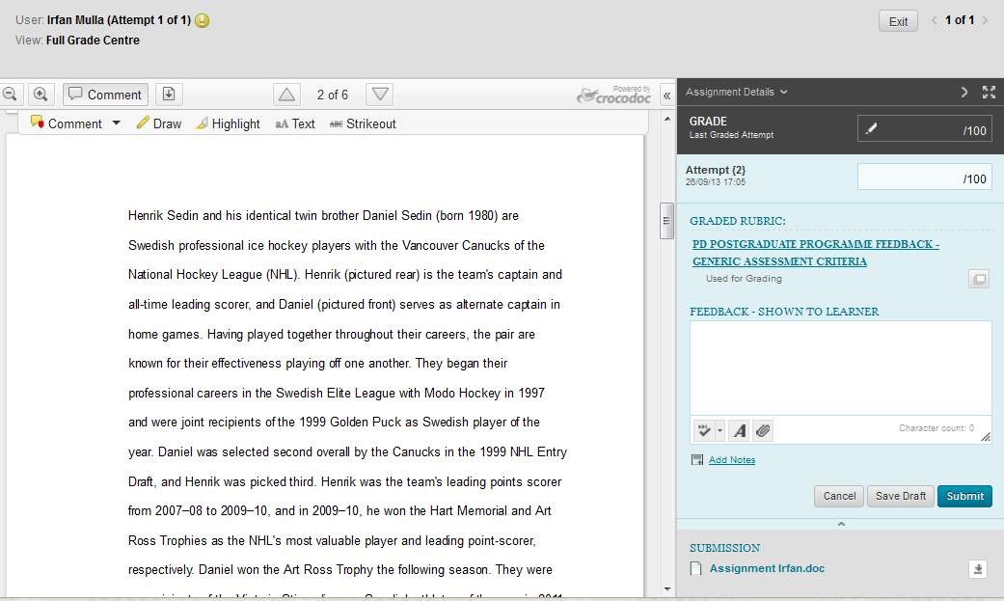
Marking Assignment – In Line Grading Tool
Grade Entry
Formatting Toolbar
Rubric
Feedback Sheet

Slide 27
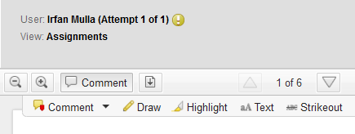
Marking Assignment – Offline Marking
Download

Slide 28
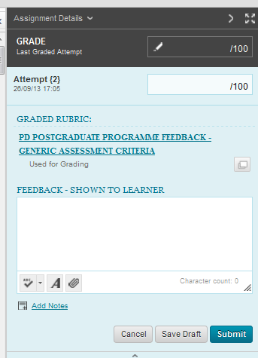
Marking Assignment – Offline Marking
Grade Entry
Rubric
Upload Feedback Sheet
Upload Annotated Assignment

Slide 29
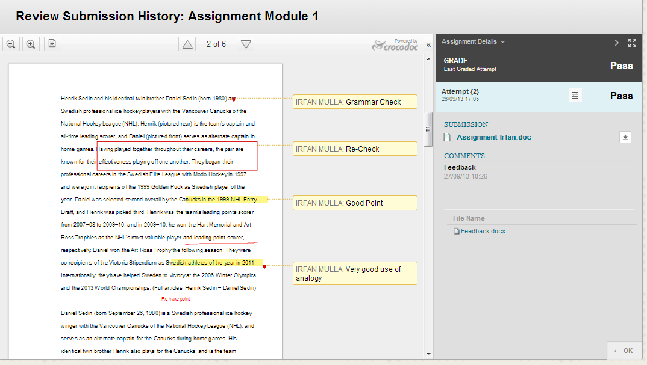
Viewing Grades (Student View) Inline Grading vs Offline Marking
Annotated Comments within Crocdoc view

Slide 30
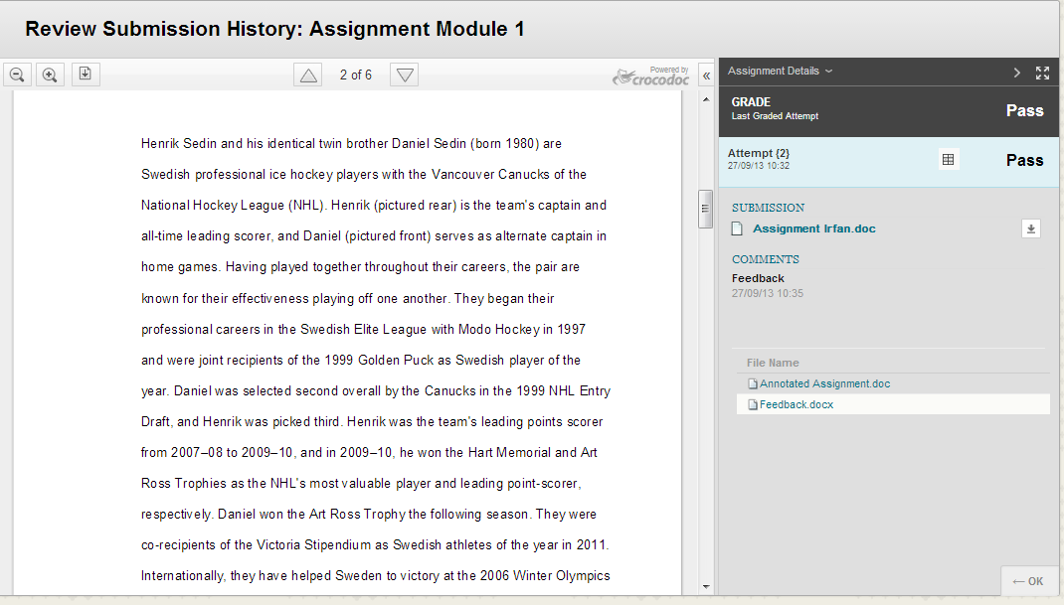
Viewing Grades (Student View) Inline Grading vs Offline Marking
Attached Feedback Files

Slide 31
Viewing Grades (Student View) Inline Grading vs Offline Marking
Inline Grading has annotated comments in crocdoc view
Must be online to mark assignments and connected to the internet.
Offline marking uses attachments to give feedback to students.
Can be downloaded and marked offline

Slide 32
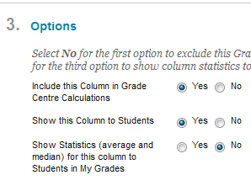
Releasing Feedback – Un-Hide Column Grade Centre

Slide 33
Smart Views
What is Smart View
Allows you to view specific students you are marking in Grade Centre rather than the full list.
Example 300 students. In charge of 20 students only.
Create a smart view to display your 20 students in Grade Centre only. Much easier to manage.

Slide 34
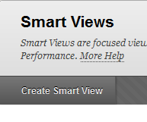
Smart Views

Slide 35
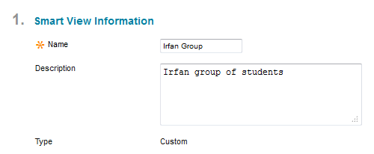
Smart Views
Enter Name
Enter Description

Slide 36
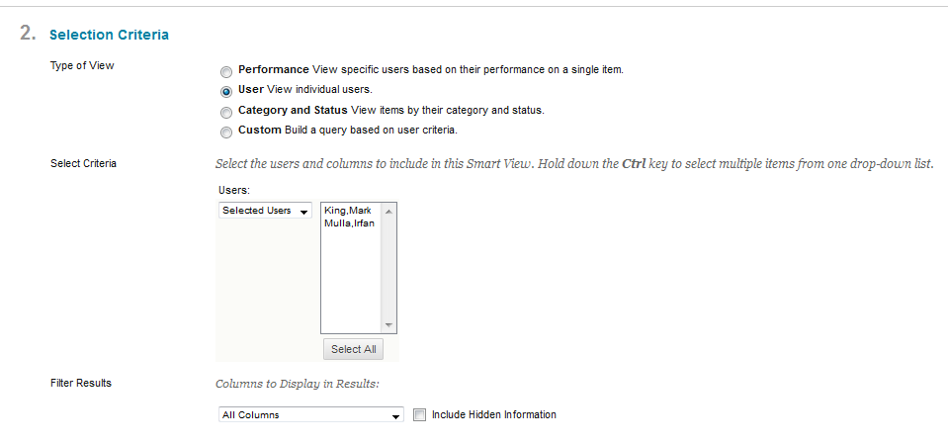
Smart Views
Select the users you wish to add to your smart view.
Select the column you wish to add to your smart view.

Slide 37
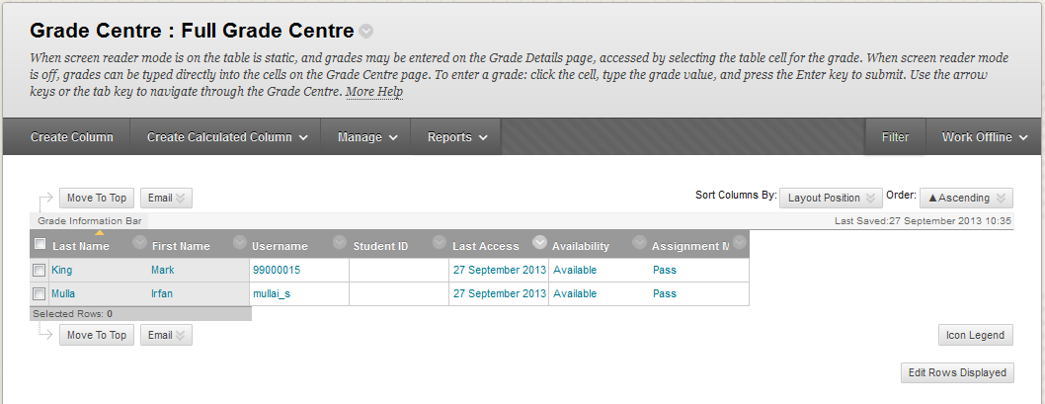
Smart Views

Slide 38
Smart Views
Select your Smart View Group

Slide 39
Downloading Reports
Create Report

Slide 40
Downloading Reports

Slide 41
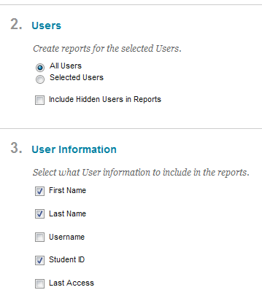
Downloading Reports

Slide 42
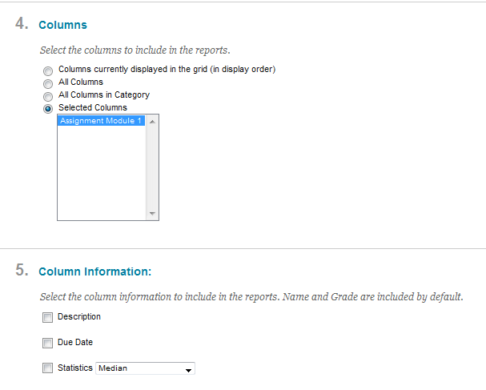
Downloading Reports

Slide 43
Downloading Reports

Slide 44
Links
Blackboard Assignment Guide
http://www.eshare.edgehill.ac.uk/2528
Presentation Assignment Workshop
http://www.eshare.edgehill.ac.uk/3904/

Slide 45
End

