Slide 1
What are they telling us? Our starting point for meeting learner needs and expectations
Lindsey Martin
Assistant Head of Learning Services
Learning, ICT & Media Technologies)

Slide 2
Background
Annual survey started December 2008 as prelude to Institutional Audit 2010
Takes pulse of VLE, TEL and strategy
A snapshot that provides rich pictures of student ownership, use and expectations of technology
Important tool in enabling us to develop our practices to meet preferences and expectations of our students
Now have 5 years worth of data and can identify trends – not simply anecdotal

Slide 3
VLE Health Check

Slide 4
Other technologies for T&L …
Facebook is the coffee shop compared to the VLE classroom
Want to be able to use mobile devices in classrooms
Blogs and wikis gaining in popularity but still niche
Few suggestions from students of what other tools/technologies could be used

Slide 5
Preferred places of study
Library consistently most preferred study space outside classes:
Quiet/silent areas most popular
Ground floor social space third popular
The Hub – central social space
24/7 open access PC space

Slide 6
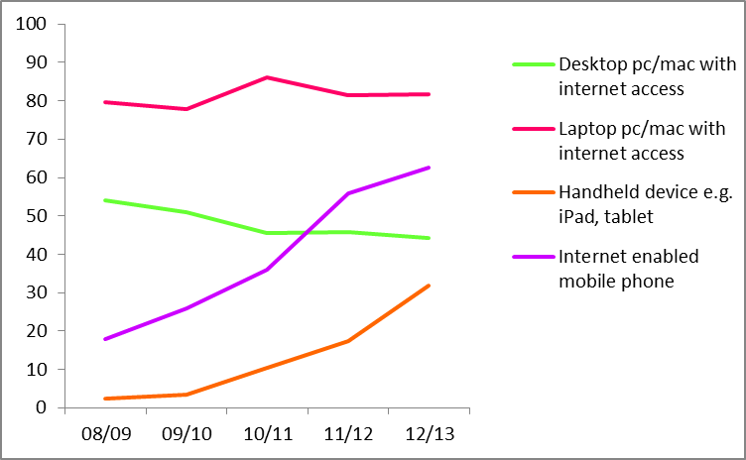
Student Device ownership

Slide 7
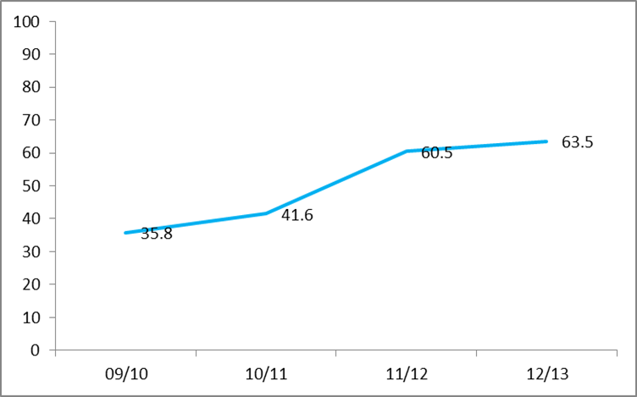
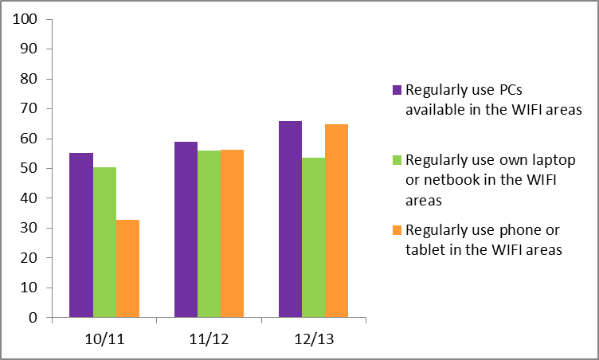
Use of University WIFI
Use WIFI spaces nearly every day
Useful to check assumptions around device use – 2 years ago library removed 20 open access PCs that have now been replaced and added to
Installing additional power supply for laptops/mobile recharging in spaces not designed for user-owned devices

Slide 8
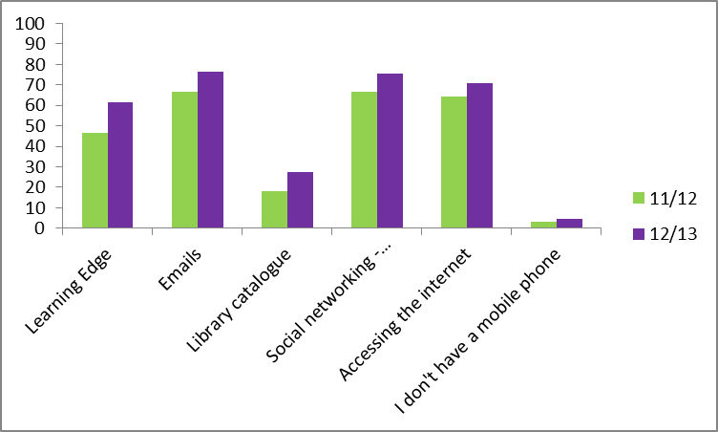
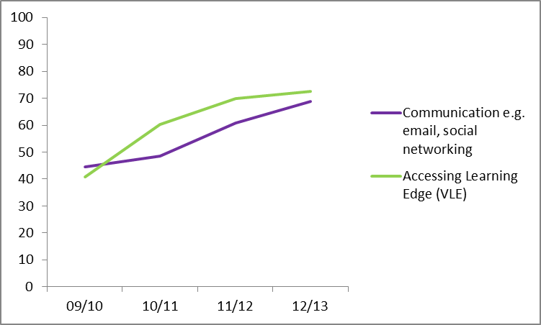
Mobile Device Activity
In general
Accessing lecture notes before/during lectures
Receiving notifications via VLE
Students without smartphone or tablet feeling excluded
Many students were accessing VLE on mobile devices before bespoke app (Blackboard Mobile Learn)
In University WIFI spaces

Slide 9
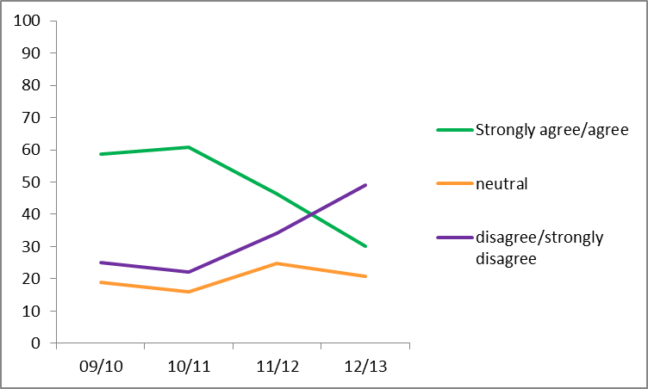
Off Campus Experience

Slide 10
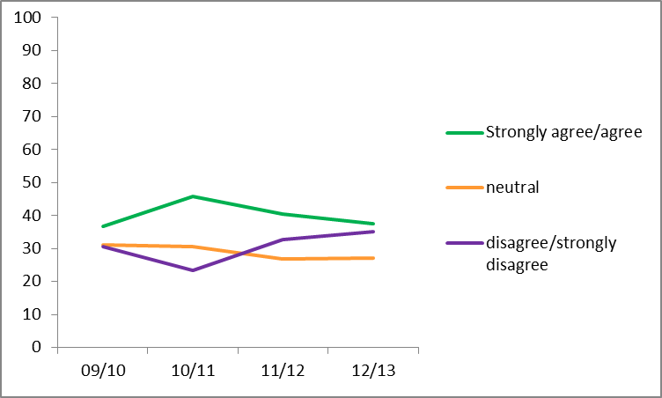
On Campus experience

Slide 11
Some responses
Survey feedback around device ownership, use and students wanting a Blackboard ‘app’ was crucial for the Mobile Learn business case
Mobile Learn provided a catalyst for a wider conversation about the potential of mobile – multi-professional, collaborative working
Mobile Learn use continues to increase rapidly – awareness-raising, clinics, bespoke and central staff development e.g Help! My mobile is smarter than me!
Case studies providing evidence that mobile ‘friendly’ courses can enhance teaching and learning e.g. discussion forum use has significantly increased on programmes that have embraced mobile
Re-thinking student technical and learner support – mental model of a student sat at a PC is no longer the norm – could be using one of a variety of devices
Looking at classroom/lecture theatre AV provision to support multi-platform, multi-device ownership

Slide 12
More information …
Lindsey Martin Lindsey.Martin@edgehill.ac.uk
Student eLearning Survey Collection http://www.eshare.edgehill.ac.uk/1348/
LearningEdge blog post: Blackboard Mobile and Clinical Education http://blogs.edgehill.ac.uk/learningedge/2012/12/12/blackboard-mobile-and-clinical-education/

