Slide 1
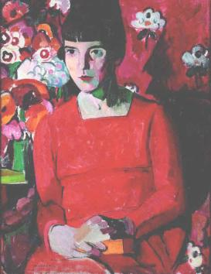
LIT 3101: The Modernist Short Story

Slide 2
Outline
The classic short story
Modernist approaches to short fiction
The context for short fiction in modernism
Katherine Mansfield

Slide 3
Definitions
E.M. Forster, Aspects of the Novel:
[Story] is immensely old – it goes back to Neolithic times, perhaps to Palaeolithic... The primitive audience was an audience of shock-heads, gaping round the campfire, fatigued with contending against the mammoth or woolly rhinoceros, and only kept awake by suspense. The [storyteller] droned on, and as soon as the audience guessed what happened next they either fell asleep or killed him.”

Slide 4
Chris Baldick
A fictional prose tale of no specified length, but too short to be published as a volume on its own, as novellas sometimes and novels usually are. A short story will normally concentrate on a single event with only one or two characters, more economically than a novel's sustained exploration of social background. There are similar fictional forms of greater antiquity— fables , lais, folktales, parables , and the French conte—but the short story as we know it flourished in the magazines of the 19th and early 20th centuries.
The Oxford Dictionary of Literary Terms

Slide 5
Dickens
“…the narrow space within which it was necessary to confine these Christmas stories when they were originally published, rendered their construction a matter of some difficulty, and almost necessitated what is peculiar in their machinery. I could not attempt great elaboration of detail…” [Preface to Dickens' Christmas Stories]

Slide 6
Twentieth Century
Nadine Gordimer:
“Short story writers see by the light of the flash; theirs is the art of the only thing one can be sure of – the present moment. Ideally they have learned to do without explanation of what went before, and what happens beyond this point.”
Gordimer, Nadine, ‘The Flash of Fireflies.’ in Short Story Theories, Ed. by Charles E. May. (Athens: Ohio UP, 1976) pp. 178-81.

Slide 7
Characteristics
Length(!)
Focus on a single event
Often moment of illumination – epiphany (Joyce)
William Trevor: “The art of the glimpse”
Elizabeth Bowen: “Peaks of common experience”
“…the evocation of the larger human condition through a distillation of behaviour and experience…is a defining feature of the great short story.”
The Concise Oxford Companion to English Literature Ed. Margaret Drabble and Jenny Stringer.

Slide 8
Short Story
Key writers of the modernist short story:
Katherine Mansfield
Virginia Woolf
Elizabeth Bowen
Jean Rhys
James Joyce

Slide 9
Key features of the modernist short story
Focus for modernist experimentation: Joyce’s Ulysses began as a short story;
Rejection of “closure”
Idea of ‘open’ form (Umberto Eco)
Attempt, esp. in Woolf and Mansfield, to render the texture of human consciousness
“Ordinary mind on an ordinary day”
Notes:
Examine for a moment an ordinary mind on an ordinary day. The mind receives a myriad impressions – trivial, fantastic, evanescent, or engraved with the sharpness of steel. From all sides they come, an incessant shower of innumerable atoms, and as they fall, as they shape themselves into the life of Monday or Tuesday, the accent falls differently from of old; the moment of importance came not here but there; so that, if a writer were a free man and not a slave, if he could write what he chose, not what he must, if he could base his work upon his own feeling and not upon convention, there would be no plot, no comedy, no tragedy, no love interest or catastrophe in the accepted sense, and perhaps not a single button sewn on as the Bond Street tailors would have it. Life is not a series of gig lamps symmetrically arranged; life is a luminous halo, a semi-transparent envelope surrounding us from the beginning of consciousness to the end. Is it not the task of the novelist to convey this varying, this unknown and uncircumscribed spirit, whatever aberration or complexity it may display.’

Slide 10
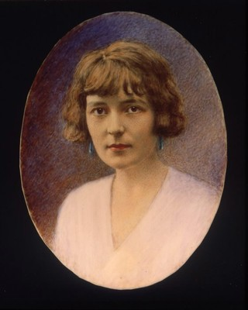
Katherine Mansfield
1888-1923
1903 – moves to England
After return to NZ, comes back to England
Series of relationships with men and women
Publishes stories in The New Age 1910-1911

Slide 11
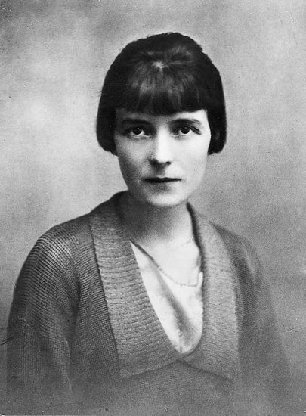
Katherine Mansfield
1911: Meets John Middleton Murry
Helps edit Rhythm
Knows Lawrence, Woolf
1918: TB diagnosed
1923: dies, having published three collections
Journals, letters and 2 more collections published posthumously

Slide 12
Mansfield’s reputation
Based entirely on short fiction
Critical bibliography quite slight – But current, and growing interest- why?
Representation of female consciousness
Redefinition of the short story
Notes:
She sought to capture the transitory vividness of life and to bring ordinary moments and people into focus so that their full significance could be understood. Accordingly she rejected the conventions of the highly plotted narrative with a carefully wrought conclusion, using instead direct and indirect narrative and a rapid transition of tenses to provide constant shifts of perspective. Often there is resolution but no definite conclusion; pattern but no plot. At times, too, there is an almost cinematic quality in her work, perhaps a result of her interest in film and her occasional work as a film extra in England. Her skilful use of these technical innovations constitutes a major advance in the evolution of the short-story form. (http://www.teara.govt.nz/en/biographies/3m42/1)

Slide 13
Mansfield and Modernism
Explores human consciousness, driven by insights of psychoanalysis (cp Sinclair, Woolf)
Explores new ways of conveying human experience on the page
Foregrounds individual consciousness against overarching, detached view
Devalues linear progression in favour of plot based on image and symbol

Slide 14
Making it New in the short story
Most obvious modernist feature: abandonment of linear plot with closure.
Fulbrook:
‘KM transformed the short story in English and did so along significantly modernist lines. Her innovative writing was especially attuned to the presentation of an unfixed and uncertain version of personality which was communicated through unifying images and through extraordinarily tight control of narration’ (Kate Fulbrook, p.2)
Notes:
Fulbrook, Katherine Mansfield (Brighton: Harvester, 1986)

Slide 15
How modernist is this?
Compare Woolf’s longer fictions, e.g. Mrs Dalloway, To The Lighthouse.
Stream of consciousness in Joyce
Interiority of Sinclair and others
Unreliable narrator – e.g. Ford in The Good Soldier.

Slide 16
Mansfield’s distinctiveness
Takes something from all of these writers
Always focus on relationships
Limited in scope and scene (but see Joyce)
Emphasis on the commonplace
Always dealing with internal world of characters
Plot, in traditional sense, is replaced by sense of life observed through prism of personality and identity.

Slide 17
Bliss
Tightly controlled focus – one evening, small company of characters
Third person narration, but focalised through Bertha
Symbolism – the pear tree
Subtle references to gender and sexuality

Slide 18
Je ne parle pas français
Censored by original publisher
Deals frankly with sexual matters
Narrative seen from perspective of older, experienced male
Corruption vs innocence
Alienation

