Slide 1


SOLSTICE & CLTR Conference 2012
Improving Quality: exchanging good practice in assessment
Tony Turjansky,
Head of Academic Quality, Edge Hill University
13th & 14th June 2012

Slide 2
Context
Definition of ‘quality enhancement’ (QE) (QAA, 2011):
“Taking deliberate steps at institutional level to improve the quality of learning opportunities… [This] means that enhancement is more than a collection of examples of good practice which might spring up across an institution. It is about an institution being aware that it has a responsibility to improve the quality of learning opportunities where that is necessary, and to have policies, structures and processes to make sure that it can detect where improvement is necessary, and where a need to improve is detected, that something will be done about it.”

Slide 3
Context (contd)
Enhancement now results in a standalone judgement at Institutional review (QAA, 2011)
Most HEIs have systems in place to identify, capture and even disseminate good practice
However, application and impact are more challenging:
  “Having identified good practice, institutions speak frequently of dissemination, with regard to publishing, making available, highlighting etc, but without any evidence of how adoption and impact is to be effected” (HEA, 2008);
  Good practice is not evidence of enhancement – the trick is to be able to translate it” (HEA, 2009).

Slide 4
Identifying ‘good practice’
What are the benchmarks?
  “The familiar debate about good practice in one area or discipline being normal practice elsewhere with perhaps limited potential for broader application” (HEA, 2009)
What are our sources?
  Annual monitoring reports (AMRs) – but these are based on self-evaluation
  Periodic review reports – more likely to be objective
  Reports of QAA and PSRB engagements – provide independent third-party verification
  External examiner reports

Slide 5
External examiners
“External examiners’ comments are reported to be one of the main ways in which good practice is identified… [and] There is evidence that as part of deliberating about the further embedding of QE, some institutions are reviewing how external examiners’ comments can contribute most effectively” (HEA, 2008)
“Awarding institutions expect their external examiners to provide informative comment and recommendations on good practice and innovation relating to learning, teaching and assessment observed by the external examiners [and] opportunities to enhance the quality of the learning opportunities provided to students” (UK Quality Code, QAA, 2011).

Slide 6
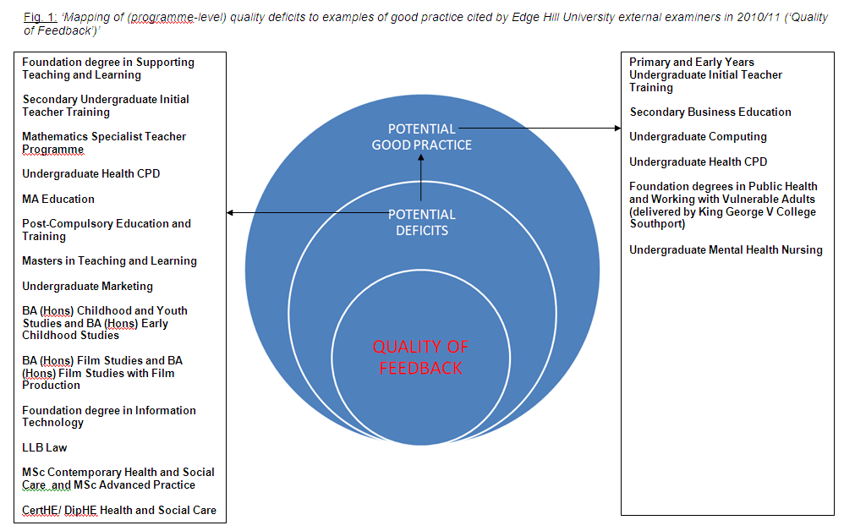

Slide 7
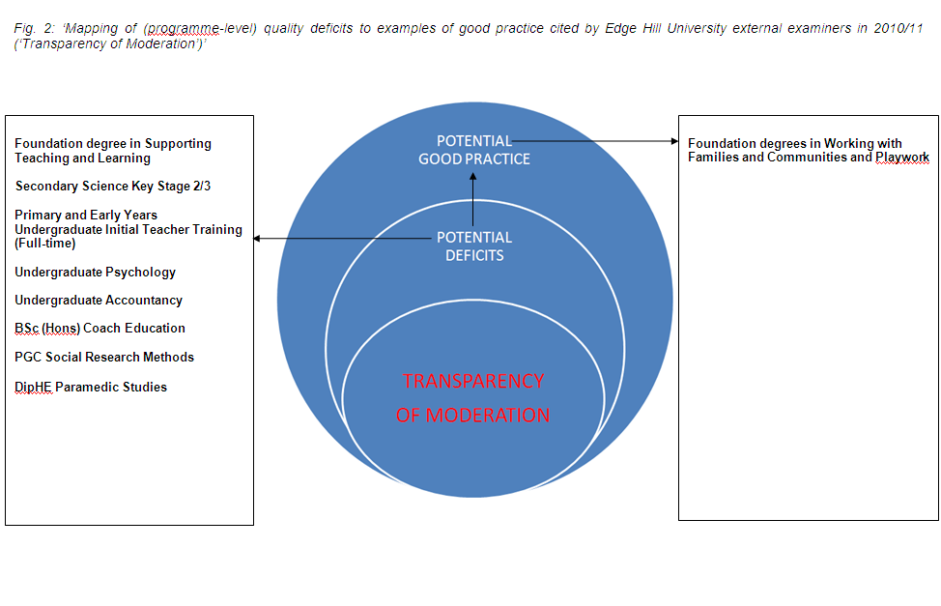

Slide 8
Initial Proposal
To use intelligence from external examiner reports to identify opportunities to enhance assessment practice
Based on ‘brokerage’ - “an intentional act in which the broker seeks to work in collaborative and creative ways with people, ideas, knowledge and resources to develop or change something” (Jackson, 2003) - to pilot one or more inter-/ intra-faculty relationships between subjects/ departments
Conduct research to establish:
  Barriers and enablers to inter-departmental collaboration
  Transferability of practice between different academic areas
  Evaluation of impact on teaching (also to inform CPD)

Slide 9
Feedback on Proposal
External examiners regarded as a valid source of evidence for enhancement purposes
But inter-departmental brokering could be viewed as matching ‘failing’ departments with ‘beacons of good practice’ – and not all staff within a successful department may necessarily demonstrate excellence
Examiners’ reports may lack sufficient specificity, making evaluation of good practice (and its transferability) difficult to establish
Enhancement should be reinforcing rather than remedial/ judgemental (cf. ‘Appreciative Inquiry’ method)

Slide 10
Developments
Project now re-defined to collect evidence from external examiner reports to harvest departmental case studies of good practice for dissemination via –
  University Learning & Teaching Fellowship
  Practice-based seminars/CPD (Centre for Learning and Teaching Research)
  Wiki-based repository of guidance and exemplars (Undergraduate Degree Framework handbook)
  Annual University Learning and Teaching Day

Slide 11
Further challenges (questions)
What adjustments can be made to the external examiner’s report form to generate more detail and specificity so that good practice with showcasing potential may be identified and evaluated?
What should be the benchmarks against which good practice is evaluated – “the idea that a particular change is an enhancement is often contested [and]… creates difficulties when we come to objective evaluation” (Jackson, 2002) – and is external examiner verification sufficient without some additional point(s) of reference?
How can the transferability of good practice from one area to another be evaluated in order to establish potential for wider dissemination/ showcasing?

Slide 12
Questions (contd)
What are the most effective institutional mechanisms for engaging stakeholders – “brokers need to think about the systems in which they are operating” (Jackson, 2003), e.g. communities of practice such as deliberative committees and working groups, or would direct intervention at department level be more effective? What incentives can be offered to potential contributors - “Several institutions refer to the challenge of engaging busy academics in QE… The time of academics, already under pressure from a number of demands, is in short supply for any new initiatives” (HEA, 2008). How might stakeholder scepticism/ resistance be overcome?
Where and how will the impact on teaching be evaluated, either within or outwith existing processes for annual monitoring and periodic review?

Slide 13
References
HIGHER EDUCATION ACADEMY, June 2008. Quality enhancement and
assurance – a changing picture? pp. 28, 50, 53-54, 56.
http://www.qaa.ac.uk/Partners/Employers/Documents/QualityEnhancementreport.pdf.
HIGHER EDUCATION ACADEMY, September 2009. Quality
enhancement and assurance in Wales – a changing picture? p. 17.
http://www.heacademy.ac.uk/assets/documents/events/academyevents/2009/Quality_enhancement_and_assurance_Report_English.pdf.
HIGHER EDUCATION FUNDING COUNCIL FOR ENGLAND, May 2012. A
risk-based approach to quality assurance (Consultation). Paragraphs 6,
8, 26, 31, 35, 43 & 44.
http://www.hefce.ac.uk/media/hefce/content/pubs/2012/201211/2012-11.pdf.

Slide 14
References (contd)
JACKSON, N., 2002. “Principles to Support the Enhancement of
Teaching and Student Learning: implications for educational
developers” in Educational Developments, SEDA Issue 3.1 ISSN
1469-3267. p.2.
JACKSON, N., 2003. “Introduction to brokering in Higher
Education”, Chapter 1 of ‘Engaging and Changing Higher
Education Through Brokerage’ ed. Jackson, N., Ashgate
Publishing. p. 5.
JACKSON, N., 2003. “The Art of Brokering”, Chapter 3 of
‘Engaging and Changing Higher Education Through Brokerage’
ed. Jackson, N., Ashgate Publishing. p. 66.

Slide 15
References (contd)
QUALITY ASSURANCE AGENCY FOR HIGHER EDUCATION,
March 2011. Institutional review of higher education
institutions in England and Northern Ireland Operational
description. p. 6.
http://www.qaa.ac.uk/Publications/InformationAndGuidance/Documents/ireni-operational-d.pdf.
QUALITY ASSURANCE AGENCY FOR HIGHER EDUCATION,
December 2011. UK Quality Code for Higher Education Part B:
Assuring and enhancing academic quality, Chapter B7:
External Examining. p. 10. http://www.qaa.ac.uk/Publications/InformationAndGuidance/Pages/quality-code-B7.aspx.

