Slide 1
Use This Template to Add Text to an Image
This template is designed to help you add text to your Blackboard course image.
The templates reduce the chance of text being cut off in different views, and screen sizes.
You do not need to add text, and Blackboard recommend just using an image.
The ‘Using the PowerPoint Banner Template’ video shows how you can use this template.
Slides 2-5 show templates that might work well.
Later slides show examples of how the templates might look when complete.
Keep accessibility in mind. Try and avoid low levels of contrast between the text and the background colours. Avoid putting text over a background that makes it tough to read.

Slide 2
TextTextTextTex

Slide 3
TextTextText

Slide 4
TextTextText

Slide 5

C36 Jan 2025

Slide 6

TextTextTextTex

Slide 7
Programme

Slide 8

Programme

Slide 10

Programme

Slide 11
C36 Jan 2025

Slide 12


Slide 13

TLC1010A
Language 1 French

Slide 15

TLC1010B
Language 1 Spanish

Slide 17

TLC1010D
Language 1 German

Slide 19

TLC1010F
Language 1 Italian

Slide 21
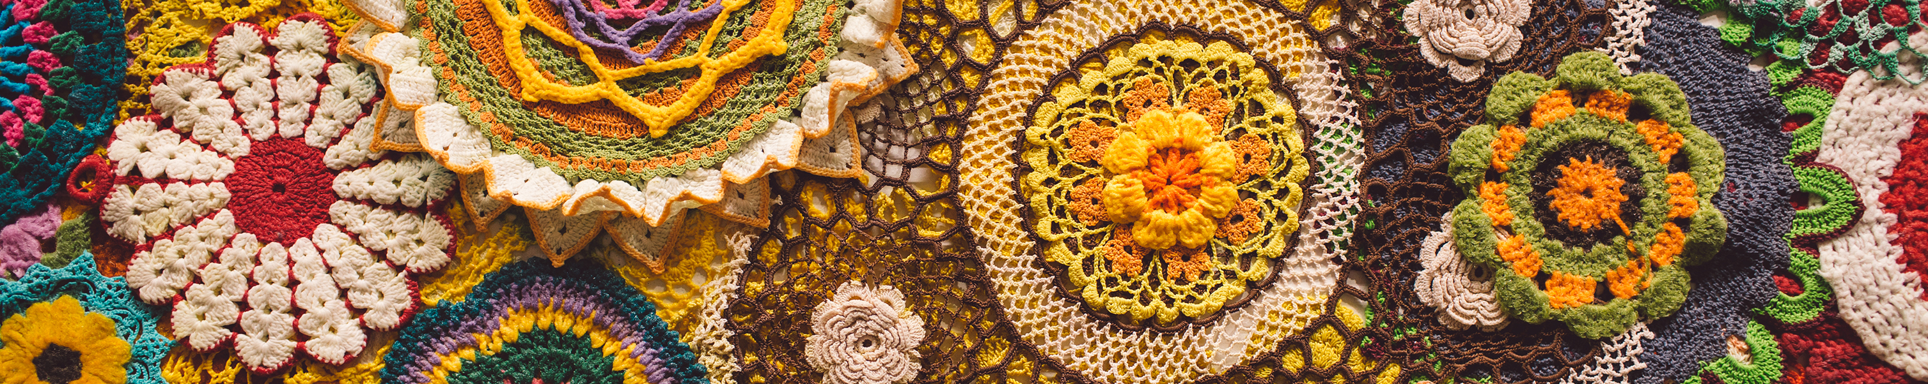

Slide 22


Slide 23


