Slide 1
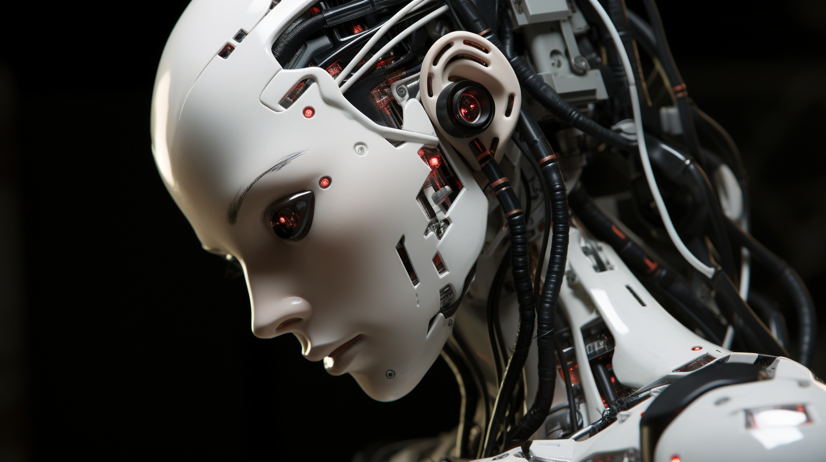

An Absolute Beginner’s Guide to Generative AI Tools
Notes:
Over the last year there’s been a lot of talk about ‘generative AI’ tools, which can generate text and images based on a prompt you give them.
While tools like this have been available for years, the growth in interest was sparked by the public release of ChatGPT which makes it easy to generate text that looks like it was written by a human.
That was a concern as many assignments involve students demonstrating their learning by ‘generating text’ and there have been discussions and debates about what this means for assessment.
Responses have varied from banning Generative AI tools on campuses and move from essays to exams, to encouraging the use of these tools use as part of the assessment process.
[Image by Peter Beaumont/Midjourney unless stated]

Slide 2
Overview
Edge Hill Position Statement
Text Generation Tools
Image Generation Tools
Notes:
Go over session outline
Check people’s experience
[1-3 minutes]

Slide 3

Edge Hill Position Statement
No detection tools
Familiarise with “capabilities and limitations in relation to your discipline”
Explore as a useful learning tool
Notes:
Edge Hill put together a central working group to look at these tools and how the institution can respond to them.
Staff Guide – Recommends not using detection tools that aim to detect text generated using these tools. They’re not reliable enough, there have been a range of controversies with students being accused of cheating. We, along with most UK HEIs asked Turnitin to remove their detector tool. We’ve had reports of staff running essays through ChatGPT, asking it if had written the essay, and it saying yes. However, it doesn’t work that way and we’ll have a basic look at how it does work.
- They assume is automatically generated text if it is simple words put together in a common way. There are ways to get around these anyway. Copy a paragraph to Quillbot. Get a paraphrase. Also, those who have English as a second language are more likely to write that way and be accused of using these tools.
Familiarise – This session is really a response to that, there is a lot being said in relation to these tools from they are just parrots repeating text, to “they might be sentient”. I hope in this session you’ll get an idea about capabilities and limitations, and some ideas of how the tools like ChatGPT might be used as a ‘useful learning tool’.
There are a lot of other things in the Position Statement such as ethical use, academic integrity, where use is prohibited, which are outside the scope of this session, but hopefully you’ll feel more confident to explore them afterwards.
[4 minutes]

Slide 4

Text Generation Tool Examples
ChatGPT 3.5 and 4
Google Bard
Bing Chat
Notes:
There are a range of tools that will generate text, such as. We’re going to focus on ChatGPT, looking at 3.5 which is the freely available version, and 4 which is paid.
These work by taking into consideration the context – so your prompt, your custom instructions which may involve a persona, the previous parts of the conversation – and choosing the next most likely word from its training data. Rather like the Predictive text on your phone. [Show the Interface]
We’ll look at how someone could use this to write or to help them write an assignment. We’ll also look at some ways academics are talking about using these tools as part of learning experiences.
KEY things to keep in mind
– Learns patterns in text from its training data and predicting the most likely next word in a context. Whether you get the result you want depends a lot on their training data. What was and was not included to a great extent
This means it’s not intelligent but simulates human written text well.
Lower quality than from people with expertise in an area.
Examples then you have a go.
[Go to ChatGPT]
[Example of writing an essay] Example - https://chat.openai.com/c/521ef9d5-c42f-404a-a221-9fb9e05de751 - Tectonic Uplift essay - Text, then adds references. I’ve used this in areas I know about SPS – GPT4 and they are real references, but old one from 2004-2011. not the best examples.
Compare with Masters - Late Cenozoic Era ~66 million years, Late Cenozoic Ice Age ~34 million years, Pronounced Seno-zoic – Voting System examples. (old references).
[Example of List of Tasks – GPT3.5 adds things, some helpful, some not. GPT4 as usual keeps things short.
[Example of specific style and iterating] You can ask it to do other things like write in certain ways. – Edge Hill University Poem // Can iterate
[Example of persona – 1-3]
[Conversation to get ideas – reply and ask me a question – see STUDY BUDDY conversation]
[Uses suggested in education]
Positive activity
Students to write their own position statement on use. [Cate Denial https://catherinedenial.org/blog/uncategorized/chatgpt-and-all-that-follows/]
Start assignments - https://peter-beaumont.blogspot.com/2023/01/chatgpt-how-have-educators-responded.html
[See next slide - UNESCO]
Avoiding plagiarism – Peer Feedback on drafts [Cate Denial https://catherinedenial.org/blog/uncategorized/chatgpt-and-all-that-follows/]
[Interaction] Ask for simple piece of writing to demonstrate how to improve it, within a conversation or by iterating the prompt.
[Activity] If you want to use - create account. Five minutes to get output. // If you cannot set up an OpenAI one can use the-good-ai.com. OpenAI just needs your phone though,
[Review] What do you think of the outputs? What might they me useful for? My feeling about the outputs is that if it is an area that you’ve got some expertise in, you see the flaws. It doesn’t replace expertise and effort, but it
[30 minutes]

Slide 5

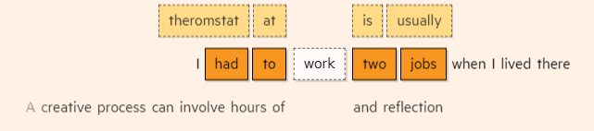
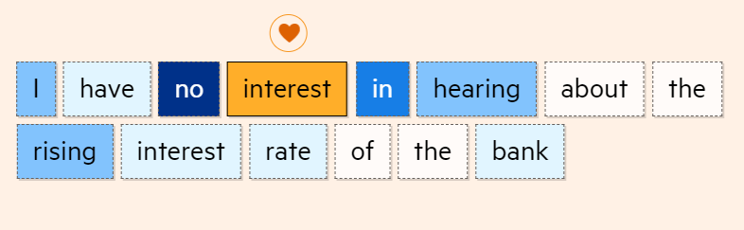
Training
Notes:
https://ig.ft.com/generative-ai/
How likely is a word in different contexts.
Large Language Models

Slide 6
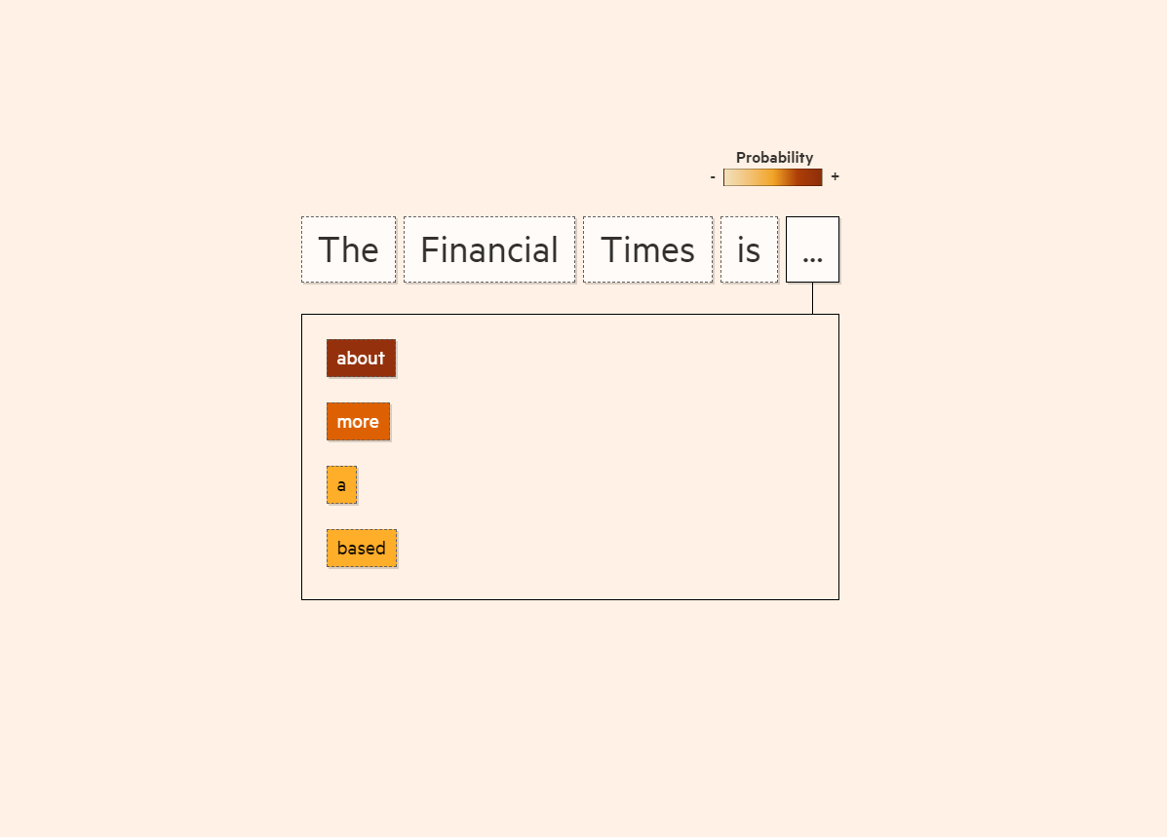
Generation: Probability Scores
Notes:
https://ig.ft.com/generative-ai/
Probability Scores like auto-suggest on phone.
But Transformers were the key to making this more human like

Slide 7
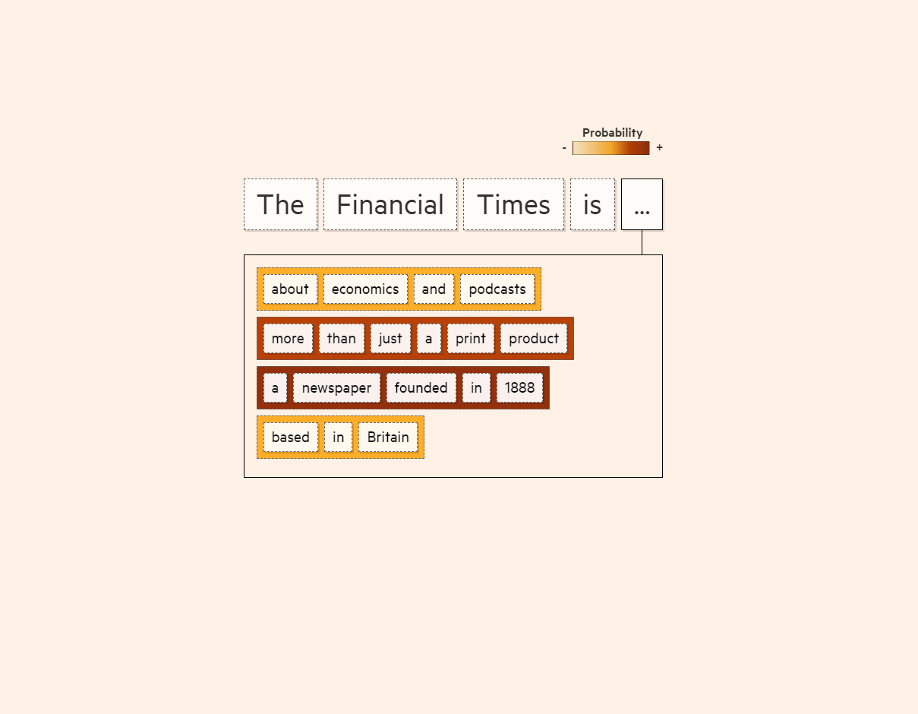
Generation: Beam Search
Notes:
https://ig.ft.com/generative-ai/
Example is Beam Search, where a sentence is generated, and the most likely sentence is chosen.
So, there are clever things going on behind the scenes, but remember that meaning is accidental, and any fact checking that a particular system may do involves comparing what is generated with something found on the internet, which may also not be true.

Slide 8
Usage Suggestions
Summarise Text
Personalisation
Study buddy
Notes:
From sources like:
UNESCO – ChatGPT and Artificial Intelligence in Higher Education
https://www.iesalc.unesco.org/wp-content/uploads/2023/04/ChatGPT-and-Artificial-Intelligence-in-higher-education-Quick-Start-guide_EN_FINAL.pdf
Page 9 - Study Buddy
LAMAR University – Centre for Teaching and Learning Enhancement
https://www.lamar.edu/lu-online/faculty-services/center-for-teaching-and-learning-enhancement/blog/2023/08/a-faculty-guide-to-artificial-intelligence.html
Page 5 – Personalised Learning, etc…

Slide 9
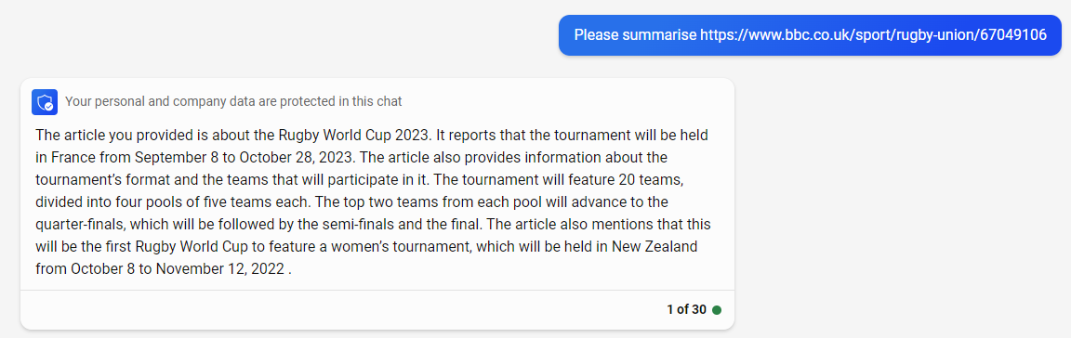
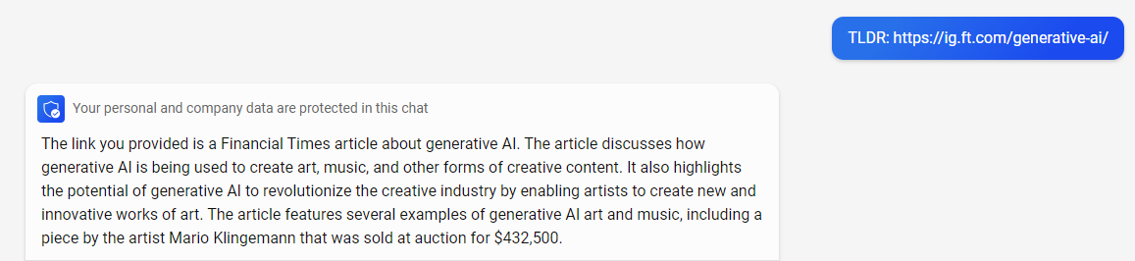
Summarise Text
Notes:
Bing Chat is used in the examples above to summarise web pages. It identifies the general subject of each but then makes up what they might be about.

Slide 10
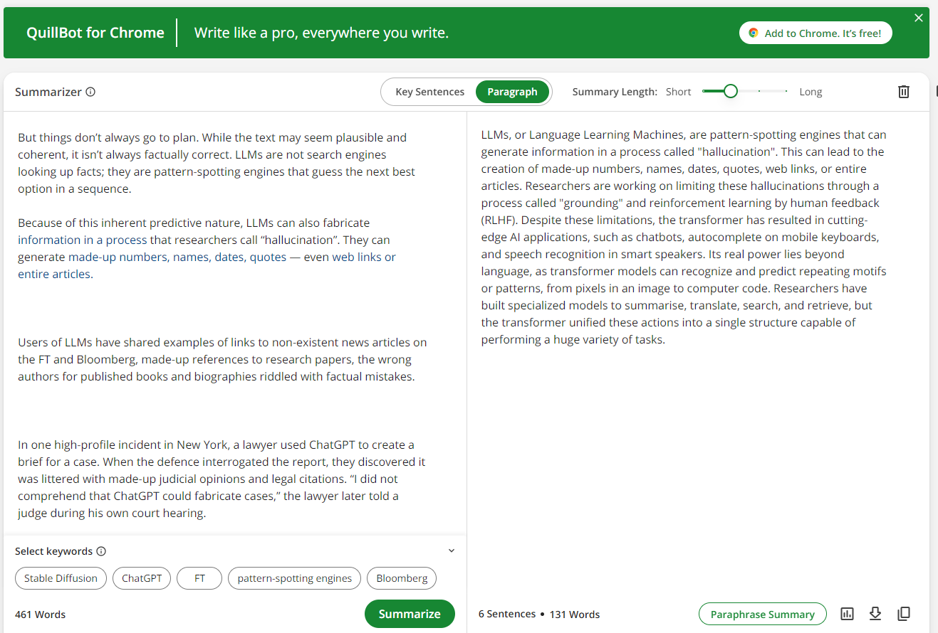
Summarise Text
Notes:
ChatGPT can summarise text, but the example above shows QuillBot doing the same thing. QuillBot is rather like Grammarly, and the paid version will also do things like rephrase your writing for you.
I think this summary is correct.

Slide 11
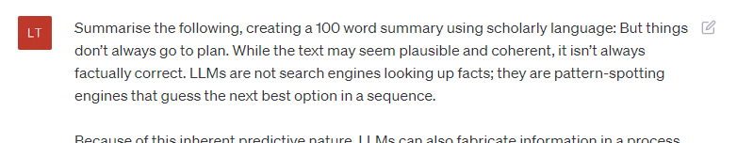
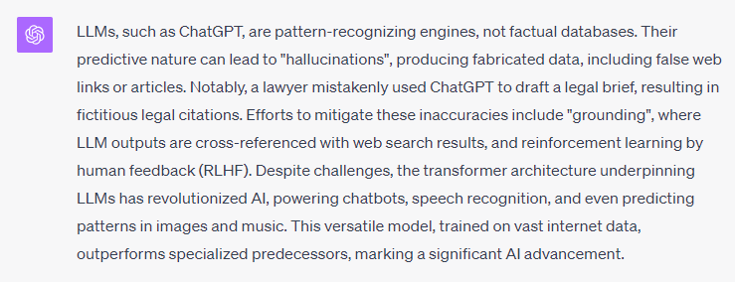
Summarise Text
Notes:
ChatGPT can take in more specific instructions. This is 103 words long.
It considers information from its training data, in addition to the actual text it is summarising.

Slide 12
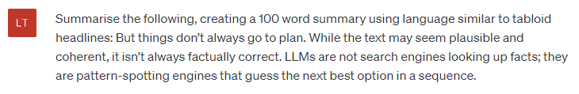
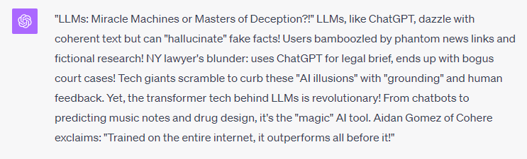
Summarise Text
Notes:
This is written in a clearly different style. Might actually be a fun way to start conversations.
Note New York Lawyer who got information on previous cases from ChatGPT which were later found not to exist.- This is important - it's not a collection of information, it's a machine that detects patterns in language and can replicate those patterns to sound authoritative.

Slide 13

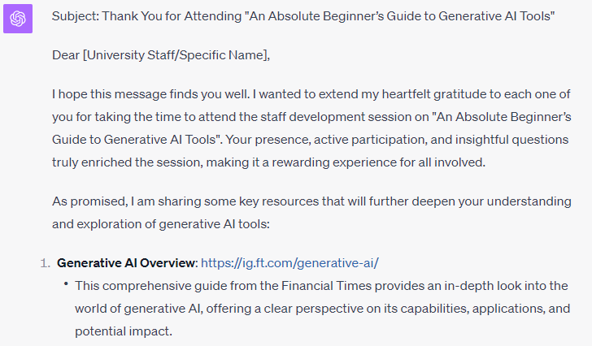
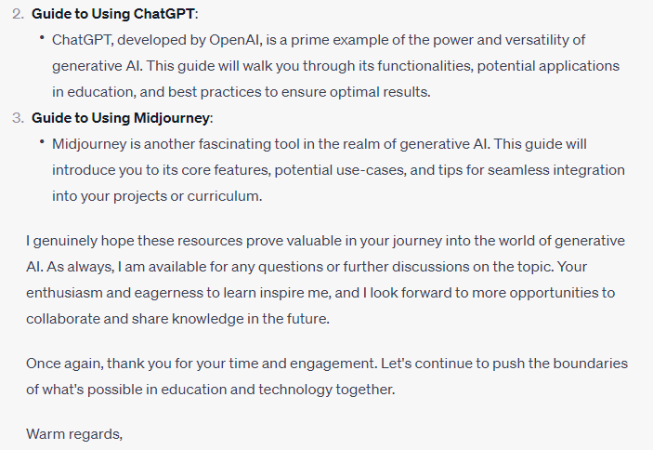
Write Emails
Notes:
I don’t know what to think about this.
If emails are just about communicating information, it’s way over the top, and gets facts wrong.
If it’s about communicating enthusiasm and nice feelings, then it’s better. I could probably learn something from it, and it wouldn’t take long to tidy up.
[Log in for image-based ones – plants, crossword, describe]
[On mobile – voice-based conversation]
ALSO, Custom Instructions and the Edge Hill style – See ChatGPT

Slide 14

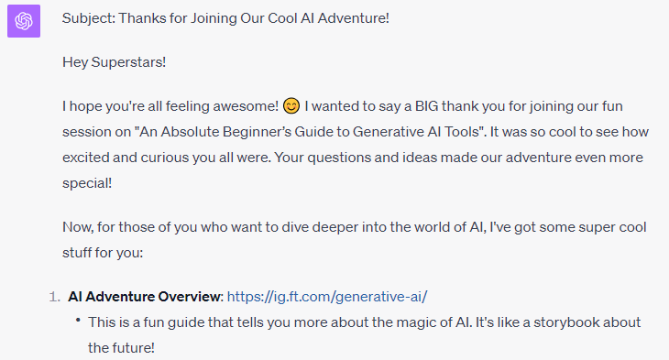
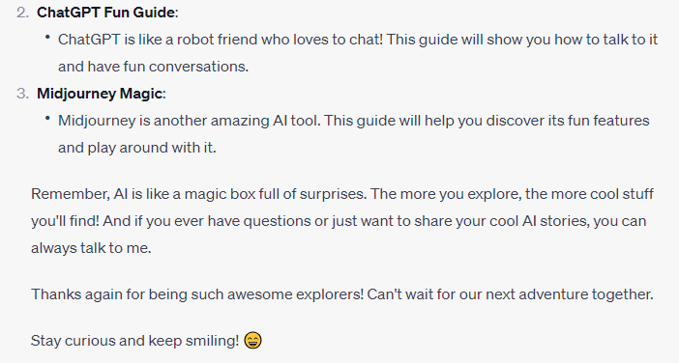
Personalisation

Slide 15
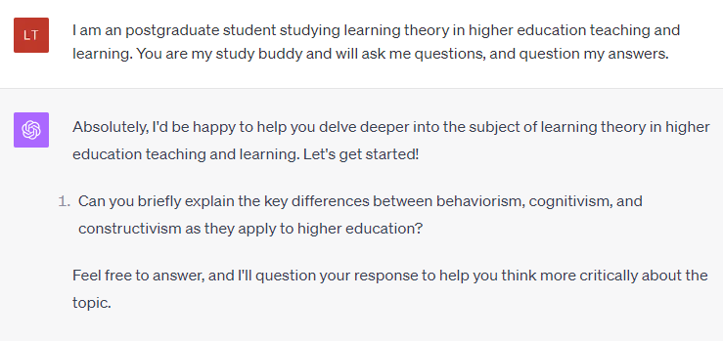
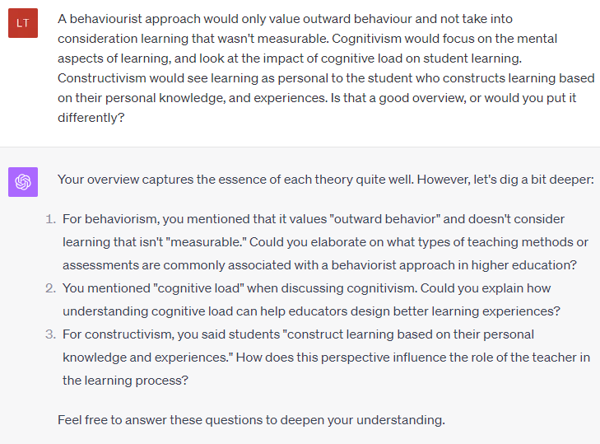
Study Buddy
Notes:
This is good because it’s not giving me facts, it’s generating questions to help me think. I’m sure it’s not as helpful as an expert in the field – they generally just say “great answer” and ask another question, but it might help a beginner explore questions that might not have occurred to them.
[Activity – Set up ChatGPT account and try some ideas out]
- Write assignment and the student critiques, spots mistakes, etc - https://youtu.be/hFui2EfjGlo?si=9QbyJPH-yDrl2spS&t=294
- Revision – explain something in a different way How would Shrek explain vaccine hesitancy. - https://youtu.be/hFui2EfjGlo?si=QqpY022hzSq7xE_v&t=233

Slide 16

Image Generation Tools
Midjourney
DALL-E
Adobe Firefly
Blackboard’s ‘AI Design Assistant’
Notes:
How it works – Part of the tool creates something based on your prompt, and the other part of the tool tries to identify it. It iterates the image to make it better.
Sheep in field examples
Examples
Blackboard areas demonstrate Midjourney.
I’m sure a painter would see where lighting was off, but it’s good for creating images that you cannot find in
Blackboard’s own output – Might be best to stick with stock images, but you can ask for a style. Impressionist…
Using Midjourney – best tool I’ve used, but still has odd things in the images.
Writing prompts – e.g. subject, pose, mood, style, lighting, framing, size
Look at some live creations
Firefly – ethical and currently free but watermarked.
[20 minutes]

Slide 17
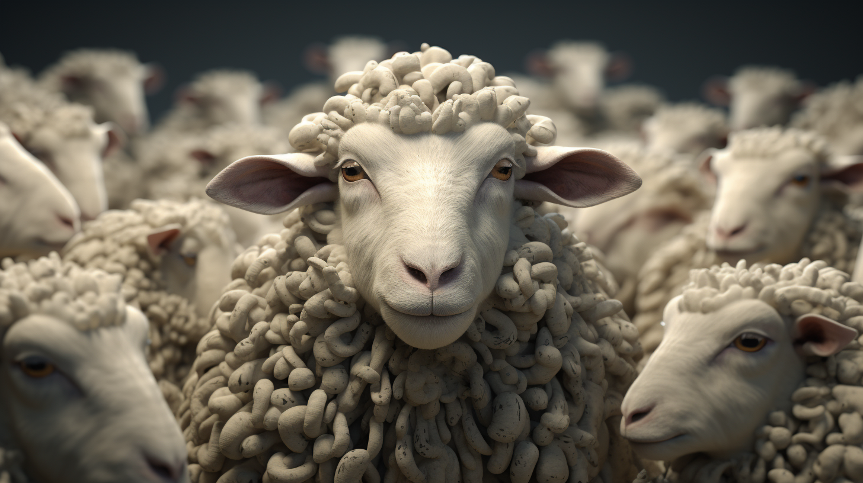
Prompt: sheep
Notes:
Go through prompt writing/engineering using Midjourney as an example. Outputs are based on patterns detected from the training data.

Slide 18
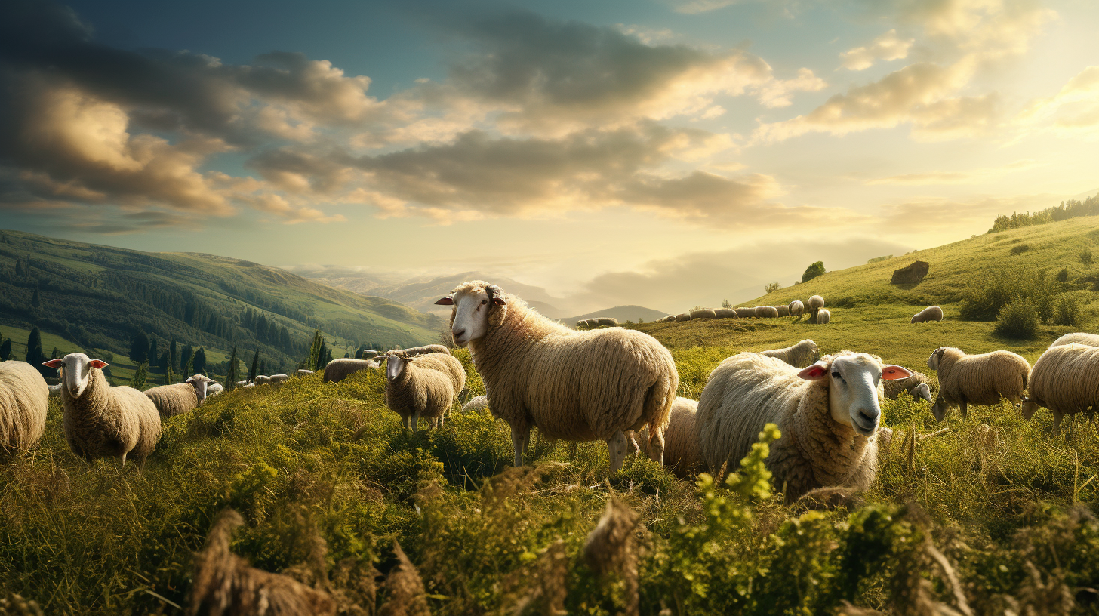
Prompt: sheep in a field

Slide 19
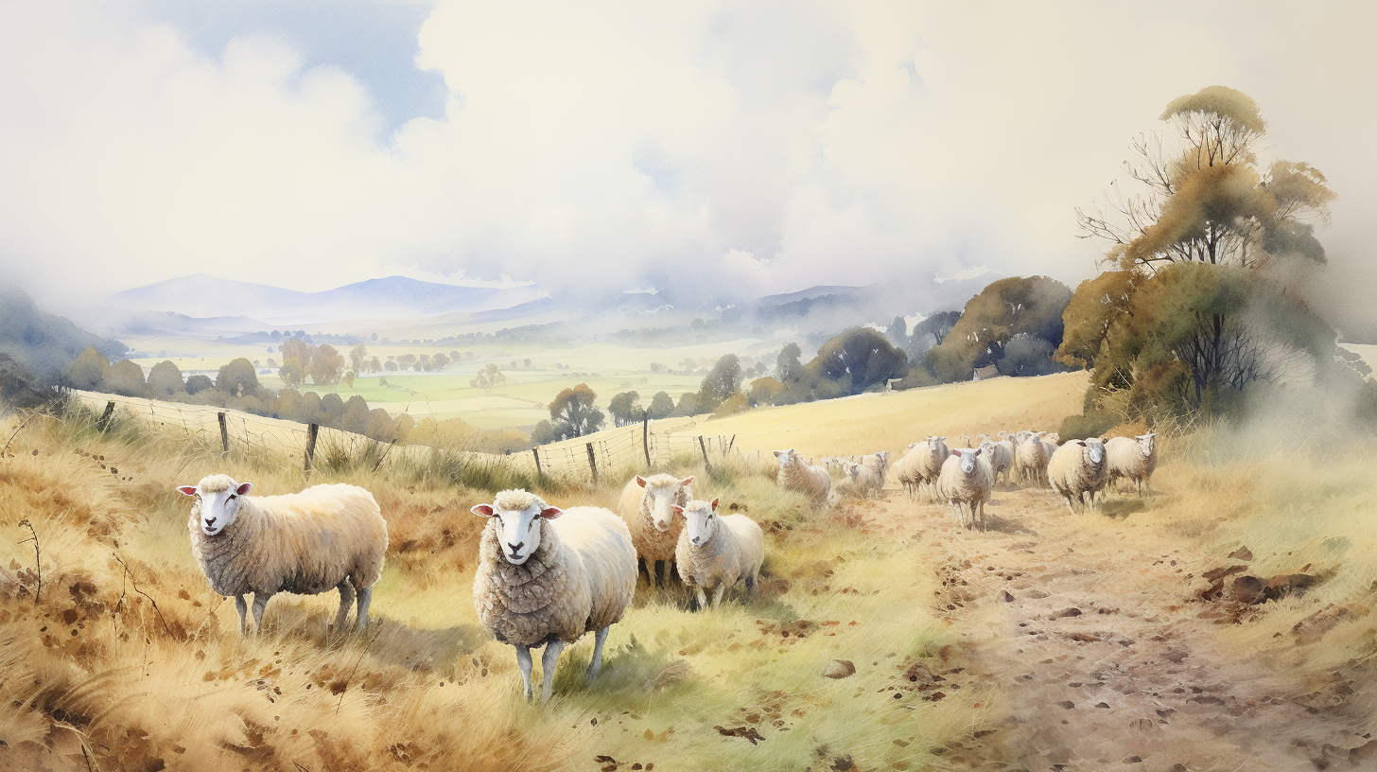
Prompt: a watercolour painting of a field of sheep

Slide 20
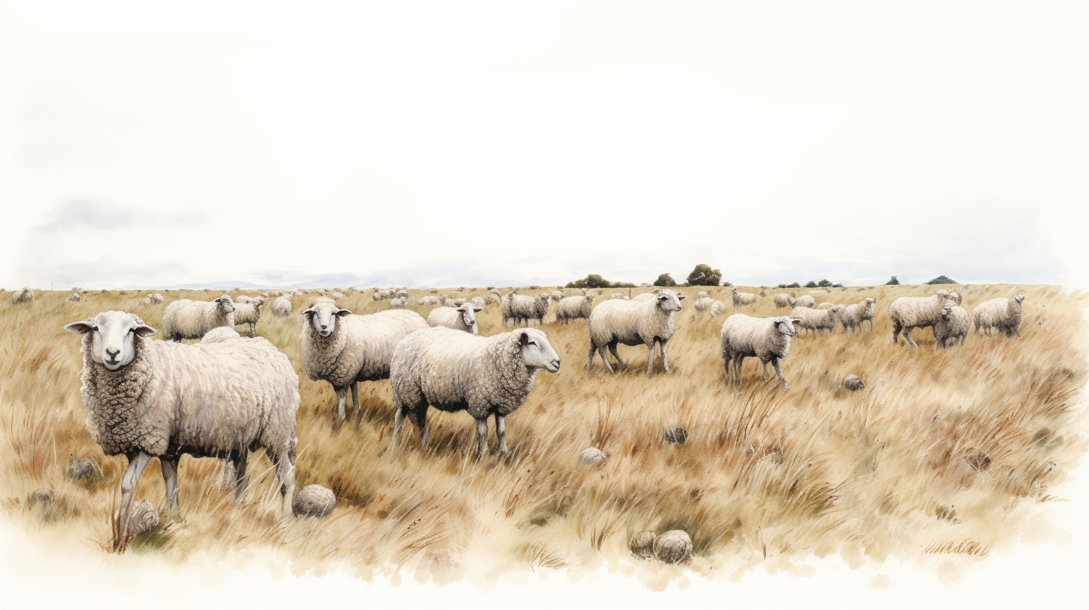
Prompt: a watercolour painting of a field of sheep, white background

Slide 21
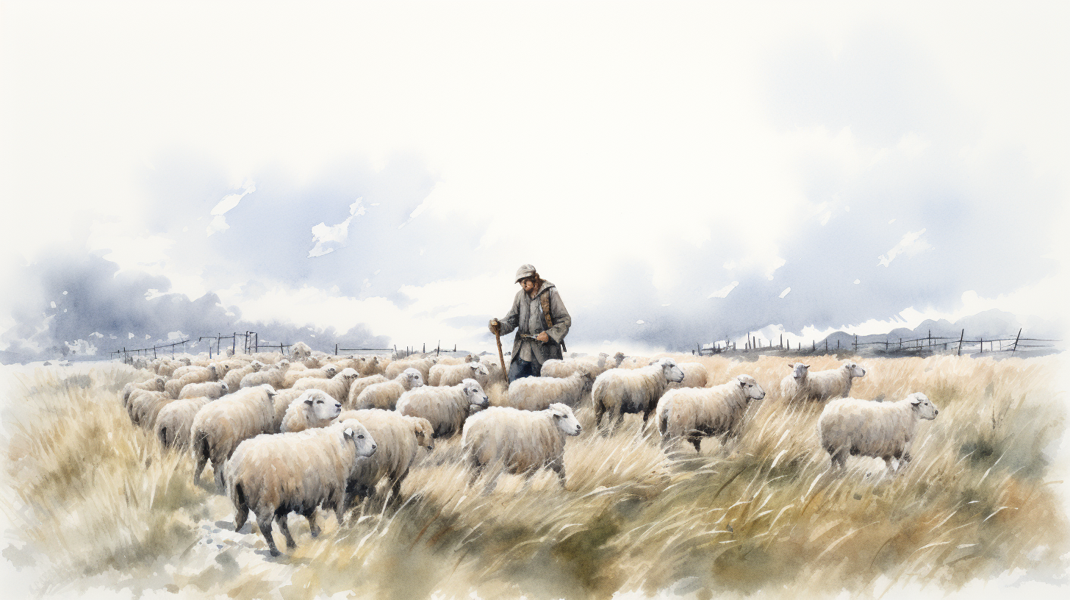
Prompt: a watercolour painting of a field of sheep, shepherd standing, white background

Slide 22
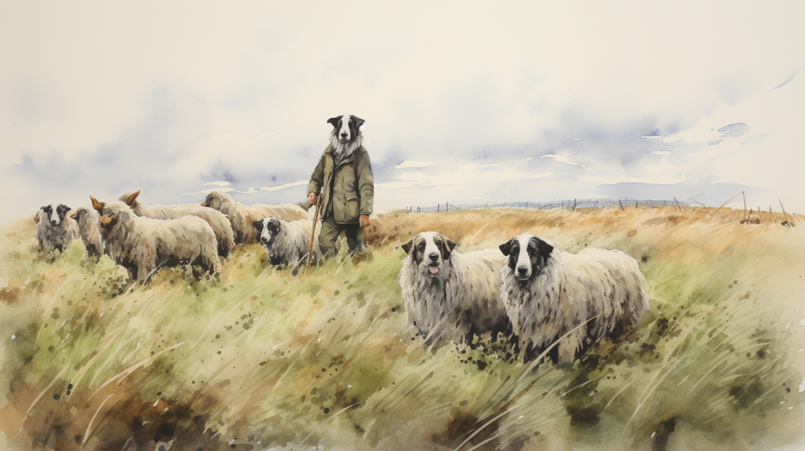
Prompt: a watercolour painting of a field of sheep, shepherd standing, sheep dog

Slide 23
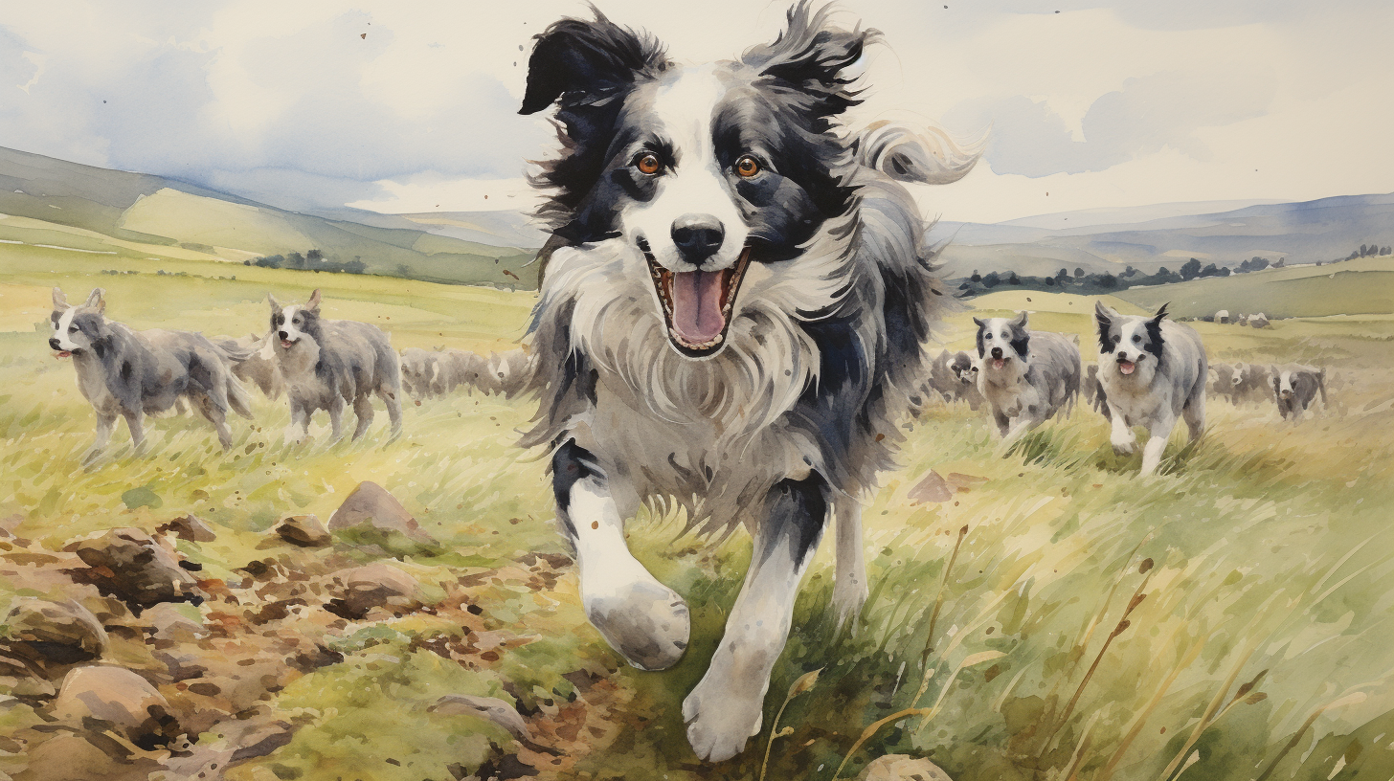
Prompt: a watercolour painting of a field of sheep, shepherd standing, border collie dog chases sheep
Notes:
Now it doesn't always work, even with a lot of recreating images. Some things confuse the machin.
Here the sheep seem to have all turned to dogs.

Slide 24
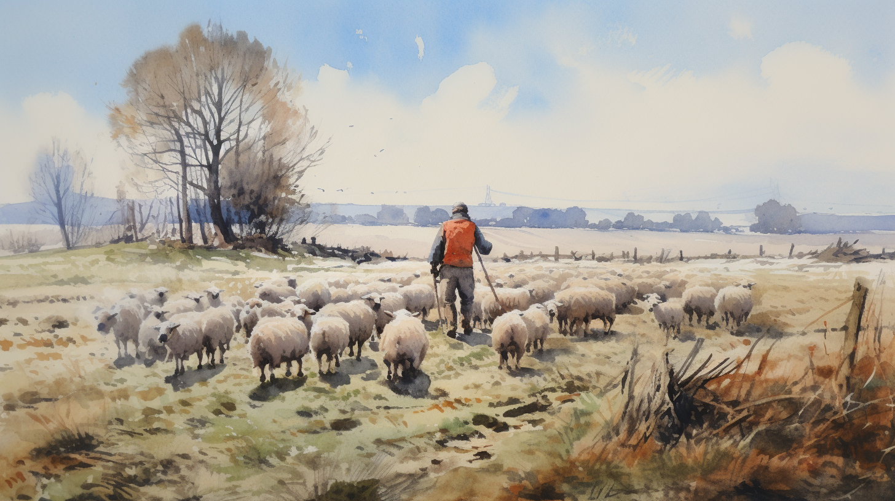
Prompt: ten sheep field shepherd watercolour
Notes:
After a lot of attempts I ended up simplifying the prompt
So, we can run into trouble when trying to ask for too much precise detail, but it's very useful if we want a style of image, or as a starting point if you want to develop some ideas, or if we have decent photoshop skills and want to tweak the images.

Slide 25
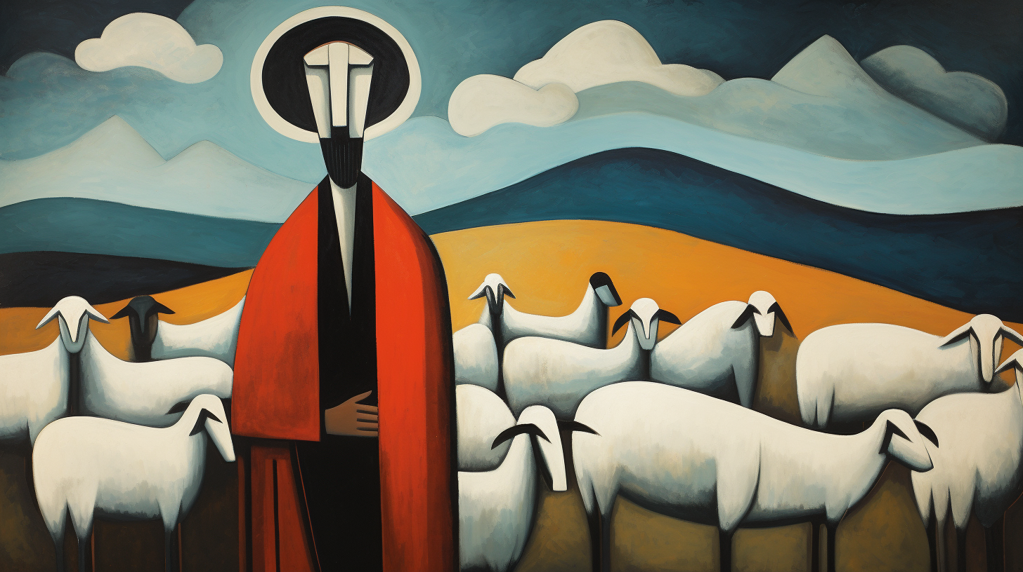
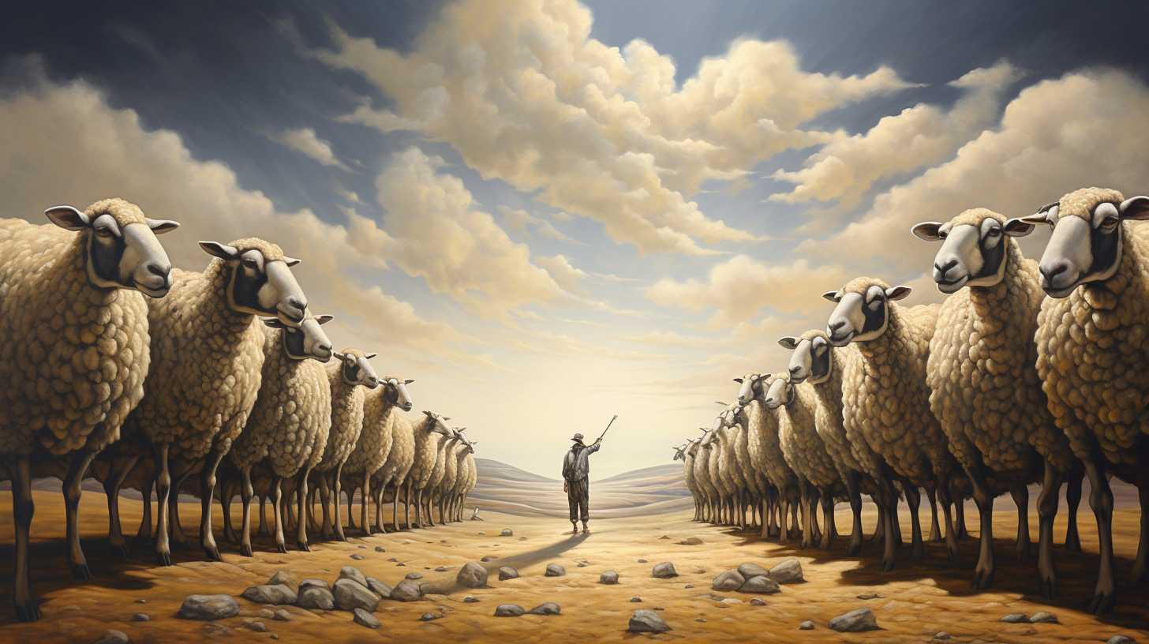
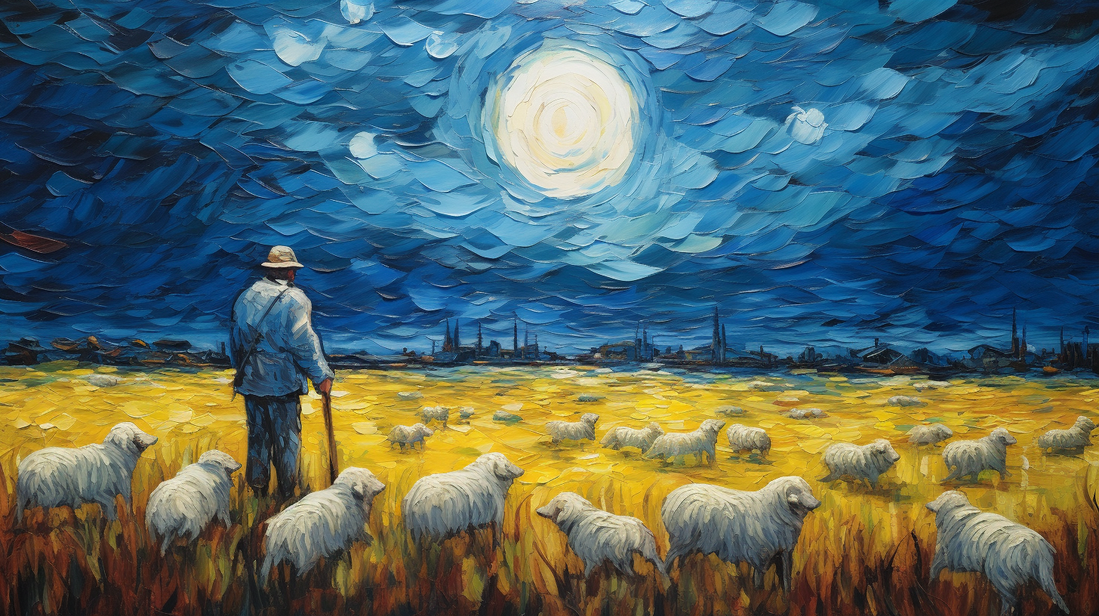
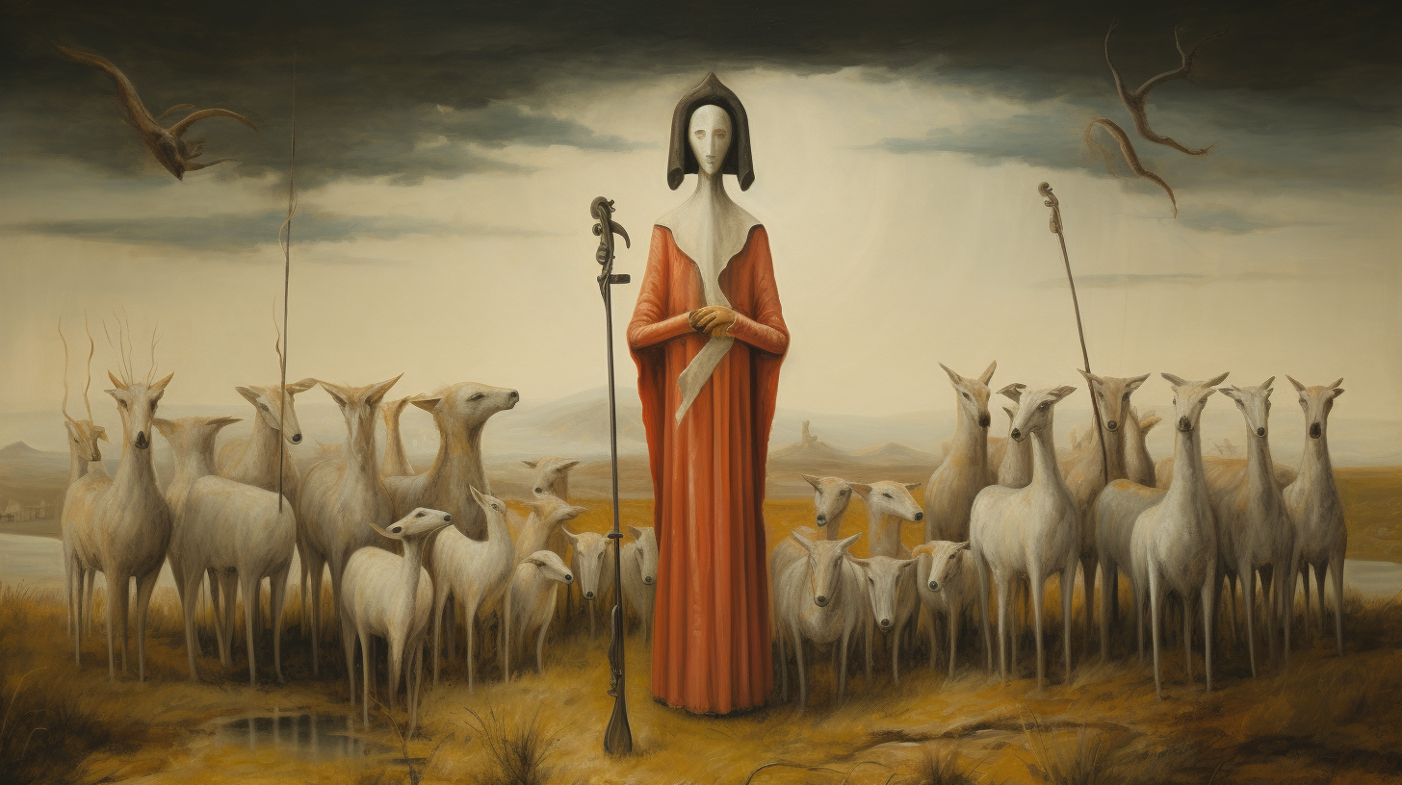
Copying styles: Ethics
Notes:
You could swap watercolour for another style or an artist's style [Picasso, Dali, Van Gogh, Carrington]. This use is controversial for living artists.
It‘s not got the meaning, and precision that an actual piece of art would have. Using this sort of thing is a fun way of making something decorative, or unusual, but it obviously loses the part of art where it is communicating emotions, feelings, and meaning between people.
So, you get the idea of how you could build a prompt, but it’s not an exact science.

Slide 26
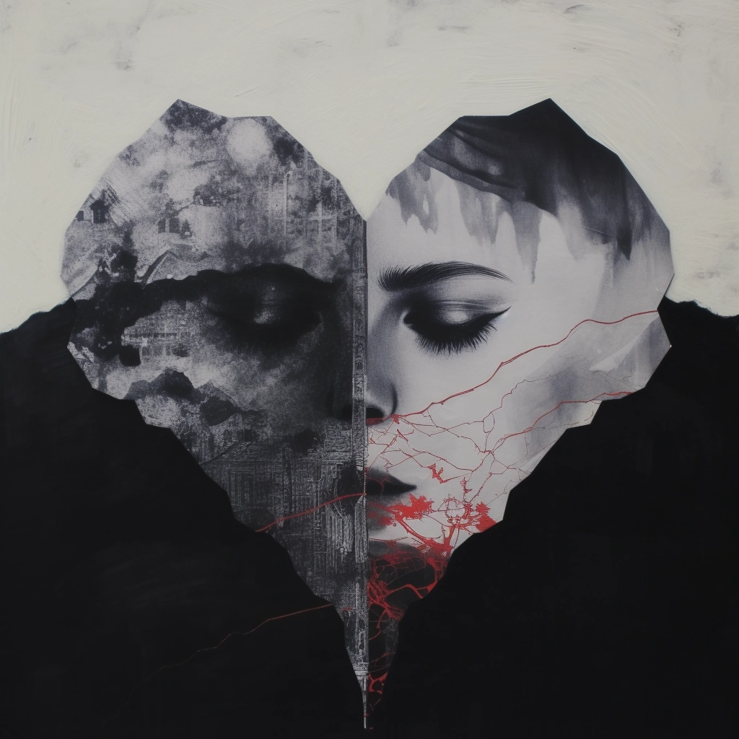
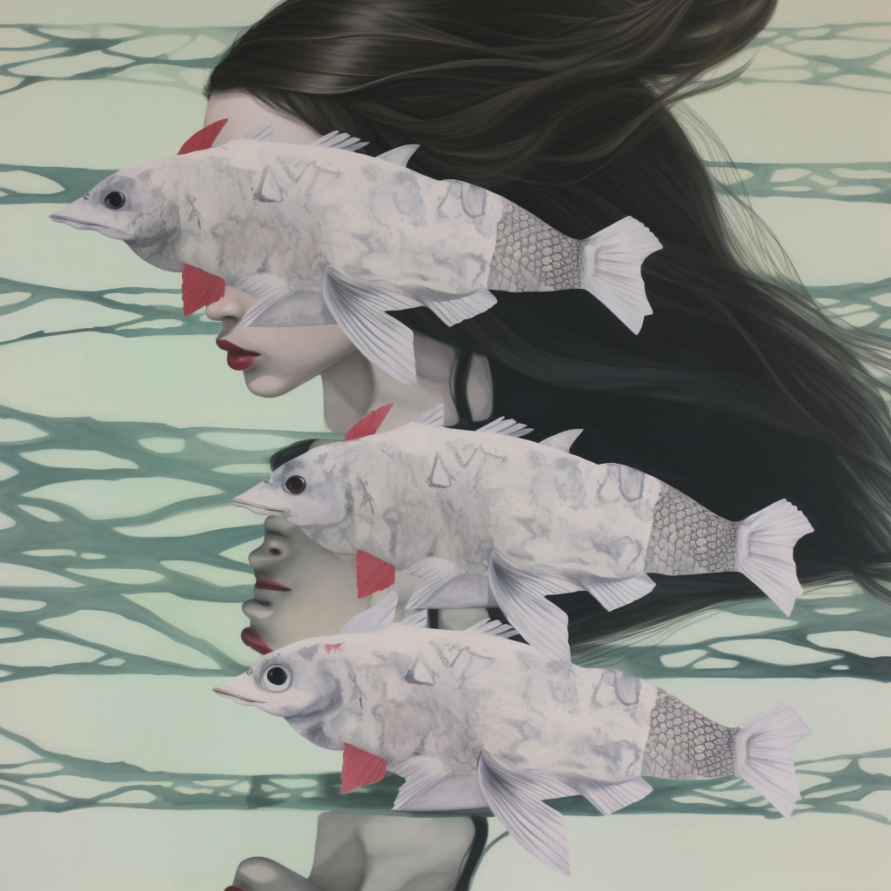
Looks like it might be conceptual art…
Notes:
But the process is very simple... art is about the process

Slide 27
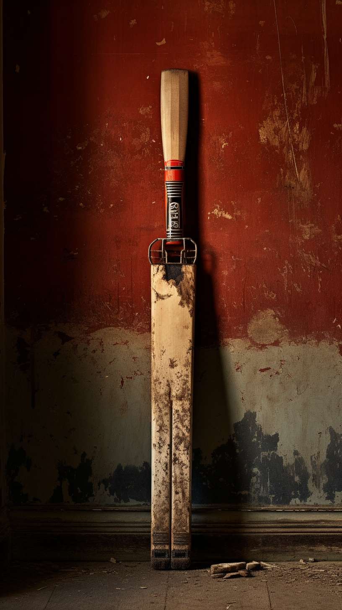

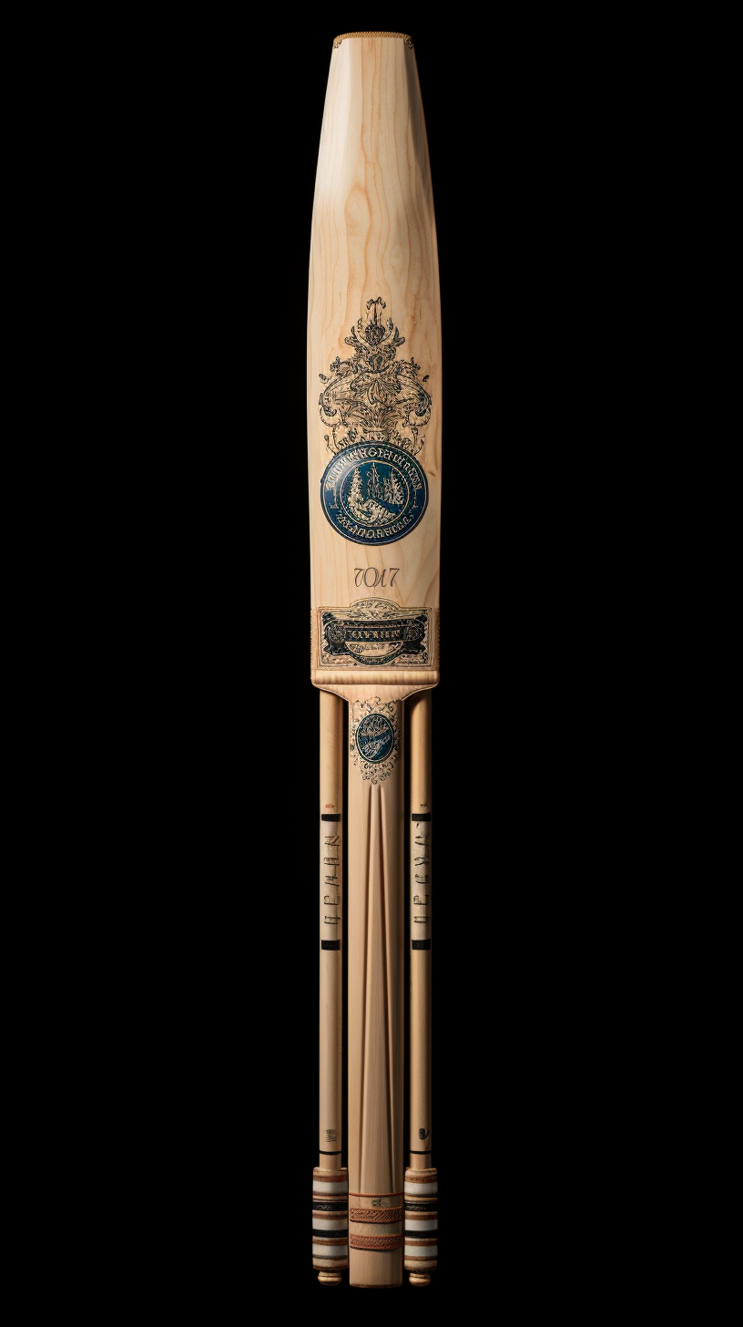
Limited Training Data: Cricket Bats
Notes:
Some things Midjourney just cannot produce. It’s confused between cricket bats, wickets and bails, and there is even a bit of a cricket helmet in there.

Slide 28
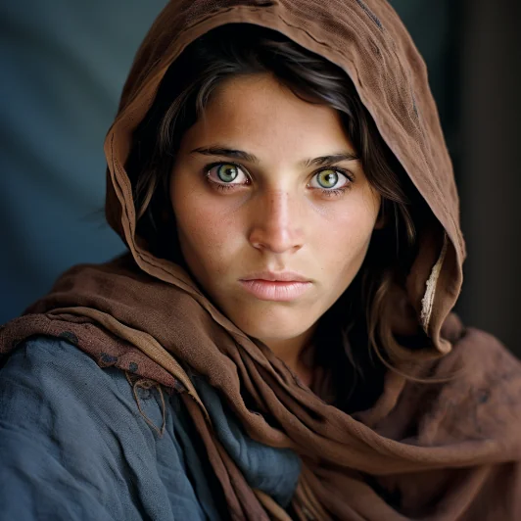
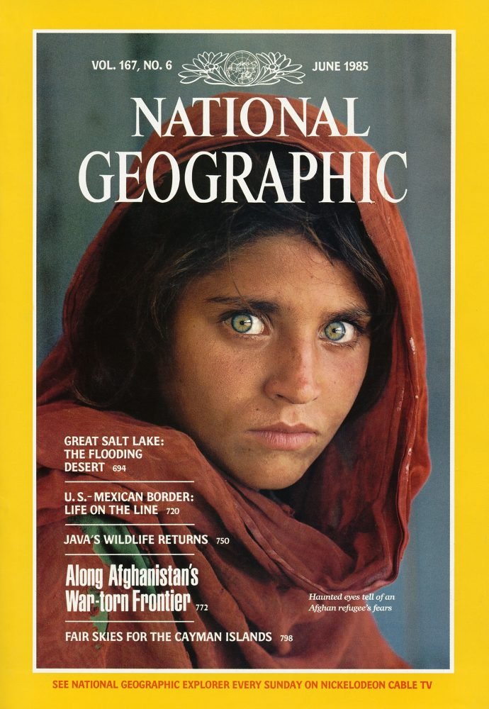
Limited Training Data: Demographics
Notes:
Or one I found today – someone shared some images on Reddit – they asked for a picture of an Afghan woman and got this, which is very close to a famous picture of an Afghan girl. It’s so famous, and perhaps the training data had few images labelled as Afghan women, that it’s clearly heavily influenced.

Slide 29
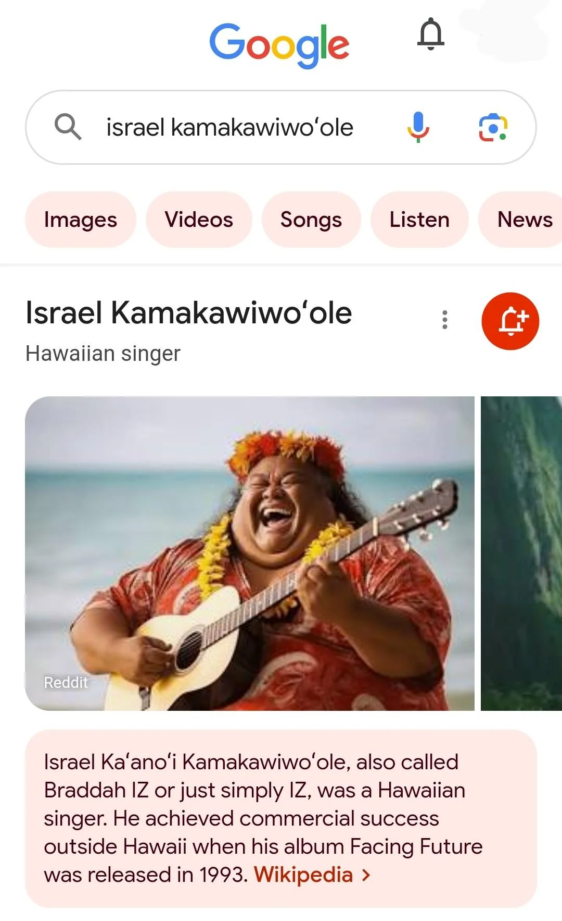
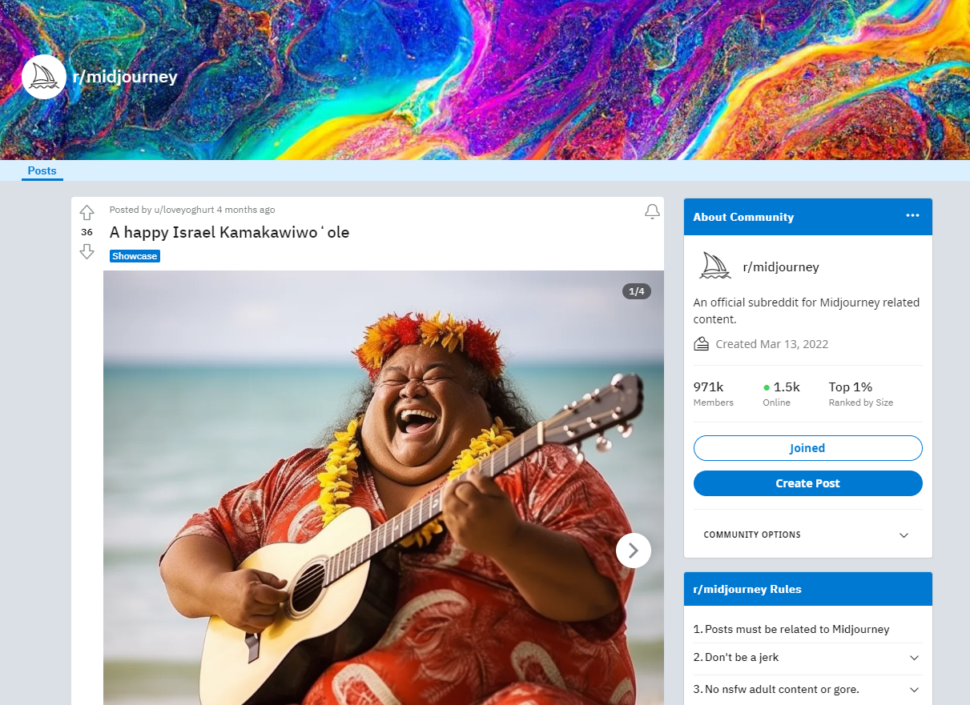
Generated Images Found on the Web
Notes:
https://www.reddit.com/r/midjourney/comments/17zimkw/oh_no_my_post_here_ruined_the_google_search/
https://www.reddit.com/r/midjourney/comments/155jzbu/a_happy_israel_kamakawiwo%CA%Bbole
Images from a Midjourney Reddit appeared as the first image on Google on mobile. I checked and saw the same thing.
You can request removal but have to notice.
https://support.google.com/websearch/answer/4628134?visit_id=638360774615194008-910549711&p=remove_image_rtr&hl=en&rd=1#zippy=%2Cremove-an-image-uploaded-to-a-social-media-platform

Slide 30
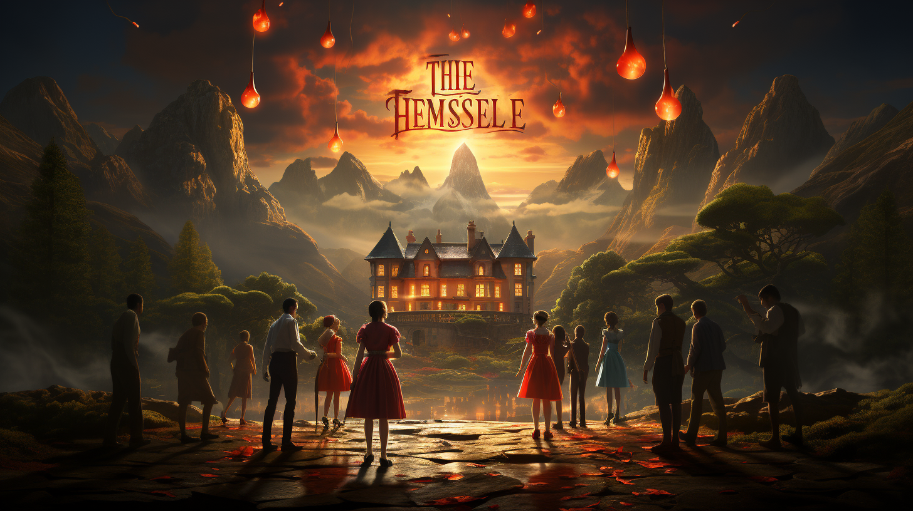
Text and Numbers: Film Posters
Notes:
Asked it to create a film poster. It recognised patterns in the training data labelled film posters, so it adds things shaped like letters, but it doesn’t have any understanding of what they are and how to add them in a meaningful way yet. Services are looking at ways to improve things like this. They’ve improved how fingers were displayed for example.
[QUESTION] What could you use this sort of thing for?
I’ve used for YouTube thumbnails, and banners.

Slide 31
Conclusion
What are good and bad uses?
Ethics – Copyright, environment, trainers
Notes:
For me - Saves time creating demonstration areas, images to use in YouTube thumbnails. Make images when I cannot find suitable stock images.
Wouldn’t use for creating things with meaning.
When experts and people are not available it can act as a patient but low-quality substitute to help you get ideas.
Ethics – copyright, trainers mental health, energy and water use to support extra computing power. Should I pay for stock images instead of paying Midjourney for the opportunity to create my own, which might be based on the artists work?
Check terms
Midjourney: "If You are an employee or owner of a company with more than $1,000,000 USD a year in gross revenue and You are using the Services on behalf of Your employer, You must purchase a “Pro” or "Mega" membership for every individual accessing the Services on Your behalf in order to own Assets You create. If You are not sure whether Your use qualifies as on behalf of Your employer, please assume it does."

