Slide 1

Queer thriving in religious schools
Cultivating vulnerable encounters with stakeholders
Dr Seán Henry
Lecturer in Education
sean.henry@edgehill.ac.uk

Slide 2
My research background
Gender, sexuality, religion, and education.
Interdisciplinary, desk-based approach to research grounded in the humanities.
To disrupt polarising discourses at this interface. To do this, I am interested in a theory of ‘queer thriving’ in Jewish, Christian, and Muslim schools.

Slide 3
Dissemination
Conventional peer-reviewed journal articles and book chapters.
A forthcoming monograph entitled Queer Thriving in Religious Schools with Routledge’s Religion and Education series.
A forthcoming edited collection entitled Queer Thriving in Catholic Education: Going Beyond the Pastoral Paradigm for LGBTQ+ Inclusion with Springer.
A key part of my work has been about cultivating vulnerable encounters with stakeholders, both about and beyond these themes …

Slide 4
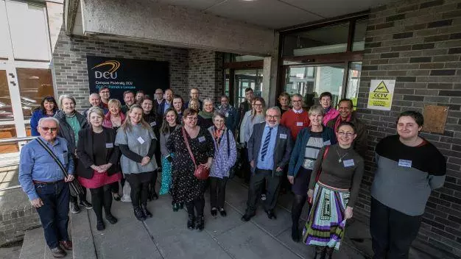
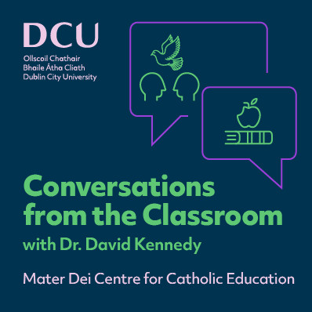

Slide 5
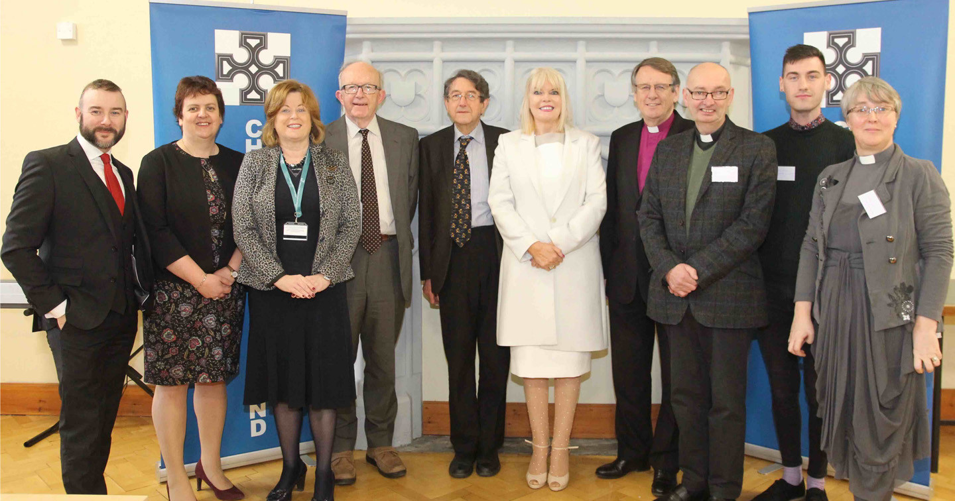

Slide 6
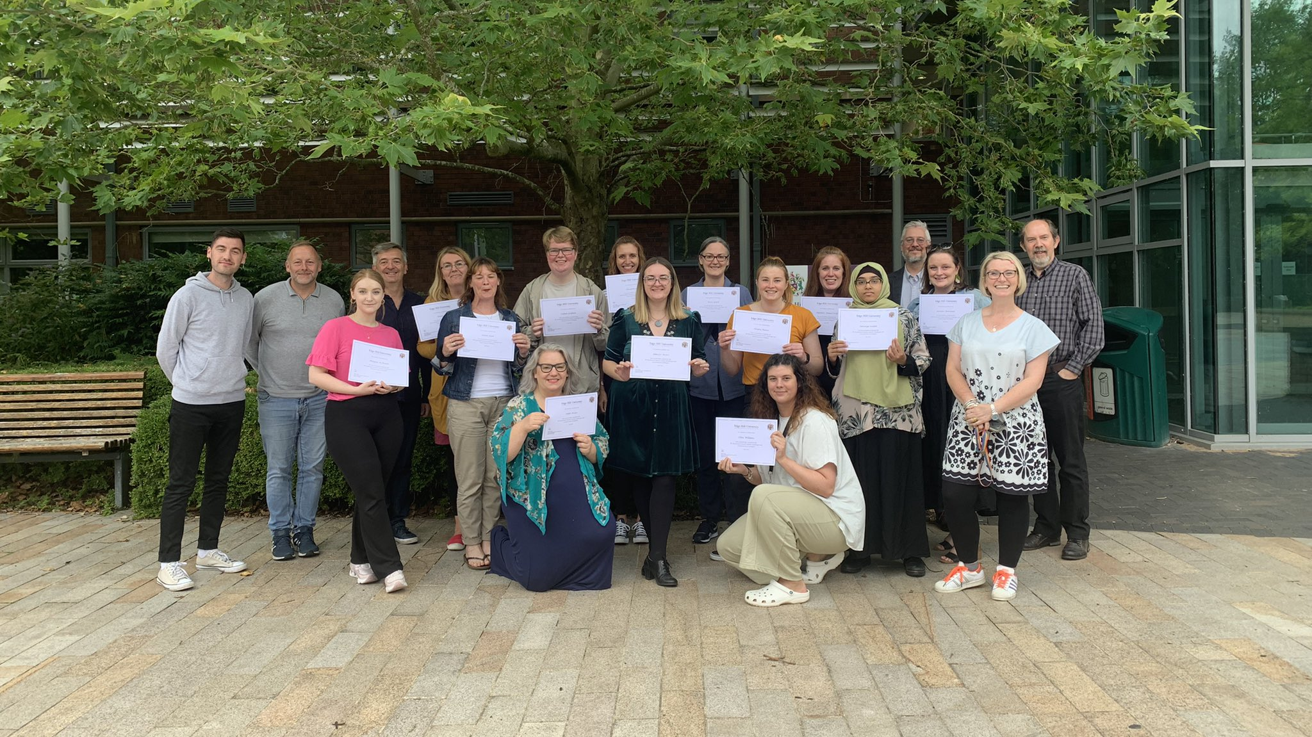

Slide 7
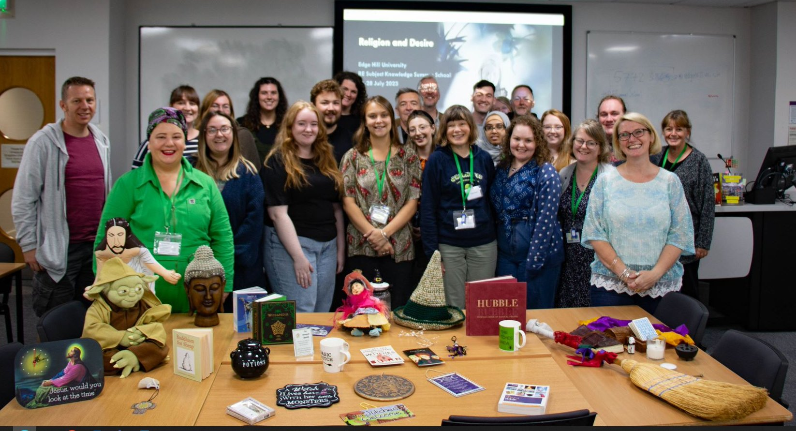

Slide 8
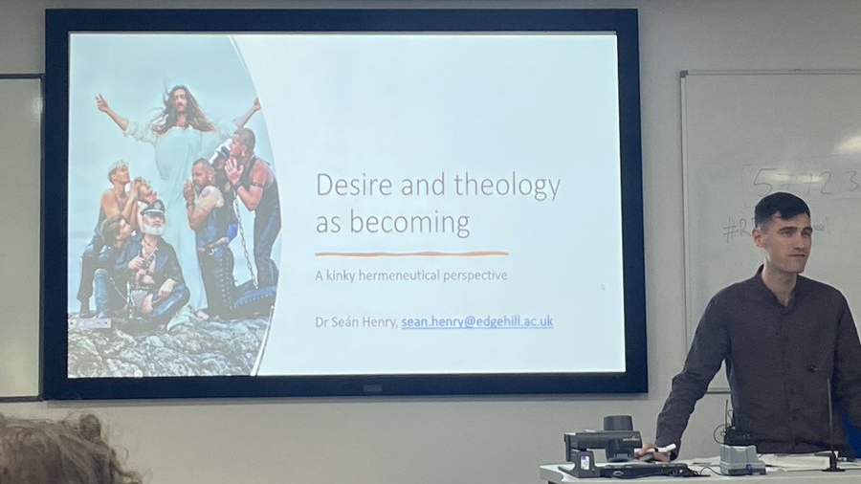

Slide 9
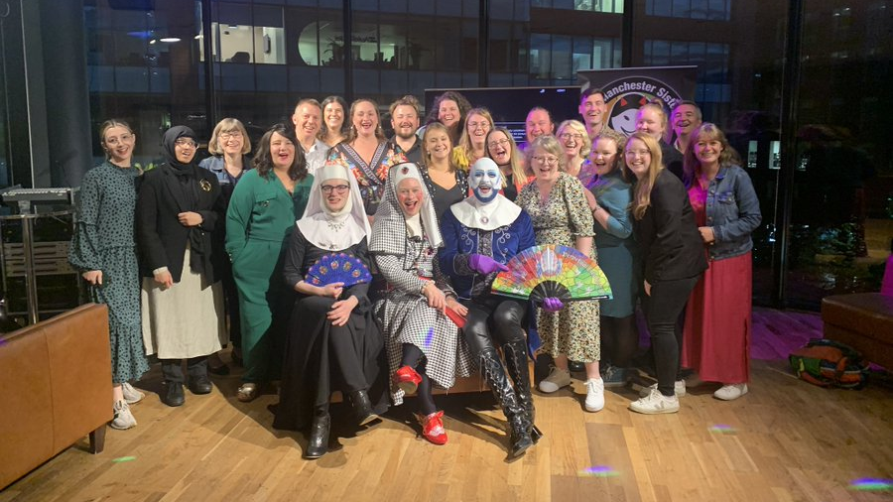

Slide 10
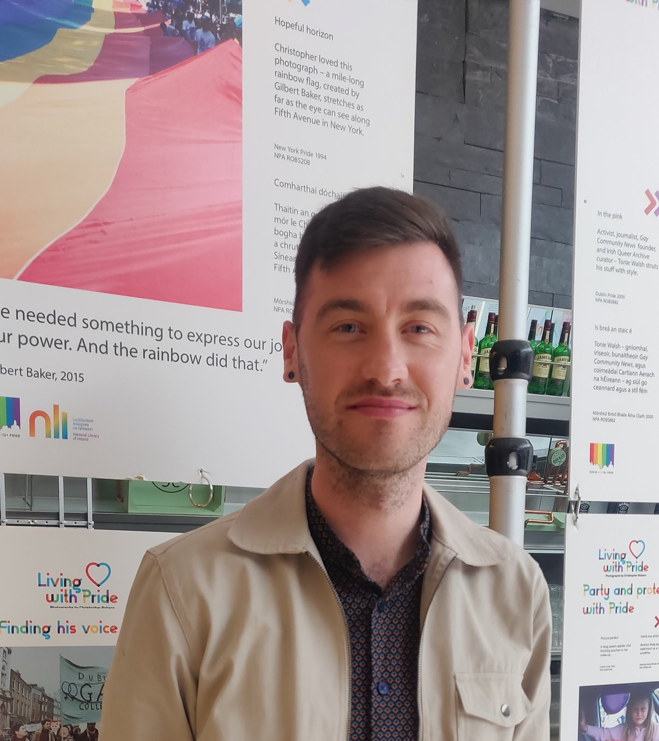
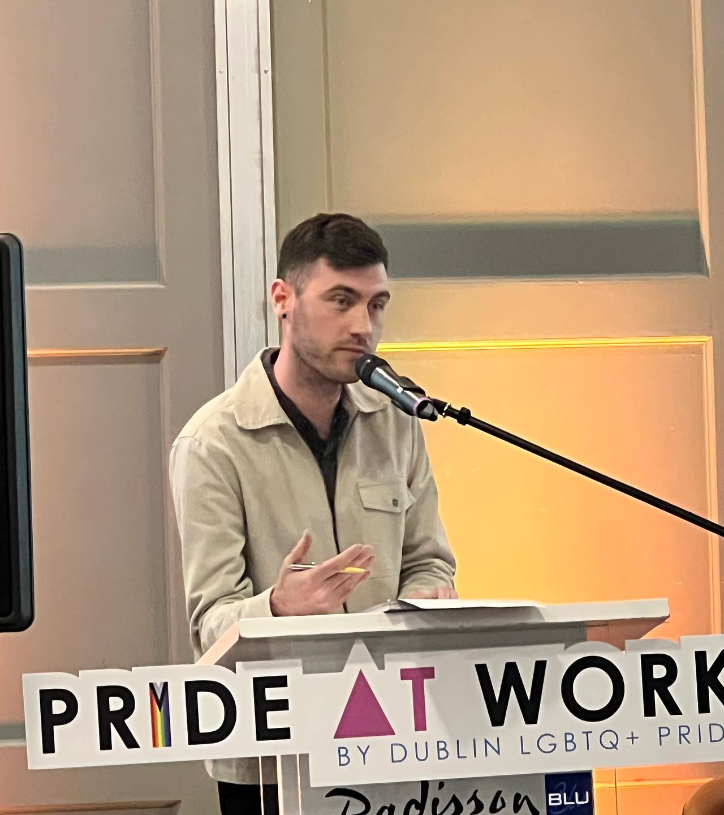

Slide 11
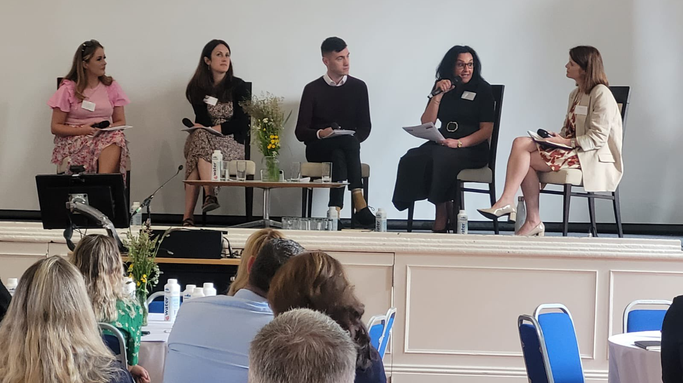

Slide 12
Cultivating vulnerable encounters with stakeholders involves …
Meeting people where they are, rather than where you would like them to be;
Not seeking to ‘resolve’ difference or conflict.
Allowing your own perspectives and insights to speak for themselves;
Close and careful listening;
Humility;
A willingness to enter new spaces with openness and respect;
Embracing the problem-posing, as well as problem-solving, role of the university;
Self-care.

