Slide 1
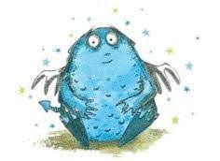
‘Research Circles’ The mutual exchange of experiences, knowledge, and ideas can provide the basis for the development of the professional’s own practice (Persson, 2009) or community engaged scholarship …..?
Dr Karen Boardman, Edge Hill University
Karen.boardman@edgehill.ac.uk
@KarenMBoardman

Slide 2
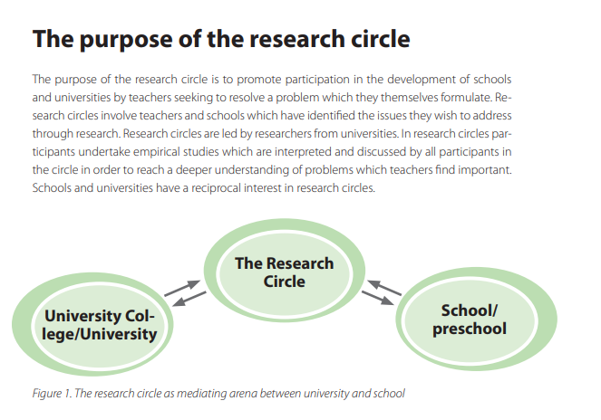
Aim of our ‘Research Circles’ … “to carry out research together with—not on—the participants” (Svensson, 2002, p. 10-11) A bridge between practice and theory? Lundgren (1999) Support, identify, prioritise, and respond to inequality and vulnerability with valuable and socially responsive approaches (Liddle and Addidle 2022)

Slide 3
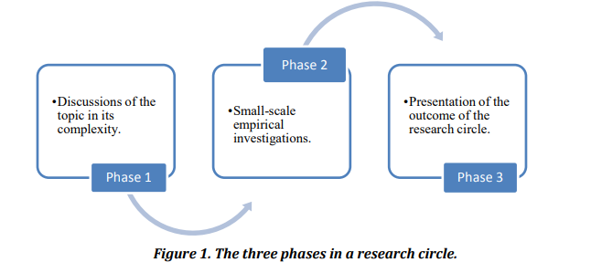
Research Circle – ‘collaboration’
Concept of collaboration for the joint work, on equal grounds, carried out by the school/setting and team of university staff – mutual agreements and all voices heard.
Active, participatory listening and engagement.

Slide 4
Research Circle projects so far …. RC1 and RC2 – Communication, Language and Literacy (CLL) (completed) RC3 - CLL, based on curriculum outcomes ELGs (completed) RC4 - Specialist provision (on-going) RC5 - Specialist provision 2 (beginning in September 2023) RC6 – Forest School/Outdoor learning (Jan 2024) RC7 – Attendance (October 2023) RC8 – Child development (supporting staff K&U) (March 2024)
More information
Karen.boardman@edgehill.ac.uk

Slide 5
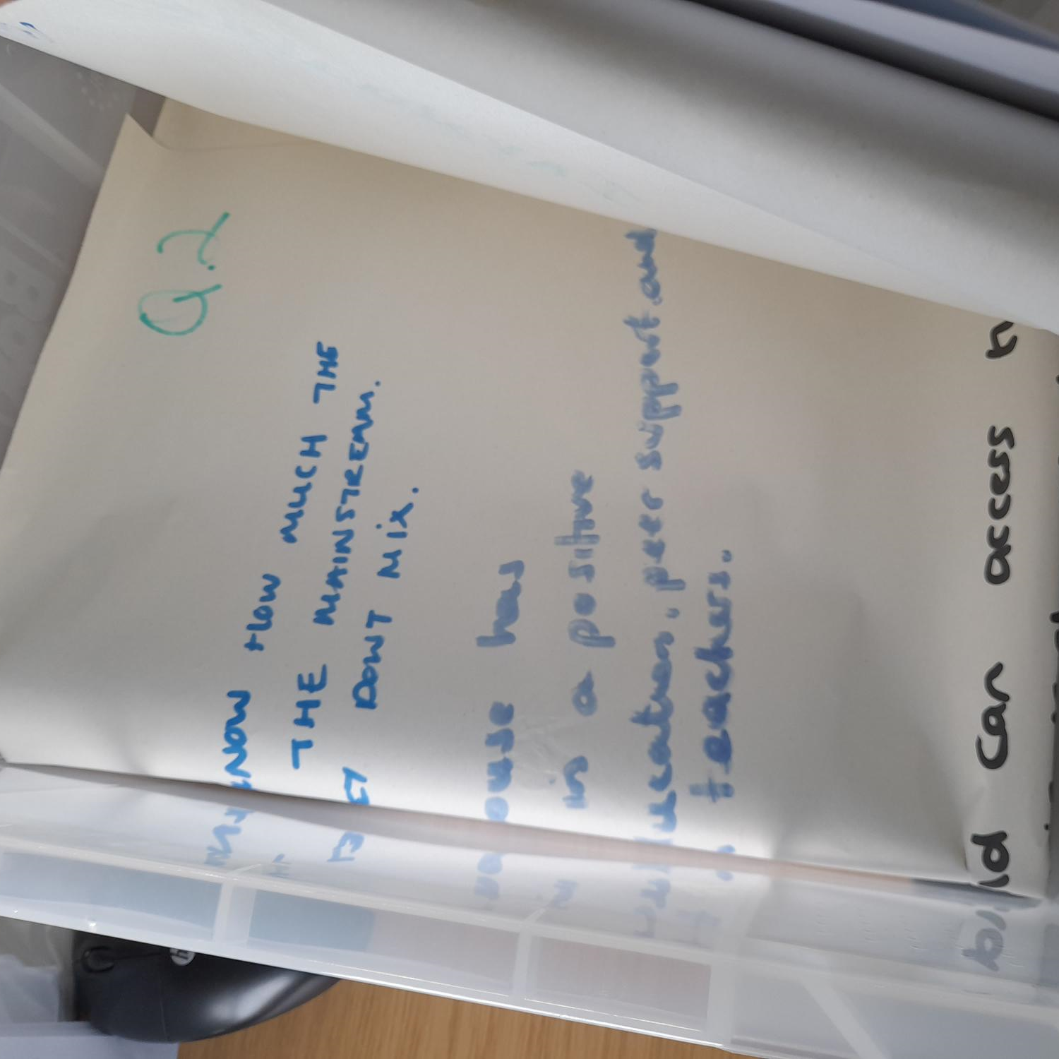
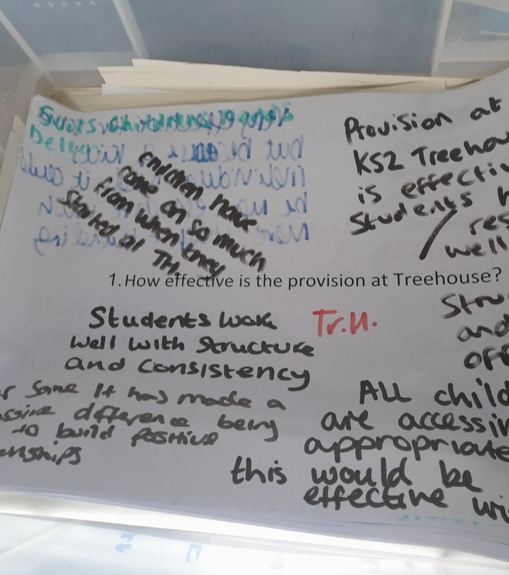
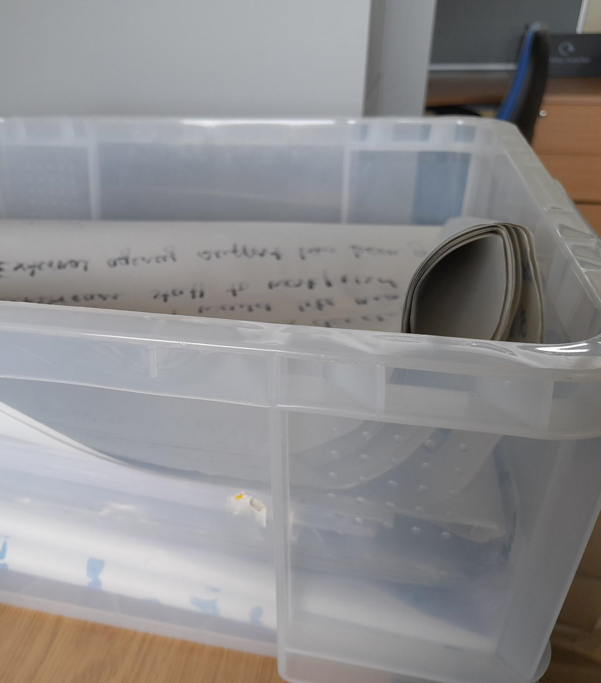
Messy data …
All stakeholder voices heard and shared ….

Slide 6
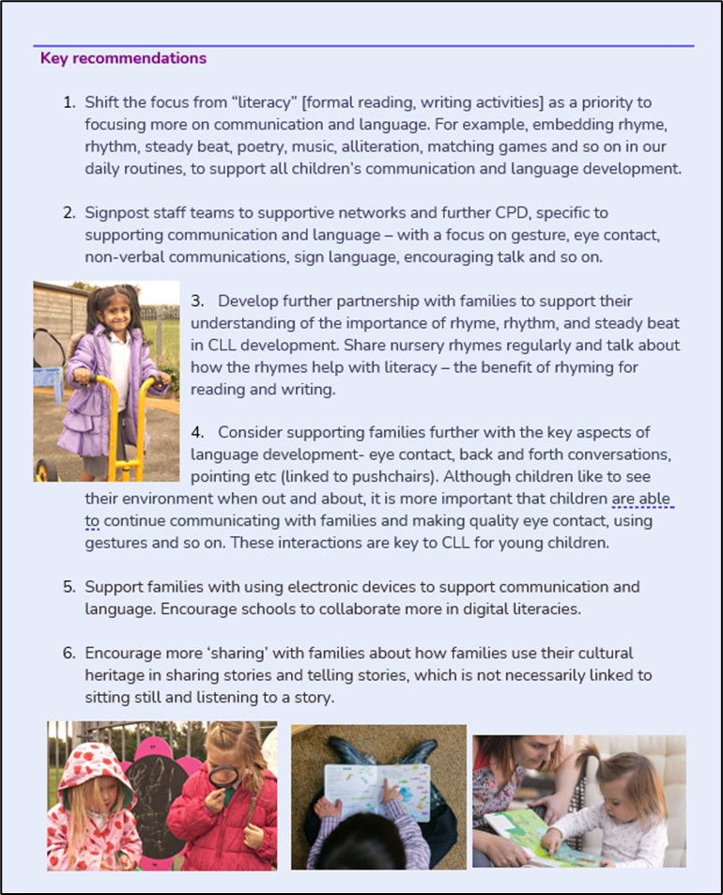
Sample dissemination

Slide 7
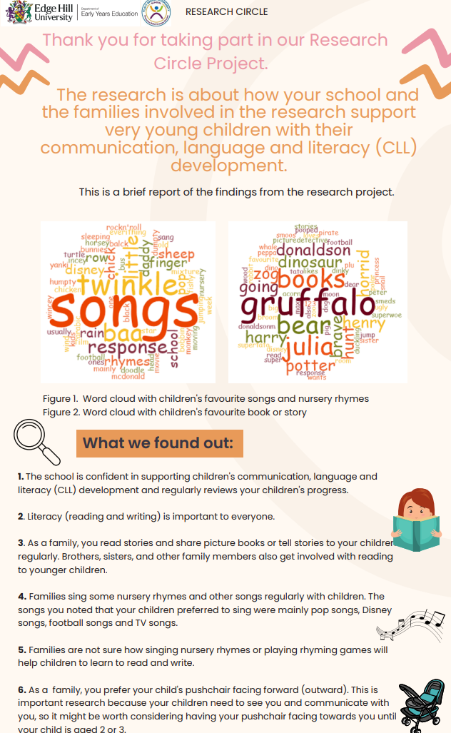
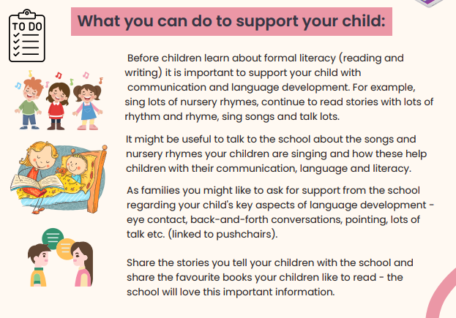

Slide 9
A word or 2 from RC ‘family’ participants …. “I didn’t really know what this (research project) was about but know that reading and writing is really important for my children.” “I really enjoyed the workshops – sharing ideas was good.” “I know what I don’t know and it is still ok to have your say.” “It feels good to be asked what I think.”

Slide 10
A word or 2 from RC participants …. “I have been so pleased with the whole project from start to finish – lots of communication, support and most importantly ownership.” “I wasn’t sure about the research circle per say, but now I totally understand that we are all equal in our roles and we all have to get on with own our own tasks.” “It is really exciting when you get the data!” “This is the best CPD ever!”

Slide 11
Publications … getting the word out there .. Impact publication September 2023: Boardman K, Hindley C, and Cont S. “Supporting under-fives and their families with communication, language, and literacy development: a collaborative research circle project”. Chartered College of Teaching. Nursery World – “Research Circles in Early Years Settings” November 2023 Early Child Development and Care. 2023: Boardman K, Hindley C. “Supporting families with a focus on communication, language and literacy development: Research Circles” (under review). Early Education 3- 13. 2024: Boardman K, Cont, S, Starkey, M. “Research circles: a methodology to engage families in communication, language and literacy development” Boardman K, Jamieson, V. and Cont, S. 2024 “Research Circles as a collaborative space”.

Slide 12
References Bergman, L. 2002. The research circle as a resource in challenging academics’ perceptions of how to support students’ literacy development in higher education. Canadian Journal of Action Research. Volume 15, Issue 2, 2014, pages 3-20. Liddle, J., Addidle, G.D. (2022). The Role of the University in the Vulnerability Agenda. In: The Role of Universities and HEIs in the Vulnerability Agenda. Rethinking University-Community Policy Connections. Palgrave Macmillan, Cham. https://doi.org/10.1007/978-3-030-89086-5_4 Lundgren, M. 1999. How are research circles used in schools? - some reflections Conference Paper Presentation - Högskolor och Samhälle i Samverkan vid Högskolan Dalarna den 16 -18 mars 1999. Persson, S. 2009. Methodology Guide. Research Circles – a guide. City of Malmo: Centre for Diversity in Education. Svensson, L. (Ed.). 2002. Interaktiv forskning: För utveckling av teori och praktik [Interactive research: For the development of theory and practice]. (Work Life inTransition No. 7). Stockholm: Arbetslivsinstitutet

