Slide 1

Exploring the experiences of staff and young people making the transition from alternative provision (AP) settings to post-16 mainstream education:
A pilot study with Manchester City Council
Dr Emma Clarke (York St John University)
e.clarke@yorksj.ac.uk
Dr Shaun Thompson (Edge Hill University)
Shaun.Thompson@edgehill.ac.uk

Slide 2
Background & Context
Pupils [in AP] are amongst those with the highest levels of need and most significant vulnerabilities in the country.
81% of pupils in AP are on the SEND register, which is almost six times more than in mainstream schools.
There are issues in funding and support for pupils over 16, within the AP sector.
66% of pupils in AP are aged 14-15, compared to 13% in the state sector.
5% of AP pupils achieved 9-4 passes in English and maths at GCSE, compared to 64% in the state sector.
14% of pupils ending KS4 in AP were NEET at 16, compared to 2% in the state sector.
(IntegratED, 2022; House of Commons Library Research Briefing, 2019)

Slide 3
Aims of the study
What strategies or structures support the transition of young people from post-16 AP settings to mainstream settings?
What strategies or structures, hinder the transition of young people from post-16 AP settings to mainstream settings?
What are the key points within the transition period, which require consideration to ensure effective and efficient transition of young people from post-16 AP settings to mainstream settings?
What does best practice look like to support young people transitioning between post-16 AP settings and mainstream settings?

Slide 4
Study Design
Phase I (2022-23)
Survey distributed to all KS4 AP providers and mainstream post-16 settings within MCC;
Settings distributed survey to all staff and students supporting/involved with transition in 2022/3 academic year;
49 staff & 18 students responded;
Phase II (2023-24)
Longitudinal, multiple case studies following students (n=15) and staff (n=15) throughout their transition period;
Visual methods: graphic elicitation, timelining, ecological system mapping
Semi-structured interviews 4 times over the duration

Slide 5
Phase I Key Findings: Staff
More time spent discussing careers and transition within the setting (71%)
  ‘Many students don’t have a clear/realistically achievable decided pathway and would benefit from some more focused and directed help and advice’
  ‘By supporting the students, we will hopefully help them through a smooth transition’
96% of settings make use of transition plans to support young people
  ‘It allows the students time to adjust and ease into the new setting, so it doesn’t become overwhelming’
  ‘The post-16 providers need to have a sensitivity to the transition needs of the young people they have coming to them and create and implement their own plans, for those who need the support, in partnership with the pre-16 provider’

Slide 6
Phase I Key Findings: Staff
80% of staff felt valued and listened to during transition discussions
  ‘Everyone has the young-person’s interests at the heart of decision-making’
  ‘Feedback goes to the SLT’
70% of staff felt they knew individuals’ needs well enough to support them in an effective way
  ‘When you have worked with the same young people for a long period of time, you understand their needs’
  ‘Staff know students and pupils very well to support and I form future decisions’
67% of staff are comfortable and confident with the way individual needs are discussed/support is put in place
  ‘Staff are around students every day and get an understanding of their academic capabilities and personal abilities’
  ‘Staff know students extremely well. Students visit the setting and EHCPs are explicit’

Slide 7
Phase I Key Findings: Staff
77% said support has been consistent throughout the transition period
  ‘Support is never stopped, or removed, and done remotely if needed’
70% reported that parents’/guardians’ views were sought
  ‘A child-centred approach is used and is beneficial for all that know the student to be involved in planning transitions’
  ‘Most of our students need parent/guardian input’
70% felt that the views of peers/community were a factor in pupils’ post-16 destination decision
  ‘Many prefer to choose colleges/pathways that peers have done in order to have some familiar contact’

Slide 8
Phase I Key Findings: Students
67% of students wanted more time discussing careers and transition
  ‘Because it would help in the future’
  ‘So I get more choices’
Pupils who had a transition plan put in place stated:
  ‘Everybody supported me’
  ‘It gave me direction’
100% of pupils felt listened to during the transition period
  ‘It was informal’
  ‘I could talk to staff’

Slide 9
Phase I Key Findings: Students
87% of students felt staff knew them well enough to support them
  ‘I could trust them’
93% were happy with the way their needs were discussed and the support that was put in place
  ‘I don’t know, but I feel like I was listened to’
87% said their parents/guardians were consulted and that their views influenced their [student] destination choice
67% felt friends and community were a factor in their destination choice
  ‘Going with friends is the most common thing’

Slide 10
Implications for Phase II: Making transitions seamless
‘I would stress the importance of recognising that transition is not only about before a young person starts in a new learning provider, as much of the transition is in the first half-term, where they are meeting new people, both students and tutors, while trying to learn new things, in an often bigger, and busier environment’
Consequently, phase II will run from October - October

Slide 11
Summary of Phase I
Transition plans form an essential backbone of the transition journey.
Multiple views and voices are important within the decision-making process: parents/carers, peers, community.
Value of strong relationships – knowing the young person’s needs.
Sufficient time spent on transition planning.
Consistent support throughout the transition period.
Importance of trust, an informal approach, choices for the young person.

Slide 12
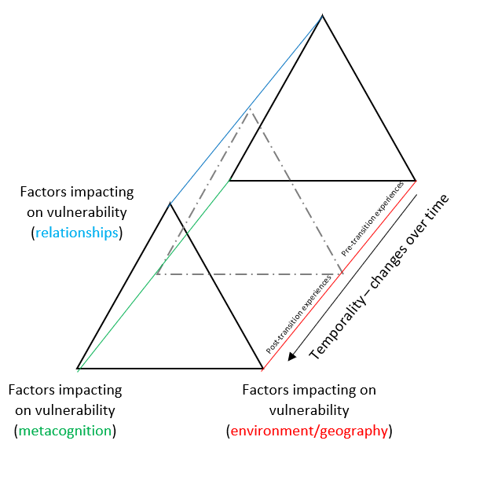
Implications for Phase II: Making transitions seamless: Theoretical underpinning
(Based on Emmel’s (2017) Toblerone Model of Spaces of Vulnerability)

Slide 13
Implications of the study
Production of best-practice guidance and co-constructed recommendations for supporting young people transitioning from AP to post-16 mainstream settings
Based on appreciative enquiry: An asset-based approach designed to uncover existing strengths, advantages, or opportunities within settings and organisations.
The co-construction of peer-to-peer toolkits to support other young people throughout transition periods

Slide 14
Thank you!
@mrt_shaun
@emmac_larke
Thanks to Manchester City Council for funding support for Phase II of this project

