Slide 1
Moving Forward
From Transactional to Transformative Partnerships

Slide 2
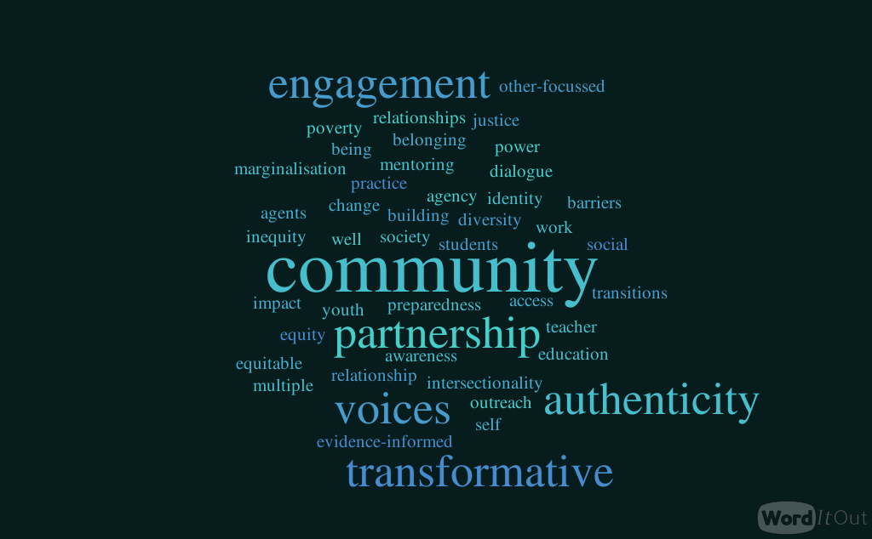

Slide 3
Potential Collaborations
University-urban engagement
The civic university and community engagement
The role of the teacher, and implications for teacher preparation
Supporting student career development
Student wellbeing & mental health
Intersectionality
Right to play, and children’s rights
Culturally responsive, transformative pedagogy
Informal, inclusive pedagogy
Educational and justice outcomes for vulnerable youth
Lesson study;
The arts for fostering including in education

Slide 4
Ways of Working
Research that includes the community, and is driven by them; collaborative co-researching with practitioners;
Multi-modal forms of research (beyond the book chapter/journal article);
Story-telling – amplifying community voices;
Comparative, cross-cultural work;
Faculty exchange, and student exchange between EHU and UCF.

