Slide 1

Lesson Study and empowerment: Disadvantaged students’ experiences of shaping teaching and learning in the classroom
Dr David Allan

Slide 2
Overview of Lesson Study
A model for professional development
Supports the construction of pedagogical knowledge
Requires intense professional collaboration
Process: planning, delivering, and evaluating teaching

Slide 3

Plan, deliver/observe, evaluate
Cycle One
Team of three teachers
Identify a focus
Case students are identified
Collaborative planning
One teacher delivers the lesson
Two observe
A post-lesson discussion is held

Slide 4
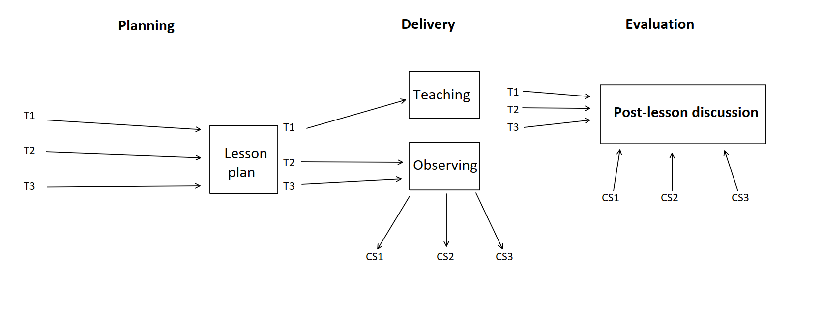
T= Teacher
CS = Case student

Slide 5
Origin and movement
Used in Japanese schools since 1870s (Dudley, 2013)
Moved Westward
‘…borrowed by American researchers in the late 1990s’ (Rappleye and Komatsu, 2017, p. 398)
The Teaching Gap (Stigler & Hiebert, 1999) International comparisons of teaching
Lesson Study identified
2000s – further borrowing by the UK

Slide 6
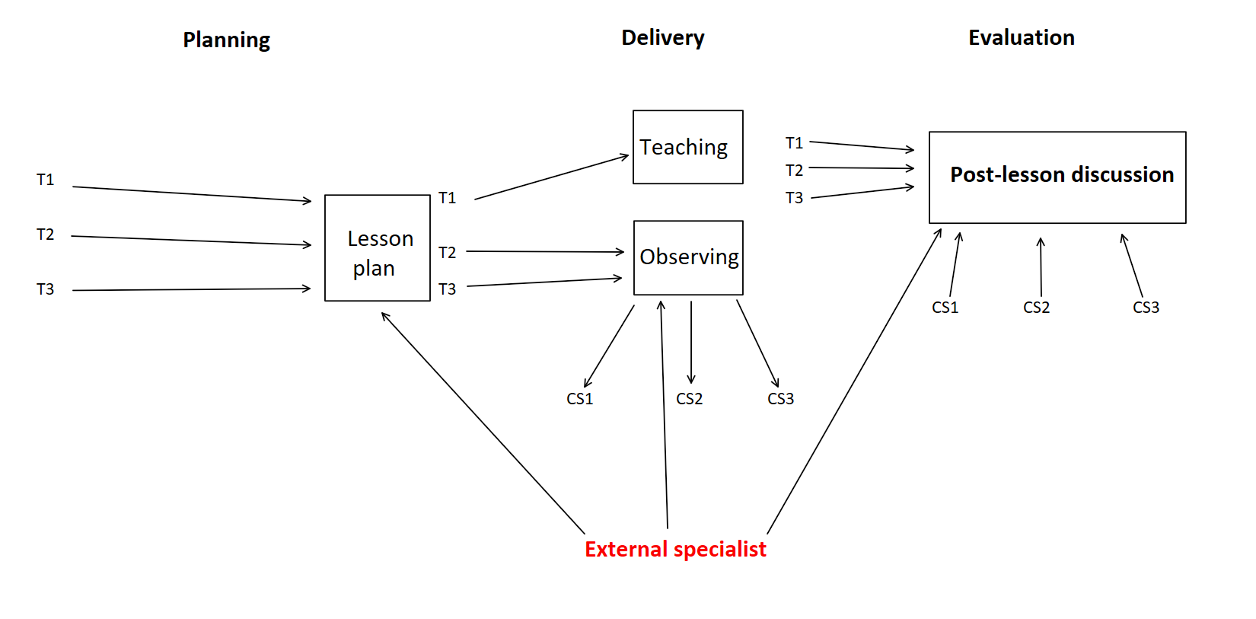

Slide 7

Western teaching
Teaching as a solitary profession – working in silos
Shared knowledge was uncommon (Hiebert, Gallimore, and Stigler 2002)
Professional development based on introspection
Need for greater collaborative working
Some sectors more collaborative – e.g. primary – but not as intense

Slide 8
What can LS do?
Professional development tool
Potential for co-constructing pedagogical knowledge
Fresh opportunities for learning
Promotes praxis, ‘the embodiment and enactment of theory in practice’ (Ng & Wright, 2017, p. 784).

Slide 9
Focusing on the case students
‘Zooming in’ on the action
Microcosm of the wider lesson
A lesson is like a ‘swiftly flowing river’ (Lewis & Tsuchida, 1999, p. 50)
Teachers filter stimuli and hone in on what is important (Dudley, 2013)
Time slowing down (Dudley, 2013)

Slide 10
Disadvantaged students
Intense focus on behaviours to capture nuanced information (Allan et al., 2021; Lewis & Tsuchida, 1999).
Observers note missed messages – e.g. disengaged students
Observers identify teachers’ misperceptions

Slide 11
Post-lesson discussion
Disadvantaged students’ voices are heard
Opportunity to shape the curriculum
Bridging the gap between various perceptions

Slide 12
Teacher-student perceptions
‘I had to stop what I was doing because it clearly wasn’t working… I thought it was obvious so I may have explained it quickly. When I tried to move on, I could see something was wrong, but I didn’t know what that was.’

Slide 13
Teacher-student perceptions
[Post-lesson discussion]: ‘… having the students in with us helped us to see where we’d gone wrong, how they needed more time, or they needed more help.’
‘I wouldn’t say that we don’t listen to the children. But I think that whole pupils’ voice has become more key for me.’
‘I didn’t know what was going on in my own classroom.’

Slide 14
Teacher-student perceptions
‘The thing that I found most useful was the post-lesson discussion and the planning together – that willingness to take risks to do something that you wouldn’t normally do.’
Teachers become less risk-averse.
Students contributing to the curriculum is no longer a threat.
Challenges the ‘guru’ in the classroom
Human side to teachers

Slide 15
Empowering disadvantaged students
Quietly disaffected (Feng & Johnson, 2009): ‘I chose a couple of children that seemed to go under the wire a lot.’
‘… but really looking in detail at what they actually tell you, and using that to inform what you then plan in the future – that was a big thing for me.’

Slide 16

Shaping the curriculum
‘They’d say what they liked and what they didn’t like, and we’d go off and change it.’
‘…we assume quite a lot when we’re planning our lessons. We think about what the children might need, but actually if you ask them they can give you a much bigger insight.’
‘…it’s allowing us to be more focused on the children and what we’ve found is it’s becoming more apparent in our general classroom practice that the things we’re picking up from Lesson Study are being applied to the lesson.’

Slide 17
References
Allan, D., O’Doherty, E, Boorman, D. & Smalley, P. (2021). Lesson Study and the construction of capital: Empowering children through dialogic engagement. Education 3-13: International Journal of Primary, Elementary and Early Years Education, 49 (6), 730–744. Doi:10.1080/03004279.2020.1781224
Dudley, P. (2013). Teacher learning in Lesson Study: What interaction-level discourse analysis revealed about how teachers utilised imagination, tacit knowledge of teaching and fresh evidence of pupils learning, to develop practice knowledge and so enhance their pupils’ learning. Teaching and Teacher Education, 34, 107–121.
Feng, Y. & Johnson, J. (2009). Integrated but not included: Exploring quiet disaffection in mainstream schools in China and India. International Journal on School Disaffection, 6(1), 12–18.
Lewis, C., and Tsuchida. I. (1999). A Lesson is like a swiftly flowing river: Research lessons and the improvement of Japanese education. Improving Schools, 2(1), 48–56.
Stigler, J.W., & Hiebert, J. (1999). The teaching gap: Best ideas from the world's teachers for improving education in the classroom. New York: The Free Press.
Ng, S. L., & Wright, S. R. (2017). When I say… praxis. Medical Education, 51(8), 784–778.
Rappleye, J. and Komatsu, H. (2017). How to make Lesson Study work in America and worldwide: A Japanese perspective on the onto-cultural basis of (teacher) education. Research in Comparative and International Education, 12(4), pp.398–430. doi:10.1177/1745499917740656.

Slide 18
Any Questions?
david.allan@edgehill.ac.uk

