Slide 1
Lifelong Learning and Intergenerational Transformation
Professor Vicky Duckworth
Edge Hill University
Vicky.Duckworth@edgehill.ac.uk

Slide 2
Transforming Lives and communities
Aims
To provide a lens to illuminate transformative pedagogical practices
To provide insights into the impact that educational experiences in FE have on learners’ families & communities
To explore the politics of education and its link to learner identity and empowerment
The Stories
Narrative methodology as a key aspect of the approach.
Further Education in England: transforming lives and communities – Witness the power of FE to change lives (ucu.org.uk)
Notes:
Funded by UCU wit Prof Rob Smith from

Slide 3
Local Level
Further Education facilitates the deployment of financial resource at a local level using local knowledge.
In the longer term, this is preventative spending as it results in greater social inclusion, greater connectedness to employment opportunities, reduced recidivism & improved integration of marginalised communities.

Slide 4
Reach
Health and well-being
Employment and work
Engagement in civic, social and community life
Challenging intergenerational inequality
The emphasis on funding achievement has to change as has the rigid timeframe for completing qualifications. Students learn at different rates and funding has to support small step progression. Some learners from our project have been facilitated by colleges to take a series of small steps and achievements leading to full engagement with a mainstream qualification

Slide 5
Motherhood and literacy
Jade expressed a sense of being comfortable, feeling welcomed and belonging in her literacy classes. The educational space here was transformative in the way it sought to connect her current aspirations for herself and her son with a future life course trajectory. Reay (1998, 2000) suggests that an investment of emotional energy in education by working class mothers depletes their own emotional well-being. However, in Jade and Anita’s cases, rather than depletion, we see invigoration: motherhood seems to have acted as a catalyst to the women accessing education and then harnessing educational experience to a future trajectory in life and work, and in helping their children to succeed.

Slide 6
Impact on the children and community
Marie: education and empowerment – Further Education in England: transforming lives and communities (ucu.org.uk)

Slide 7
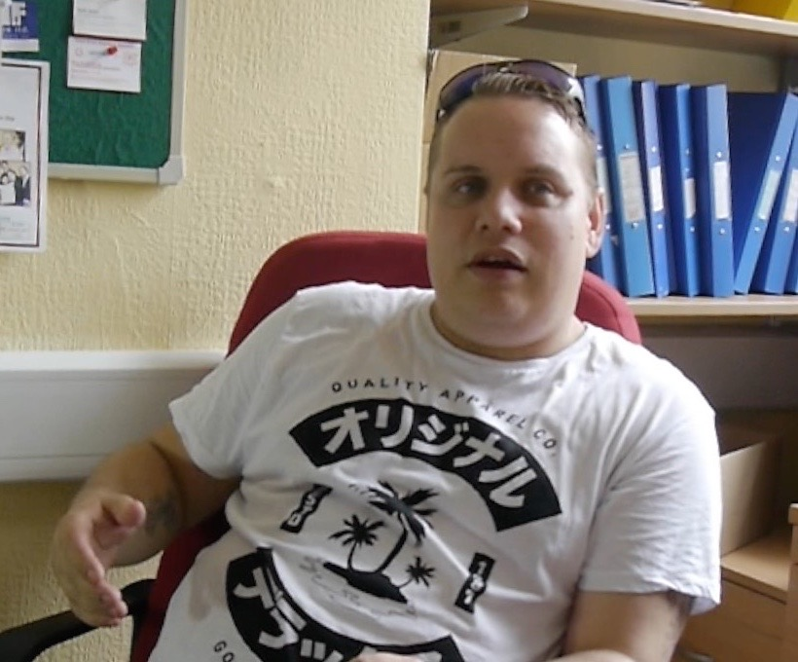
Further education & social engagement
David’s story:
traveller background; wanted to be able to read to his 4yr old daughter; voted for the first time.
Driving licence; employment prospects opened up. Here
Notes:
Duckworth (2013) documents, deprivation and poverty are strongly linked to the prevalence of mental ill-health in communities.
Further education is shown to be beneficial in the positive effect it can have on mental health and well-being. For several of the participants in the UCU Transforming lives and communities project, further education offered a lifeline that helped in their recovery from a mental health issue. Transformative education is drawn from and situated within individual and communal resources. The positive impact of the transformation extended to their family circumstances.

Slide 8
Impact
The impact of this project is evidenced by the national attention the project has garnered from colleges and FE staff nationally, policy makers and international scholars. The findings of the research have been widely disseminated at national and international conferences in for example: London, Glasgow, Copenhagen, Birmingham, Nottingham, York, Belgrade, Derby, Dublin, Belfast, Bolton, Sussex, Dundee and Liverpool.
The research has changed perceptions that the benefits of FE are only economic by focusing on the wider social impact of colleges’ work. The project played an important role in Guernsey College’s bid to expand their FE provision with increased investment from Government. This provided the college with the means to offer further and higher education to 3,000+ students across 15 vocational areas, as well as providing learning and development opportunities to the local community

Slide 9
The evidence has been shared with the European Agenda for Adult Learning (EAAL) and was also presented to the NUS Poverty commission. The research influenced Labour Party policy and fed into Labour’s Lifelong Learning Commission Report and has informed Conservative response to COVID 19 by upping the profile of the importance of lifelong learning at a critical time for our economy and society.
Australia impact – collaborations
UNESCO Promoting health and literacy for women's empowerment; 2016 (uea.ac.uk)

Slide 10
Right2Learn
Unequal access to education throughout life is a huge, growing cause of inequality in our country - with four million fewer adults participating in education now than in 2010.
It creates division in our communities; entrenches low skills, low wage work and levels down the life chances of millions. Building back better must mean breaking down these barriers. That is why, taking inspiration from the report last year of the Lifelong Learning Commission, R2L are calling or a new statutory right to learn for every UK citizen throughout their lives – enabled and backed up by strong funding, information, advice and guidance.
Notes:
Right2Learn campaign launch
09th December 2020 launched in decmber

Slide 11
The FE sector and practitioner-led research
Enables teachers to generate powerful knowledge from their practice
Empowers them, the learners and the communities they serve
In these complex times of accountability, changing student demographics, inequity and notions of professionalism the importance of PR is vital for teachers – underpins the importance of who they are as professionals, returning to teachers their voices as thinkers, curriculum developers, data analysts, and generators of knowledge about teaching and learning.

Slide 12
Positioning
As a critical educator/researcher, I seek to develop my practice through the research and reflect a critical pedagogy, providing a curriculum which is culturally relevant, learner driven, and socially empowering. Critical education and leadership can open up spaces for a more equitable approach where a more level playing field is established for those from disadvantaged backgrounds. As educators I would argue that we need to recognise and address the historical and contemporary disparities that exist in the structural inequalities between the learners and their lives, for example, class, gender and ethnicity. We need to find critical emancipatory spaces to give them a voice and empower them, their families and communities.

Slide 13
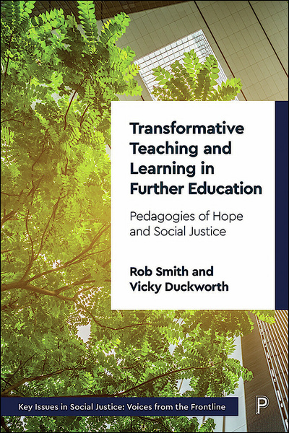
info@right2learn.co.uk
https://transforminglives.web.ucu.org.uk/category/about/

