Slide 1
Inclusion, Diversity and Identity Research Network Lead - Prof Peter Hick peter.hick@edgehill.ac.uk Co-Lead Dr Anna Mariguddi mariguda@edgehill.ac.uk
https://www.edgehill.ac.uk/departments/academic/education/research/research-groups-projects/inclusion-diversity-identity-research-network/
Join our mailing list: https://forms.office.com/pages/responsepage.aspx?id=kYY1CY5NHEmqdgpcvVunNDvebwlxpY9MsQxwLQ_H_QBURUZHRTk5NzRENU5RWDNJNDkzOUs0MDVBMC4u

Slide 2
What do we mean by ‘inclusion, diversity & identities’?
… the inclusive education movement should constitute an ongoing struggle toward:
the redistribution of access to and participation in quality opportunities to learn (redistribution dimension);
the recognition and valuing of all student differences as reflected in content, pedagogy, and assessment tools (recognition dimension);
the creation of more opportunities for nondominant groups to advance claims of educational exclusion and their respective solutions (representation dimension).
Waitoller, F. R., & Artiles, A. (2013). A Decade of Professional Development Research for Inclusive Education: A Critical Review and Notes for a Research Program. Review of Educational Research, 83(3), 319–356

Slide 3
Inclusion, Diversity and Identity Research Network
Network membership:
38 internal EHU staff.
232 unique external registrations for IDI Research Network mailing list.
2022-23 activities:
External online seminar series
Attracting 250 registrations from 26 countries.
Supporting the development of external research collaborations.
Internal network meetings
Research presentations, discussion, support.
Hosting Annual Conference for Research in Education (EHU)

Slide 4
Watch our seminars: https://figshare.edgehill.ac.uk/Inclusion_Diversity_and_Identity

Slide 5
Watch our seminars: https://figshare.edgehill.ac.uk/Inclusion_Diversity_and_Identity

Slide 6
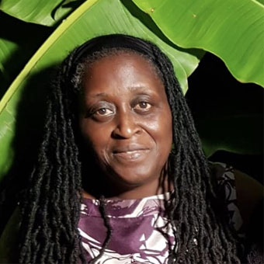
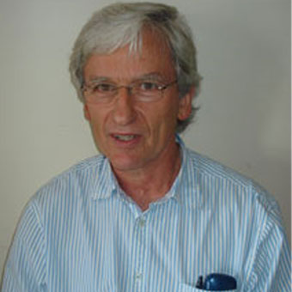
Seeking Equity in a World in Crisis: Critical Engagements through Educational Research (ACRE)
A forum for exploring critical engagements through research with broad issues of equity in education, encompassing all phases of education, from the early years to adult learners, embracing both formal and non-formal educational settings and sectors.
Keynote speakers:
Dr Christine Callender, Associate Professor at University College London
Black males in education: exploring stigma and intersectional discrimination
Professor Brahm Norwich, University of Exeter
Enhancing the participation of young people with SEN/D in a deliberative dialogue about inclusion in school education: a citizen panel pilot.

Slide 7
Post-ACRE writing retreat
Edge Hill University, The Knowledge ACRE Blog series:
Pushing the pedagogical boundaries through collaborative research, Dr Ian Shirley and Dr Anna Mariguddi
The richer relationship between disadvantaged students and their achievement, Matthew Greenhalgh
Playing outdoors; access, agency, and the Forest School approach, Dr Karen Boardman, Jackie Sumner and Silvia Cont
Plato, Professionalism, and the Everyday Life of Schools, Dr Naomi Hodgson
Exposure to Social Injustice: Towards Social Justice, Dr Victoria Jamieson
https://blogs.edgehill.ac.uk/theknowledge/news/

Slide 8
Plans for 2023/24
ThinkTank sessions on campus to support colleagues developing work in progress including research proposals, funding bids & draft articles
Writing Retreats termly – to support bid writing, publication.
Internal network meetings, including short presentations of research to spark discussion – widened scope beyond the Faculty.

Slide 9
2023-24 External seminar series
To address cutting edge issues in research, externally promoted, with internal ECR discussant:
Dr Sadia Habib
Wed 11 Oct 2023, 2-3pm
Prof. Yvette Taylor
Wed 29 Nov 2023, 2-3pm
Dr Sean Demack
Wed 7 February 2024, 12.30-1.30pm
Dr Gurpinder Lalli
Wed 20 March 2024, 12.30-1.30pm
To book: https://forms.office.com/r/5MsF2YGfbn

Slide 10
Opportunities for research collaboration
Addressing racial disproportionalities in school disciplinary outcomes and in the identification of special educational needs or disabilities
School and community partnerships for developing more inclusive practices in educational settings
Teacher preparation for inclusive practice with diverse students
Empowering the voices of students with disabilities
Narrative approaches to research with vulnerable learners

