Slide 1
Higher Education Research Network
Network Leads: Dr Naomi Hodgson
& Dr Marlena Chrostowska

Slide 2
Aims of the Network
The HERN aims to provide ...
A forum for the discussion of new research on higher education
A space to develop proposals and publications
Opportunities to develop practice and theoretical understanding through engaged reading
Sessions that develop understanding of key concepts and practices used in educational research
Supporting research, scholarship, pedagogy, and knowledge exchange

Slide 3
Four strands of activity
Forum for Research on Higher Education
Online seminars featuring invited external and internal speakers for the presentation of research on higher education
Demystifying Research Methods and Concepts
An opportunity to hear from those who have experience and expertise in using particular methods and concepts in their research to develop understanding of common but complex terminology and build confidence and skills for undertaking research
This year: ethics of researching our own practice; subjectivity and positionality; epistemology and ontology; research impact ...
Practicing Engaged Reading
Putting a key element of higher education practice (and the signature pedagogy of the new MA programme) to work focusing on sharing interesting and challenging academic literature
Writing Support Workshops
Space and time scheduled specifically for the development of draft proposals, articles, and other scholarly material and to seek feedback from colleagues

Slide 4
Research on Higher Education in the Faculty
Research methods and doctoral education
Higher Education leadership
Philosophy of higher education
Higher Education pedagogy
Access, participation, and inclusion
https://research.edgehill.ac.uk/

Slide 5
This year's seminars...
Term 1
Thursday 12 October, 3.30-5 GMT | ‘Go to Oxbridge, get a job, start a career’: The ‘Low Value’ Arts Degree and the Neoliberal University Áine Mahon and Orlaith Darling, University College Dublin
Thursday 16 November, 3.30-5 GMT | The future of higher education and the claim of globalization: Revisioning the past, re-imagining the future Hans Schildermans, University of Vienna
Term 2
18 January, 3.30-5 GMT | Sexual Misconduct in Academia: Informing an Ethics of Care in the University Erin Pritchard, Liverpool Hope University
22 February, 3.30-5 GMT | What and who are (not) part of the ‘higher education landscape’? Richard Budd, Lancaster University
Term 3
18 April, 3.30-5 GMT | The Metrics and Aesthetics of University Performance Amanda Fulford, Edge Hill University
23 May, 3.30-5 GMT | Fadia Dakka, Birmingham City University

Slide 6
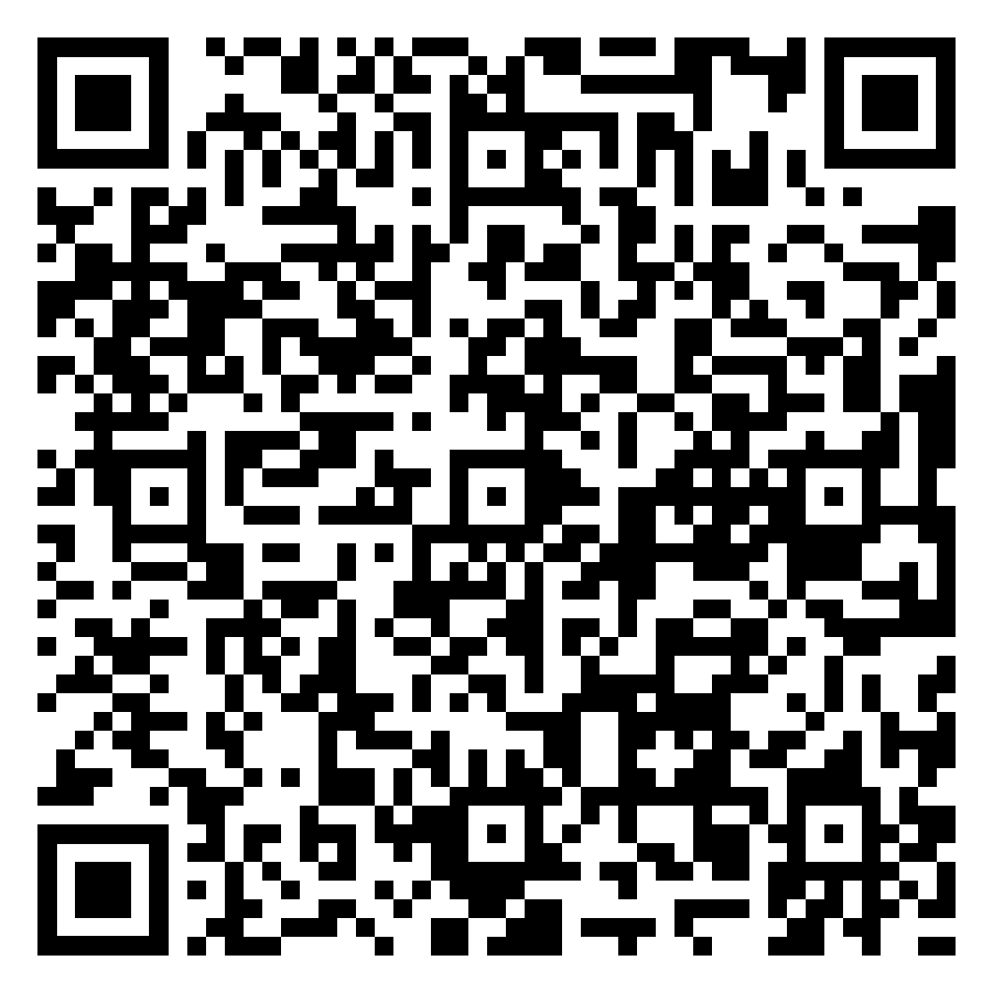



Join the mailing list
Other ways to stay in touch...
@ehu_foe
@drnaomihodgson
@Marleyy_sso
Faculty of Education at Edge Hill University
Naomi Hodgson
Marlena Chrostowska
naomi.hodgson@edgehill.ac.uk
chrostom@edgehill.ac.uk

