Slide 1
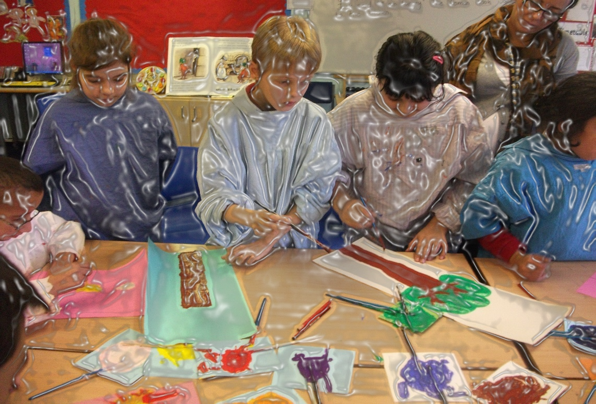
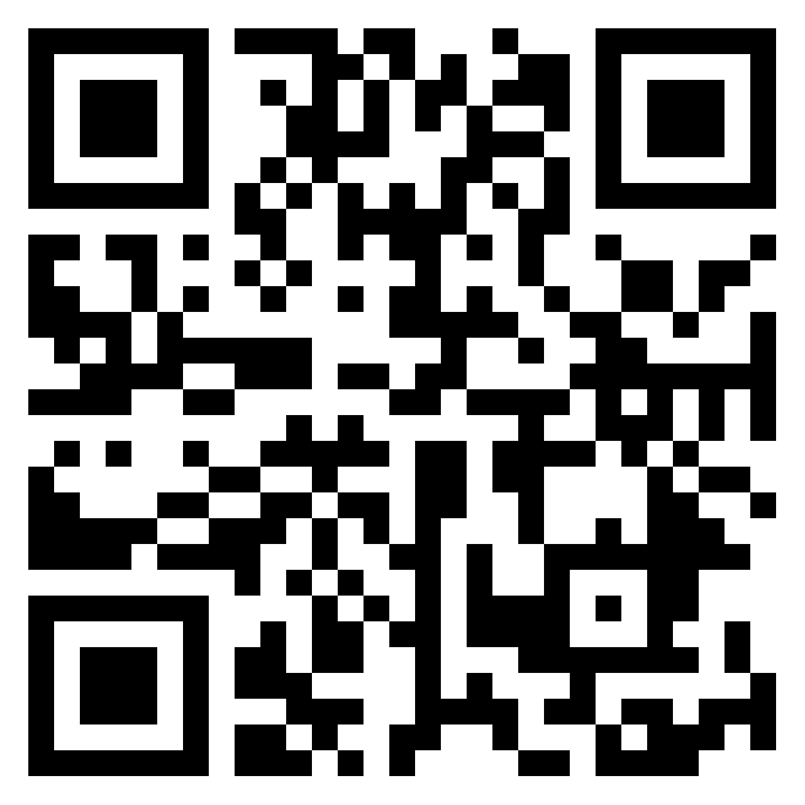
Children's Rights and Wellbeing Research Network
Jo Albin-Clark – Early Years Education
Clare Woolhouse – Secondary and Further Education
Edge Hill University
Notes:
Summarise network,- Launch, seminars, reading groups, writing sessions, collective bids,

Slide 2
The right to play - UNCRC Article 31*
Parties recognize the right of the child to rest and leisure, to engage in play and recreational activities appropriate to the age of the child and to participate freely in cultural life and the arts.
United Nations Convention on the Rights of the Child (UNCRC) (UN, 1989)
Notes:
The United Nations Convention on the Rights of the Child (UNCRC) (UN, 1989)

Slide 3
Play matters
‘Here, we position play in relation to democracy, equity, and social justice, by storying how two teachers facilitate the right to play, and we argue this is a fruitful sub-context for resistance. From this perspective, teachers’ resistances do not just enable play, they embody and enact representative and democratic justice.’ Albin-Clark and Archer Forthcoming
ALBIN-CLARK, J. and ARCHER, N., Forthcoming. Playing social justice: How do early childhood teachers enact the right to play through resistance and subversion? Prism Journal
ALBIN-CLARK, J., ARCHER, N., and CHESWORTH, L., 2023. Storying hopeful resistances to datafication: Cracking cracks that create spaces of collective agency for different doings within the more-than-human of early childhood education. Contemporary Issues in Early Childhood Education
ROBERTS-HOLMES, G.. ., PAANANEN, A., ALBIN-CLARK, J., ARCHER, N., and CHUNG, J., n.d. Metric Fixation and The Datafication of Early Childhood Education and Care . Contemporary Issues in Early Childhood Education [online]. Available from: https://journals.sagepub.com/pb-assets/cmscontent/CIE/Special%20Issue%20on%20Datafication-1669110182887.pdf.

Slide 4
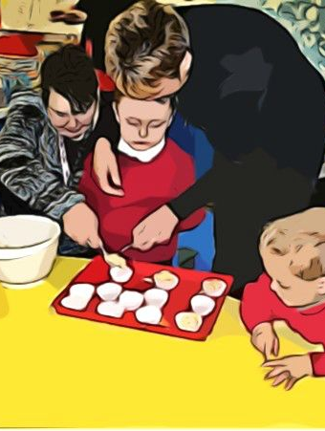
The right to inclusive education The right to be listened to and taken seriously
“Recognise the right of the child to education, and with a view to achieving this right progressively and on the basis of equal opportunity.”
UN Convention on the Rights of the Child (Article 28.1, 1989)
“Parties shall assure to the child who is capable of forming his or her own views the right to express those views freely in all matters affecting the child, the views of the child being given due weight in accordance with the age and maturity of the child”. UN Convention on the Rights of the Child (Article 12.1, 1989)
The need for children to be consulted on practices that affect them. Section 2B of UK Children and Families Act (2004).
Notes:
The United Nations Convention on the Rights of the Child.
Adopted and opened 20 November 1989.
Entry into force 2 September 1990. Underpins VOICES project re children’s access to inclusive education and right to be treated as competent re decisions around their learning.
The right to inclusive education is acknowledged in key educational policies currently operationalised at local and national level in the UK, with documents making reference to the common principles of inclusion, social justice, equitable education systems and the responsiveness of schools towards diversity (i.e. Children and Families Act, 2014; DfE, SEND Code of Practice 2014).
Woolhouse, C. 2019. Conducting photo methodologies with children: framing ethical concerns relating to representation, voice and data analysis when exploring educational inclusion with children. International Journal of Research and Method in Education. 42 (1) P.3-18. http://dx.doi.org/10.1080/1743727X.2017.1369511

Slide 5
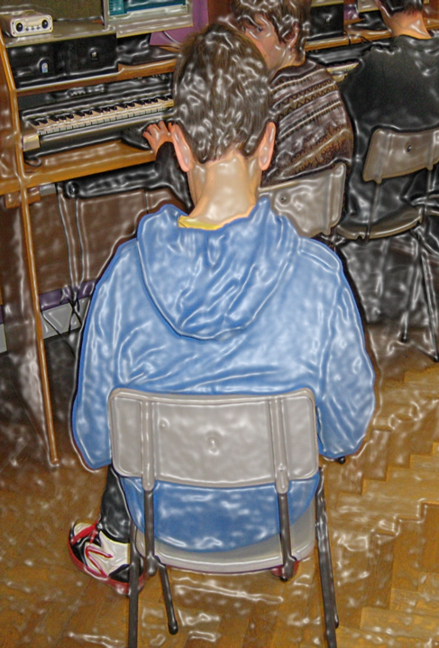
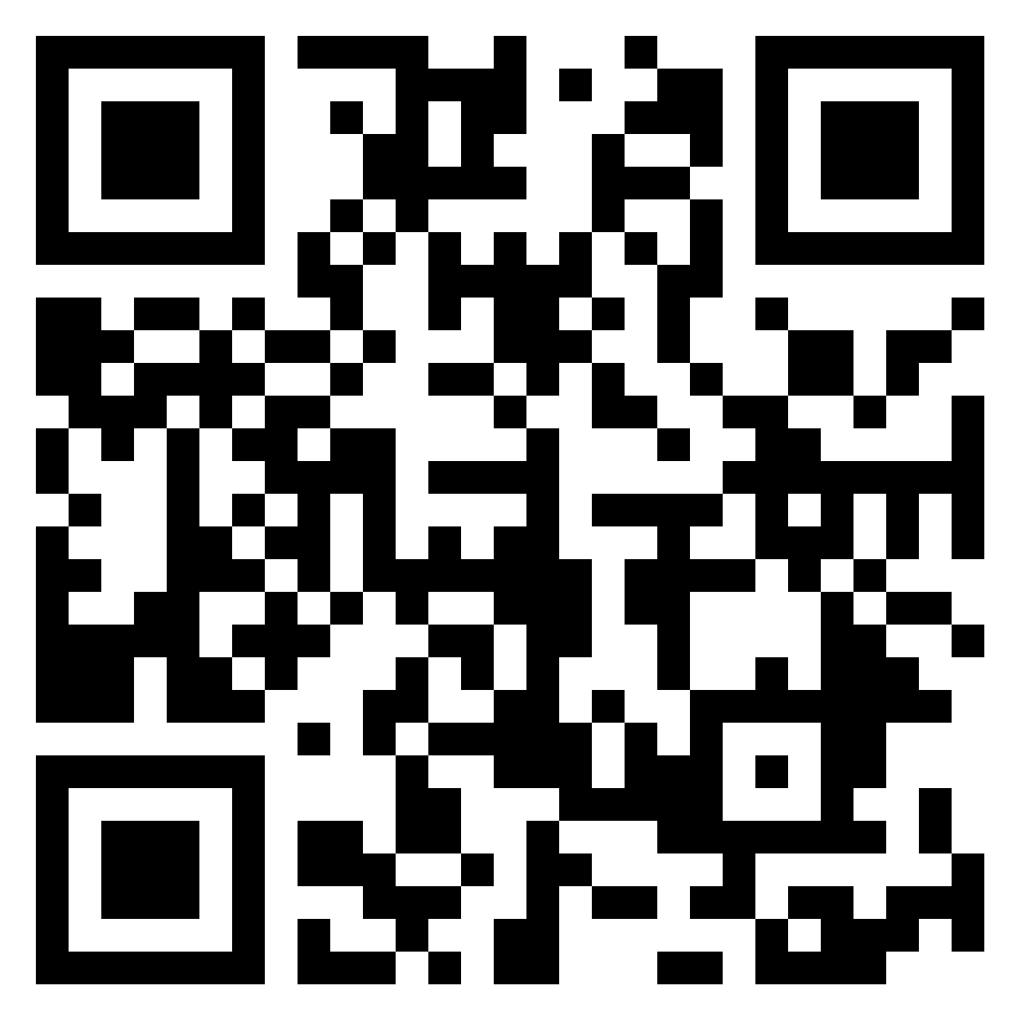
‘Visualising Opportunities: Inclusion for Children, Education and Society’ (VOICES) project Fiona Hallett, Virginia Kay and Clare Woolhouse
How can young people’s voices and power be amplified and heard in ways that has a positive impact on their and others’ educational experiences, mental health and wellbeing?
Utilising photo-elicitation and other multisensory, arts based methods to explore children’s concerns.
Role of professional development and mentoring for those who support children.
Woolhouse C. & Kay, V. 2024. (Eds), Championing Co-production in the Design of Inclusive Practices. Positioning children and young people’s voices at the heart of education policy and practice. Routledge, Nasen spotlight series.

Slide 6
Selected Research Outputs – Children's education
Albin-Clark, J., 2022. The Right To Play: Are Young Children Free To Determine Their Own Actions? . Blog [Online]. Available From: Https://Blogs.Edgehill.Ac.Uk/Isr/The-right-to-play-are-young-children-free-to-determine-their-own-actions/.
Albin-Clark, J. and Archer, N., 2023. Resisting Intensified Accountability: Is Now The Time For Inspection Reform? . Blog [Online]. Available From: Https://Early-education.Org.Uk/Resisting-intensified-accountability/
Albin-Clark, J., Archer, N., and Chesworth, L., 2023. Storying Hopeful Resistances To Datafication: Cracking Cracks That Create Spaces Of Collective Agency For Different Doings Within The More-than-human Of Early Childhood Education. Contemporary Issues In Early Childhood Education
Albin-Clark, J. And Archer, N., Forthcoming. Playing Social Justice: How Do Early Childhood Teachers Enact The Right To Play Through Resistance And Subversion? Prism Journal
Albin-Clark, J., Shirley, I., Webster, M. and Woolhouse, C., 2018. Relationships in early childhood education – beyond the professional into the personal within the teacher–child dyad: relationships ‘that ripple in the pond’. Early Child Development and Care, 188 (2): 88-101. http://www.tandfonline.com/doi/full/10.1080/03004430.2016.1220374 https://research.edgehill.ac.uk/en/publications/relationships-in-early-childhood-education-beyond-the-professiona-2
Dunne, L., Hallett, F., Kay, V. and Woolhouse, C. 2018. Spaces of inclusion: Investigating place, positioning and perspective within educational settings through photo-elicitation. International Journal of Inclusive Education. 22 (1) pp. 21-37. http://www.tandfonline.com/doi/full/10.1080/13603116.2017.1348546 https://research.edgehill.ac.uk/en/publications/spaces-of-inclusion-investigating-place-positioning-and-perspecti-2
Dunne, L., Hallett, F., Kay, V. and Woolhouse, C. 2017. Visualising Inclusion: Employing a photo-elicitation methodology to explore views of inclusive education, SAGE Research Methods Cases. Part 2. http://methods.sagepub.com/case/visualizing-inclusion-photo-elicitation-methodology-inclusive-education DOI: http://dx.doi.org/10.4135/9781473995215

Slide 7
Hawxwell, L., Ovington, J., Latto, L., and Albin-Clark, J., Forthcoming. Who says we have to stop playing? Disrupting adult-hood in (childhood) spaces Children’s Geographies
Roberts-Holmes, G.. ., Paananen, A., Albin-Clark, J., Archer, N., and Chung, J., n.d. Metric Fixation and The Datafication of Early Childhood Education and Care . Contemporary Issues in Early Childhood Education [online]. Available from: https://journals.sagepub.com/pb-assets/cmscontent/CIE/Special%20Issue%20on%20Datafication-1669110182887.pdf.
Woolhouse, El-Zerbi & McFarlane-Troy (forthcoming) Addressing a youth mental health crisis; Utilising therapeutic landscapes and creative approaches in schools with children and young people.
Woolhouse, C., Fraser, L. and Dougherty, S. 2024. Using visual methods for researching disability in physical education, in Maher, A.J., Haegele, J. A. and Coates, J. (Eds) Routledge Handbook of Qualitative Methods for Researching Disability in Physical Education, Routledge.
Woolhouse C. & Kay, V. 2024. (Eds) Championing Co-production in the Design of Inclusive Practices. Positioning children and young people’s voices at the heart of education policy and practice. Routledge, Nasen spotlight series.
Woolhouse, C. Hasting C. and Hallett, F. 2021. Perspectives on inclusion: Close encounters of the creative kind. International Journal of Art and Design Education. 40 (2) P. 420-435. https://onlinelibrary.wiley.com/doi/10.1111/jade.12357
Woolhouse, C. 2019. Conducting photo methodologies with children: framing ethical concerns relating to representation, voice and data analysis when exploring educational inclusion with children. International Journal of Research and Method in Education. 42 (1) P.3-18. http://dx.doi.org/10.1080/1743727X.2017.1369511
Woolhouse, C. 2019. ‘Research in Special Education (RISE) project’ in Atkins, L. and Duckworth, V. Research methods for social justice and equity in education, London, Bloomsbury Research Methods for Education. P.256-260. https://research.edgehill.ac.uk/en/publications/research-in-special-education-rise-project-2

Slide 8
Selected Research Outputs – Professional development and mentoring​
Woolhouse C. 2023. Reimagining time, space and identity through narrative research with teachers: “these ghosts came back to haunt me”. Education Studies, http://dx.doi.org/10.1080/03055698.2023.2216822
Woolhouse, C. 2023. Technologies of the self and narrating an ethical teacher identity, or how to tell stories of a life well lived. International Journal of Qualitative Studies in Education. https://dx.doi.org/10.1080/09518398.2023.2181453
Woolhouse, C. and Nicholson, L. 2020. (Eds) Mentoring in Higher Education: Case Studies of Peer Learning and Pedagogical Development. Palgrave Macmillan. ISBN 978-3-030-46890-3
Woolhouse, C. Albin-Clark, J., Shirley, I. and Webster, M. 2019. Collaborative research as community learning in a Higher Education context, or “What would Rod Stewart do?” Studies in Higher Education. Vol 4 (3) P.477-491.
https://www.tandfonline.com/doi/full/10.1080/03075079.2019.1630808
Nicholson, L., Rodriguez, S. and Woolhouse, C. 2018. Reframing peer mentoring as a route for developing an educational community of practice. Mentoring and Tutoring: Partnership in Learning Journal. 26 (4):420-440. https://doi.org/10.1080/13611267.2018.1530163
Woolhouse, C. 2017. Multimodal life history narrative: embodied identity, discursive transitions and uncomfortable silences, Narrative Inquiry. 27 (1) June 2017: 109-131. https://doi.org/10.1075/ni.27.1.06woo
Woolhouse, C. 2015. Teachers performing gender and belonging: a case study of how SENCOs narrate inclusion identities. Gender and Education, 27 (2): 131-147. http://dx.doi.org/10.1080/09540253.2014.992300 Woolhouse, C. and M. Cochrane. 2015. Educational policy or practice? Traversing the conceptual divide between subject knowledge, pedagogy and teacher identity in England, European Journal of Teacher Education, 38 (1): 87-101.
http://www.tandfonline.com/doi/full/10.1080/02619768.2014.921154
Woolhouse, C. 2012. ‘Reflective practice and identity (re)formation: the particularities of the experiences of teachers specialising in Dyslexia’, Reflective Practice, 13 (6): 747-760. http://dx.doi.org/10.1080/14623943.2012.697884
Woolhouse, C., L. Dunne, and G. Goddard. 2009. ‘Lifelong learning: teaching assistants' experiences of economic, social and cultural change following completion of a foundation degree. International Journal of Lifelong Education, 28 (6). pp. 763-776.

Slide 9
Children's Rights and Wellbeing Research Network Any questions?
Contact
Jo Albin Clark clarkj@edgehill.ac.uk
Clare Woolhouse woolhouc@edgehill.ac.uk

