Slide 1
Uniskills First Slide
Notes:
Standard in all slides

Slide 2
UniSkills
Mastering Microsoft Word
ehu.ac.uk/ls
ehu.ac.uk/uniskills
Notes:
Standard in all slides – update title

Slide 3
Overview of session
Identify key features in Microsoft Word to assist in writing an assignment.
Recognise the most popular features to assist in structuring an assignment
Demonstrate how to review spelling, punctuation, and grammar
Discuss getting started with your assignment
Apply the advice to a Word Document
Notes:
Standard in all slides

Slide 4
Confidence
How confident are you using Microsoft Word?

Slide 5
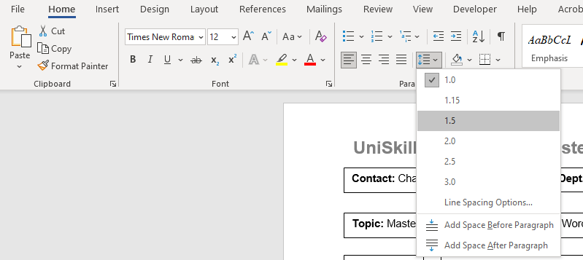
Overview Of Features in the Home Tab
2. Bullet points & number lists
1. Font, size & bold
3. Line spacing
4. Alignment:
Left align
Justified

Slide 6
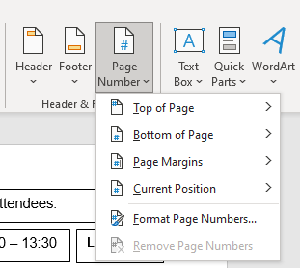
Overview Of Features in the Insert Tab
1. Page numbers

Slide 7
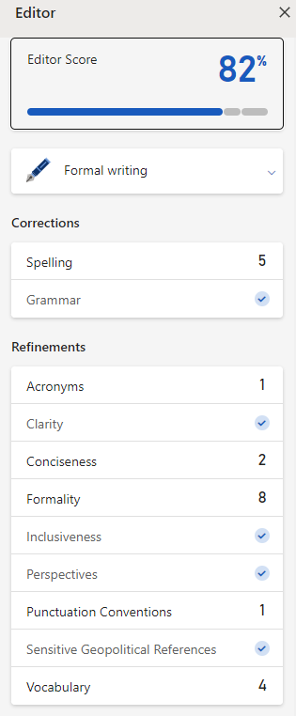
Overview Of Features in Review Tab
4. Spelling & Grammar Editor
1. Editor to check spelling, grammar & refinements
2. Word count to keep you on track
3. Read Aloud, help you proofread your work, and listen for errors.

Slide 8
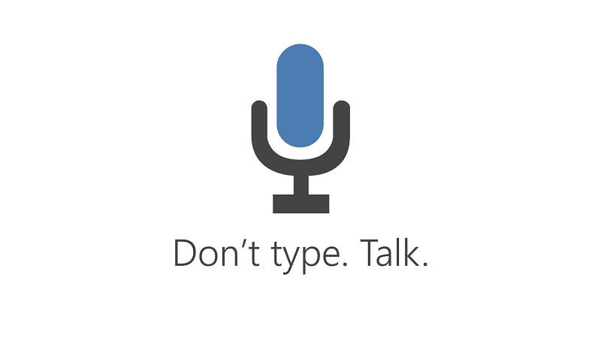
Writer’s Block?
Use Microsoft Dictate to get your thoughts and ideas down on paper before focusing on writing academically.
(Dictate is found in the Home tab).

Slide 9
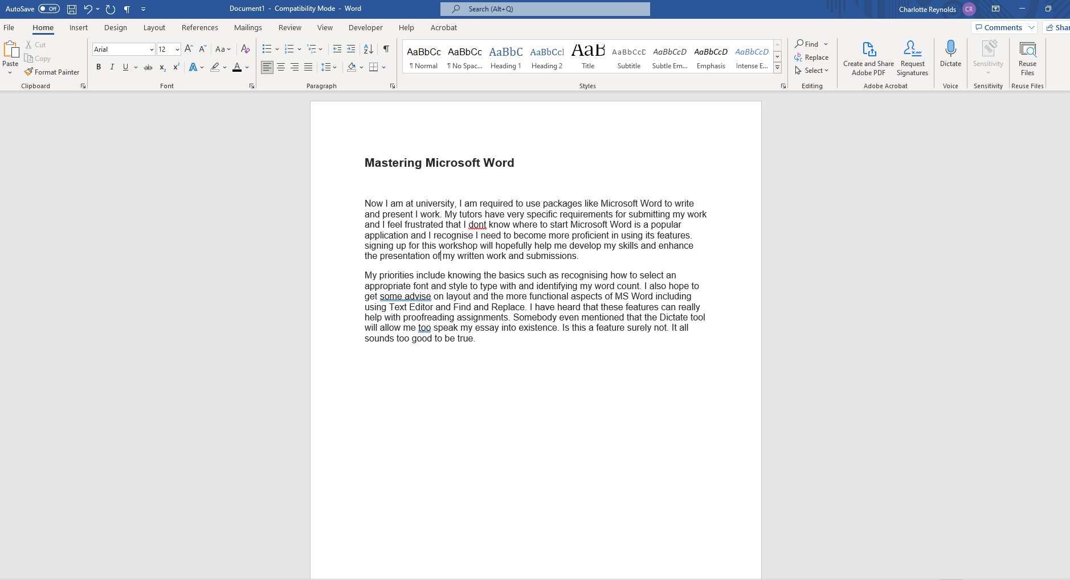
Demonstration

Slide 10
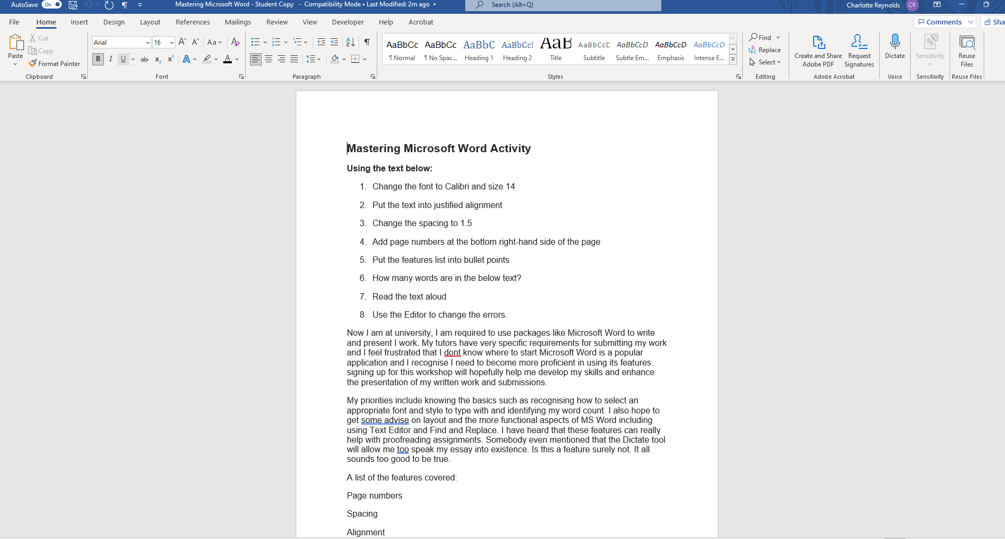
Activity

Slide 11
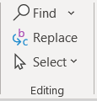
Technologies for Proofreading
Use Read Aloud to hear your work read back to you with simultaneous highlighting. | Use find and replace for any contractions. | Use Editor to check for formality.
Breaks words into syllables to promote concentration. | Helps to remove informality. | Use Editor to check for spelling and grammar errors.
Helps you to check the fluency of your work. | Helps you to establish a more academic tone. | Use Editor to check for clarity and conciseness.
Makes editing much easier. | Saves time in long documents. | Use Editor to check for punctuation conventions.

Slide 12
Remember…
Assistive technologies might not pick up every error.
Use the technologies but a ‘human eye’ is still always recommended when proofreading your work.

Slide 13
Confidence After Session
How confident are you using Microsoft Word?

Slide 14
LinkedIn Learning
At Edge Hill, all students have access to LinkedIn learning with courses that add to your LinkedIn profile to help with your studies and employability.
Below are two courses on Microsoft Word:
Word Essential Training
Word Formatting and Styles in Depth
Notes:
Change to correct screen shot and URL – HIDE if no suitable toolkit to link to

Slide 15
Further support
Discover information, guides, videos and toolkits on our webpages
Book your place on a UniSkills webinar or workshop running throughout the year
Book an appointment with UniSkills for 121 support
Contact the Catalyst Helpdesk via email at CatalystEnquiries@edgehill.ac.uk, search our FAQs or Ask a Question online
Explore LinkedIn Learning to access online courses and video tutorials, written by industry experts, to help develop your skills and boost your employability
Attend 3 UniSkills workshops and/or webinars to gain 10 activity points towards the Extra Edge Award
Notes:
Standard in all slides

Slide 16
Keep in touch
@EHULibrary
@EHULearnService
edgehill.ac.uk/uniskills
blogs.edgehill.ac.uk/ls
Notes:
Standard in all slides

Slide 17
UniSkills Last Slide
Notes:
Standard in all slides

