Slide 1
Using LinkedIn Learning to Support Student Learning
Peter Beaumont
Michelle O’Connell
Notes:
Peter Beaumont from Learning Technology Development, and Michelle O’Connell from Academic Engagement.
This session is about “Using LinkedIn Learning to Support Student Learning”
LinkedIn Learning is a collection of video-based courses designed to help people learn to use software, or to develop other skills like presentation and leadership skills.
Why? We started providing LinkedIn Learning as we couldn’t provide training for all the software that people around Edge Hill were wanting to use.
While YouTube might be great for quickly finding an answer. LinkedIn Learning offers something different.
It uses expert trainers who create structured courses, often with Exercise Files to help you follow along. There are no adverts, it’s usually clear which version of software is being covered, and the content doesn’t have to serve the YouTube algorithm meaning it doesn’t have to be longer than it needs to be, or focussed on entertainment over education.
All staff and students at Edge Hill can set up accounts and use LinkedIn Learning for free during their time at Edge Hill.

Slide 2
Session Outline
Using LinkedIn Learning
Setting up an Account
Using Courses
Finding Resources
Collections
Reading Lists
Certificates
Examples of Use
Independent Uses
Guided Uses
Notes:
In this session we'll primarily be looking at how it works, but we’ll also go through the ways in which people have used it with their students, and what they’ve learned.

Slide 3
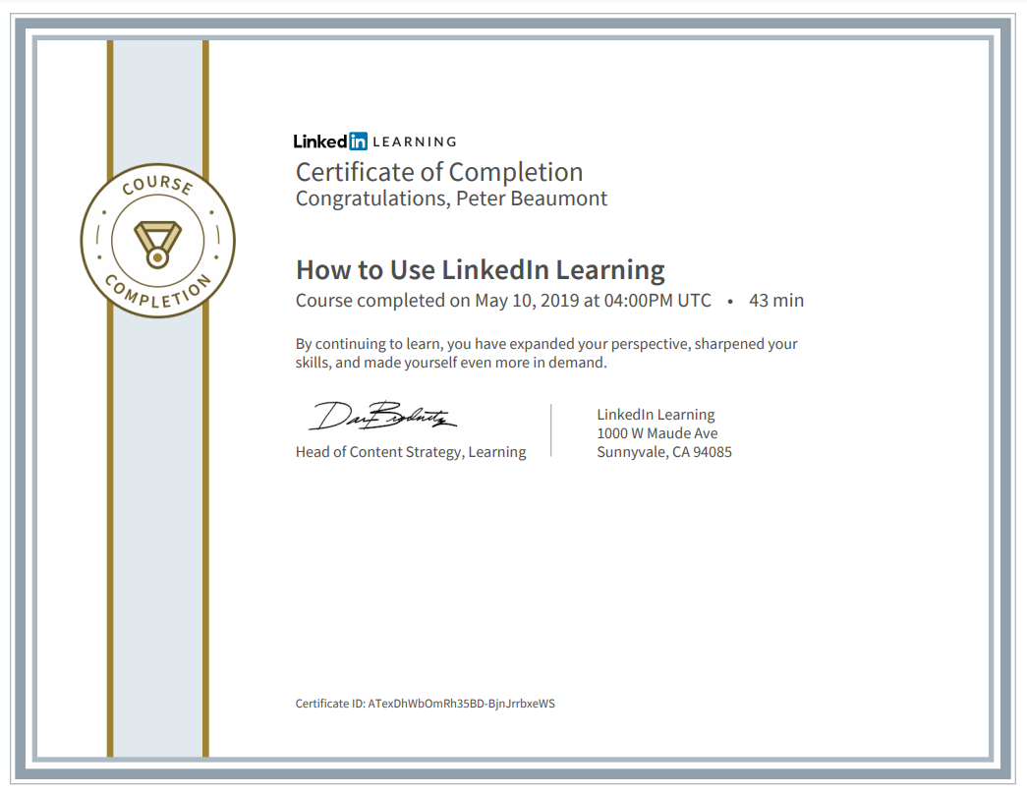
Examples of Use
Independent Uses (Barbeau, 2019)
Personal development time.
Only 20-25% watching videos.
Notes:
[Advice] Jennifer Rouse Barbeau has written about her use of LinkedIn Learning as part of planned professional development time. Jennifer suggests planning to use 20-25% of your personal development time actually watching the videos and the rest for note taking and hands on practice

Slide 4
Examples of Use
Independent Uses (Xiangping, 2021)
Expand on classroom learning
Certificates
Research skills
Employability skills
Professional development
Notes:
Masters Students used it to
1. enhancing their knowledge and understanding beyond classroom delivery
2. boosting their professional profile by gaining certificates attached to their LinkedIn profiles
3. improving their research skills and helping with their final research project
4. enhancing their employability by learning industry-relevant technical skills
5. inspiring them to embark on more LiL courses for continuous professional development

Slide 5
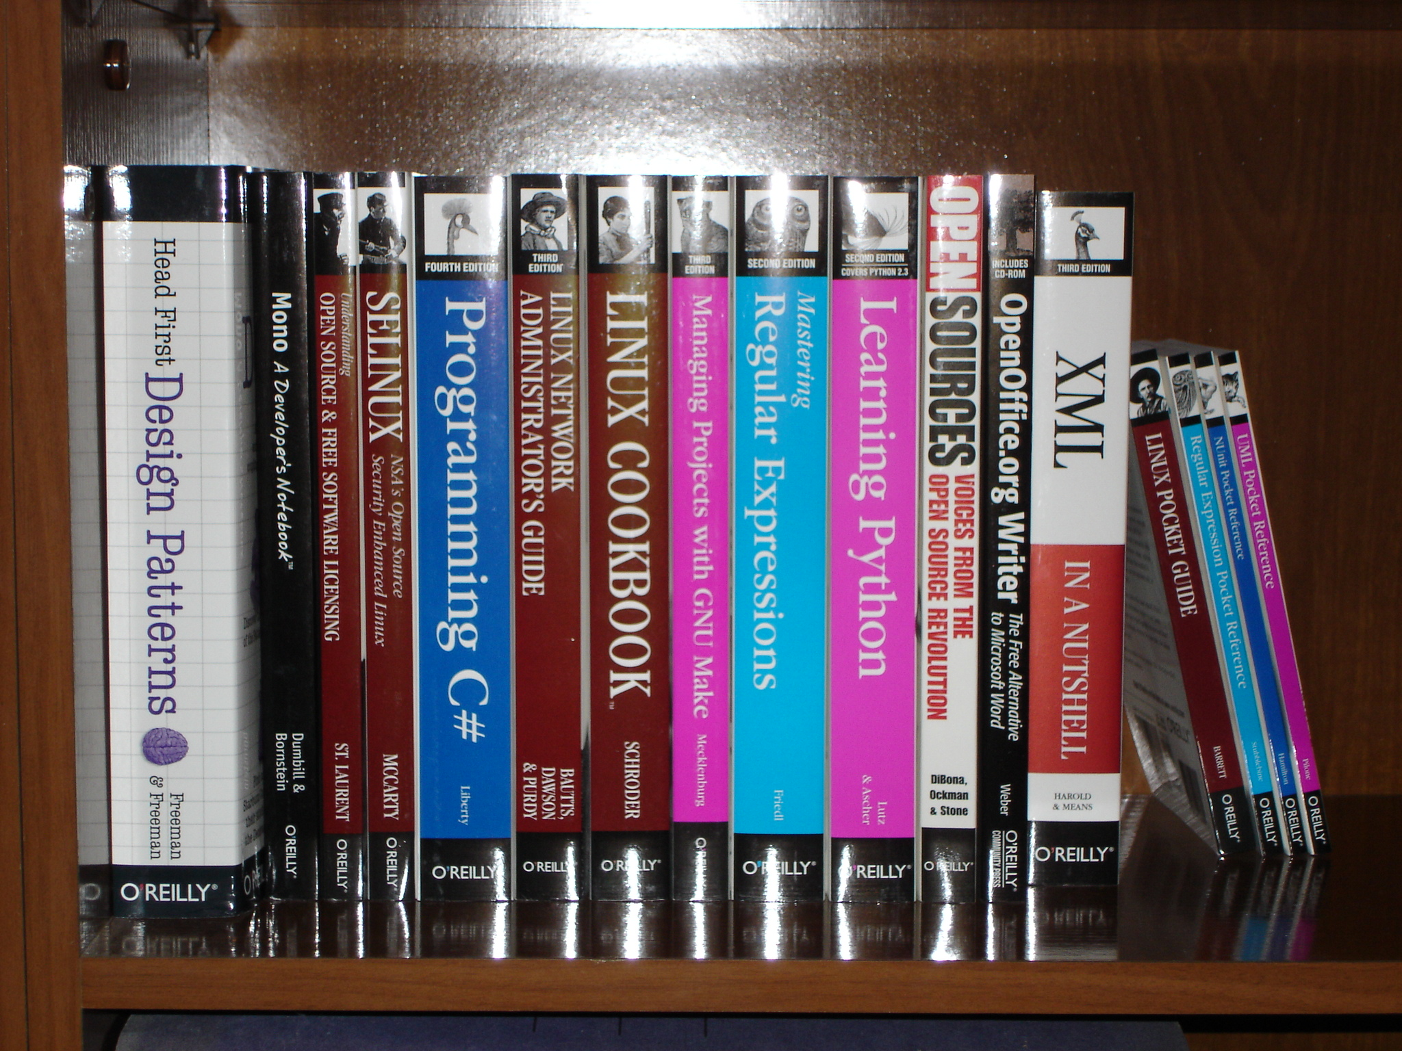
Examples of Use
Independent Uses: Student led learning (Shahi and Giachi, 2019)
Used for student-led independent study courses
Notes:
“In a student-led course, students often get the chance to develop their own individual syllabus catered to their interests and their larger research projects at hand”
“the students are … responsible for developing their own learning paths and curriculum” and LinkedIn Learning was suggested as a framework
Students used LinkedIn Learning to create a framework for their own curriculum, based on their area of interest.

Slide 6
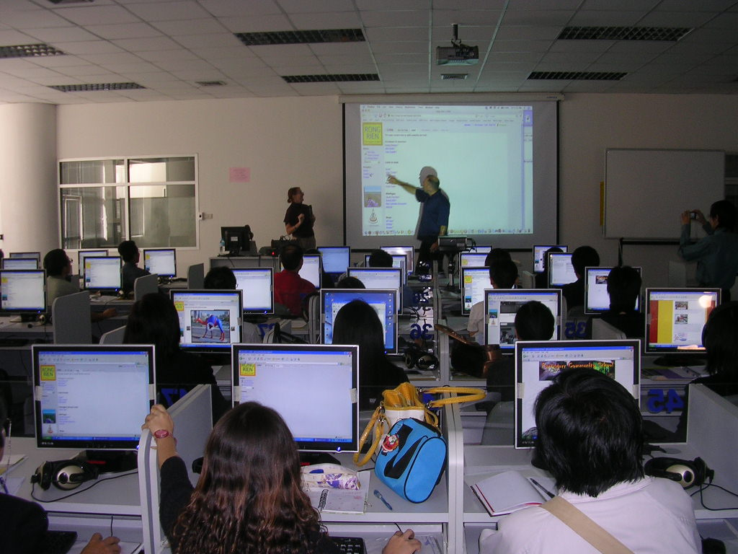
Examples of Use
Guided Uses: Available Resources (Lieberman, 2017)
“Serves a purpose similar to a textbook”.
Harvard’s graduate design school used for incoming students.
“I just have to be very, very selective and make sure what I’m choosing for them to watch is closely aligned to what I’m asking them to produce”.
Notes:
[Comparing to other resources]
I really liked this service because in situations where I was a beginner, I struggled with the more abstract nature of printed instructions, it’s been much more effective to see people doing things.
Some learners may use YouTube. That may be better for finding solutions to problems, but when you are learning software from scratch this gives
Structured courses led by experts
Clearer information about the versions of software being covered
Content can be purely learning focused, doesn’t have to serve the algorithm e.g. being longer than it needs to be
No adverts
Harvard’s use with new students before they arrived so they could come prepared.
Use cooled as novelty wore off. Brian Emery who taught photography said “I just have to be very, very selective and make sure what I’m choosing for them to watch is closely aligned to what I’m asking them to produce”

Slide 7
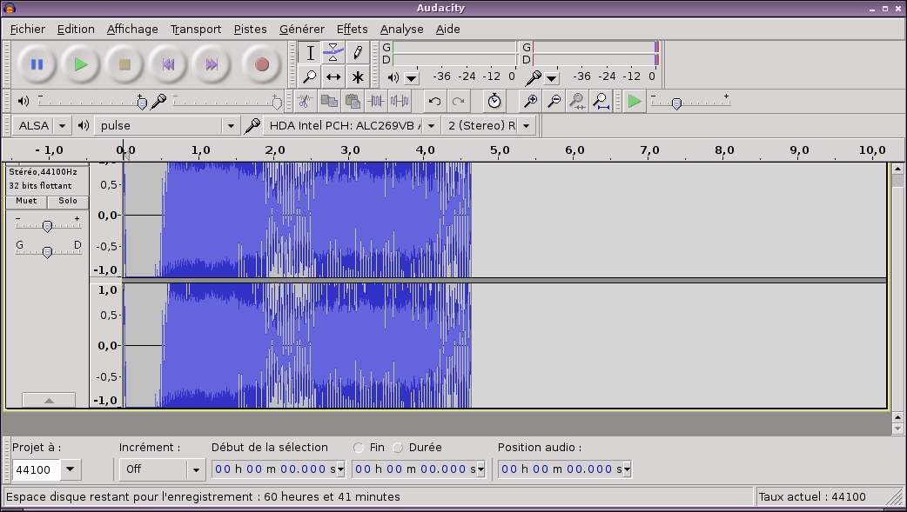
Examples of Use
Guided Uses: Resource Replacement (Kosloski, 2019)
Media Course
Replaced ‘click-and-follow’
Compared with text-based
Notes:
Students had to learn photoshop and after effects
Previously they’d used in class click and follow sessions but this is too fast for some and too slow for others.
Compare LinkedIn Learning to textbooks.
Better comprehension with LinkedIn Learning

Slide 8
Examples of Use
Guided Uses: Enable innovation (Starkman, 2019)
Audio-based assessment
Teacher cannot help

Slide 9
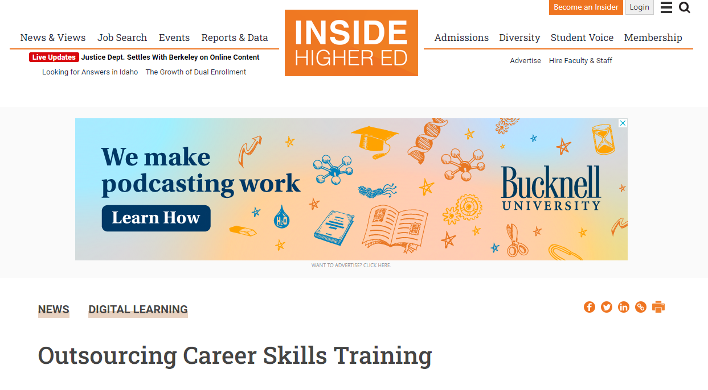
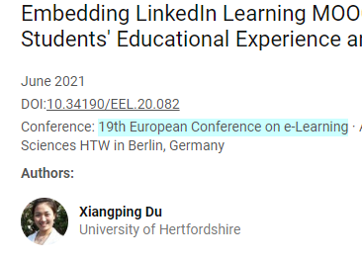
References
Outsourcing Career Skills Training, by Mark Lieberman, Inside Higher Ed, 2017
Applications of LinkedIn Learning in Ontario's Post-Secondary Institutions, by Anne-Marie Taylor (ed.), 2019
Embedding LinkedIn Learning MOOCs to Enhance Students' Educational Experience and Employability, by Xiangping Du, 19th European Conference on e-Learning, 2021

Slide 10
Image Credits (1 of 3)
Salford Business School launches unique open access online course, by University of Salford
Laptop Table, by Burst
dsc00681.jpg, by Antonio Zugaldia

Slide 11
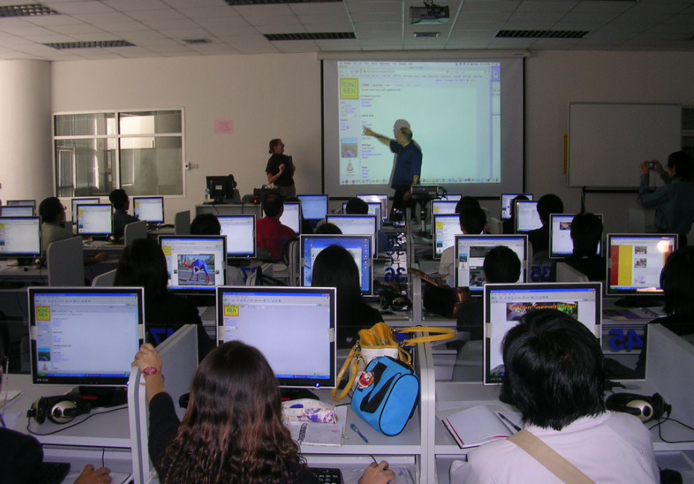
Image Credits (2 of 3)
Day 12, Project 365 - 11.1.09, by William Brawley
Computer Room Workshop, by Michael Coghlan
Studying, by mer chau

Slide 12
Image Credits (3 of 3)
Audacity - Audio Editor, by Linux Screenshots

