Slide 1


Including Child Athletes in Decision-Making in Sport:
Moving from Lip Service to Active Participation
Dr Mel Lang
SIMS webinar, 12th October 2022

Slide 2
Introduction
Reader (Associate Professor) in Child Protection & Safeguarding in Sport
Co-founder and Director of the Centre for Child Protection and Safeguarding in Sport (CPSS)
Member of the Council of Europe’s Pool of European Experts on Safe Sport
Member of SIMs
Former elite (youth) athlete & lived experienced of abuse

Slide 3
Overview
Defining ‘participation’
Benefits of youth participation… and the challenges
Surveying the (sports) field
  Where is sport at?
  Example initiatives (and a BIG caveat)
  Building a culture of participation
Conclusion and Q&A

Slide 4
Defining ‘participation’

Slide 5

Defining ‘participation’
“State parties shall assure to the child who is capable of forming his or her own views, the right to express those views freely in all matters affecting the child, the views of the child being given due weight in accordance with the age and maturity of the child.” (UN General Assembly, 1989, Article 12(1))
= a shift from a welfare-based approach to children to a rights-based approach
Participation = a process where children are enabled to give their opinions, are listened to, and influence decisions about their lives to bring about change

Slide 6
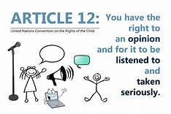
Children’s participation: 2 key points
The “participation of children and young people … plays a fundamental role in realising all the rights in the Convention for all children” (UNICEF, no date)
  Other rights cannot be realised without the actualisation of children’s participation rights
Gathering children’s views is not analogous with participation
We must hear and act upon children’s opinions, not just listen to them

Slide 7
Benefits…and challenges

Slide 8
The benefits of participation
Develops understanding of agency and autonomy, social skills, group and interpersonal skills
Enhances self-esteem and confidence, promotes pro-social behaviour
Increases political understanding, social inclusion and awareness of rights
Breaks down power imbalances between adults-children in sport = empowers children
Creates innovative and more athlete-centred sporting spaces
Shows the value that an organisation places on children and on supporting them
Supports the identification of potential concerns (including safeguarding concerns)
Encourages trust – vital for disclosures
(Hart, 1992; Harris & Manatakius, 2013; Kitzinger, 1997; Lang, 2022; Smith, 2012; Whitty et al., 2007)

Slide 9
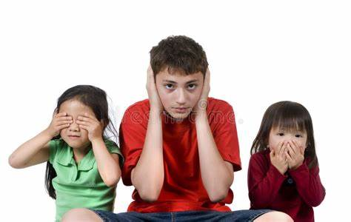
Challenges to participation
Incorporating children’s views can be challenging!
Practical/ material challenges:
  funding, resources, staffing, facilities
Structural/ socio-cultural challenges:
  hierarchical power dynamics, traditional understandings of children as ‘seen but not heard’, resistance from staff, fear, lack of expertise/ confidence
  (James & Prout, 1997; Everley, 2021; Lang, 2022 Tucker, 2011)

Slide 10
Surveying the sports field

Slide 11
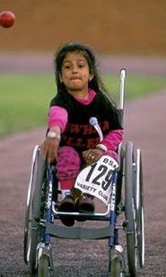
Where is sport at?
Most policy, practice & research developments to date have focused on children’s protection rights in sport – far less attention paid to children’s participation rights (Lang, 2022)
Children are rarely involved in decision-making in sport:
  Policy/ strategy developments
  Recruitment decisions
  Induction programmes
  Education and training
  Training plans
  Team selection
  Research
  (Everley, 2021; Lang, 2022; Lang & Purdy, 2023)

Slide 12
Where is sport at?
Everley (2021) found most UK clubs said they valued the inclusion of children’s voices… but…
…68% did not think they were expected to include children in decision-making
Some adult resistance to listening to children’s voices – a legacy of welfare-based approach
Most clubs that did try to engage with children did not do so directly – used an intermediary (parent, coach, welfare officer etc.) = mediation not active representation

Slide 13
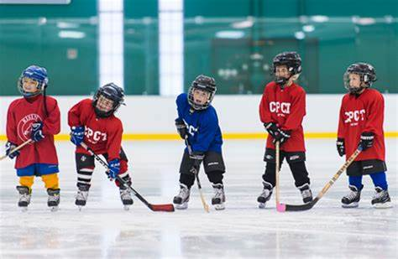
Where is sport at?
40% of adult welfare officers thought that children couldn’t effectively participate because either they couldn’t understand what was going on or they couldn’t express themselves
29% felt children couldn’t understand the paperwork used in meetings
24% said children wouldn’t be able to understand the consequences of decisions made that they are contributing to
(Everley, 2021)

Slide 14
Example initiatives – and a caveat
The following may or may not contribute to children’s active participation in sport. Participation should not be seen as a one-off event or initiative approached as a tick-box exercise
Ask children to join existing committees – and to lead/ chair them
Allow children to choose their own goals or priorities
Involve children in policy development/review
Involve children in staff training/workshops – and offer training tailored to children
Involve children in coach/staff recruitment and annual performance reviews
Involve children in research – as participants but also as researchers

Slide 15
Example initiatives
Use a range of approaches to engage with children regularly (questionnaires, surveys, focus groups, ‘communication book’)
Have champions of children’s participation/ children’s advocates – and child leaders/ambassadors
Require a commitment to children and young people’s participation in all job descriptions
Hold staff workshops to discuss or generate ideas for including children in your organisation – and child-only/led ‘agenda days’ for children
Evaluate initiatives and share best practice
Respect children’s views if they DON’T wish to get involved

Slide 16
Building a culture of participation

Slide 17
Building a culture of participation
A trio of teenage girls were grouped together talking in the leisure centre foyer after training. One girl mentioned she didn’t enjoy the session as much as usual. A second girl commented on the coach’s coaching style. The third added she’d enjoyed the session but wished they’d had a longer cool down as she was sore.
A club official nearby, who was eavesdropping on the conversation, popped their head into the group and, with a smile and a roll of their eyes, jokingly said, “you’re a right bunch of old moaners, you lot!”

Slide 18
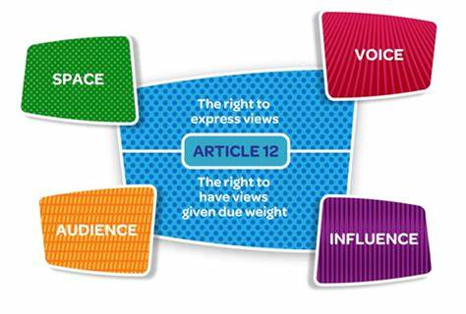
The Lundy model (Lundy, 2007)
1. Children must be given the opportunity & the space to express their views
2. Children must be facilitated to express their views
3. Children’s views must be listened to
4. Children’s views must be acted upon (as appropriate)

Slide 19
Building a culture of participation
SPACE
Have children’s views been actively sought?
Is there a safe space in which children can express themselves?
Have steps been taken to ensure that all children can take part?

Slide 20
Building a culture of participation
VOICE
Have children been given the information they need to form a view?
Do children know that they do not have to take part?
Have children been given a range of options as to how they might choose to express themselves?

Slide 21
Building a culture of participation
AUDIENCE
Is there a process for communicating children’s views?
Do children know who their views are being communicated to?
Does that person/body have the power to make decisions?

Slide 22
Building a culture of participation
INFLUENCE
Were the children’s views considered by those with the power to effect change?
Are there procedures in place that ensure that the children’s views have been taken seriously?
Have the children been provided with feedback explaining the reasons for decisions made?

Slide 23
Conclusion
Meaningful participation is a long-term systematic process, not simply the application of isolated participation activities or events
It requires:
  Transforming traditional paternalistic attitudes to children and forging new child-adult relationships rooted in mutual respect
  Rethinking traditional patterns of behaviour, processes, practices and systems in sport that may be inconsistent with the notion of children’s participation rights
  Adults to embrace change and see children’s participation as a positive development, one that will enhance our sports communities and practice
  (James & Prout, 1997; Lang, 2022; Lansdown, 2001; Lundy, 2007)

Slide 24


Questions?
Melanie.Lang@edgehill.ac.uk
@DrMelLang

Slide 25
Work Cited
Everley, S., 2021. The Child Protection in Sport Unit: Supporting national governing bodies in hearing the voices of children – An evaluation of current practice. Child Abuse Review, 29 (2), pp. 114-129.
Harris, P. & Manatakius, H., 2013. Children as citizens: Engaging with the child’s voice in educational settings. New York: Routledge.
James, A. & Prout, A. 1997. Constructing and reconstructing childhood: Contemporary issues in the sociological study of childhood. London: Taylor & Francis.
Kitzinger, J., 1997. Who are you kidding? Children, power and the struggle against sexual abuse. In A. James, C. Jenks & A. Prout (Eds.) Constructing and reconstructing childhood: Contemporary issues in the sociological study of childhood. London: Taylor & Francis.
Lang, M., 2022. Advancing children’s rights in sport: Coaching, childhood agency and the participatory agenda. Sports Coaching Review, 11 (1), pp. 41-63.
Lang, M., & Hartill, M., 2015. Safeguarding, child protection and abuse in sport: International perspectives in research, policy and practice. London: Routledge.
Lang, M. & Purdy, L., 2023. Child's play? Safeguarding and protecting children in sport. In M. Toms & R. Jeanes (Eds.) The Routledge Handbook of Coaching Children. London: Routledge.
Lansdown, G., 2001. Promoting children’s participation in democratic decision-making. Geneva: UNICEF.
Lundy, L. 2007., ‘Voice’ is not enough: Conceptualising Article 12 of the United Nations Convention on the Rights of the Child. British Educational Research Journal, 33 (6), pp. 927-942.
Smith, A.-M., 2012. Paving the way for pupil voice? School council’s campaign for fairtrade in Liverpool. In S. Cox et al. (Eds.) Children as decision makers in education: Sharing experiences across cultures. London: Bloomsbury.

Slide 26
Work Cited
Tucker, S., 2011. Listening and believing: An examination of young people’s perceptions of why they are not believed by professionals when they report abuse and neglect. Children and Society, 25, pp. 458-469.
UNICEF, n.d. The Right to Participate. https://www.unicef.org.uk/rights-respecting-schools/the-right-to-participation/#:~:text=The%20Right%20to%20Participation%20is%20one%20of%20the,the%20rights%20in%20the%20Convention%20for%20all%20children
League of Nations, 1924. Geneva declaration of the rights of the child. http://www.un-documents.net/gdrc1924.htm
UNICEF, 2005a. Survival and development rights. http://www.unicef.org/crc/files/Survival_Development.pdf
UNICEF, 2005b. Protection rights. http://www.unicef.org/crc/files/Protection_list.pdf
UNICEF, 2005c. Participation rights. http://www.unicef.org/crc/files/Participation.pdf
UN General Assembly, 1948. Universal declaration of human rights. https://www.un.org/sites/un2.un.org/files/udhr.pdf
UN General Assembly, 1959. Declaration of the rights of the child https://www.ohchr.org/EN/Issues/Education/Training/Compilation/Pages/1DeclarationoftheRightsoftheChild(1959).aspx
UN General Assembly, 1989. Convention on the rights of the child. www.unhcr.org/refworld/docid/3ae6b38f0.html
Whitty, G. et al., 2007. Real decision-making? School councils in action. London: HMRS.

