Slide 1
Title
Subtitle

Slide 2
Using this template to add text to an image
Slide 1 is the template to use.
  You can add an image by selecting Insert > Pictures > Stock Images. Resize it to cover the light blue part of the background, then use the Crop tool to cut the extra bits off.
  You can add text by editing the default text in the text boxes.
  Slides 3-6 show examples of how this might look when complete.
Save your image by selecting all items on the slide (Hold Ctrl + press A), right-clicking the slide and choosing ‘Save as Picture’.
The light blue box shows the recommended limit for text so that it is not cut off on Course Images and course Banners under normal circumstances. You can make the box smaller, but not larger.
You can change the background colour for the text boxes, by right clicking each text box and choosing the fill colour. Keep accessibility in mind though, so try and avoid low levels of contrast between the text and the background, and avoid putting text over a background that makes it tough to read.
You can delete the text boxes and just have an image. Slide 4 shows this.
Note that the banner may show different parts of the image depending on the screen size. It will look different on mobile devices for example.

Slide 3
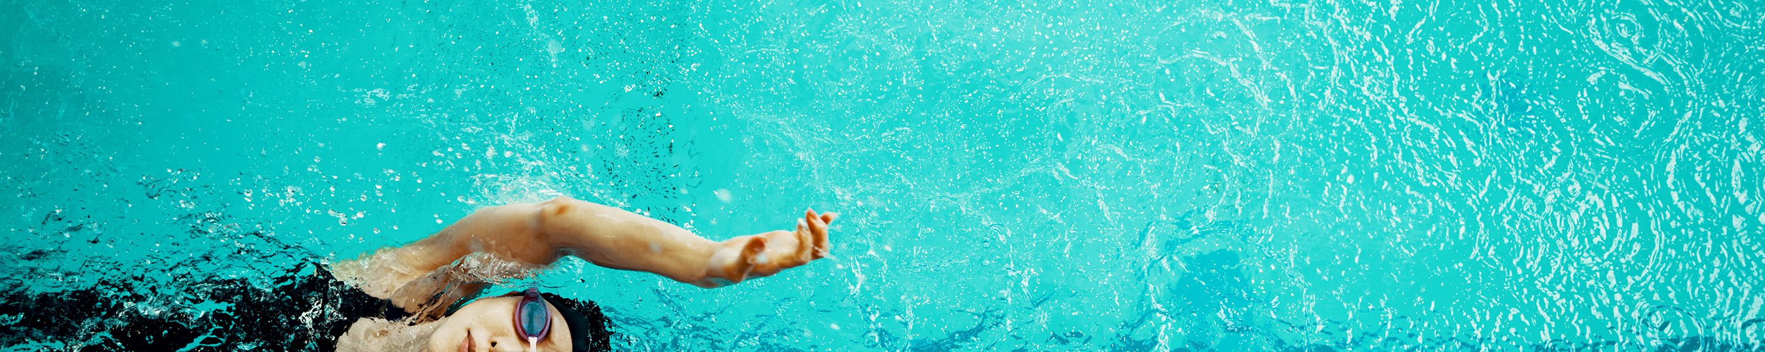
SWM1000
An Introduction to Swimming and Movement in Water

Slide 5

SWM2007
Dissertation

