Slide 1
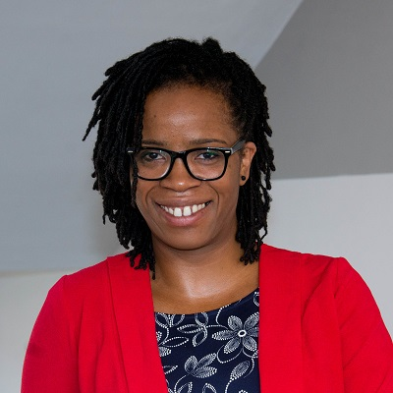
Getting students ready for work – what it means for all students
Dr Iwi Ugiagbe-Green, Associate Professor
(Accounting & Finance, University of Leeds)

Slide 2
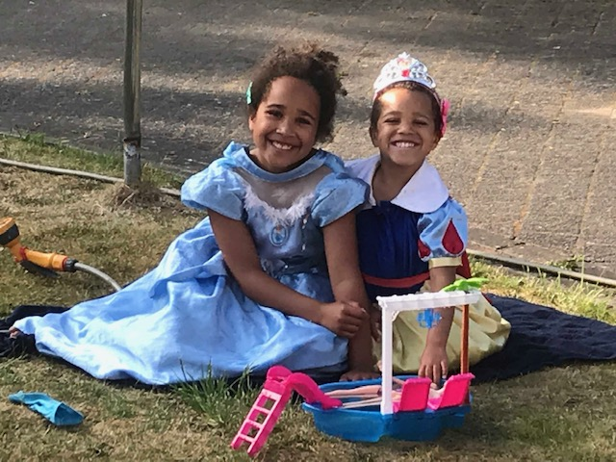
Societal Inequalities
Race is not a health risk factor – Racism is
Health inequalities
Achievement gap
Employment gap
Pay Gap
Life opportunities and choices

Slide 3
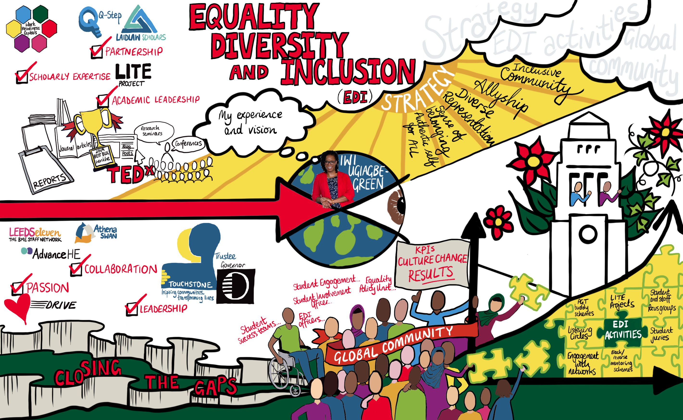

Slide 4
Brief overview
Context – Accounting and Finance (transferable to other disciplines)
Literature review – Work readiness, structuration theory
Project results (undergraduate & postgraduate projects) - themes
Response: Work-readiness (capital) framework
Application and evaluation of model by employers – questionnaire
Very initial themes – employer interviews
Summary and next steps

Slide 5
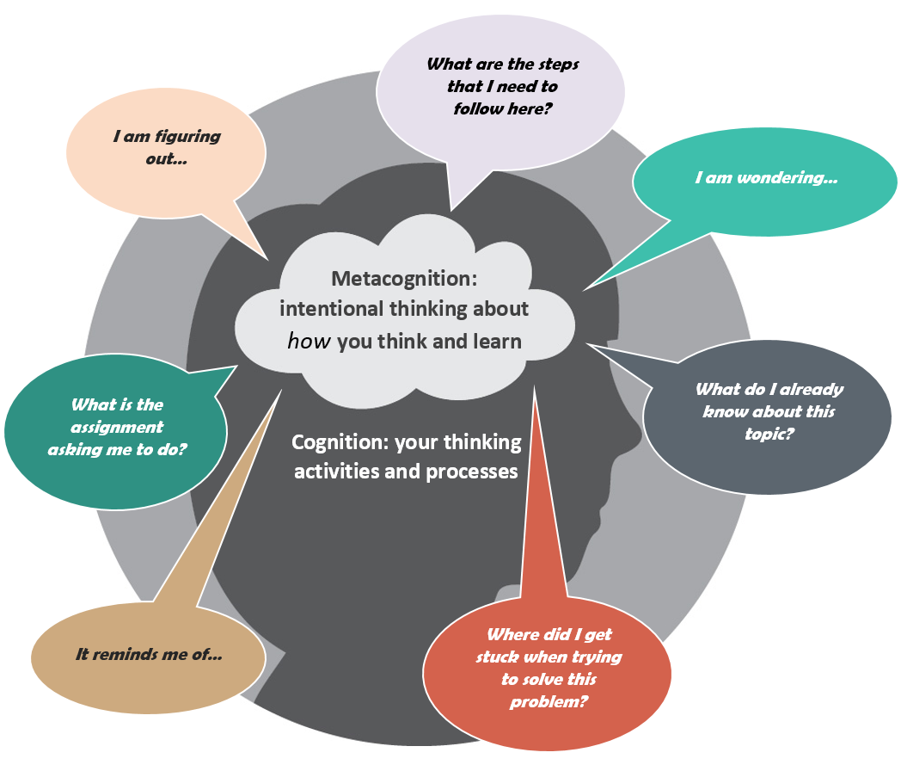
Conceptualisation of work-readiness
This Photo by Unknown Author is licensed under CC BY-NC

Slide 6
Work-readiness perception based on?
Intellectual capital
League tables (designed for males, middle/upper class – Dr Charlie Ball), Non contextualized A levels, Degree award ,Russell group universities bias (Prof. Tristram Hooley), Other bias; Accent, Gender, Ethnicity/Race
Personality
Identity politics (personal epistemologies, veneer, confidence, sense of belonging & fit), Organizational professionalism- (Evetts, 2008)
(Lack of job) specific skills
Placements, internships (Ugiagbe-Green, 2019)
Meta skills
Structures of opportunity (Ken Roberts, 1997) impacts disproportionately on different student groups
Transformative space for self development, self-actualization, reflection, identity transformation does not exist equally for all student groups

Slide 7
Values, judgements, bias

Slide 8
Work-readiness
“The level to which graduate students are perceived as possessing attitudes and attributes that enable them to be prepared for success in the workforce” (Caballero & Walker, 2010)

Slide 9
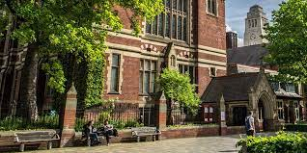
Conceptualisation of work-readiness
Who determines if a student/graduate is work-ready?

Slide 10
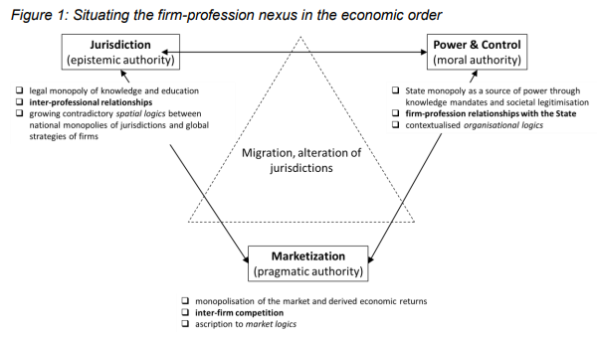
Agency, identity, structure – competing logics
Dorry, S (2018)

Slide 12
CBI (2019) reports % of employers do not perceive graduates to be work ready

Slide 13
CBI (2019) reports 44 % of employers do not perceive graduates to be work ready

Slide 14
Problematization of “success in the workplace”
Opportunity structures (Ken Roberts, 1997)
Pragmatic rationality (Phil Hodkinson, 1998) – not everyone has the capacity to be anything that they want to be
Mimetic isomorphism (Fogarty, 1992) – Performance reviews are used to design algorithms in AI systems for recruitment and selection – is this what success looks like?
Conformance with organisational professionalism (Evetts 2008) – what does “professional” look like according to the employer. What does the employer value?
Critical race theory (structural racism)– ‘whiteness’ is centred in systems, policies that perpetuate bias, inequity of opportunity for non-white people

Slide 15
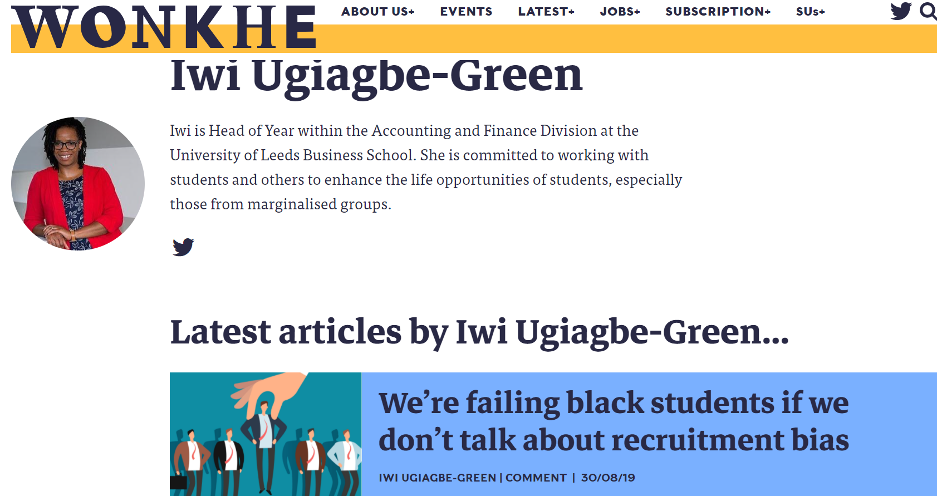
Wonkhe

Slide 16
(Work-readiness) - A Student Lifecycle approach
ACCESS
CONTINUATION
ATTAINMENT
PROGRESSION
Structures of opportunity – Multi-stakeholder engagement approach
Formal: Work based learning, internships, placements, year in industry, volunteering, commercial skills projects, consultancy, careers service
Informal: Family, friends, societies, faith communities, sports clubs

Slide 17
Racialised degree awarding gaps Focus groups (work-readiness) Listening rooms (racialized experiences) Ubuntu Kindness circles (sense of belonging, authentic self) PGR (teaching excellence development) pipeline
Ongoing projects

Slide 18
Work-readiness
Projects focus on student experience through different lens
Intersections between professional identity (student), structures of opportunity & agency (e.g. employers, PSRBs)

Slide 19
Structuration theory
Intersection of AGENTS (Professional IDENTITY), their (and other agents) AGENCY and STRUCTURES of opportunity
Is the student work ready?

Slide 20
Accounting and Finance Sample (2018)
2nd year undergraduate (n=87):
A semi-structured questionnaire was designed to collect qualitative and quantitative (PIFFS) data on the main work-readiness themes identified in the literature as important at the micro level; prior work experience, professional identity, professional skills, self-efficacy.
Postgraduate (n=38)
Surveyed LUBS postgraduate students (n= 38) during academic year 2018/19 who attended the highly selective post graduate study tours in Zurich in June 2019
We undertook 4 focus groups with 38 postgraduate students to explore work-readiness constructs (intersections of identity, structure and agency)
Table 1 – A summary of ethnicity and gender of the postgraduate LUBS students who completed the questionnaire and took part in the focus groups

Slide 21
A variety of projects
Postgraduate (n=38)
Surveyed LUBS postgraduate students (n= 38) during academic year 2018/19 who attended the highly selective post graduate study tours in Zurich in June 2019
We undertook 4 focus groups with 38 postgraduate students to explore work-readiness constructs (intersections of identity, structure and agency)
Table 1 – A summary of ethnicity and gender of the postgraduate LUBS students who completed the questionnaire and took part in the focus groups

Slide 22
Methodology (1)
Individual issues: Students’ AGENCY and Professional identity (PIFFS)
Structural issues: Employer perceptions of work-readiness

Slide 23
Summary of Themes– Whose job is it anyway?
Dichotomous, yet overlapping responsibilities (knowledge is applied in authentic environments, professional socialization/competence is validated)
Expectation that professional socialization starts within University and is validated by employer through tasks and development of competency in authentic occupational contexts
Reliance on University to support life design and articulation of narrative of work-readiness and therefore to access opportunities - but that employers provide an insight into what is possible and help shape the narrative
Learning is not seen as a disposable commodity – but in of itself a skill that enables flex, adaptation, development of capability – meta-skills
Table 1 – A summary of ethnicity and gender of the postgraduate LUBS students who completed the questionnaire and took part in the focus groups

Slide 24
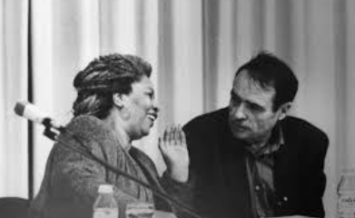
Critical themes
Dynamics of power in society (education and labour markets – principally organisations – employers in the field (structures of opportunity)
Cultural, social and symbolic forms of capital (student/graduate)
Preservation of privileges – e.g. class, gender and race (through recruitment and selection practices)
Habitus – ingrained values, bias, perspectives on the world due to our own experiences and meta-cognition – influences physical embodiment of what is perceived as ‘work ready’
Table 1 – A summary of ethnicity and gender of the postgraduate LUBS students who completed the questionnaire and took part in the focus groups
Other literature/theory
Professional identity
Structuration theory
Capitals/habitus

Slide 25
Work-readiness framework (agency, structure and identity) - othering
Capitals are used to frame what students need to be perceived by others, e.g., employers as work-ready.
Students are ‘othered’(positioned as different) because they are perceived to not have the capitals (particularly identity capital) that are valued by employers.
Ugiagbe-Green & Southall, 2020

Slide 26
Work readiness Capitals
Human Capital: The skills and knowledge of the graduate, as evidenced by their qualifications and experience e.g. degree classification, degree subject, prior work experience
Social Capital: The graduate’s network of personal and professional relationships, as well as their capability to form professional relationships e.g. graduate having friends or family in their desired industry / sector
Cultural Capital: The graduate’s embodiment of organisational professionalism e.g. the way in which the graduate dresses or the way in which they speak

Slide 27
Work readiness Capitals
Identity Capital: The ability of the graduate to demonstrate self-reflexive understanding of their positioning in the graduate labour market field e.g. having set career goals, being able to communicate one's skills and experiences in the language of the employer
Employment Capital: The differentiated occupational behaviours, judgments and moral orientations that are valued by employers e.g., business acumen, situational judgement and ability to manage up
Economic Capital: The ability of a graduate to bear financial risks related to employment opportunities e.g. whether or not there are financial barriers to geographical mobility or taking on unpaid work experience

Slide 28
Methodology (2) - (Ongoing) studies
Individual: Students’ (n=c120) AGENCY and Professional identity (PIFFS)
Structured questionnaire: Employer (n=28) validation of capitals (n=17 graduate recruiters)

Slide 29
Racialised student perspectives – agency, professional identity
Sense of belonging issues
Authentic self issues
Capital gained/developed within informal spaces not valued
Lack of representation – ‘cannot be what you cannot see’
Confidence issues – fit, articulation of self

Slide 30
Methodology (2) – RQs - Employers’ perspectives (Employers’ questionnaire)
Which capitals do employers’ value to inform perceptions of what ‘success in the workplace’ looks like?
Which capitals do employers feel students commonly should have against what capitals employers perceive students are lacking?

Slide 32
Employers’ report to be capital to be the most important capital in perceiving graduates to be work ready

Slide 33
Employers’ report Employment capital to be the most important capital in perceiving graduates to be work ready

Slide 34
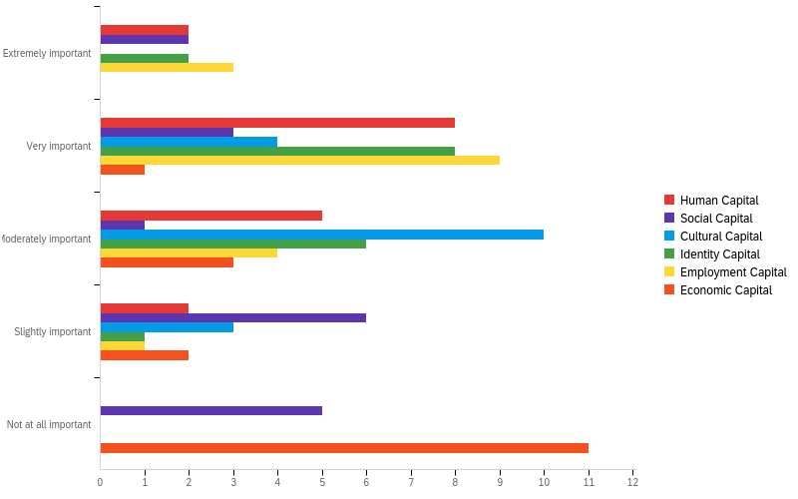
Q9: How important is it that a student embodies the above ‘capitals’, in determining whether or not the student should be hired for a graduate position?
Employment capital
Identity capital
Human capital

Slide 35
Q9: How important is it that a student embodies the above ‘capitals’, in determining whether or not the student should be hired for a graduate position?
1 (extremely important) to 6 (not important at all).
# | Field | Minimum | Maximum | Mean | Std Deviation | Variance | Count
1 | Human Capital | 1.00 | 4.00 | 2.41 | 0.84 | 0.71 | 17
2 | Social Capital | 1.00 | 5.00 | 3.53 | 1.38 | 1.90 | 17
3 | Cultural Capital | 2.00 | 4.00 | 2.94 | 0.64 | 0.41 | 17
4 | Identity Capital | 1.00 | 4.00 | 2.35 | 0.76 | 0.58 | 17
5 | Employment Capital | 1.00 | 4.00 | 2.18 | 0.78 | 0.62 | 17
6 | Economic Capital | 2.00 | 5.00 | 4.35 | 0.97 | 0.93 | 17
Notes:
What students should have
1 – they really need it, 6 - they don’t really need it
They really need (1) Employment capital (occupational - judgment, business acumen, ability to manage up) - (2) human capital – skills, knowledge, qualifications and 3 (identity capital ) understand their position in graduate labour market, set career goals, communicate skills/experiences

Slide 37
Employers’ report
capital to be that which students/graduates lack most

Slide 38
Employers’ report Identity
capital to be that which students/graduates lack most

Slide 39
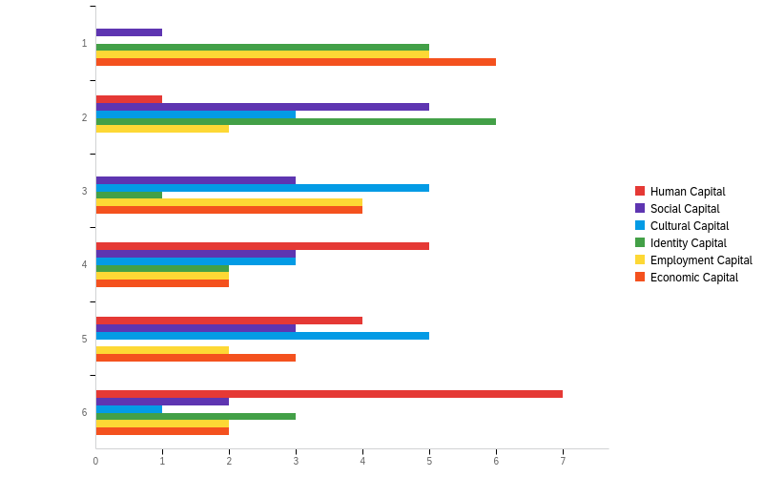
Q10: Which of the 6 capitals do you think graduates lack the most? Drag and drop the capitals from 1 (lacking the most) to 6 (lacking the least).
Identity capital
Employment capital
Economic capital

Slide 40
Q10 - Q10: Which of the 6 capitals do you think graduates lack the most?
Drag and drop the capitals from 1 (lacking the most) to 6 (lacking the least).
# | Field | Minimum | Maximum | Mean | Std Deviation | Variance | Count
1 | Human Capital | 2.00 | 6.00 | 4.94 | 1.11 | 1.23 | 17
2 | Social Capital | 1.00 | 6.00 | 3.47 | 1.50 | 2.25 | 17
3 | Cultural Capital | 2.00 | 6.00 | 3.76 | 1.21 | 1.47 | 17
4 | Identity Capital | 1.00 | 6.00 | 2.71 | 1.77 | 3.15 | 17
5 | Employment Capital | 1.00 | 6.00 | 3.00 | 1.71 | 2.94 | 17
6 | Economic Capital | 1.00 | 6.00 | 3.12 | 1.81 | 3.28 | 17

Slide 41
Summary
Individual and structural issues
Hegemonic structures mean employers determine work-readiness
Perpetuate ‘status quo’ through systems, policies, procedures – (even when using AI)
Students who do not ‘fit’ in with status quo are othered
Employers perceive work readiness based on; Occupational context - Judgements, values, articulation (life design), skills, prior work experience, qualifications
Employers perceive graduates lack above (except e.g. qualifications) and economic capital (linked with social mobility – evidenced by regional graduate markets)

Slide 42
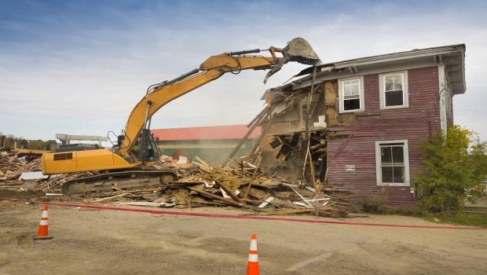
Closing thoughts
Consider how to help students to develop employment capital (work-based learning)
Help students better navigate structures of opportunity (equity work)
Scaffold learning design/surfacing of skills (identity capital)
Work with companies to dismantle their structures, status quo, policies that marginalize and perpetuate inequality – ‘othering’ students who are different

Slide 43
Thank you!

Slide 44
References
Alvesson M., Ashcraft, K. L. and Thomas, R. (2008). “Identity matters: Reflections on the construction of identity scholarship in organization studies” Organization vol.15 (1) pp5-pp28
Alvesson, M. & Willmott, H. (2002). Identity regulation as organizational control: Producing the appropriate individual, Journal of Management Studies, vol. 39(5), pp619-pp644
Barrie, S.C. (2006). Understanding what we mean by the generic attributes of graduates. Higher Education, 51 (2), 215-241.
Brew, A. (2010). Imperatives and challenges in integrating teaching and research. Higher Education Research & Development, 29, 139–150.
Caballero, C and Walker, A (2010) Work readiness in graduate recruitment and selection: A review of current assessment methods. Journal of Teaching and Learning for graduate employability, 1(1), p.13-p.25
Dörry, S. (2018) Creating institutional power in financialised economies: The firm-profession nexus of advanced business services, Financial Geography Working Paper No. 12 March 2018 DOI: 10.13140/RG.2.2.26064.00008
Durkheim, E. (1984). The Division of Labour in Society, New York: The Free Press
Evetts, J. (2006). Short Note: The Sociology of Professional Groups: New Directions, Current Sociology vol.54 (1) pp.133-pp143
Evetts, J. (2010). Organizational Professionalism: changes, challenges and opportunities, Paper presented at conference, ‘DPU Conference: Organizational Learning and Beyond’ Copenhagen, Denmark 20th October 2010
Evetts, J. (2011). A new professionalism? Challenges and opportunities, Current Sociology vo.59 (4) Monograph 2 pp.406-pp422
Evetts, J. (2012). Professionalism in Turbulent Times: Changes, Challenges and Opportunities, Paper presented at conference, ‘Propel International Conference’ Stirling, Scotland 9-11 May 2012
Evetts, J. (2013). Professionalism: Value and Ideology, Current Sociology Review vol.0(0) pp.1-pp19
Fogarty, T. (1992). OrganizationaI socialization in accounting firms: A theoretical framework and agenda for future research, Accounting, Organisations and Society, vol 17(2), pp129-pp149

Slide 45
References
Finch, D.J, Peacock m. Levallet, N. & Foster, W. (2016),"A dynamic capabilities view of employability", Education + Training, Vol. 58 Iss 1 pp. 61 - 81 (4) (PDF) A dynamic capabilities view of employability. Available from: https://www.researchgate.net/publication/288855396_A_dynamic_capabilities_view_of_employability [accessed Sep 15 2020].
Hodkinson, P. (1998). Choosing GNVQ Journal of Education and Work, 11 (2) 151-165
Roberts, K. (2009) Opportunity structures then and now, Journal of Education and Work, 22:5, 355-368, DOI: 10.1080/13639080903453987
Weber, M., (1968). Economy and Society, vol. 1. New York: Bedminster Press
Wilson, I., Cowin L.S, Johnson, M. and Young, H. (2013), Professional Identity in Medical Students: Pedagogical Challenges to Medical Education, Teaching and Learning in Medicine, p. 370. Available at: http://www.tandfonline.com/doi/pdf/10.1080/10401334.2013.827968 [
Winterton, J. (2006). Social dialogue and vocational training in Europe: Are we witnessing the emergence of a European model? Journal of European Industrial Training, vol. 30(1) pp.65

