Slide 2
While we’re waiting…
In the chat box, please share:
Your year
Your course name
What you hope to get out of today’s session

Slide 3
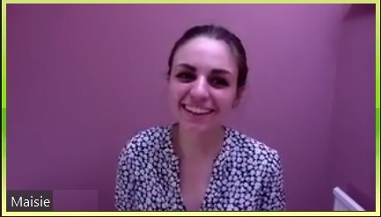
UniSkills Workshops
Introduction to Critical Thinking
ehu.ac.uk/uniskills

Slide 4
Overview of session
Developing a definition of ‘critical thinking’
What this means for your reading and writing at university
How to assess the strength and validity of arguments in academic texts
Signposting to further resources
An opportunity to ask questions

Slide 5
Discussion
What does ‘criticality’, ‘being critical’ or ‘critical thinking’ mean to you?
Notes:
What do the terms mean? Are there any you don’t understand? How would you define them? Discuss as best suits the group size and level….
Bring the group back together – focus on what ‘critical’ ‘being critical’ and ‘critical thinking’ are – it means realising not all evidence is equal ….
It might help to think about the origin of these words from Greek – kritēs – is a judge, umpire, interpreter (‘theatre critic’) – if a person has the quality of being kritikos (i.e. critical) the root meaning is that they can discern, choose between different options, for us now, that means fairly and through reasoning as in our modern idea of a legal judge (and Latin iudico), or a sports official, who must trust their own decision making, but also the context they are operating in, and the rules, laws, norms etc. that must influence and govern those decision. It means to assess, to evaluate, to weigh up options for their relative validity (how true, how relevant, how applicable they are) and worth (how useful, how important are they) – of course the criteria (derived from the same root) will vary….[krinō, the verb = I separate/choose/discern/decide/judge/interpret/put on trial, inc. condemn, crown winner…]
If practice based, stress that these are the skills they use in practice too – choosing how to best plan a class, treat an issue, assessing the situation and coming to a decision (criticare ‘to come to a crisis’– Latin – is where the sense of an urgent situation comes from as in ‘critical care’)

Slide 6
And in your assignments?
Learning how to spot and present an effective argument
To do this you need to:
Investigate evidence for and against different ideas
Test this evidence by comparing to other literature
Consider alternate perspectives and implications
Reach your own informed conclusion

Slide 7
Critical writing vs. descriptive writing
Descriptive writing | Critical/analytical writing
describes what happened | identifies the significance
states what something is like | evaluates strengths and weaknesses
gives the story so far | weighs one piece of information against another
outlines the order in which things happened | makes reasoned judgements
instructs how to do something | argues a case according to the evidence
lists the main elements of a theory | shows why something is relevant or suitable
outlines how something works | indicates why something works
notes the methods used | identifies appropriate or suitable methods
states when something occurred | identifies why the timing is important
states the different components | weighs up the importance of component parts

Slide 8
Applying critical analysis to your writing
Peters (2015) is perhaps misguided when she claims that nurses need to be shown how to use online learning tools to be effective learners.
Furthermore, it appears that Lane et al. (2002) may have overlooked some key data when they raise the possibility that ethnicity is the key indicator for hypertension amongst the UK population.
…However, it is important to recognize that not all schools have sufficient space of facilities for outdoor learning, such as those in inner cities. An alternative in these cases might be to pilot indoor forest school activities, such as den making, bug hunts or sensory creative play (Prior, 2020)

Slide 9
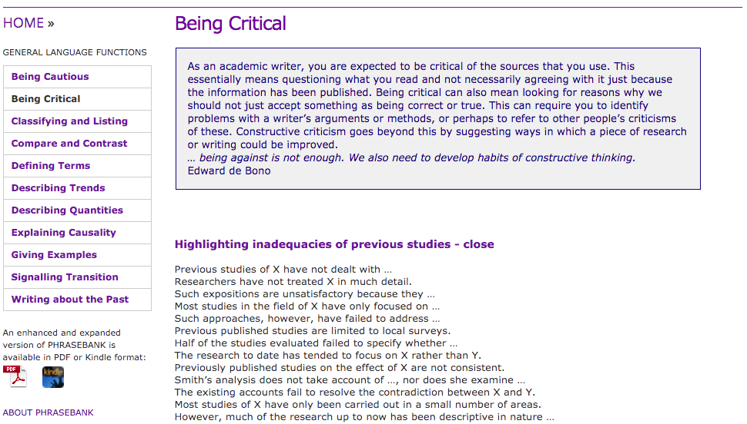
Academic phrasebank

Slide 10
What does critical thinking involve?
Consideration: giving an idea a fair hearing: thorough, interested and honest.
Openness: Willingness to change your stance if justified by the arguments on offer; suspending final judgement if you already hold a strong view on the topic – scepticism and cynicism are not the same thing!
Reconsideration: re-reading, returning to ideas in light of new knowledge and your own developing thoughts, and from more than one angle.
Duration: thinking about something for a decent amount of time.
Notes:
/interpretation is always provisional to some extent, rather than absolute. That this is not a quick or easy process
Tenacious reasoning:
Tracking the logic of an argument, the ‘line of reasoning’
Juggling multiple arguments, trying to work out how they fit together or not, seeking out where the problems and gaps are
Assessing evidence
On an individual, analytical, case by case basis AND in wholesale evaluation
Thinking about wider implications, or the consequences of a particular idea
E.g. following an argument to its logical conclusions
E.g. thinking about how it might apply elsewhere
E.g. thinking about its impact, what it means more broadly
MAIN POINT: Its root meaning is to assess, evaluate, weigh options for both their relative…
VALIDITY -how true, how relevant, how applicable?
VALUE – how worthwhile, useful, important, convincing, well-evidenced, or ‘good’?
Not purely intellectual skills – we assess situations every day, choose from a range of options and come to a decision – e.g. what’s the best way to plan a class, treat an issue….etc. – and think about the different ways to best go about different tasks

Slide 11
Being critical
Why should we care?
A useful place to explore these questions and the definition is at
https://plato.stanford.edu/entries/critical-thinking/
Notes:
Mark scheme and our assignments
Reflection
Evidence-based research, professions: honesty and integrity
Communication with others: real world skills
Balance and multiple perspectives
Academic work goes beyond simple pros and cons that can result in false equivalence – it asks for breadth and depth (analysis, synthesis, evaluation, implications, gaps)
Weighing the evidence, tensions and grey areas, building complex pictures too
Subjectivity, Objectivity and Bias

Slide 12
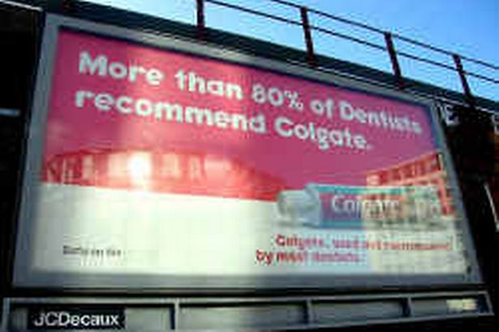
Critical reading: statistical manipulation
The manipulation of statistics to persuade the reader to accept claims at ‘face-value’, without evidence or a false presentation of the evidence, for example:
Implied data ‘60% of scholars agree that….’
Use of percentages when the sample size is small (misleading impression of greater significance)
False claims of causation from correlation of data
Cherry-picking, manipulation of data
Misleading visualization of data
….and other more complex statistical debates
Notes:
In the Colgate example, of the dentists surveyed by telephone, it turned out they were in fact allowed to name more than one brand, so the ASA ruled that the adverts had to be banned, as the claim was a misleading representation of the data. OR while 80% of dentists (sample size?) do recommend Colgate, they do not necessarily do so over and above any other brand (whereas we know 1 in 5 do not!).
Also comes down to study design – statistics may look convincing, but if the study is poorly-designed, or inherently biased (before the data is even gathered!) then there is not much point poring over the number crunching!

Slide 13
Example:
‘Vegetarians are less likely to smoke than meat-eaters’
Remember:
Correlation is not causation!
Notes:
Correlation: Vegetarians and non-smokers/carnivores and smokers
Statement implies Causation: People dont not smoke because they are vegetarian, do smoke because they eat meat etc. not the same!! (false inference)
https://www.students4bestevidence.net/blog/2018/10/01/a-beginners-guide-to-confounding/ - you could also discuss in terms of confounding variables

Slide 14
Rhetorical Manipulation
The use of literary/rhetorical devices to persuade the reader to accept claims at ‘face-value’, often without any real further evidence to back statements. An example:
‘This craze for veganism surely must be stopped if we are to save our agricultural industry from disaster, as Smith (2018) has rightly argued…..’
Notes:
Exercise: What’s wrong with this statement in a piece of academic writing?
Unnecessary use of emotive/poetic language in order to persuade: ‘Epidemic’ implies what? What does the overall statement imply? ‘This epidemic’ (what epidemic? Does it really exist?)
What is the problem with using a word like ‘disaster’ in academic writing? What would you need to do to make it acceptable (define/quantify/qualify it)? Can you think of a more appropriate and less rhetorical way to begin looking at this issue would be?
This may also be more subtle (e.g. something is ‘clearly’, ‘surely’, ‘obviously’ ‘of course’ the case…..do they show it is or just say it is so ‘it is evident that’, ‘it is arguable that…’ – ‘arguably’ and ‘probably’ are not your friends if they stand alone!
Does the author go on to explain why Smith is right, and what their argument and evidence is? Do they have any evidence other than a secondary view?
You can use and will see these modifiers BUT the argument and evidence must follow through, otherwise it is hollow rhetoric – use your judgement!

Slide 15
Notes:
Written in 2006 – over a decade old Funded by international Olympic committee

Slide 16
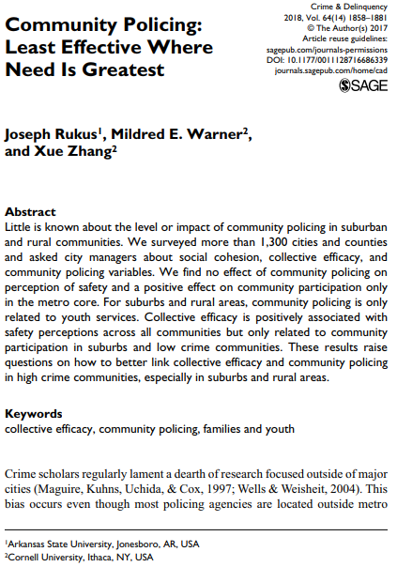

Slide 17
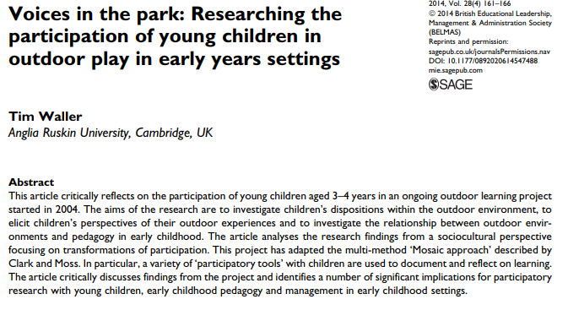
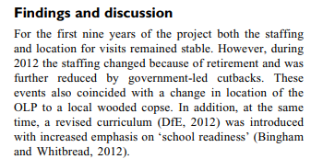

Slide 18
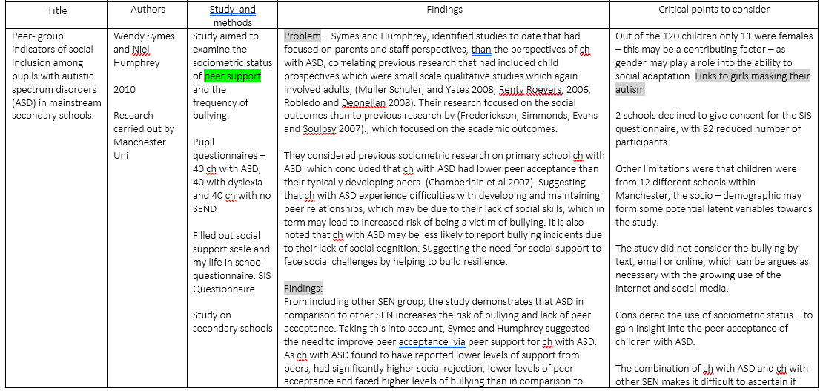
Make a plan

Slide 19
Article Workshop
Critically assess Mahotra, Noakes and Phinney, 2015:
https://bjsm.bmj.com/content/49/15/967
(Main thesis: physical activity does not promote weight loss)
Is this a credible source? Why/why not?
Is the article biased?
Notes:
https://bjsm.bmj.com/content/49/15/969
There are many bad things about this article, but the key thing is the late addition of competing interests (Atkins affiliation) calling into question the main thesis that ’physical activity does not promote weight loss’. Even in an editorial, there seems to be a lack of openness with the reader, despite the credible looking source.

Slide 20
Article Workshop
Competing interests – Atkins diet affiliation
“exercise doesn’t work we want you to buy our book!”
hollow rhetoric e.g. ‘obesity has rocketed’, ‘the public drowned’
Lack of references
Cherry picking – ignoring other evidence out there
To name a few!
https://bjsm.bmj.com/content/49/15/969
Notes:
https://bjsm.bmj.com/content/49/15/969
There are many bad things about this article, but the key thing is the late addition of competing interests (Atkins affiliation) calling into question the main thesis that ’physical activity does not promote weight loss’. Even in an editorial, there seems to be a lack of openness with the reader, despite the credible looking source.

Slide 21
Applying critical analysis to your reading: when you finish reading!
Would you be able to summarise the main argument/s for someone?
Would you be able to explain to someone why this particular view might be best, why you are convinced by it – or not?
Would you be able to outline the strengths and weaknesses of the research, in terms of its arguments, design and evidence?
Do you need to investigate further, read more, find out something else to be sure?

Slide 22
It’s supposed to be challenging
Many students find being critical difficult due to:
Feeling like they don’t have the authority
It being an unfamiliar way of thinking
The amount of reading required
The complex set of possibilities an idea/concept can present
Most academic work you read will be persuasive

Slide 23
Online Toolkit
Notes:
Change to correct screen shot and URL

Slide 24
My Library Tab in Learning Edge
Notes:
Standard in all slides

Slide 25
Links to some food for thought…
The Colgate ad and marketing: https://medium.com/@Daniel_Sharp_UK/the-truth-about-misleading-numbers-in-advertising-15625332c9e9
Types of bias and healthcare research:
https://www.students4bestevidence.net/blog/2019/01/21/bias-how-much-difference-does-it-really-make-in-randomized-trials/
Critical approaches to systematic reviews:
https://blogs.plos.org/blog/2018/05/01/systematic-reviews-meta-analyses-a-5-step-checkup/
Types of argument:
http://podcasts.ox.ac.uk/different-types-arguments

Slide 26
More help/follow up resources
Frameworks and Checklists – subject pages, or ask your tutor for discipline specific recommendations: for Health see here: https://www.edgehill.ac.uk/ls/subject/health/?tab=evidence-based-research or follow the ‘Journals and Databases’ button on your My Library page
Recommended Resources on critical thinking and writing:
COTTRELL, S., 2013. The Study Skills Handbook. 4th ed. ed. Basingstoke, Hampshire: Palgrave Macmillan. Available from: http://capitadiscovery.co.uk/edgehill/items/77215
PRICE, B. and HARRINGTON, A., 2016. Critical Thinking and Writing for Nursing Students. 3rd ed. ed. Los Angeles: Learning Matters. Available from: http://capitadiscovery.co.uk/edgehill/items/268436
WESTON, A., 2018. A rulebook for arguments. Fifth edition. ed. Indianapolis: Hackett Publishing Company. Available from: http://capitadiscovery.co.uk/edgehill/items/329313

Slide 27
Further support
Discover lots of useful information, guides, videos and interactive online toolkits on our UniSkills webpages ehu.ac.uk/uniskills - available 24/7!
Book your place on a UniSkills webinar running throughout the year ehu.ac.uk/workshops
Search our FAQs or Ask a Question online ehu.ac.uk/askus
Contact the Catalyst Helpdesk via email at CatalystEnquiries@edgehill.ac.uk or live chat
Notes:
Standard in all slides

Slide 28
Keep in touch
@EHULibrary
@EHULearnService
edgehill.ac.uk/uniskills
Blogs.edgehill.ac.uk/ls

