Slide 1
Interpersonal violence in sport: What we know and recommendations for practice and good governance
Dr. Melanie Lang
Edge Hill University, Lancashire, UK
9th May 2019
Sport and Global Governance annual conference,
Barcelona, Spain
Melanie.Lang@edgehill.ac.uk
langm@edgehill.ac.uk
Notes:
About me
Thanks to Alberto Carrio and Perez Triviño for the kind invite

Slide 2
Overview
Interpersonal violence in sport: Historical context
Concepts and definitions
Prevalence estimates (Vs. reporting rates)
Known risk factors
Managing and preventing IV in sport: A case study of England
Recommendations for research, practice and good governance
Melanie.Lang@edgehill.ac.uk

Slide 3
Violence
“use of physical force or power, threatened or actual … that either results in or has a high likelihood of resulting in injury, death, psychological harm, maldevelopment, or deprivation”
(Krug et al., 2002, p. )
Melanie.Lang@edgehill.ac.uk
Notes:
Violence is “the intentional use of physical force or power, threatened or actual, against oneself, or against a group or community that either results in or has a high likelihood of resulting in injury, death, psychological harm, maldevelopment or deprivation” (WHO/ UN Development Programme/ UN Office on Drugs & Crime, 2014, p. 2).
Some people may prefer abuse as ‘violence’ suggests physical force when in fact violence may not involve force – it may include coercive control, financial/economic abuse, spiritual abuse for example

Slide 4
Interpersonal Violence
“violence that occurs between family members, intimate partners, friends, acquaintances and strangers” (WHO/ UN Development Programme/ UN Office on Drugs & Crime, 2014, p. 2)
Intimate partner violence
Elderly abuse
Workplace violence
Sexual violence
Child abuse/maltreatment
Youth violence
(Acquaintance violence, i.e.: coach-athlete, athlete-coach)
Melanie.Lang@edgehill.ac.uk
Notes:
More specifically, IV refers to violence between individuals – includes child abuse, peer-on-peer abuse, gender-based violence such as homophobic abuse, domestic violence,
IV is distinct from self-directed violence and collective violence, (Self-directed violence is that which people inflict upon themselves, such as suicidal behaviour and self-mutilation. Collective violence refers to instrumental violence inflicted by larger groups such as nation states, militia groups and terrorist organizations in order to achieve political, economic or social objectives).

Slide 5
Modes of IV
Sexual
Physical
Psychological/ emotional
Neglect/ deprivation
Economic
Social
(Krug et al., 2002)
Melanie.Lang@edgehill.ac.uk
Notes:
Most importantly literature commonly identified 6 modes in which violence may be inflicted: physical; sexual; and psychological attack; and deprivation/neglect, economic/financial, and social (Krug, Mercy, Dahlberg et al., 2002).
a typology of violence that can be a useful way to understand the contexts in which violence occurs and the interactions between types of violence. This typology distinguishes four modes in which violence may be inflicted: physical; sexual; and psychological attack; and deprivation. It further divides the general definition of violence into three sub-types according to the victim-perpetrator relationship
Social abuse is behaviour that aims to cut you off from your family, friends, or community. It can also involve a person or people trying to damage your relationships with others. People who are socially abusive may also attempt to make you look bad or ruin your reputation. Social abuse can include things done in the home, in public, over the phone, or on the internet and social media.
Long- and short-term physical, psychological & social effects
increased use of health care services (Eisenstat & Bancroft, 1999; McCauley, Kern, Kolodner K. et al., 1995; Council on Scientific Affairs American Medical Association, 1992)

Slide 6
Prevalence Estimates
Mode | Estimate
Sexual harassment | 1% - 64%
Sexual abuse/ violence | 0.5% - 17%
Physical abuse/ violence | 11% - 24%
Psychological/ emotional abuse/ violence | 38% - 75%
(Alexander et al., 2011; Fasting et al., 2011; Lang et al., 2019; Mergert et al., 2016; Parent et al., 2015; Timpka et al., 2014; Vertommen et al., 2016)
Melanie.Lang@edgehill.ac.uk
Notes:
IV against children in sport data from Netherlands and Belgium
Retrospective of violence experienced while playing sport under age 18
Vertommen, T., Schipper-van Veldhoven, N., Wouters, K., Kampen, J. K., Brackenridge, C. H., Rhind, D. J. A., … Van Den Eede, F. (2016). Interpersonal violence against children in sport in the Netherlands and Belgium. Child Abuse & Neglect: The International Journal, 51, 223–236.
While past research suggests some coaches don’t consider CP a core (or even in some cases partial) part of their role, all parents identified the coaches’ primary responsibility as ensuring their child(ren)’s welfare.
Parent data from Canada – representative sample of the general population of adolescents aged between 14 and 17 years, not just sport
Looked only at “sexual violence”
0.5 % of respondents (0.4% of girls and 0.7% of boys) had been sexually abused
0.4% of respondents (0.2% of girls and 0.6% of boys) had been sexually harassed by a coach
Parent, S., Lavoie, F., Thibodeau, M.-È., Hébert, M., Blais, M., and the members of the PAJ team. (2015). Sexual violence experienced in the sport context by a representative sample of Quebec teenagers. Journal of Interpersonal Violence, [Online First], pp. 1-21.
-
Retrospective of uni students on their experiences in sport as children
While past research suggests some coaches don’t consider CP a core (or even in some cases partial) part of their role, all parents identified the coaches’ primary responsibility as ensuring their child(ren)’s welfare.
-
Only focused on sexual harassment
Sample of students studying sport courses in Norway, Czech republic and Greece about their experiences in sport
Women (N = 616) who were studying in sport departments of academic institutions in the three countries participated in the study. T
-
Out on the fiels
9500 lesbian, gay, bisexual and straight people took part from around the world
80% of participants witnessed or experienced homophobia in sport (both straight and LGB) • Participants were more likely to have witnessed homophobia than experienced it personally. Half (54%) of gay men and lesbians (48%) said they had personally experienced homophobia
27% of gay men and 16% of lesbians said they have received verbal threats of harm
19% of gay men and 9% of lesbians have been physically assaulted
=

Slide 7
Prevalence Estimates
Mode | Estimate
Bullying | 10% - 79%
Hazing | 17% - 31%
(Allan et al., 2018; Nery et al., 2018; Waldron, 2015)
Melanie.Lang@edgehill.ac.uk
Notes:
IV against children in sport data from Netherlands and Belgium
Retrospective of violence experienced while playing sport under age 18
Vertommen, T., Schipper-van Veldhoven, N., Wouters, K., Kampen, J. K., Brackenridge, C. H., Rhind, D. J. A., … Van Den Eede, F. (2016). Interpersonal violence against children in sport in the Netherlands and Belgium. Child Abuse & Neglect: The International Journal, 51, 223–236.
While past research suggests some coaches don’t consider CP a core (or even in some cases partial) part of their role, all parents identified the coaches’ primary responsibility as ensuring their child(ren)’s welfare.
Parent data from Canada – representative sample of the general population of adolescents aged between 14 and 17 years, not just sport
Looked only at “sexual violence”
0.5 % of respondents (0.4% of girls and 0.7% of boys) had been sexually abused
0.4% of respondents (0.2% of girls and 0.6% of boys) had been sexually harassed by a coach
Parent, S., Lavoie, F., Thibodeau, M.-È., Hébert, M., Blais, M., and the members of the PAJ team. (2015). Sexual violence experienced in the sport context by a representative sample of Quebec teenagers. Journal of Interpersonal Violence, [Online First], pp. 1-21.
-
Retrospective of uni students on their experiences in sport as children
While past research suggests some coaches don’t consider CP a core (or even in some cases partial) part of their role, all parents identified the coaches’ primary responsibility as ensuring their child(ren)’s welfare.
-
Only focused on sexual harassment
Sample of students studying sport courses in Norway, Czech republic and Greece about their experiences in sport
Women (N = 616) who were studying in sport departments of academic institutions in the three countries participated in the study. T
-
Out on the fiels
9500 lesbian, gay, bisexual and straight people took part from around the world
80% of participants witnessed or experienced homophobia in sport (both straight and LGB) • Participants were more likely to have witnessed homophobia than experienced it personally. Half (54%) of gay men and lesbians (48%) said they had personally experienced homophobia
27% of gay men and 16% of lesbians said they have received verbal threats of harm
19% of gay men and 9% of lesbians have been physically assaulted
=

Slide 8
Prevalence Estimates
Mode | Estimate
Neglect | Unknown
Economic abuse | Unknown
Social abuse | Unknown
Melanie.Lang@edgehill.ac.uk
Notes:
IV against children in sport data from Netherlands and Belgium
Retrospective of violence experienced while playing sport under age 18
Vertommen, T., Schipper-van Veldhoven, N., Wouters, K., Kampen, J. K., Brackenridge, C. H., Rhind, D. J. A., … Van Den Eede, F. (2016). Interpersonal violence against children in sport in the Netherlands and Belgium. Child Abuse & Neglect: The International Journal, 51, 223–236.
While past research suggests some coaches don’t consider CP a core (or even in some cases partial) part of their role, all parents identified the coaches’ primary responsibility as ensuring their child(ren)’s welfare.
Parent data from Canada – representative sample of the general population of adolescents aged between 14 and 17 years, not just sport
Looked only at “sexual violence”
0.5 % of respondents (0.4% of girls and 0.7% of boys) had been sexually abused
0.4% of respondents (0.2% of girls and 0.6% of boys) had been sexually harassed by a coach
Parent, S., Lavoie, F., Thibodeau, M.-È., Hébert, M., Blais, M., and the members of the PAJ team. (2015). Sexual violence experienced in the sport context by a representative sample of Quebec teenagers. Journal of Interpersonal Violence, [Online First], pp. 1-21.
-
Retrospective of uni students on their experiences in sport as children
While past research suggests some coaches don’t consider CP a core (or even in some cases partial) part of their role, all parents identified the coaches’ primary responsibility as ensuring their child(ren)’s welfare.
-
Only focused on sexual harassment
Sample of students studying sport courses in Norway, Czech republic and Greece about their experiences in sport
Women (N = 616) who were studying in sport departments of academic institutions in the three countries participated in the study. T
-
Out on the fiels
9500 lesbian, gay, bisexual and straight people took part from around the world
80% of participants witnessed or experienced homophobia in sport (both straight and LGB) • Participants were more likely to have witnessed homophobia than experienced it personally. Half (54%) of gay men and lesbians (48%) said they had personally experienced homophobia
27% of gay men and 16% of lesbians said they have received verbal threats of harm
19% of gay men and 9% of lesbians have been physically assaulted
=

Slide 9
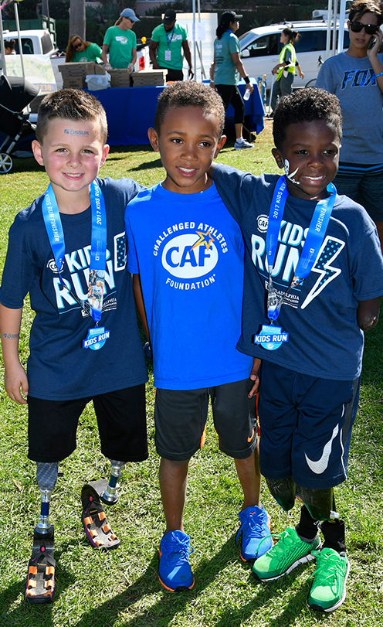
Known Risk Factors
Athletes from ethnic minority groups
Female athletes
Disabled athletes
Lesbian/ gay/ bisexual athletes
Elite & sub-elite level athletes
Stage of Imminent Achievement (SIA)
(Bjørnseth & Szabo, 2018; Fasting et al., 2010; Vertommen et al., 2016)
Melanie.Lang@edgehill.ac.uk
Notes:
Most research on sexual violence and espc against children so these risk factors relate to sexual violence only
Their key outcomes suggest that sexual violence against children in sports is prevalent Bjørnseth & Szabo, 2018
Girls are more often the victims than boys Bjørnseth & Szabo, 2018
Minority groups are at higher risk for sexual violence Bjørnseth & Szabo, 2018
athletes at higher levels of competition seem to be more vulnerable for grooming. While the coach is often seen as the perpetrator, new research suggests that peer-athletes may precede the coach (Bjørnseth & Szabo, 2018)
chances of being harassed by someone in sport increased with performance level, from 29.7% among the exercisers to 55.2% among the elite-level athletes (Fasting et al., 2010)

Slide 10
Management & Prevention
IV occurs in all sports and at all levels of sport
IV frequently intersects with other forms of oppression
Most perpetrators are (male) coaches – but women & peer athletes also commit IV
Power imbalance = coaches in a position of power over athletes …
… and athletes often disempowered = by their status, age, size, knowledge etc.
Melanie.Lang@edgehill.ac.uk
Notes:
IV is form of violence rooted in the dynamics of power and control of one person over another - systems of privilege in society such as gender, ethnicity and class are tools used to maintain power and control over others
IV frequently intersects with other forms of oppression (gender, ‘race’/ethnicity, disability, age)
Most perpetrators of acquaintance violence, sexual violence & child abuse are (male) coaches = position of power
Females & peer athletes can also commit IV (including but also beyond forms of youth violence)
Sport as ‘family’ – trust, closeness, isolation, in loco parentis
Power imbalance = coaches in a position of power over athletes …
… and athletes often disempowered = by their status, age, size, knowledge etc.
Example of what’s being done in England

Slide 11
Known Risk Factors
Abuser inclination
Sport opportunity
Athlete vulnerability
Melanie.Lang@edgehill.ac.uk
Notes:
Triad of factors that influence whether IV occurs

Slide 12
Case Study
Melanie.Lang@edgehill.ac.uk
Notes:
Moving on to management and prevention strategies – case study of england
Child Protection in Sport Unit (CPSU)
Established in 2001 as partnership between national sport funders & children’s charity
A capacity-building organisation
Funded by taxpayer’s money through the sport councils (like Sport England) but is independent from government
Established when concern about child sexual abuse in sport was high (hence the name being about CP)
Develops professional standards for sports organisations
Provides SCP education and training
Central point of contact for sport organisations for advice, training and resources on SCP in sport
Provides advice & (paid) consultancy to sports organisations in the development of their safeguarding strategies
Represented recognition of the ‘issue’ and move towards increasingly interventionist approach
Development and implementation of national safeguarding standards for sports organisations
Provision of education and training
Ongoing advocacy for safeguarding in sport

Slide 13
Case Study
Standard 1 – Policy & procedures for responding to concerns
Standard 2 – Operating systems
Standard 3 – Prevention
Standard 4 – Codes of ethics and conduct
Standard 5 – Equity
Standard 6 – Communication
Standard 7 – Education & training
Standard 8 – Access to advice & support
Standard 9 – Implementation & monitoring
Standard 10 – Influencing
(CPSU, 2003, 2006, 2019)
Melanie.Lang@edgehill.ac.uk
Notes:
Standards for Safeguarding and Protecting Children in Sport (CPSU 2003, 2006a and b)
Aim to ‘help create a safe sporting environment for children and young people and protect them from harm’
To ‘provide a benchmark to assist those involved in sport to make informed decisions’
To ‘promote good practice and challenge practice that is harmful to children’

Slide 14
Case Study
Melanie.Lang@edgehill.ac.uk
Notes:
NWG – child sexual exploitation expert charity
Funded since 2016 to develop resources and awareness and expertise around all forms of abuse and exploitation in sport – specifically outside of formal sport structures such as affiliated clubs, national federations etc. (ie: leisure providers, informal clubs/networks/ leagues etc.)

Slide 15
Case Study
Melanie.Lang@edgehill.ac.uk
Notes:
National charity for adults and young people with disabilities established in 1992 – vulnerable adults and children
Funded from national grassroots sport organisations since 2015 to develop resources and raise awareness of ‘adults at risk’ in sport
Capacity building – provides advice and training to sports org, conducts research, lobbies government
Currently developing training strategy and professional standards for sport clubs

Slide 16
Case Study
AT CLUB LEVEL:
IV policies & procedures
Codes of conduct/ behaviour
Designated staff - Club Welfare Officers
Reporting procedures
Mandatory training for staff – coaches, managers
Criminal history checks for adults
Melanie.Lang@edgehill.ac.uk
Notes:
Sport has since late-2000s begun to introduce & embed SCP policies:
AT CLUB LEVEL:
SCP policies
Club Welfare Officer(s)
Mechanisms in place to report suspicions
SCP training for coaches
DBS checks for adults working unsupervised with children
Codes of ethics/behaviour
AT NGB LEVEL:
SCP policies
Safeguarding and child protection Lead Officer
Mechanisms in place for managing suspicions
Links with external statutory agencies (police, social

Slide 17
Case Study
AT FEDERATION LEVEL:
IV policies & procedures
Designated staff – Lead Welfare Officers
Reporting & management procedures
Mandatory training for staff – coaches, managers
Access to experts (legal advisors, child welfare experts, Sport England Advisory Panel)
Links with external statutory agencies (police, social services)
Government funding linked to achieving & evidencing progress
Melanie.Lang@edgehill.ac.uk
Notes:
Sport has since late-2000s begun to introduce & embed SCP policies:
AT CLUB LEVEL:
SCP policies
Club Welfare Officer(s)
Mechanisms in place to report suspicions
SCP training for coaches
DBS checks for adults working unsupervised with children
Codes of ethics/behaviour
AT NGB LEVEL:
SCP policies
Safeguarding and child protection Lead Officer
Mechanisms in place for managing suspicions
Links with external statutory agencies (police, social

Slide 18
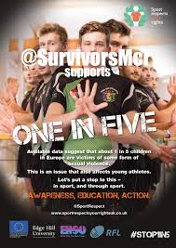
Caveats
Primary focus on sexual violence & protecting children
Unclear how/whether procedures in place are monitored
Effectiveness of strategies is unknown
Sport-specific strategies needed to attract stakeholder ‘buy in’
More needs to be done to involve children
Melanie.Lang@edgehill.ac.uk
Notes:
Primary focus on sexual violence
Tick-box exercise?
Unclear how/whether procedures in place are monitored – tick box exercise?
Effectiveness of strategies is unknown
Sport-specific strategies most likely to attract stakeholder ‘buy in’
More needs to be done to involve children

Slide 19
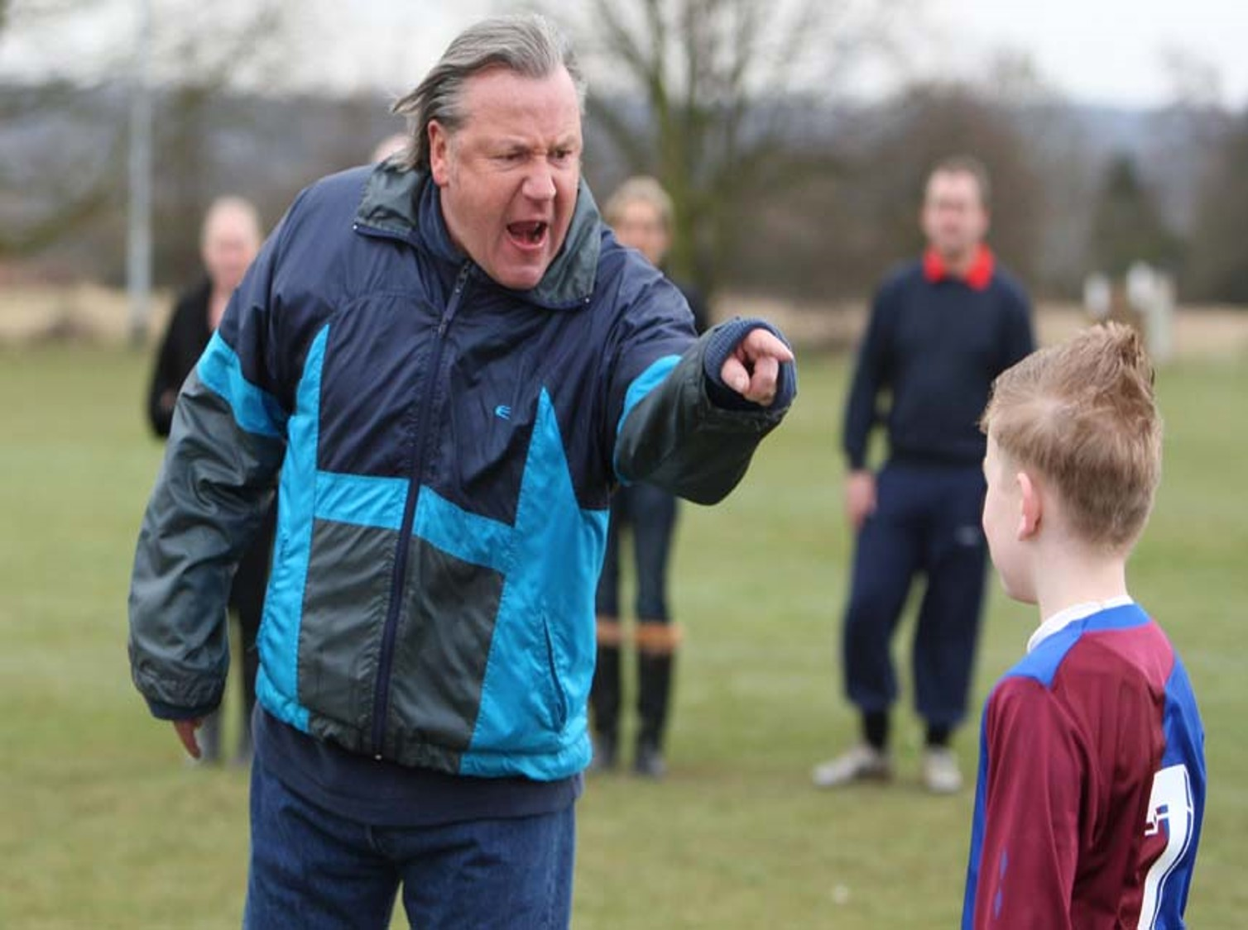
Recommendations
More research is needed on IV in sport:
Quantitative & qualitative
All forms of IV
Across all sports & all levels of sport
Adult & child ‘victims’
Melanie.Lang@edgehill.ac.uk
Notes:
More research on IV is needed in sport
Quantitative & qualitative – prevalence & experience, evaluation
All forms of IV – individual modes & intersecting modes
Across all sports
Focus on adults & children
Focus on sexual violence at expense of other forms and modes of IV
Focus on children’s experiences through retrospective studies
Focus on sexual violence at expense of other forms and modes of IV
Focus on children’s experiences through retrospective studies
Current focus on:
Football / male victims / most serious child sexual assaults
Other sports? / females? / spectrum of sexual violence?
Lack of systematic, robust data
prevalence data
reporting data
abusers …

Slide 20
Recommendations
Sports organisations need to:
Acknowledge the existence of IV in sport
Draw up and embed policies and procedures for adults AND children
Link implementation to funding
Monitor & evaluate implementation
Initiate vetting procedures (& recording) for all staff
Establish rigorous disciplinary measures for perpetrators
Develop links with statutory sector/offender management services
Develop a culture of openness & transparency
Melanie.Lang@edgehill.ac.uk

Slide 21
Alexander, K., Stafford, A. & Lewis, R. (2011). The experiences of children participating in organised sport in the UK. Edinburgh: The University of Edinburgh/NSPCC.
Allan, E. J., Kerschner, D. & Payne, J. M. (2018). College student hazing experiences, attitudes, and perceptions: Implications for prevention. Journal of Student Affairs Research and Practice, 56(1), 132-1748.
Bjørnseth, I. & Szabo, A. (2018). Sexual violence against children in sports and exercise: A systematic literature review. Journal of Child Sexual Abuse. 27 (4), pp. 365-385.
Child Protection in Sport Unit (2018). Standards for Safeguarding Children in Sport (3rd. edn). Leicester: CPSU.
Council on Scientific Affairs American Medical Association (1992). Violence against women. Relevance for medical practitioners. JAMA, 267, pp. 3184-3189.
Eisenstat, S. & Bancroft, L. (1999). Domestic violence. New England Journal of Medicine. 341, pp. 886-892.
Fasting, K. & Brackenridge, C., Knorre, N. (2010). Performance Level and Sexual Harassment Prevalence among Female Athletes in the Czech Republic. Women in Sport and Physical Activity Journal. 19(1), pp. 26-32.
Fasting, K., Chroni, S., Hervik, S.E., & Knorre, N. (2011). Sexual harassment in sport toward females in three European countries. International Review for the Sociology of Sport. 46, pp. 76-89.
Krug, E. G., Mercy, J. A., Dahlberg, L. L. et al. (2002). The world report on violence and health. The Lancet. 360, pp. 1083-1088.
Krug, E. G., Dahlberg, L. L., Mercy, J. A., Zwi, A. B. & Lozano, R. (Eds.) (2002). World Report on Violence and Health. Geneva: World Health Organsiation.
McCauley, J., Kern, D., Kolodner K., et al. (1995). The ‘battering syndrome.’ Prevalence and clinical characteristics of domestic violence in primary care internal medicine practices. Annals of Internal Medicine. 123, pp. 737-746.
Melanie.Lang@edgehill.ac.uk

Slide 22
Lang, M., Mergaert, L., Arnaut, C. & Vertommen, T. (forthcoming). Gender-based violence in EU sport: Prevalence and problems. European Sport Management Quarterly.
Lang, M., Mergaert, L., Arnaut, C. & Vertommen, T. (2018). Gender-based violence in EU sport policy: Overview and recommendations. Journal of Gender-based Violence. 2 (1), pp. 109-118.
Nery, M., Neto, C., Rosado, A. & Smith, P. (2018). Bullying in youth sport training: A nationwide exploratory and descriptive research in Portugal. European Journal of Developmental Psychology. DOI: 10.1080/17405629.2018.1447459.
Parent, S., Lavoie, F., Thibodeau, M.-È., Hébert, M., Blais, M., and members of the PAJ team. (2016). Sexual violence experienced in the sport context by a representative sample of Quebec teenagers. Journal of Interpersonal Violence. 31(16), pp. 2666-2686.
Timpka, T., Janson, S., Jacobson, J., Kowalski, J., Mountjoy, M. & Svedin, C. G. (2014). Lifetime sexual and physical abuse among elite athletic athletes: A cross-sectional study of prevalence and correlates with athletics injury. Presented at the IOC World Conference on Prevention of Injury & Illness in Sport, Monaco.
Waldron, J. J. (2015). Predictors of mild hazing, severe hazing, and positive initiation rituals in sport. International Journal of Sports Science and Coaching. 10(6), pp. 1089-1101.
World Health Organisation (2009). Violence Prevention Alliance: The VPA Approach. Retrieved from: https://www.who.int/violenceprevention/approach/definition/en/
World Health Organisation / UN Development Programme/ UN Office on Drugs & Crime (2014). Global Status Report on Violence Prevention 2014. Geneva: WHO/ UN Development Programme/ UN Office on Drugs & Crime. Retrieved from file:///C:/Users/user/Downloads/9789241564793_eng%20(1).pdf
Melanie.Lang@edgehill.ac.uk

