Slide 1
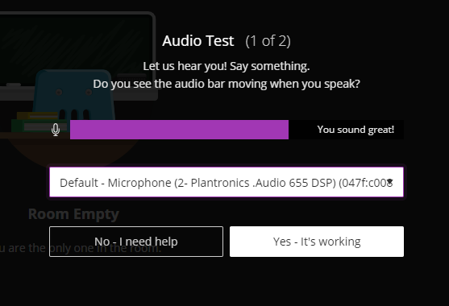


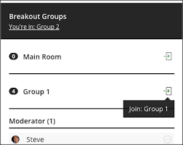
Welcome
Need to troubleshoot audio?
Open Settings in the Collaborate Panel, choose Audio and Video Settings
Select your preferred device and watch for the moving metre bar.
Want to speak?
Open the mic. Switch off afterwards.
Moving between group rooms?
Open the ‘attendee’ section in the Collaborate Panel
Enter your desired group room by clicking on the icon indicated

