Slide 1

Portfolio Tools in Learning Edge
Using Journals and Blackboard Portfolios
Notes:
We’ve had some requests to record this, so unless anyone would rather I didn’t record it and sent out the presentation slides instead, I’ll record the session.
Session Focus
In this session we will look at the Blackboard Portfolios and Blackboard Journals tools.
These are centrally supported, Learning Edge tools that have been used at Edge Hill to create ePortfolio, and for similar activities.
By the end of the session I hope you’ll have a better understanding of the capabilities of these tools, and be in a better position to make decisions about the tools you want to use.

Slide 2
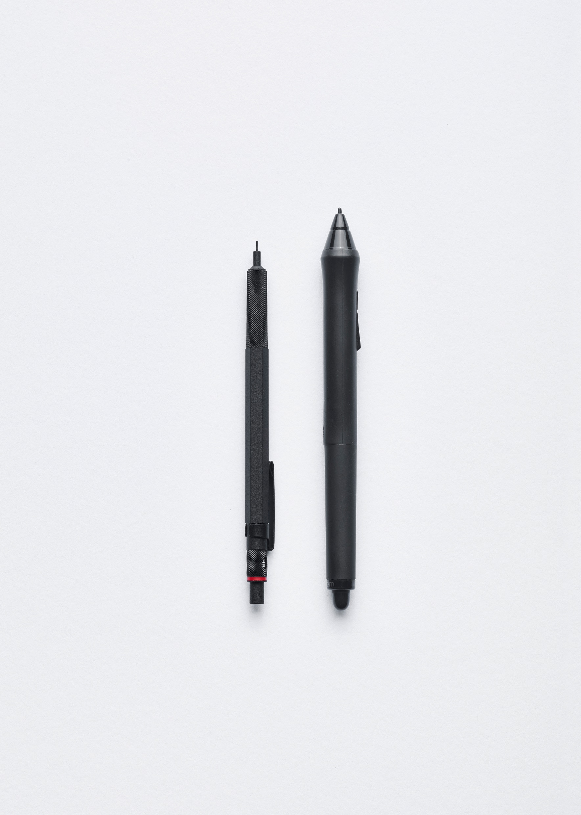
Software Tools
Blackboard Portfolios
Blackboard Journals
Microsoft OneNote
Google Sites
PebblePad
Word Documents
Notes:
Tools: There are a lot of reasons why you might be using Portfolios in education, and so the activities might benefit from different tools. It might be self-monitored reflection or part of a group activity. It might be formative, or summative. You might be asking the student to share the developing portfolio with you, or just want the final version submitted. It might be required for professional qualification, or not.
Portfolios is a portfolio tool which links to the Blackboard Grade centre, and allows snapshots of the portfolio to be shared with staff. Students have a lot of control over their portfolios, but at when they leave the institution they would have to download the portfolio as a zip file and take it away. It wouldn’t continue to be hosted for them.
Journals isn’t really a portfolio tool, it is rather like a blog tool that only staff and the student creating it can view. It can be graded, but is not really suitable for taking away afterwards. We’re including this in the session as sometimes people have asked us about Portfolio software, and found it was actually much easier to just use a simple tool like this for reflective writing.
The other tools are not ones we are looking at today, as I’ve little or know experience with them.
Microsoft OneNote and Google Sites are not Portfolio tools as such, but they do allow students to create and collect artefacts, and I’ve heard of them being used at the institution.
PebblePad is currently being used in the Medical school, and it enables a very wide range of activities, but is expensive and would need your faculty to be willing to invest in it.
You: So I think it’s important to know what you are wanting to get out of meeting today, so we can make sure we focus on those things. So, have you got plans to start using Portfolios, change current practice, or something else?
[Move on to Demos of Portfolios and Journals.]

Slide 3

Blackboard Portfolios
Staff - Creating a Portfolio Assignment
Students - Creating and Editing a Portfolio
Students - Submitting a Portfolio
Staff - Grading a Portfolio
Students - Viewing Marks
Students: Exporting a Portfolio

Slide 4

Blackboard Journals
Staff: Setting up a Journal
Students: Creating Posts
Staff: Grading and Commenting
Students: Accessing Grades and Comments
Students: Exporting work
Notes:
Staff: Setting up a Journal
By default it is just staff and the individual student who can access, but you can change the settings if you want to open it up later. // Marking? Can create a Grade Centre column. If you just want open writing though, you would use the Blog tool. // Due date – can students make changes after this? It looks like it, but students will know when the deadline is.
Students: Creating Posts
It’s the favourited course area. Enter ‘Create Journal Entry’. Add text and files. Can create multiple posts.
Staff: Grading and Commenting
Staff can access, click through the student’s posts, and add comments. If grading enabled you see the options on the right hand side. Can be multiple posts, and each can be commented on, but there is only one grade per Journal. For another graded activity, create a new Journal.
Students: Accessing Grades and Comments
Will just appear. Also appears to them in Marks if grades are on for the Journal.
Students: Exporting work
Not for exporting work. This would need doing manually, so isn’t really
Access on mobile: App and web
Works on the Blackboard app for students, so they could update where they have internet access.

Slide 5

Post Session Resources
Blackboard Portfolios
  Staff - Creating a Portfolio Assignment
  Students - Creating and Editing
  Students - Submitting a Portfolio
  Staff - Grading a Portfolio
  Students - Viewing Marks
  Staff Help Pages
  Student Help Pages
Blackboard Journals
  Staff Help Pages
  Student Help Pages

Slide 6

Image Credits
Vintage typewriter by Florian Klauer
Writing instruments by Florian Klauer
iPad by Leone Venter
Typing by Damian Zaleski
Watching by Annie Spratt
Photographer by Jordan Whitfield

