Slide 1

Developing ethical internationalisation of the curriculum and pedagogy
Dr Jenna Mittelmeier
Lecturer in International Education
The University of Manchester
20 October 2020
@JLMittelmeier

Slide 2
What is internationalisation?
@JLMittelmeier
‘…process of integrating an international, intercultural, or global dimension into the purposes, functions, or delivery of postsecondary education’
(Knight, 2004)

Slide 3
Curriculum internationalisation
@JLMittelmeier
“…the incorporation of an international and intercultural dimension into the content of the curriculum as well as the teaching and learning processes and support services of a program of study.
(Leask, 2009)

Slide 4
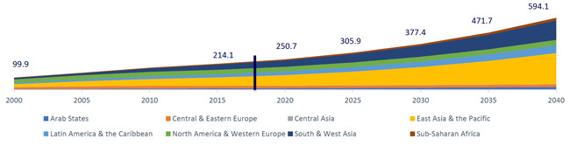
Why is this a topic of conversation?
@JLMittelmeier
Projections of worldwide international student number growth (ICEF, 2018)

Slide 5
What are (some of) the ethical tensions of internationalisation?

Slide 6
Ethical considerations for our work with international students
@JLMittelmeier
‘Diversity’ often equated with ‘nationality’
Homogenisation of THE ‘international student experience’
Binary division between ‘home’ and ‘international’ students
In more detail: Lomer, S. & Mittelmeier, J. (2020). Ethical challenges of hosting international Chinese students. In M. Natzler (ed). UK universities and China. Higher Education Policy Insititute. https://www.hepi.ac.uk/wp-content/uploads/2020/07/UK-Universities-and-China_HEPI-Report-132_FINAL.pdf

Slide 7
Ethical tensions for the curriculum
@JLMittelmeier
Skills development outside of content knowledge tends to be centralised (language centres, study skills, etc.)
Tendency to focus on additive measures rather than transformative
Tendency for inclusions to be performative rather than meaningfully engaged with

Slide 8
Mittelmeier (2017)
@JLMittelmeier
‘Home’
From students’ own backgrounds
Broadly ‘international’
Types of curricular content
Gave home students an advantage, but was more easily relatable and interesting to international students
Provided opportunities for intercultural discussion, but made some students feel uncomfortable
Led students to feel disconnected, more instances of discriminatory language

Slide 9
Ethical tensions for pedagogy
@JLMittelmeier
Tendency for discussions to focus on ‘adaptation’ (i.e. assumptions that students should ‘adapt’ to British-style learning)
Tendency to focus on what students are assumed to ‘lack’: participation, critical thinking, experience, etc.
Limited recognition or reflection on the cultural and historical educational values that shape students’ perceptions or contributions

Slide 10
‘Pedagogies of Internationalisation’
SRHE project – (Lomer & Mittelmeier, 2020)
@JLMittelmeier
Limited academic research about internationalisation that focuses specifically on pedagogy
Pedagogic research overwhelmingly to single-site case studies
Tendency for research in this area to focus on deficit narratives
Lack of systematic evidence about good practice for teaching in internationalised classrooms

Slide 11
What can universities do to take a more ethical approach to internationalisation?
10 suggestions

Slide 12
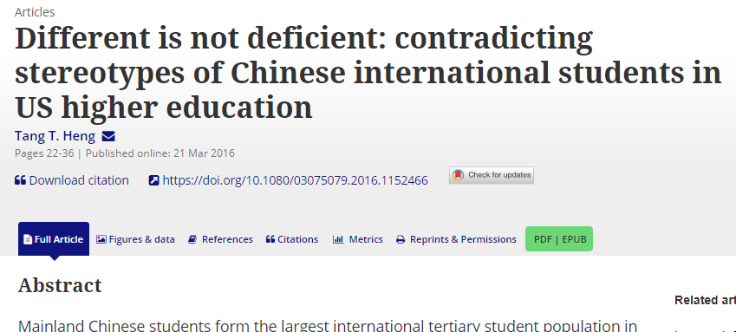
1) Disrupt the deficit model
@JLMittelmeier
Need for recognition and reflection on the underlying assumptions we have about international students’ skills and knowledges
Need for action to transform deficit approaches, such as by calling out deficit narratives in our conversations
https://www.tandfonline.com/doi/full/10.1080/03075079.2016.1152466

Slide 13
2)Dismantle the international / home student binary
@JLMittelmeier
International
Not international?
?
Jones (2017): https://www.tandfonline.com/doi/full/10.1080/03075079.2017.1293880

Slide 14
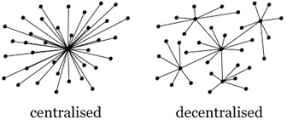
3) Decentralise support
@JLMittelmeier
Critical questions about:
Why are support systems segregated into different departments?
How can experts in different areas work together to develop a decentralised approach to support?
Why are some supports separated for international and home students?

Slide 15
4) Recognise intersectionality
@JLMittelmeier
Tendency for other facets of international students’ identities to be ignored:
  Race
  Gender
  Socioeconomic status
  Disability
  Religion
  Caring responsibilities
  (and more)

Slide 16
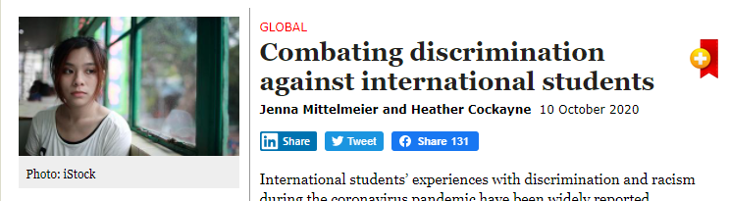
5) Address discrimination and racism
Developing and supporting faculty roles around workload allocation for anti-racism initiatives that include international students
Inclusion of international student representatives on equality and diversity committees;
Staff training and reflection to identify and act on micro-aggressions witnessed in the classroom and on campus;
Co-creating with students culturally sensitive mechanisms for disclosing instances of discrimination and racism, with explicit policies for acting on disclosures;
Continued funding and resources for international societies and campus events that promote intercultural engagement;
Resources and commitment to internationalising the curriculum and support for teaching approaches that meaningfully include international students and promote intercultural interaction; and
Engagement with wider communities and local businesses around issues that affect students’ experiences off-campus.
https://www.universityworldnews.com/post.php?story=20201009142439903

Slide 17
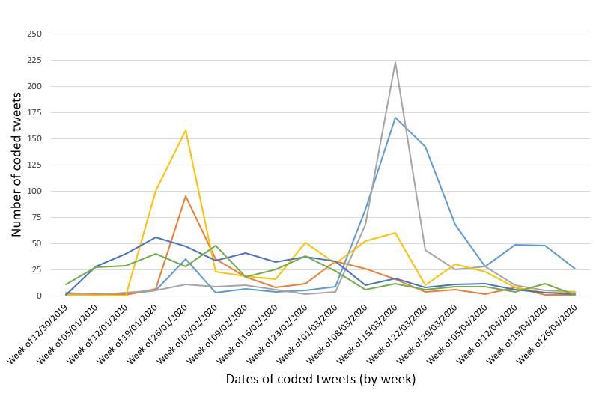
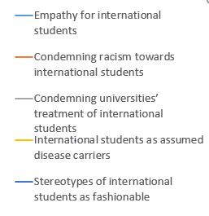
Thematic analysis of social media posts about international students post-COVID (Mittelmeier & Cockayne, under review)
Pre-print: https://papers.ssrn.com/sol3/papers.cfm?abstract_id=3703604#references-widget
@JLMittelmeier
@h_cockayne

Slide 18
6) Support meaningful social interactions
@JLMittelmeier
International students are often:
  Less likely to report having social relationships with home students
  (Gareis, 2012; Rienties et al., 2013; Heliot et al., 2019)
  More likely to encounter stereotypes compared to home students (Ruble & Zhang, 2013; Imamura et al., 2016)
  Often perceived by their peers as ‘less assimilated’ (Imamura & Zhang, 2014)

Slide 19
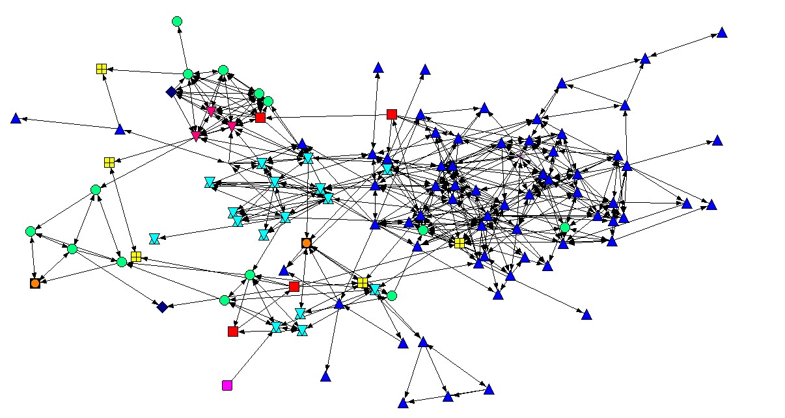
Patterns of social division
Example from a UK classroom:
(Mittelmeier, 2017; follow up work Heliot, Mittelmeier, & Rienties, 2020)
@JLMittelmeier

Slide 20
7) Decolonise and internationalise the curriculum
@JLMittelmeier
Useful reflection tool for internationalisation: https://srhe.tandfonline.com/doi/abs/10.1080/14703297.2017.1386118
Decolonisation toolkit from SAOS: https://blogs.soas.ac.uk/decolonisingsoas/files/2018/10/Decolonising-SOAS-Learning-and-Teaching-Toolkit-AB.pdf
‘Adding a few readings from non-Western scholars to reading lists or adding a section of the course on “race” is a shallow interpretation of the decolonial agenda.’
(Laing, 2020, p. 6)

Slide 21
8) Transform our teaching practices
@JLMittelmeier
Considering opportunities for:
Developing students’ “critical consciousness” (Freire, 1970)
Questioning the underlying cultural assumptions of our pedagogies
Developing opportunities for students to drive the direction of the conversation

Slide 22
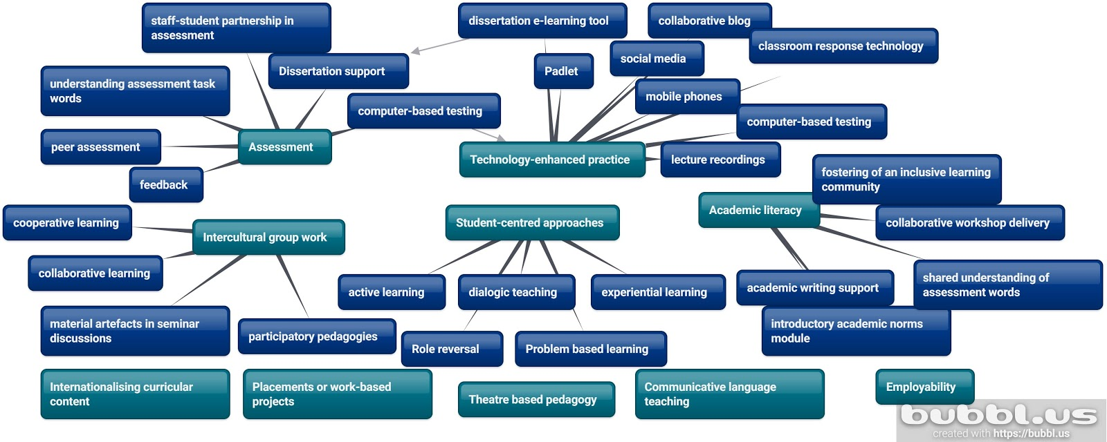
9) Develop evidence for pedagogies
@JLMittelmeier
from Lomer & Mittelmeier (under review)

Slide 23
10) Engage with local communities
@JLMittelmeier
Growing polarisation of views towards international students:
UK: Majority of the public believe (58%) the UK should continue competing for international students, while a sizable minority (19%) wish to see numbers decrease (UUK, 2018).

Slide 24
Some takeaway messages…
@JLMittelmeier
Internationalisation is about more than just the presence of international students
Internationalisation brings questions of ethics and inclusivity
Internationalisation is, at its very core, a transformative rather than additive approach

Slide 25
Readings for critical internationalisation: Some good starting points
@JLMittelmeier
Buckner, E., & Stein, S. (2020). What Counts as internationalization? Deconstructing the internationalization imperative. Journal of Studies in International Education, 24(2), 151–166. https://doi.org/10.1177/1028315319829878
Gayton, A. M. (2019). Exploring the widening participation-internationalisation nexus: evidence from current theory and practice Exploring the widening participation-internationalisation nexus: evidence from current theory and practice. Journal of Further and Higher Education https://doi.org/10.1080/0309877X.2019.1678014
Heng, T. T. (2018). Different is not deficient: Contradicting stereotypes of Chinese international students in US higher education. Studies in Higher Education, 43(1), 22-36. https://doi.org/10.1080/03075079.2016.1152466.
Jones, E. (2017). Problematising and reimagining the notion of ‘international student experience’. Studies in Higher Education, 42(5), 933-943. https://doi.org/10.1080/03075079.2017.1293880
Madge, C., Raghuram, P., & Noxolo, P. (2014). Conceptualizing international education: From international student to international study. Progress in Human Geography, 39(6), 681-701. https://doi.org/10.1177/0309132514526442
Madriaga, M., & McCaig, C. (2019). How international students of colour become Black: a story of whiteness in English higher education. Teaching in Higher Education. https://doi.org/10.1080/13562517.2019.1696300
Rizvi, F. (2019). Global interconnectivity and its ethical challenges in education. Asia Pacific Education Review, 20(2), 315–326. https://doi.org/10.1007/s12564-019-09596-y
Stein, S. (2019). Critical internationalization studies at an impasse: making space for complexity, uncertainty, and complicity in a time of global challenges. Studies in Higher Education. https://doi.org/10.1080/03075079.2019.1704722

Slide 26
Contact Information:
Jenna Mittelmeier
Lecturer in International Education
University of Manchester
jenna.mittelmeier@manchester.ac.uk
Twitter: @JLMittelmeier

