Slide 1
Returning to Catalyst
September 2020

Slide 2
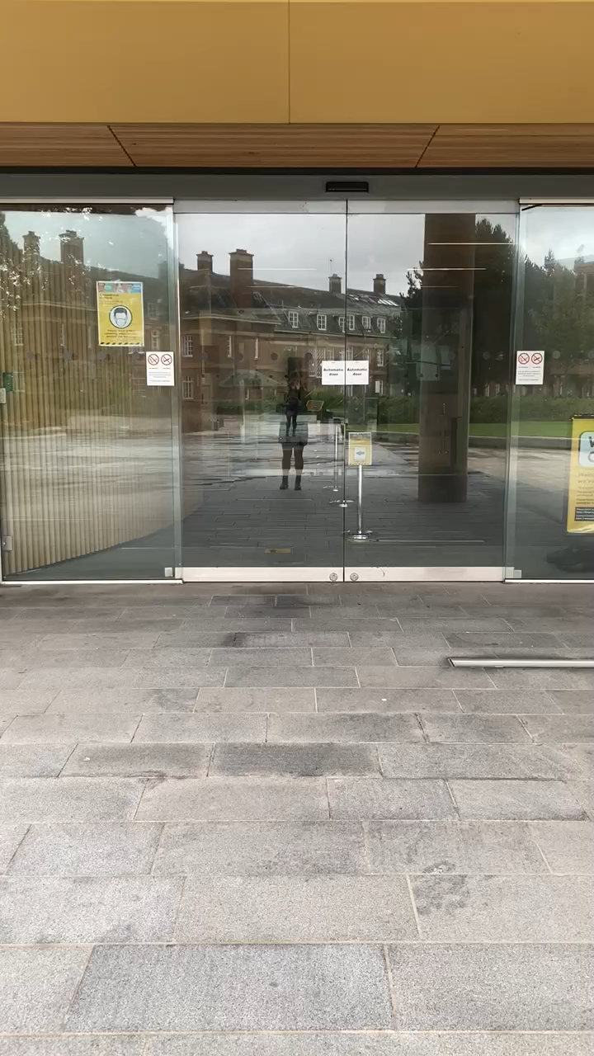
Main Entrance
All staff and students will be required to swipe in and swipe out of the building.
The lenel system will monitor the capacity in the building and stop access to students once we hit capacity.
Catalyst staff will be able to gain access even when the building is at capacity.
There is hand sanitiser at the entrance/exit of the building
Watch the video

Slide 3
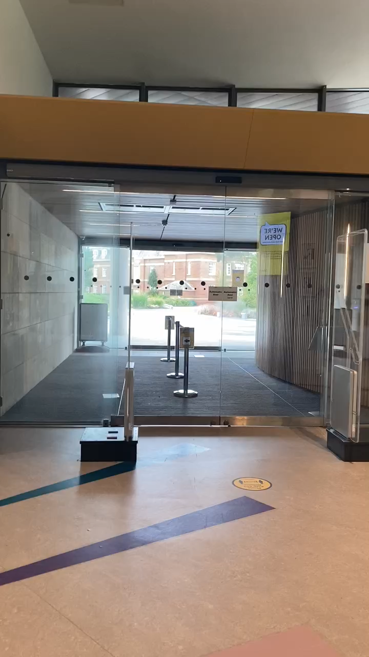
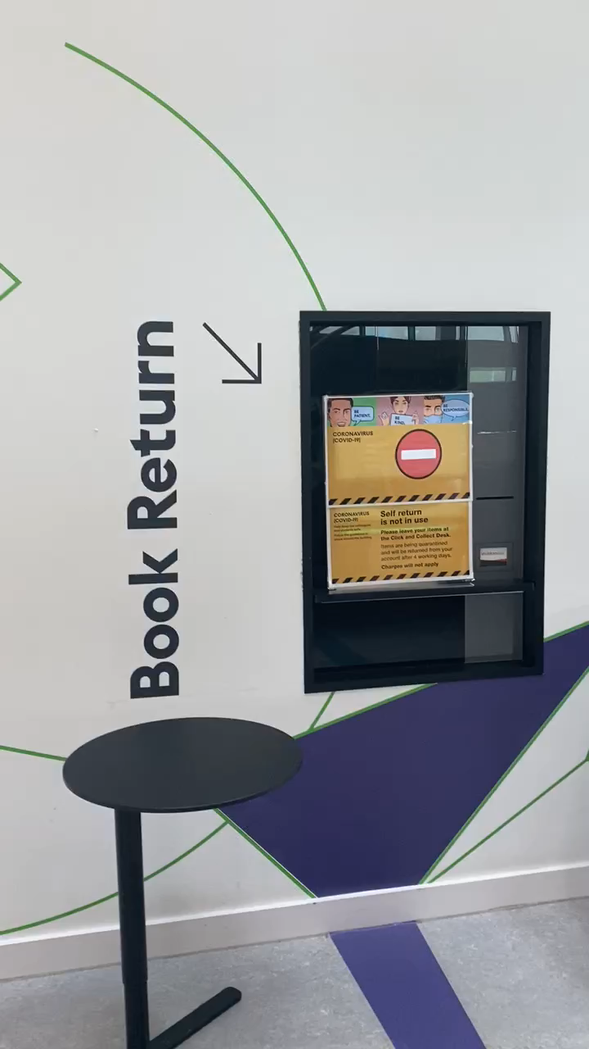
Ground Floor
We are currently offering a temporary Click & Collect Service for students.
The Click and Collect desk is situated to the right of the main entrance.
Returned book stock will be quarantined for 72 hours before being processed and the 3 group rooms on the ground floor are being used to store the quarantined books.
Watch the videos

Slide 4
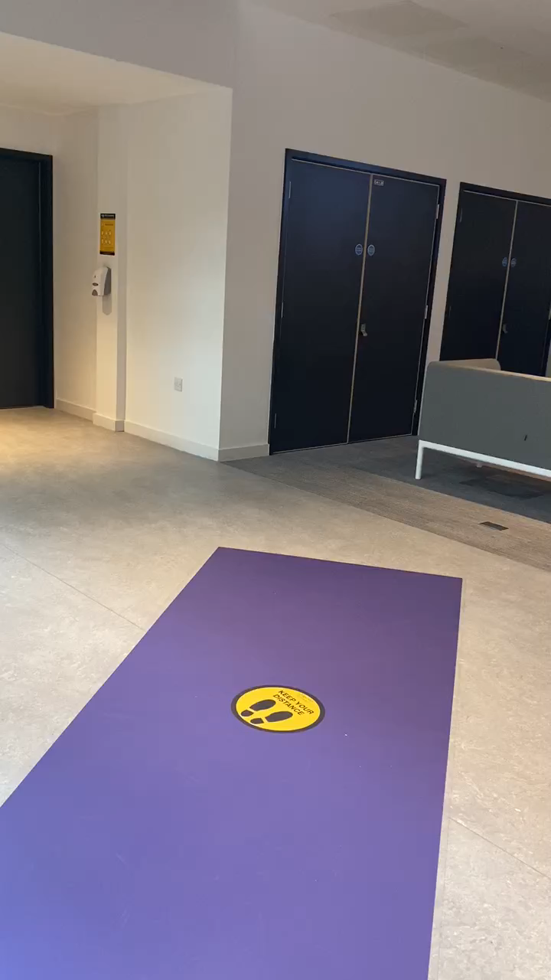
Staff Office 1st Floor
The 1st floor staff office will operate a one-way system for entry and exit.
Entry to the office is via the set of doors across the stairwell walkway.
To exit the office please use the doors near the accessible toilet.
Social distancing measure are in place within the office.
Watch the video

Slide 5
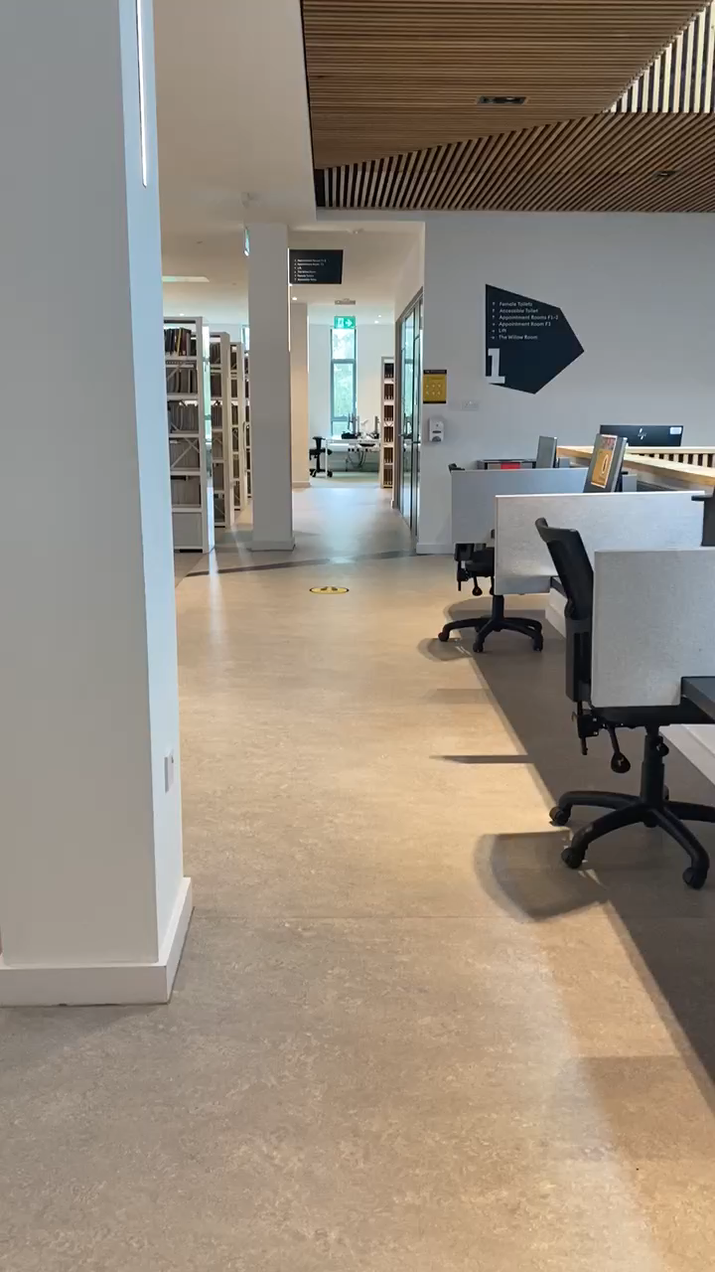
Staff room
The staff room on the 1st floor has a reduced capacity. A max. of 8 people at one time.
There is seating for 5 people at tables
1 person can sit in the soft seating area.
2 people at the sink/cupboard area.
FM have provided blue roll to dry hands/items
Watch the video

Slide 6
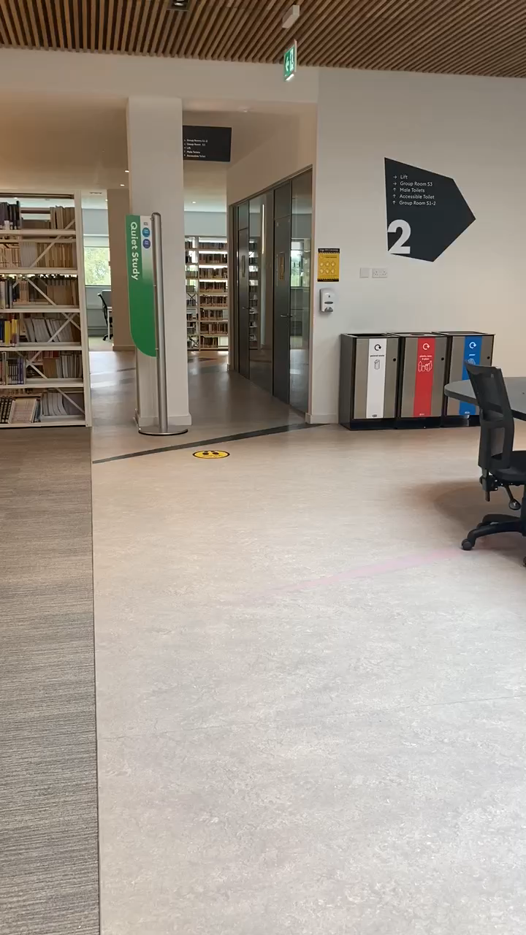
Staff Office 2nd floor
The 2nd floor staff office has been split in half.
Colleagues in Academic Engagement and LTD will use the door closest to the accessible toilet.
Colleagues in CAT and XX will use the door closest to the lift.
If you need to you use the kitchen, you will be required to follow the one way system.
Watch the video

Slide 7

See you soon!

