Slide 1

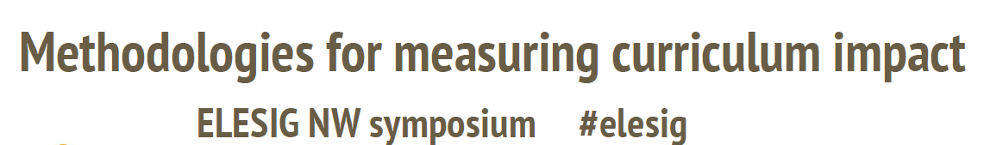


29th May 2018
Creating and Measuring the Future
Professor Gilly Salmon
Professor of Innovation & Transformation
Associate Dean, Online

Slide 2


Slide 3

Carpe Diem
Learning Design

Slide 4
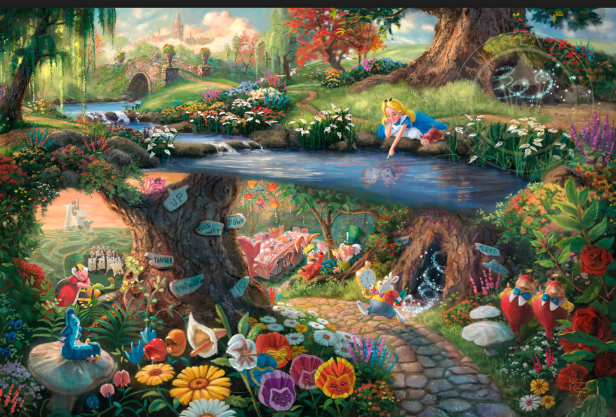
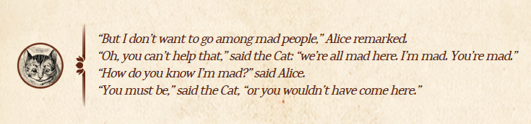
"Would you tell me, please, which way I ought to go from here?“
  "That depends a good deal on where you want to get to," said the Cat.
  "I don't much care where—" said Alice.
  "Then it doesn't matter which way you go," said the Cat.
  "—so long as I get SOMEWHERE," Alice added as an explanation.
  "Oh, you're sure to do that," said the Cat, "if you only walk long enough."

Slide 5
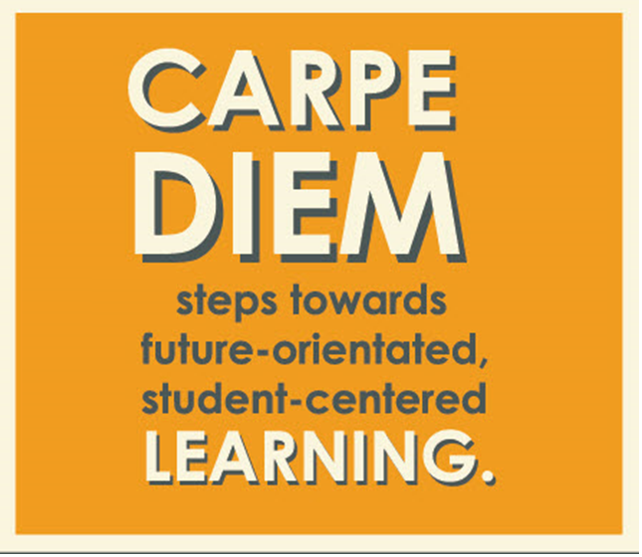

For modules
Modules & Programmes:
6 steps

Slide 6
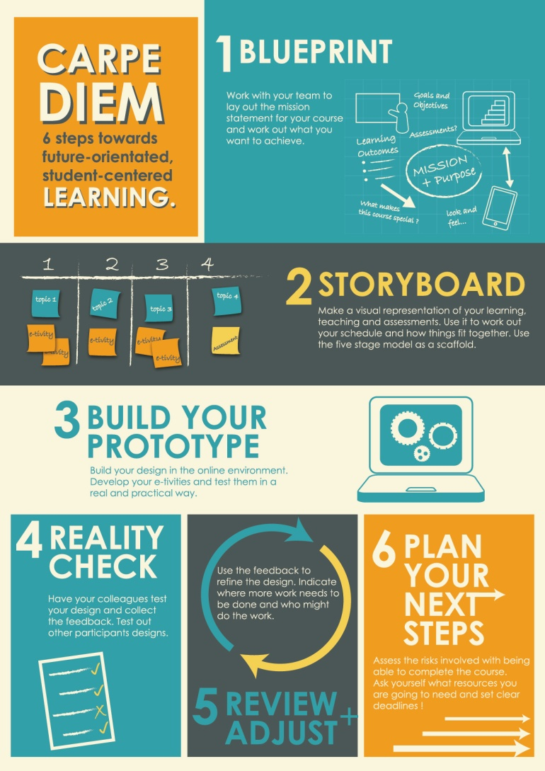
Carpe Diem for modules
Incorporates 5 stage model
& e-tivities

Slide 7
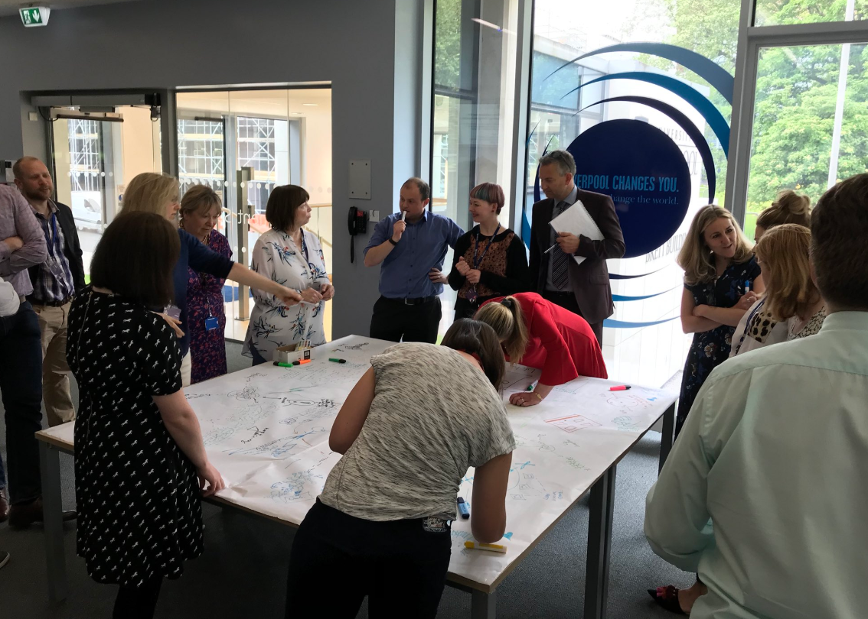

Slide 8
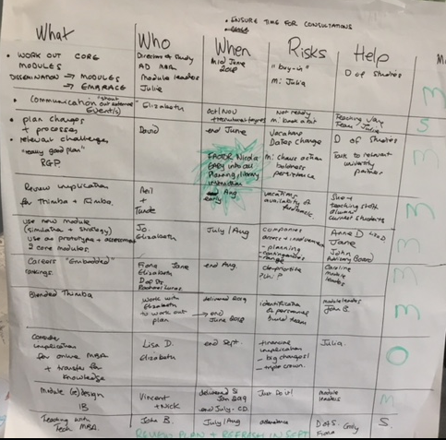

Slide 9
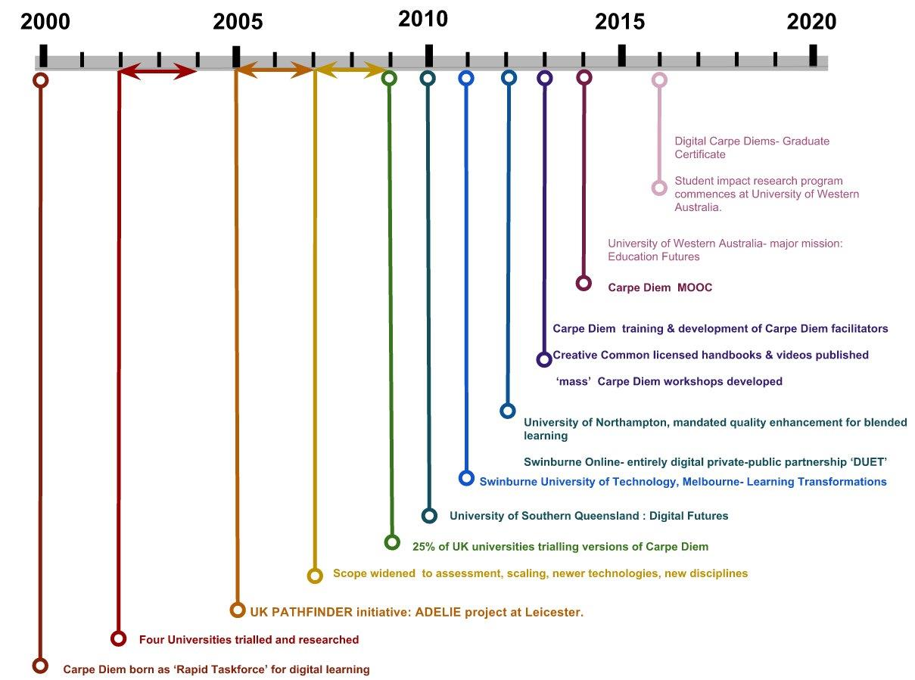
400 Carpe Diems completed across all disciplines and for special purposes e.g. introduction of Learning Analytics and for innovative research
Carpe Diems in place in the Management School at Liverpool for ‘jobs of the future’ curriculum’
Programme Carpe Diem developed in South Africa

Slide 10
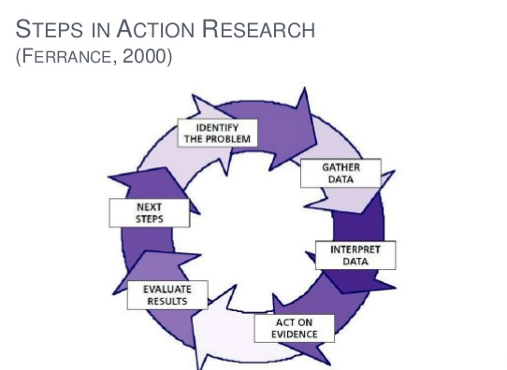

Slide 11
Sector
Institution
Faculty
Creating new ways : Innovation
Programme
Enabling new ways
Course
Pointing the way
Individual

Slide 12
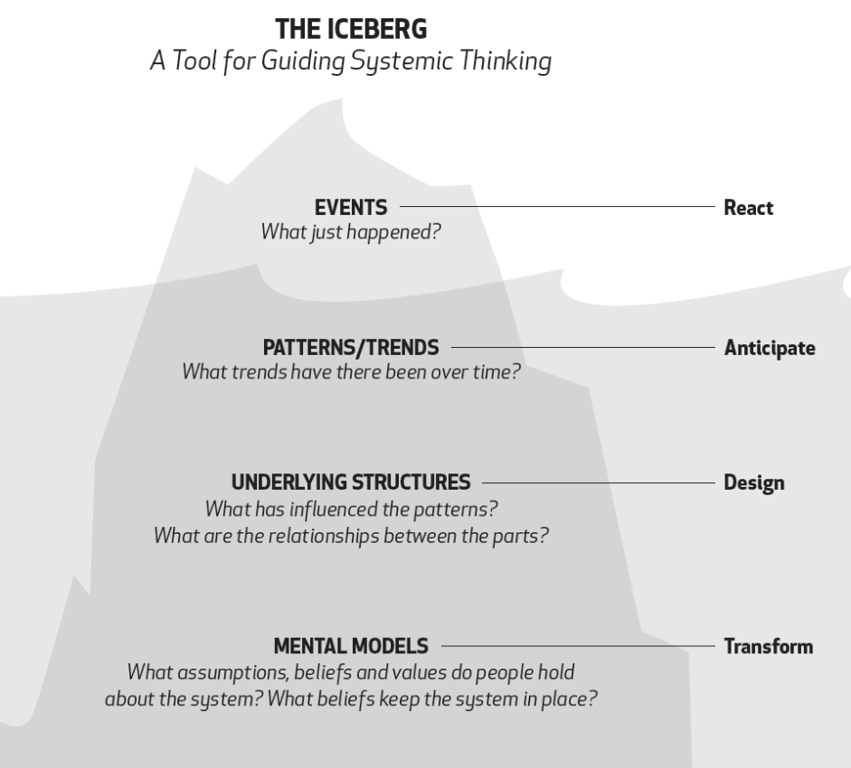
www.nwei.org/iceberg

Slide 13
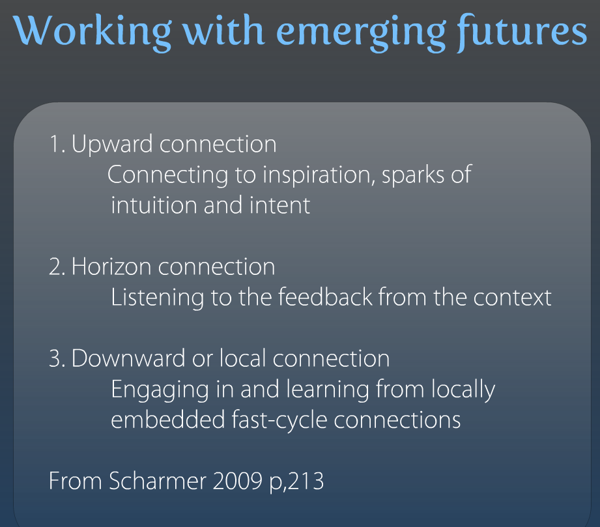

Slide 14

“Those who pursue what may at first seem impossible are the ones who keep the world turning.”
(Ghandi)
“Every society honours its live conformists and its dead troublemakers.“
Mignon McLaughlin
:
“If you don’t like change,
you’re going to like irrelevance even less.”
Eric Shinsek
,
Gillysalmon.com/learningfutures
No budgets or humans were harmed in the making of this presentation

Slide 15
Carpe Diem: some Publications & Papers
Armellini, A., & Aiyegbayo, O. (2010). Learning design and assessment with e-tivities. British Journal of Educational Technology, 41(6), 922-935. doi: 10.1111/j.1467-8535.2009.01013.x
Armellini, A., & Jones, S. (2008). Carpe Diem: Seizing each day to foster change in e-learning design. Reflecting Education, 4(1), 17-29. http://tinyurl.com/58q2lj
Armellini, A., & Nie, M. (2013). Open educational practices for curriculum enhancement. Open Learning, 28(1), 7-20. doi: 10.1080/02680513.2013.796286
Armellini, A., Salmon, G., & Hawkridge, D. (2009). The Carpe Diem journey: Designing for learning transformation. In T. Mayes, D. Morrison, H. Mellar, P. Bullen, & M. Oliver (Eds.), Transforming higher education through technology-enhanced learning (pp. 135-148). York: The Higher Education Academy. http://bit.ly/1XL7ncN
Lokuge Dona, K.L., Gregory, J., Salmon, G., & Pechenkina, E. (2014). Badges in the Carpe Diem MOOC. Paper presented at the ascilite conference, Dunedin, New Zealand, 23-26 November 2014.
Salmon, G. (2013). E-tivities: the key to active online learning (2nd ed.). London and New York: Routledge. See especially Chapter 4.
Salmon, G., Jones, S., & Armellini, A. (2008). Building institutional capability in e-learning design. ALT-J, Research in Learning Technology, 16(2), 95-109. doi: 10.1080/09687760802315978
Salmon, G., Gregory, J., Lokuge Dona, K., & Ross, B. (2015). Experiential online development for educators: The example of the Carpe Diem MOOC. British Journal of Educational Technology, 46(3), 542-556. doi: 10.1111/bjet.12256
Salmon, G., & Wright, P. (2014). Transforming teaching through Carpe Diem learning design. Education Sciences, 4, 52-63. doi: 10.3390/educsci4010052
Usher, J., MacNeill S.,Creanor, L. (2018) Evolutions of Carpe Diem for learning design. Journal of Learning and Teaching, Vol. 46 (1)
Wright, P. (2015) Comparing e-tivities, e-moderating, and the 5 Stage model to the community of inquiry model for online learning design. The Online Journal of Distance Education and e-Learning, April 2015 Volume 3, Issue 2

Slide 16
References, with thanks
www.brown.edu/academics/education-alliance/sites/brown.edu.academics.education-alliance/files/publications/act_research.pdf
Ferrance 2000
Theory U: Leading from the Future as It Emerges 2016 2nd Ed, Otto Scharmer.

Slide 17
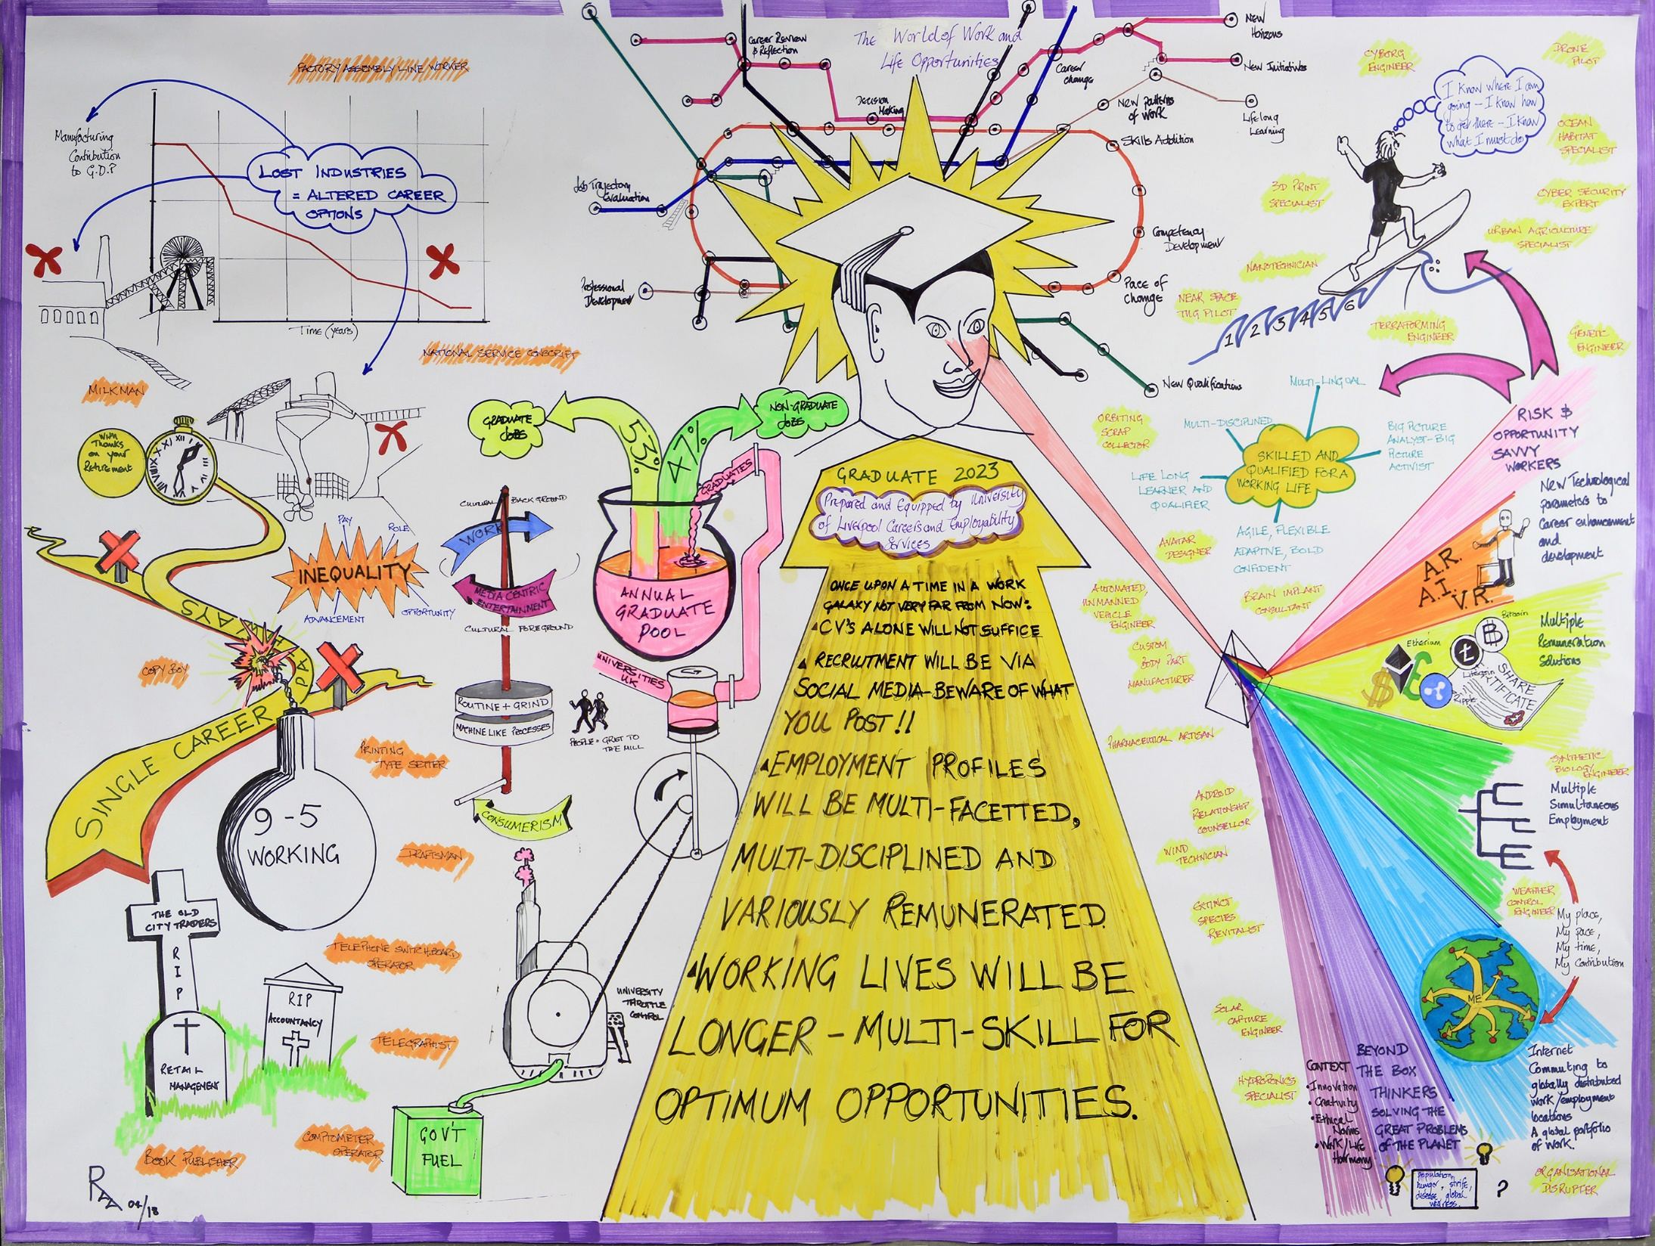

Programmes:
4 steps

Slide 18
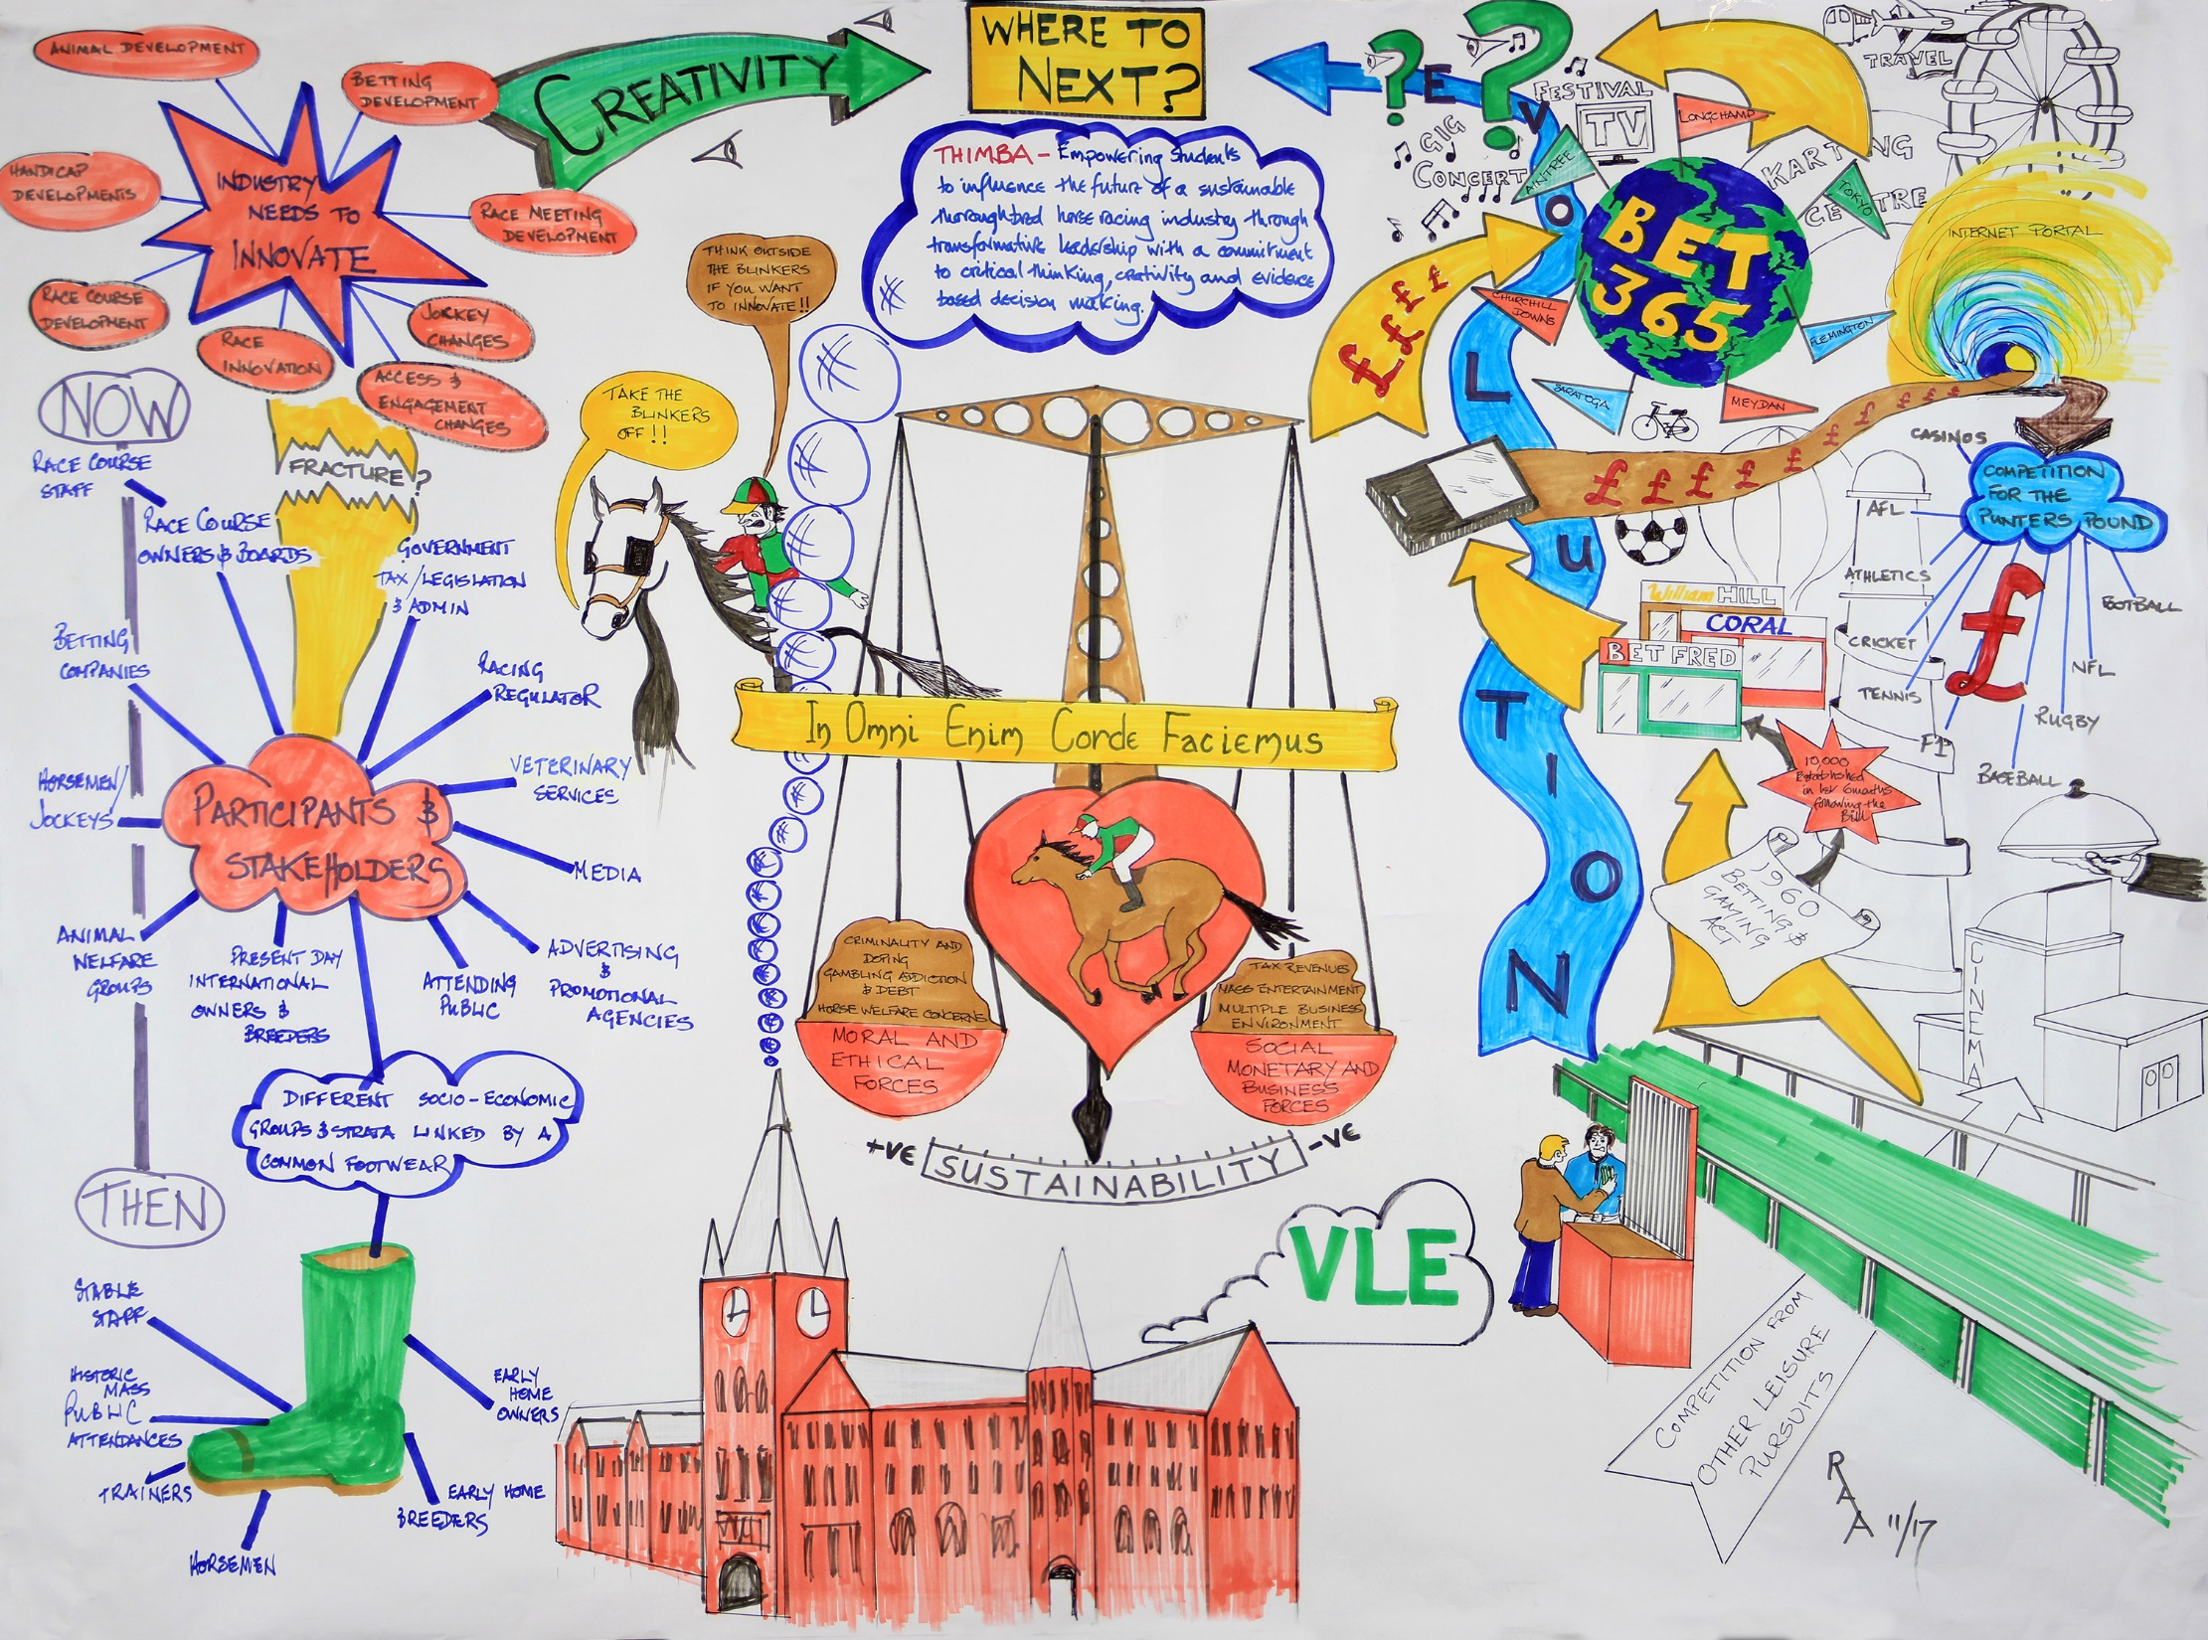
Programmes:
4 steps

Slide 19
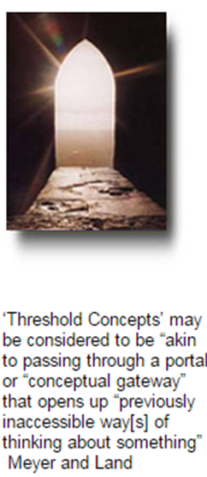
Threshold knowledge
: the ‘right of passage’
Scaffolding knowledge:
core concepts that once understood, transform perception of a subject

Slide 20
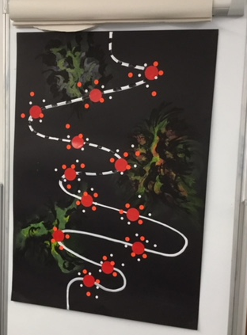
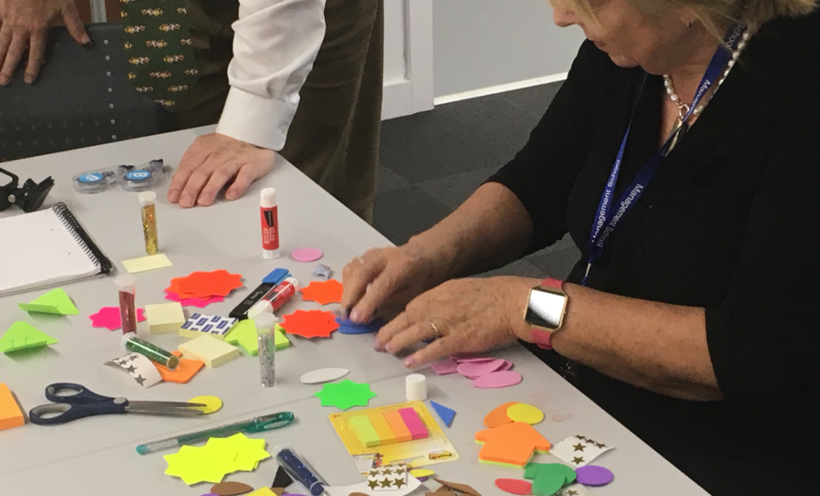
Digital @ ULMS

Slide 21
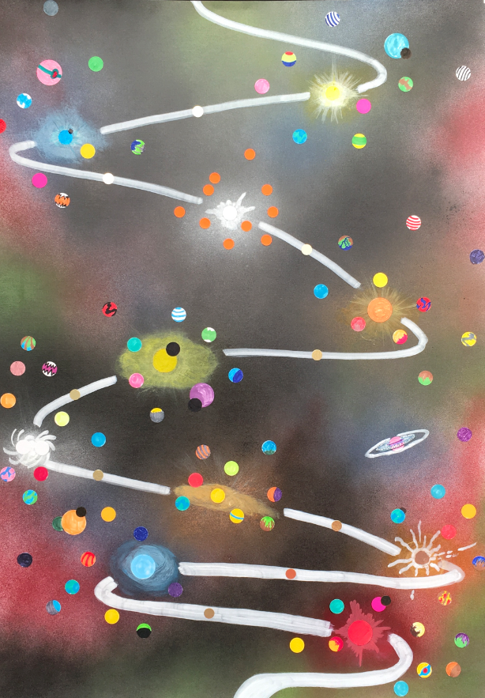
Developing your Programme Story Board V3
‘Star Gates’
(threshold concepts)

Slide 22
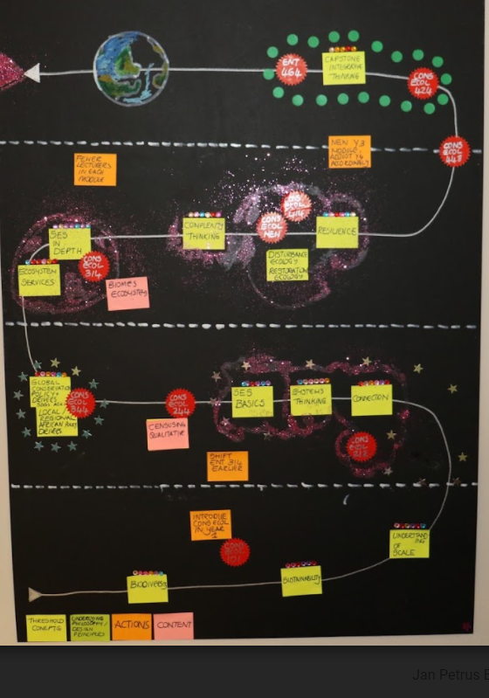

Slide 23
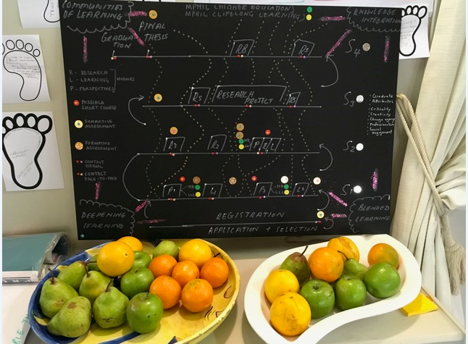

Slide 24
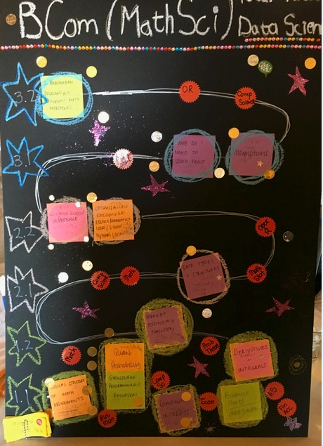

Slide 25
