Slide 1
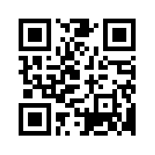
The BIG Debate: “The glass ceiling is shattered: women are equal in the workplace” Come and have your say: scan the QR code below or register at http://www.keele.ac.uk/medicine/newsevents/ 12th October 2016, 5.30pm, CEC
Keele School of Medicine & ISTM Present
Guest speaker: Dr Jenny Myers, Ph.D, MRCOG
Clinical & Research Lead, University of Manchester
Free Pizza!
Everyone welcome

