Slide 1
The Practice of social research
Dr victoria foster
October 2017

Slide 2
Session aims
To discuss some of the key stages of social research practice:
reading
project design
ethical considerations
data collection
analysis
writing up
To explore some of the less discussed – but vitally important – elements of doing research:
Creativity
Self reflection
Self discipline
Dialogue with self and others
Interpersonal skills
To consider how these apply to your own projects and lives

Slide 3
The text books
‘Such books may be useful for those who happen to believe that research can be practised or taught according to a narrow understanding of its process and place in society. Nevertheless, practitioners who actually interact with co-participants in the process of research can then be left totally unprepared, while the imagination that is so important to the scientific enterprise cannot be taught through the contents of any one book.’
(may 2011, p.271-2)

Slide 4
Research Is neither a linear nor a tidy process
reading
project design : Questions/ Methodology/ theory
ethical considerations
data collection: dealing with gatekeepers, recruitment, consent, unreliable participants
analysis: transcription and use of data analysis software
writing up

Slide 5
Keep a research diary
Image credit: Jolson.typepad.com

Slide 6
Critical thinking, Reflection and reflexivity
Critical thinking Means asking questions
What? How? When? Where? Who? WHY?
What if…? What next…? So what…?
Not taking things for granted
Considering how political and social forces shape values, assumptions, judgements and beliefs

Slide 7
Reflection
Reflection is concerned with thoughtful questions about something you want to understand. This might be difficult because:
It might require changing deeply held beliefs
It is hard to admit we have been wrong
It Can involve ‘loss of… an element that made a part of what you were’ (Roffey-Barentsen and Malthouse cited in Bolton 2014, p8)
Doubt and uncertainty are frightening
Easy to dismiss as a waste of time – ‘soft and fluffy’, feminine

Slide 8
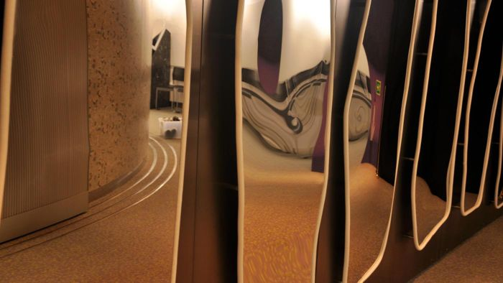
reflexivity
Reflexivity – a deeper, more philosophical form of reflection that requires thinking about one’s position in the world; how our presence shapes knowledge and actions
‘Reflexivity involves entering a hall of mirrors that illuminates a social phenomenon from many angles’ (riessman 2015, p233)
Photo Credit: tc397 E+ Getty Images

Slide 9
reflexivity
‘Often condemned as apolitical, reflexivity, on the contrary can be seen as opening the way to a more radical consciousness of self in facing the political dimensions of fieldwork and constructing knowledge. Other factors intersecting with gender – such as nationality, race, ethnicity, class and age – also affect the anthropologist’s field interactions and textual strategies. Reflexivity becomes a continuing mode of self analysis and political awareness’ (callaway cited in riessman 2015, p230).

Slide 10
Ethical considerations
Be thoughtful - and reflexive - about research ethics
Should not just be a tick box exercise
Think about what you’re ‘taking’ from participants
What are you giving back?
Think about the interpersonal skills you might need to make the experience a positive one for participants

Slide 11
Data collection
dealing with gatekeepers, recruitment, consent, unreliable participants…..
Keep calm and find solutions to obstacles
Write about it all in your research diary
Develop ‘people’ skills and do not take people for granted or see them as pawns in your research project
Careful listening is the key – see les back’s (2007) ‘the art of listening’ for a meditation on the importance of attending to the seen and unseen

Slide 12
Reading and dialogue
“Reading is dialogue with oneself; it is self-reflection, which cultivates profound humanity. Reading is therefore essential to our development. It expands and enriches the personality like a seed that germinates after a long time and sends forth many blossom-laden branches. People who can say of a book ‘this changed my life’ truly understand the meaning of happiness. Reading that sparks inner revolution is desperately needed to escape drowning in the rapidly advancing information society. Reading is more than intellectual ornamentation; it is a battle for the establishment of the self, a ceaseless challenge that keeps us young and vigorous.”
DAISAKU IKEDA (2007) ‘Buddhism Day By Day’

Slide 13
Creativity and procrastination
- you are creating a project and creating a contribution to knowledge
Creativity comes arm in arm with anxiety
Creativity needs feeding
Procrastination: EXPECTANCY x VALUE / IMPULSIVENESS x DELAY = MOTIVATION (siegel 2010)
Set small achievable goals
the compound effect

Slide 14
Exercise: one idea
Is there one idea or one issue that particularly stood out for you as I spoke?
Something that inspired you or annoyed you or made you consider something you hadn’t previously though about? Something that worried you or you feel confident about?
What was it? Why do you think it provoked a reaction? How might it relate to your research?
[If there was nothing that you gained from the lecture then why was that?]

Slide 15
Reference list
Back, les (2007) The Art of Listening. Oxford: Berg
Bolton, gillie (2014) Reflective Practice: Writing and Professional Development. London: sage.
Ikeda, daisaku (2007) Buddhism Day by Day: Wisdom for Modern Life. santa Monica: Middleway press
May, Tim (2011) Social research: Issues, Methods and Research. 4th edition. Maidenhead: Oup
Riessman, Catherine kohler (2015) ‘entering the hall of mirrors: reflexivity and narrative research’. In de fina, anna and georgakopoulou, Alexandra (eds) The Handbook of Narrative Analysis. Chichester: john wiley and sons.Pp219-235
Siegel, Daniel j. (2010) mindsight: the new science of personal transformation.oxford: Bantam.

