Slide 1
Communicating in Lay Terms
Dr Linda K. Kaye
Department of Psychology
Linda.kaye@edgehill.ac.uk

Slide 2
Overview
By the end of the session, we should have:
1. Developed an understanding of the skills involved in writing and communicating to non-academic audiences
2. Developed an understanding of the mechanisms of outreach and promotion of research to the public and wider scientific community

Slide 3
Some background

Slide 4
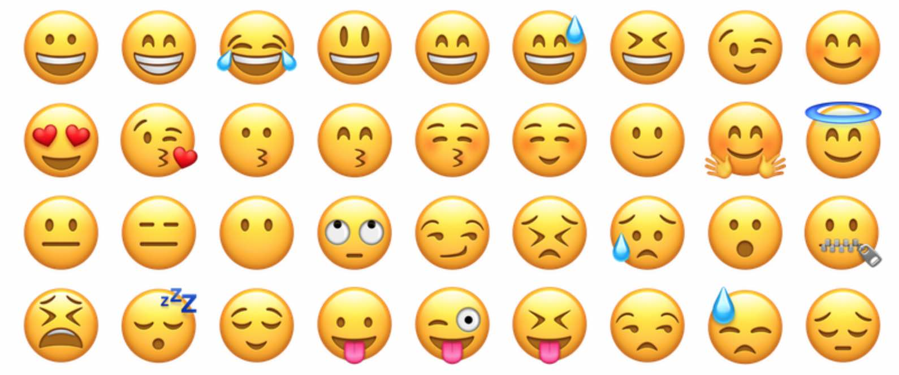

Slide 5
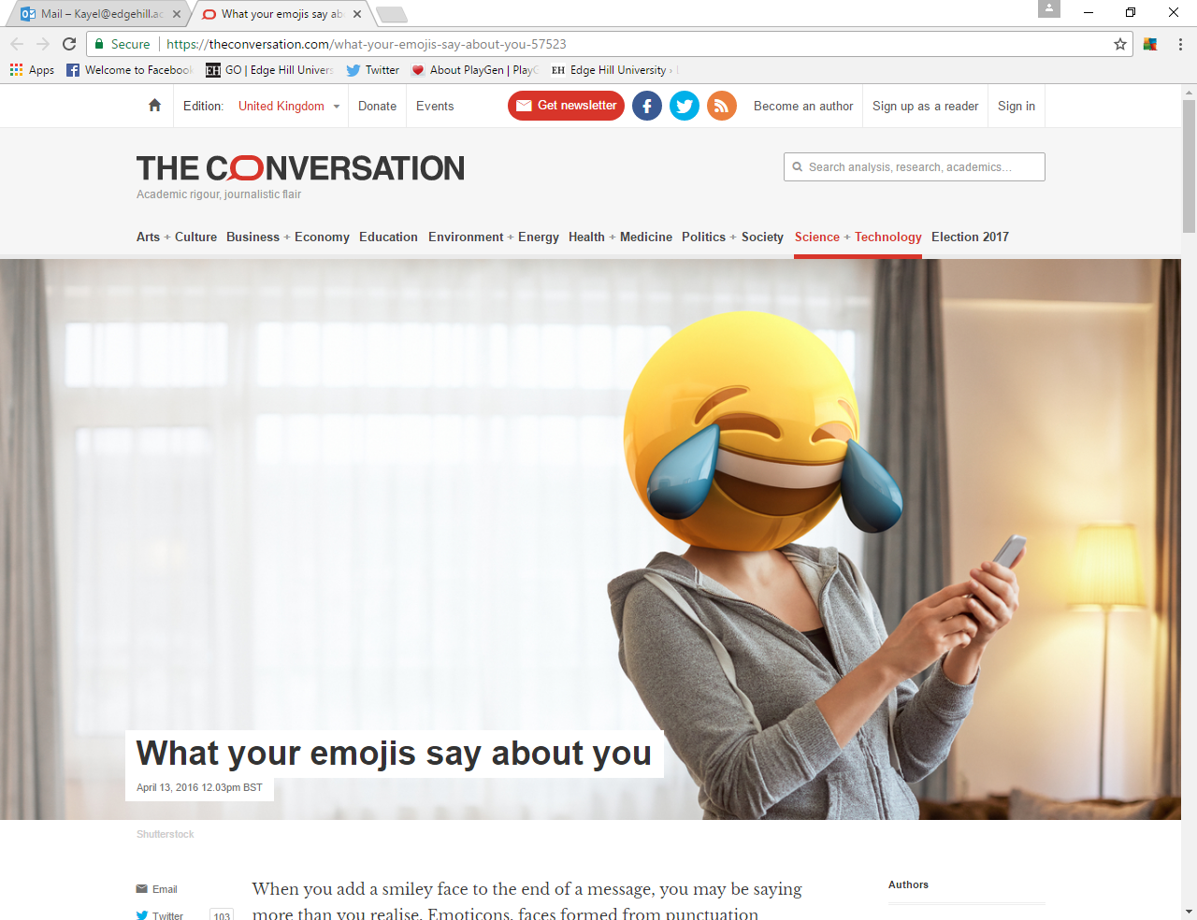

Slide 6
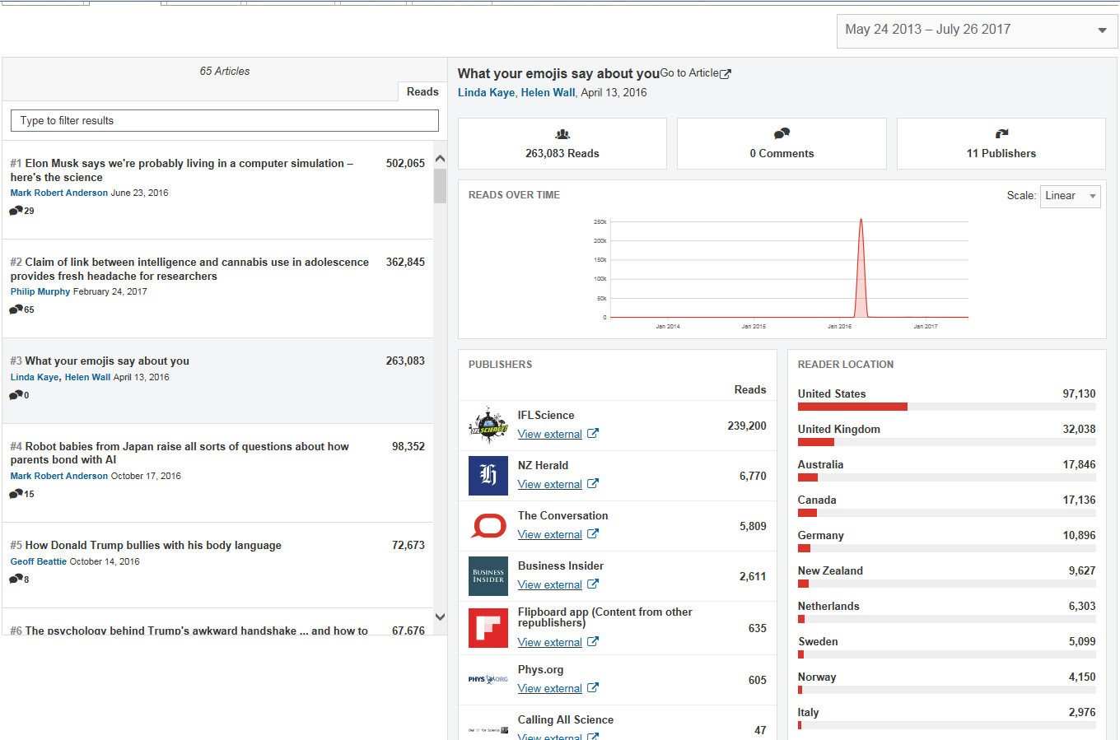

Slide 7
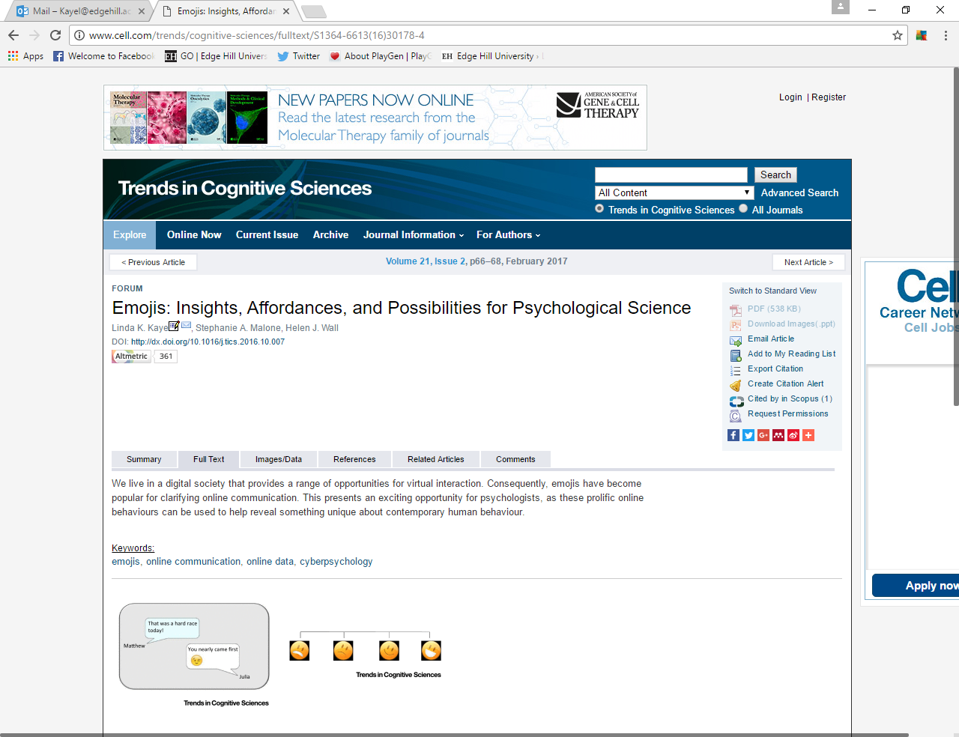

Slide 8
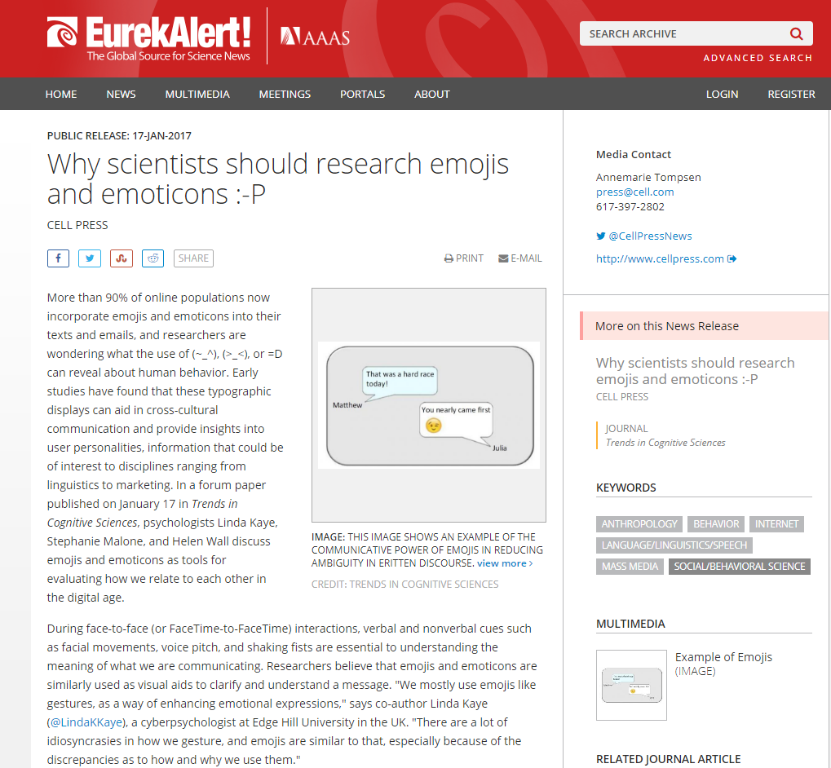

Slide 9
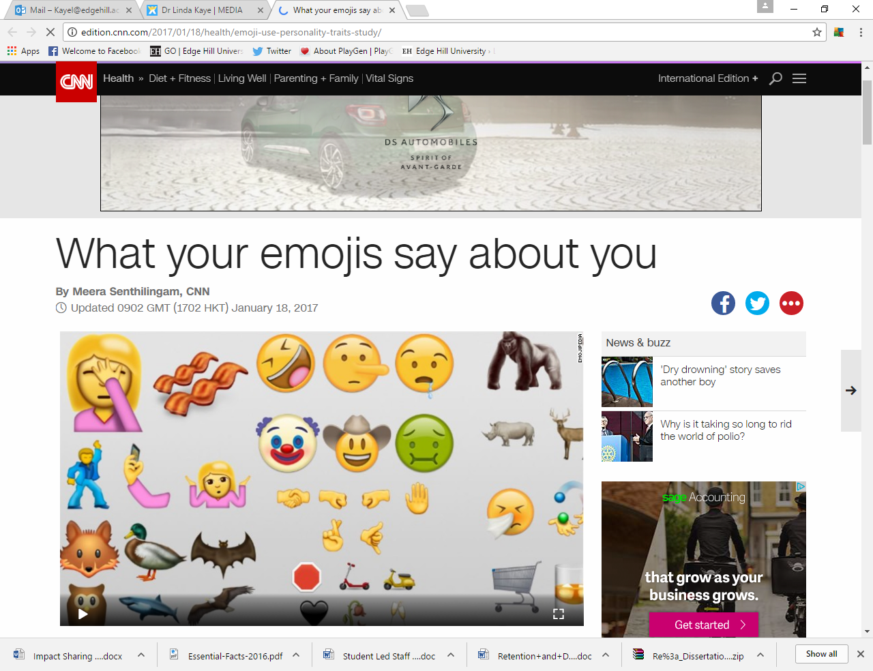

Slide 10


Slide 11
Research findings
Research concept
Research publication
Media engagement

Slide 12


Slide 13
Who are the audiences of your research?

Slide 14
Audiences as beneficiaries of your research
Who (will benefit)?
How (will they benefit)?
Why (is it important they benefit)?
How (will you know they have benefited?)

Slide 15
What evidence is needed?
Social media metrics, interview request emails
User data, organisational commentary via emails/letters
What resources do I
need to record impact?
Social media metrics, interview request emails
User data, organisational commentary via emails/letters
Do I need to
collaborate (externally)?
No- previously undertaken research
Yes- with commercial sector
How could I (or EHU)
facilitate measurement?
Databases or resource-base to hold data
Requests for information, formal correspondence assistance
How will impact be measured?
Shares, social media metrics, republishing, interview requests
User data, organisational commentary
How will they benefit?
Informing public debate
Commercial change- Make changes to technology systems, interaction features
Who are the beneficiaries?
Public
Commerce

Slide 16

Language
Non-academic
audiences
Academia

Slide 17

Academia
Non-academic
audiences

Slide 18


Slide 19
Activity- verbal communication
A: “So tell me a bit about your research”
B: “_______________________________”
A: “Why is your research important (e.g., why should I care about it)?”
B: “_______________________________”
Notes:
In pairs label yourselves A and B
A will start as Journalist and B as Researcher
A to ask the following questions
Swap over

Slide 20
Activity- WRITTEN communication
1. Using the abstract you have brought in, re-write this so a non-subject specialist will understand it
2. In pairs, swap your re-written abstracts
  The recipient of your abstract should now describe the following two things:
  What your research did
  What your research found
3. Recipient to give constructive feedback on the re-written abstract

Slide 21
Activity- reflection
What have you learnt about written communication?

Slide 22
How can we get our research to the public?

Slide 23
Ideas
1. Produce summaries:
  Fact Sheets
  Summary reports
  Recommendations
2. Use visual communication methods
3. Use Twitter for useful networking and establishing reputation
4. Write with The Conversation

Slide 24
Reflection and Action plan
I have developed an understanding of the skills involved in writing and communicating to non-scientists
1 2 3 4 5 6 7 8 9 10
I have developed an understanding of the mechanisms of outreach and promotion of research to the public and wider scientific community
1 2 3 4 5 6 7 8 9 10

Slide 25
Reflection and Action Plan
Objective | Tasks | Resources | Time-scale
1. Develop writing skills in lay terms | A. Re-write research abstracts in “simple” terms | Research reports; dissertations; peer feedback | Nov-Feb 2018
 | B. See some Conversation pieces | The Conversation website | Dec 2017
 | C.
2. | A.
 | B.
 | C.

Slide 26



Dr Linda K. Kaye
Linda.kaye@edgehill.ac.uk
@LindaKKaye
http://lindakkaye.wixsite.com/dr-linda-kaye

