Slide 1

File Storage (campus)
A guide to your file storage options when on campus
Notes:
A concise guide to your file storage availability while using a campus machine

Slide 2
File Storage (campus)
What is it used for?
You can use your file storage quota to save files whilst you are on campus using a networked PC on site.
Notes:
When you are on site, everyone has a personal file storage area to save your files to when using a university PC. When you save these files, they are saved to our own network which is backed up a number of times a day to help minimise the chance of losing a file.

Slide 3
How much space?
250mb limit
It is a good habit to get into to back up your files and remove them from your student file area when you no longer need them!
Notes:
250mb limit although this may be increased if you require more space.
Use the quota to manage your files appropriately. It is a good habit to get into to back up your files when you no longer need them!

Slide 4
Drives you can save to
When you log in using a campus PC you will be able to see two drives to be able to save to
X:\ Open student drive
Z:\ Personal drive
Notes:
X:\ This is the student drive that may be used to share work amongst students. Work saved here can be seen by all students.
Z:\ This is your own personal drive and you can save your own private files here. Only you can see your drive area.

Slide 5
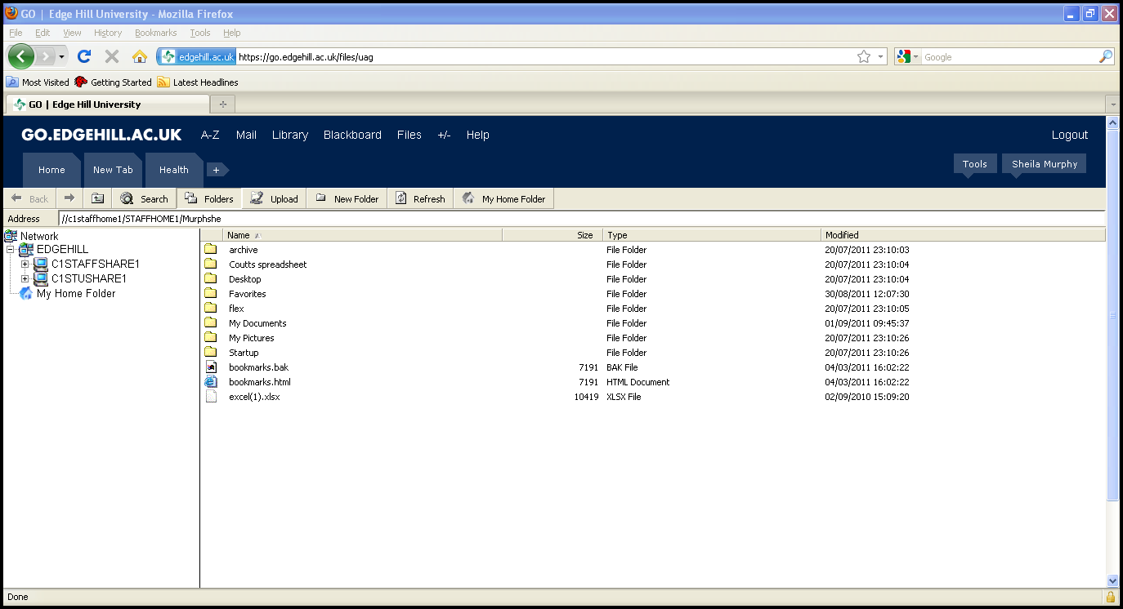
Notes:
When you click on files the screen will appear similar to this.

Slide 6
Can I save to the desktop?
When you save a file to your desktop, it will follow you when you log in on a different computer on campus.
It will add towards your file storage quota though – so be careful what you save there!
Notes:
A new system that was installed over summer has enabled all students to have a ‘roaming profile’
This means that when you save a file to your desktop, it will follow you when you log in on a different computer on campus.
It will add towards your file storage quota though – so be careful what you save there!

