Slide 1
Library and IT facilities
A guide to the Library, Media and IT facilities on the Ormskirk Campus

Slide 2
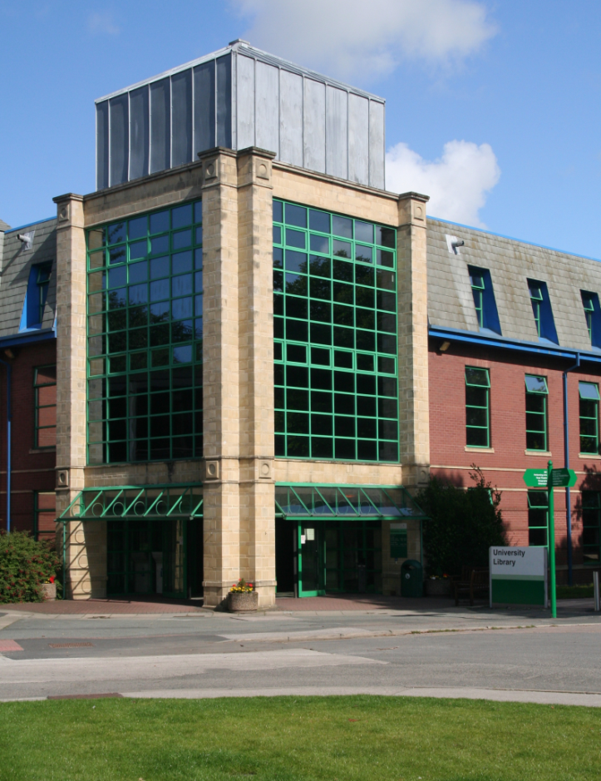
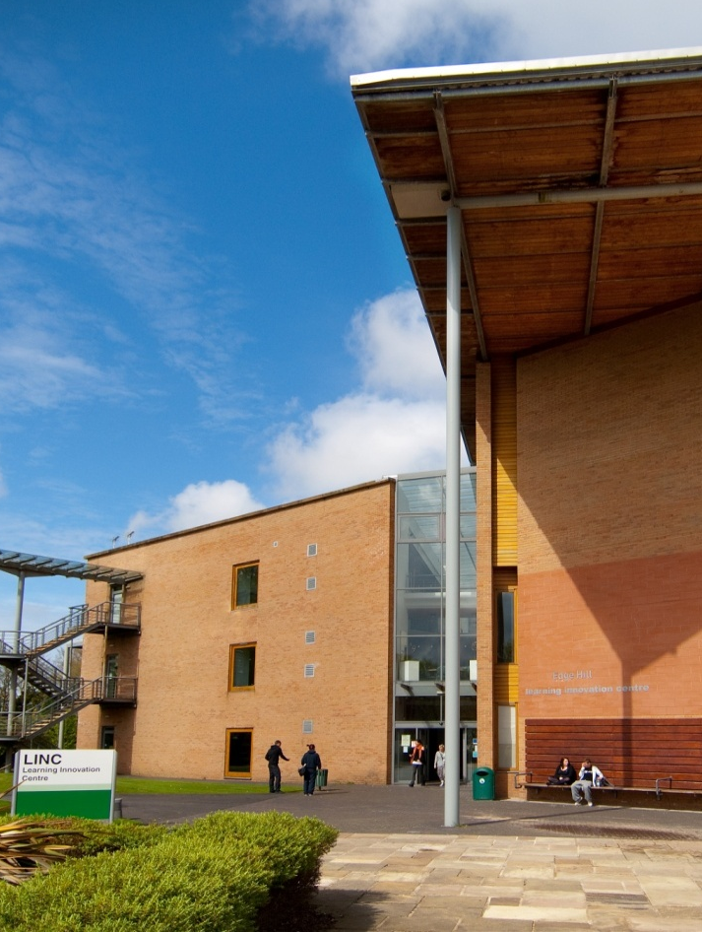

Library and IT facilities
University Library
LINC
Notes:
There are a range of library, media and IT facilities available to you on the Ormskirk campus. Both the University Library and the LINC offer both study spaces and computer access, as well as a range of other facilities. The University Library is situated at the heart of the campus close to the Hub and the main building. Next door to the Library is the LINC, or Learning Innovation Centre.

Slide 3
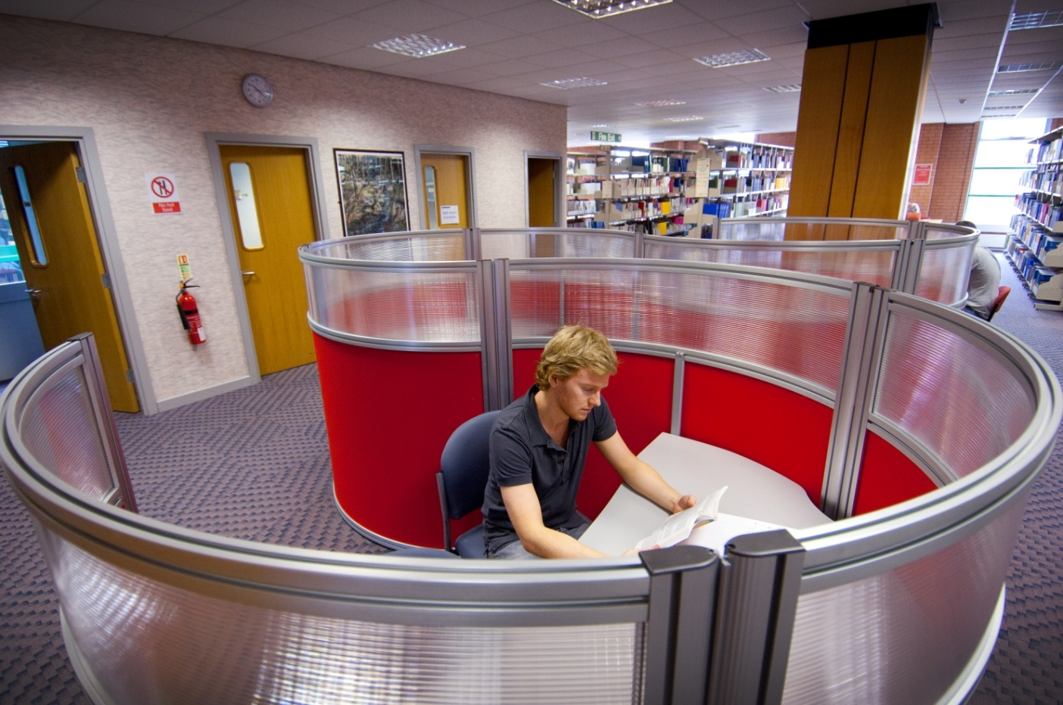
University Library
Places to
study…
Notes:
In the University Library, you’ll find more than just books. There are also places to study, both individually and with friends. We offer a range of study spaces, including areas designated for silent study and group work. We also have a number of individual study carrels equipped with a PC, which you can book for when you need some quiet time to write an assignment.

Slide 4
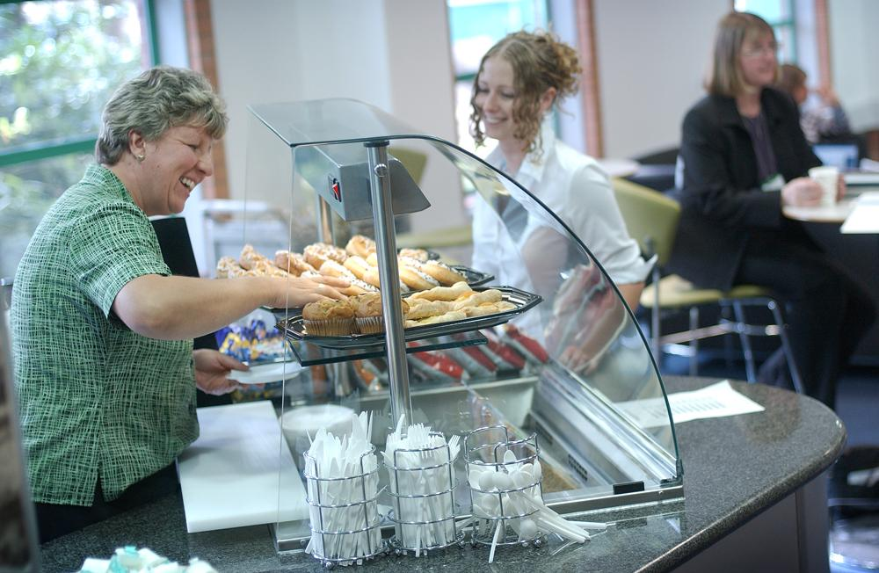
University Library
Book Ends
café…
Notes:
There is also a café on the ground floor of the Library.

Slide 5
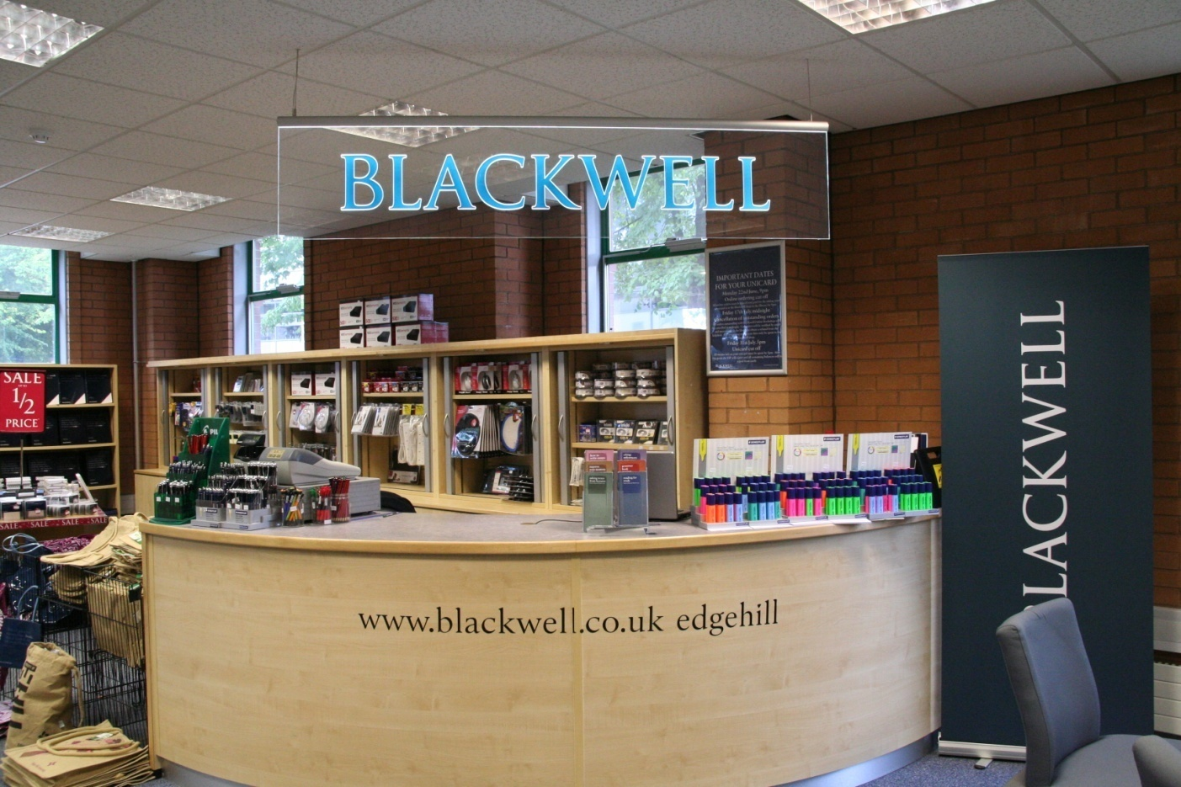
University Library
Blackwell’s
bookshop…
Notes:
And a shop selling books, stationery and some computer equipment.

Slide 6
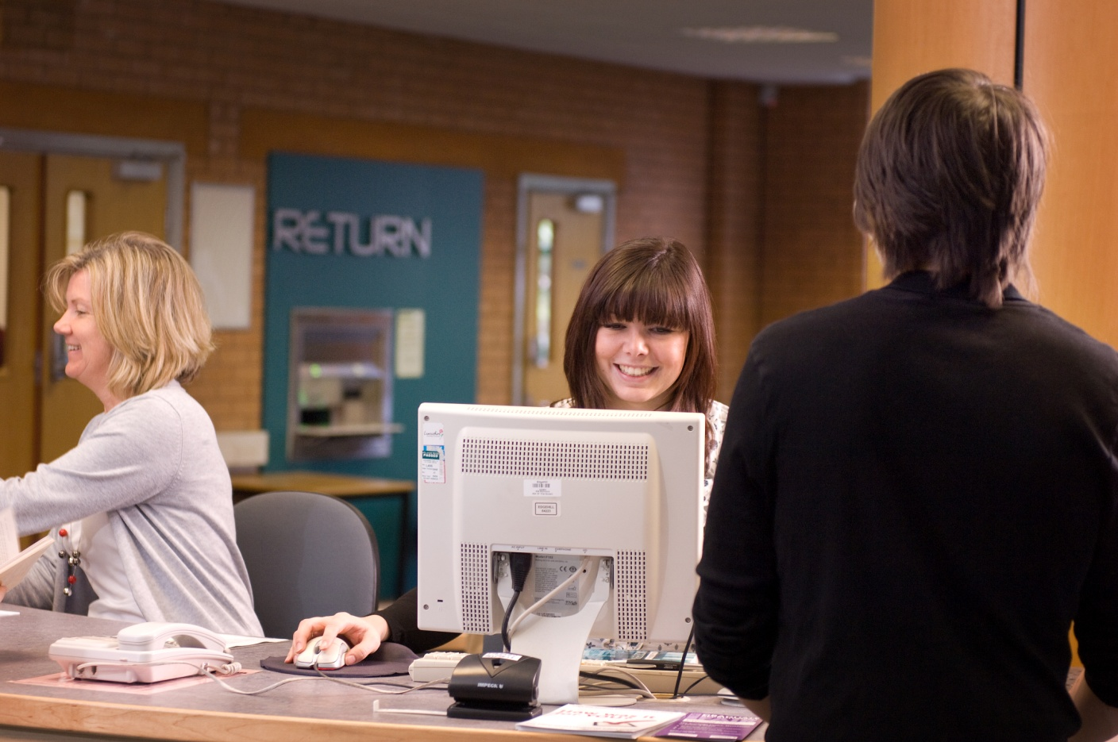
University Library
Help desks…
Notes:
Don’t forget, the library staff are there to help you. We have help desks on the ground floor and the first floor so if you have any questions, please just ask.

Slide 7
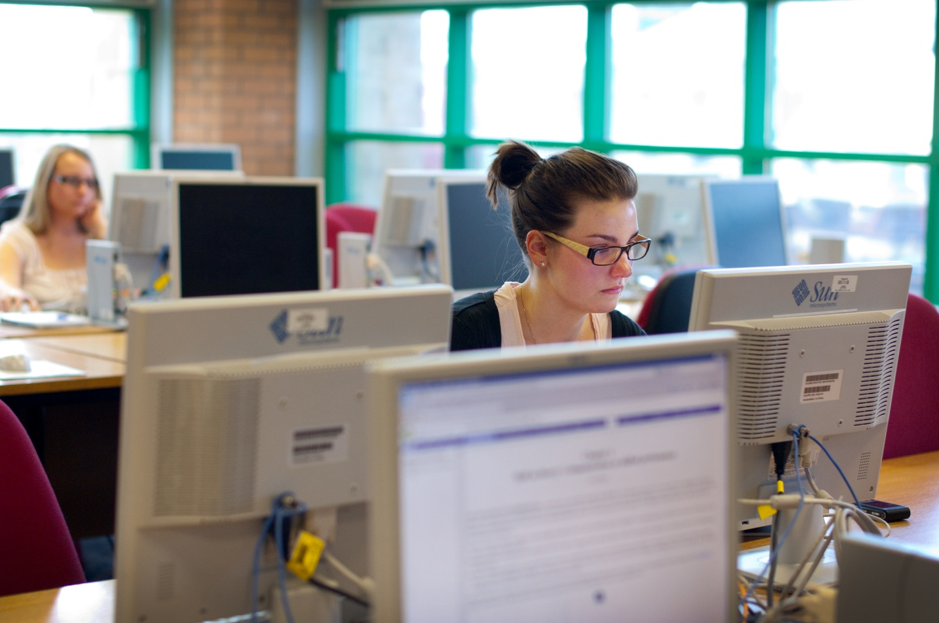
University Library
Computer
access…
Notes:
We also have over 100 open access PCs in the Library, plus wireless internet access if want to bring your own laptop.

Slide 8
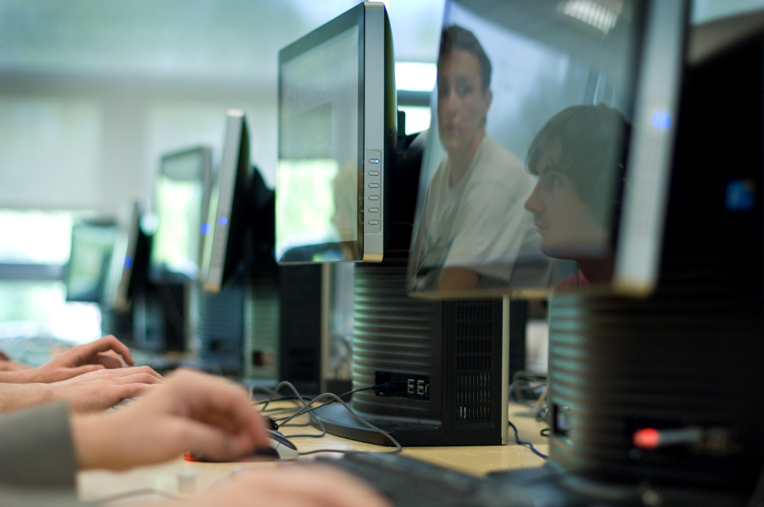
The LINC
24/7 computer
access with
your Unicard…
Notes:
Next door to the Library in the LINC, there are two more open access computer labs. These are available 24 hours a day. Simply swipe your Unicard at the door outside of normal opening hours.

Slide 9
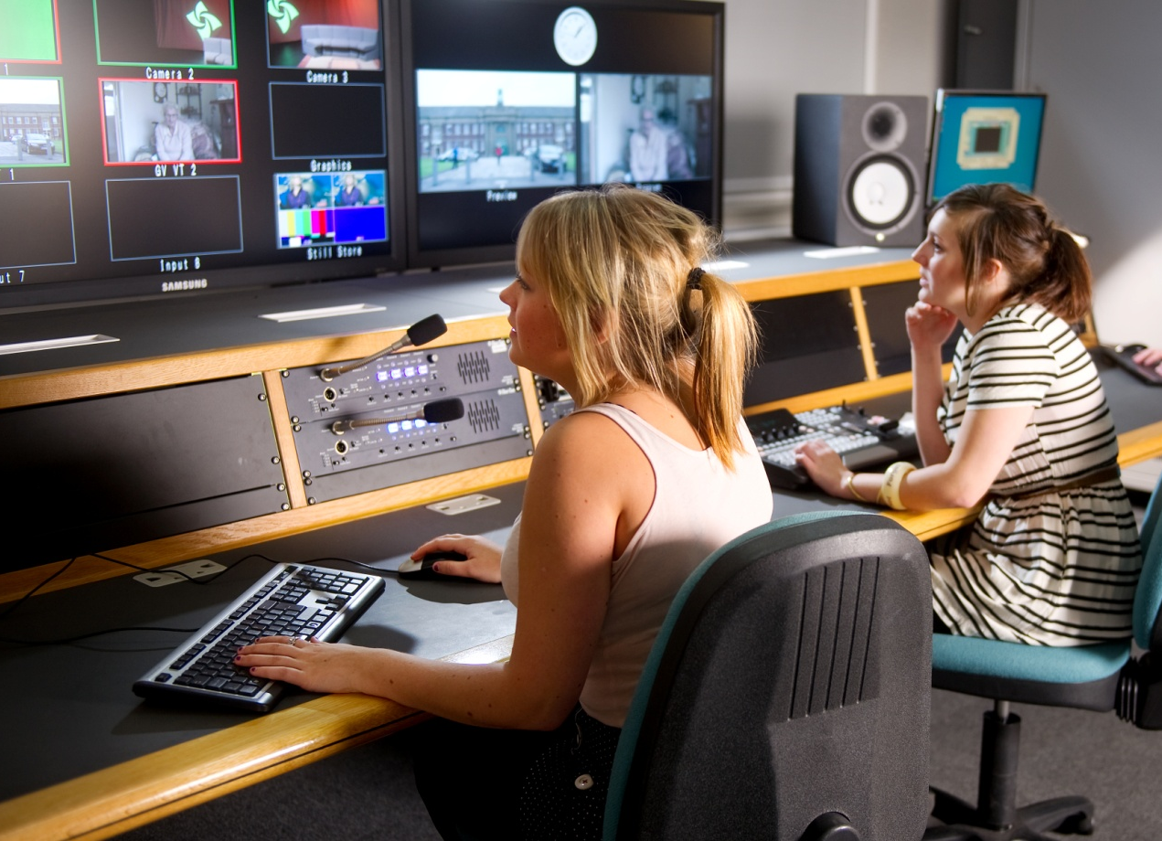
The LINC
TV studio and
editing suites…
Notes:
On the top floor of the LINC you will find Edge Hill’s media facilities, including a high definition TV studio and several edit suites.

Slide 10
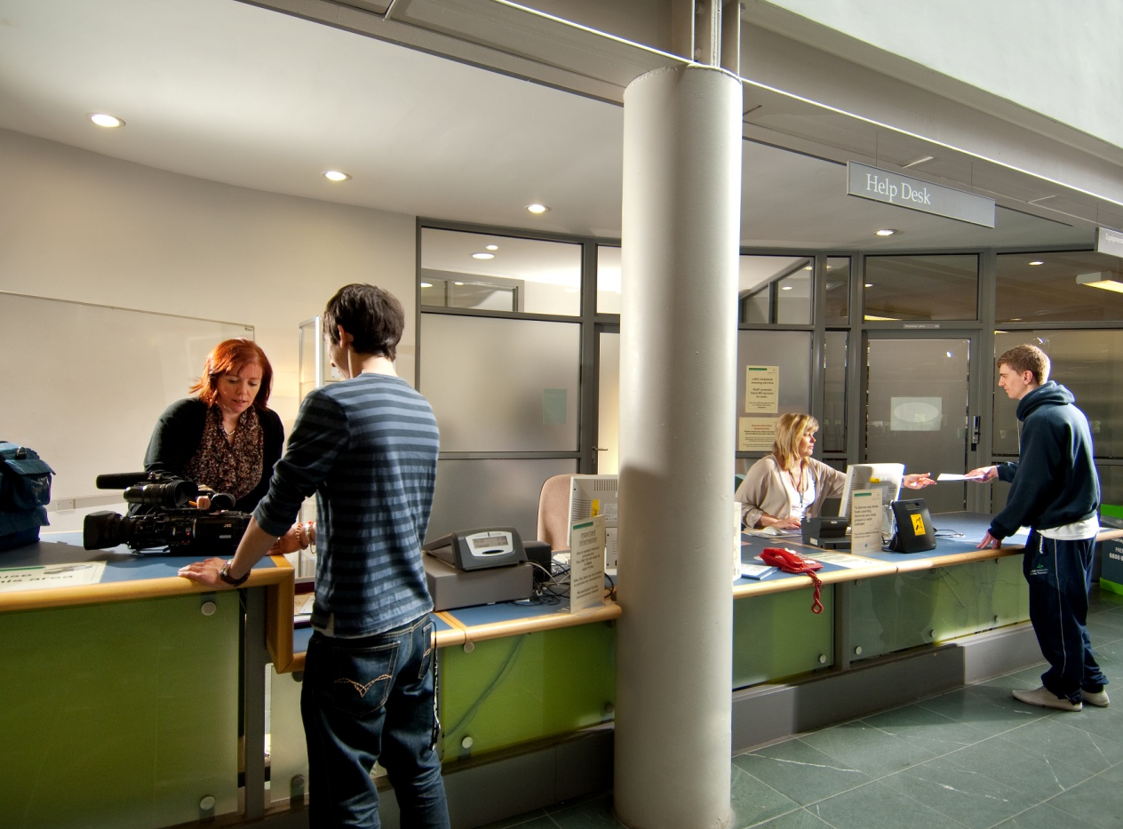
The LINC
Help desk
for media and
IT enquiries…
Notes:
You can also borrow media equipment, such as digital cameras and audio recorders, from the help desk on the ground floor of the LINC. The staff at this help desk can also help you with IT enquiries.

Slide 11
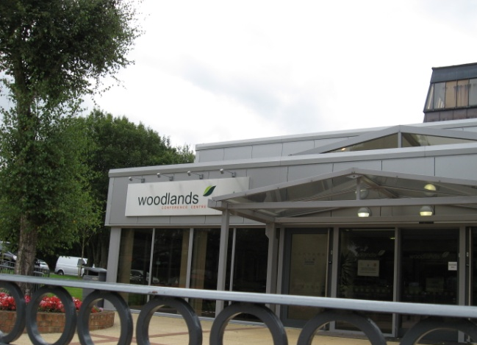
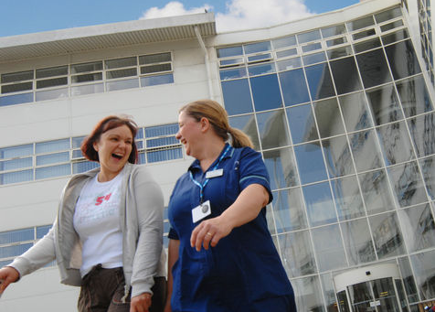
Library and IT facilities
Edge Hill has sites libraries at:
Woodlands (Chorley)
Aintree Hospital
Armstrong House (Manchester)
At all these sites you can:
borrow and return books
use the IT facilities
find a place to study
Notes:
Edge Hill also sites at Woodlands on the outskirts of Chorley, Aintree Hospital and Armstrong House in central Manchester. At these sites you will find library and IT resources, so you can borrow or return books at these sites or simply use them as a place to study.

Slide 12
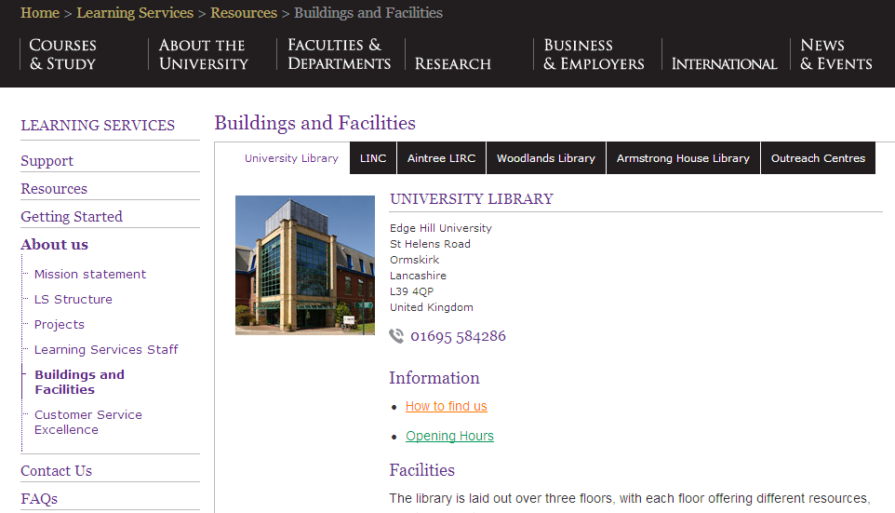
Library and IT facilities
See the Learning Services web pages for more details of our locations and opening hours:
edgehill.ac.uk/ls
Notes:
For more information on our facilities on both the main Ormskirk campus and at the other sites, see the Buildings and Facilities section of the Learning Services web pages.

