Slide 1

Library Catalogue
How to use the Library Catalogue to find print and online resources
Notes:
The Library catalogue provides access to all of Edge Hill University’s library Resources.

Slide 2
Library Catalogue
Finding Books on the Catalogue
Finding Books on the shelves
Borrowing and returning
Reservations
Notes:
Why would students need to use the Library Catalogue? Well, we have a large amount of stock. Everything on the catalogue has been selected by tutors. So it’s Relevant- to your course. Reliable- this means it meets academic standards, and the catalogue makes it really easy to find.
The catalogue is designed not just for you to search for any book but for you to search for the books selected for your course.
With over 200,000 items in stock finding the books you need could be a challenge. That is why everything is carefully catalogued with it’s own number to make it easy to locate. Once you can use the library catalogue then you can easily find books on the shelves; borrow and return them.
If the books you need aren’t on the shelves then there is a reservation system.

Slide 3
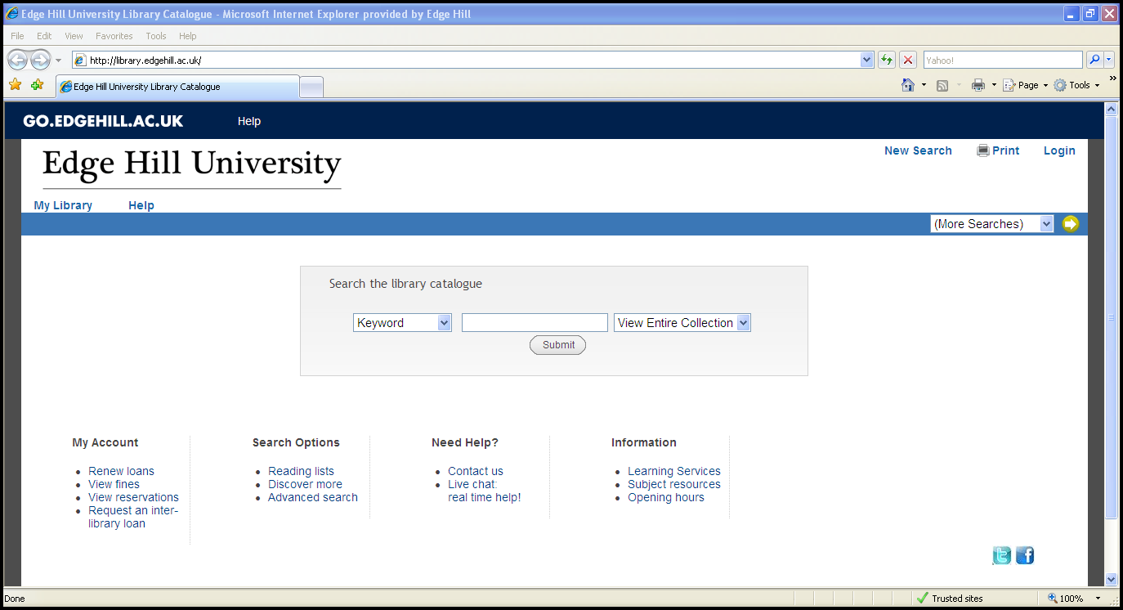
Library Catalogue
Notes:
To access the library catalogue login to the GO portal, then click the Library Catalogue link. The search page will look like this.

Slide 4
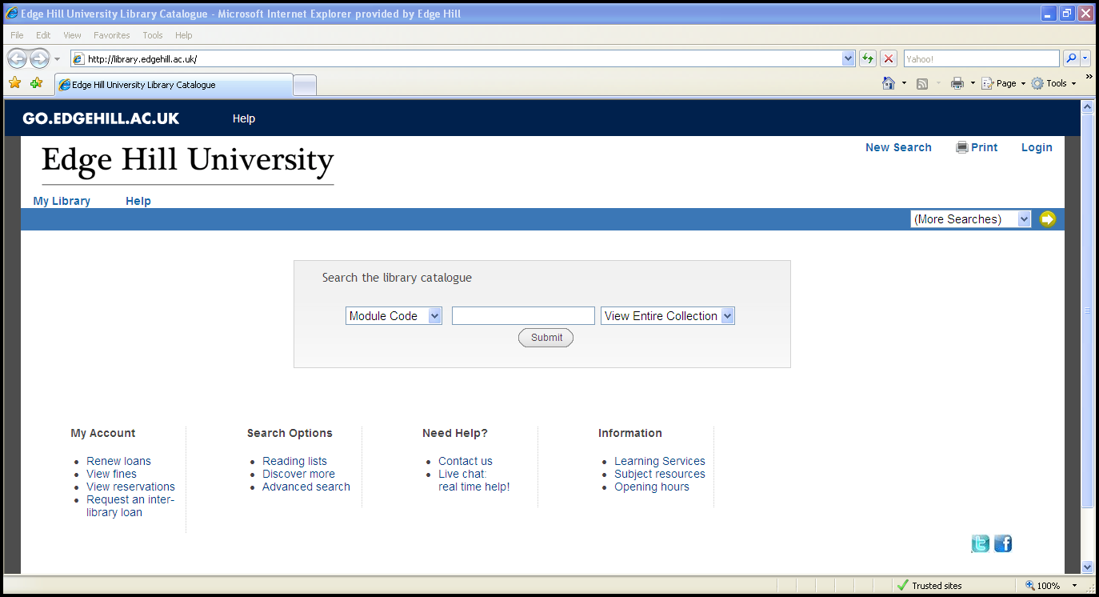
Resources for courses
Type in your module code
Find your reading list
SCREEN SHOT OF SEARCH PAGE
Select ‘Module Code’
Click ‘Submit’
Notes:
The first place to look on the catalogue should always be your reading lists.
Having navigated to the catalogue select module code from the drop down menu at the left. Type the module code, from your module handbook, into the search box and await the results.

Slide 5

Finding the book
Notes:
Note down the numbers on the reading lists , which floor in the library the book is on and check if it is available.
Following the numbers on the shelves the number will then be found on the individual book.

Slide 6
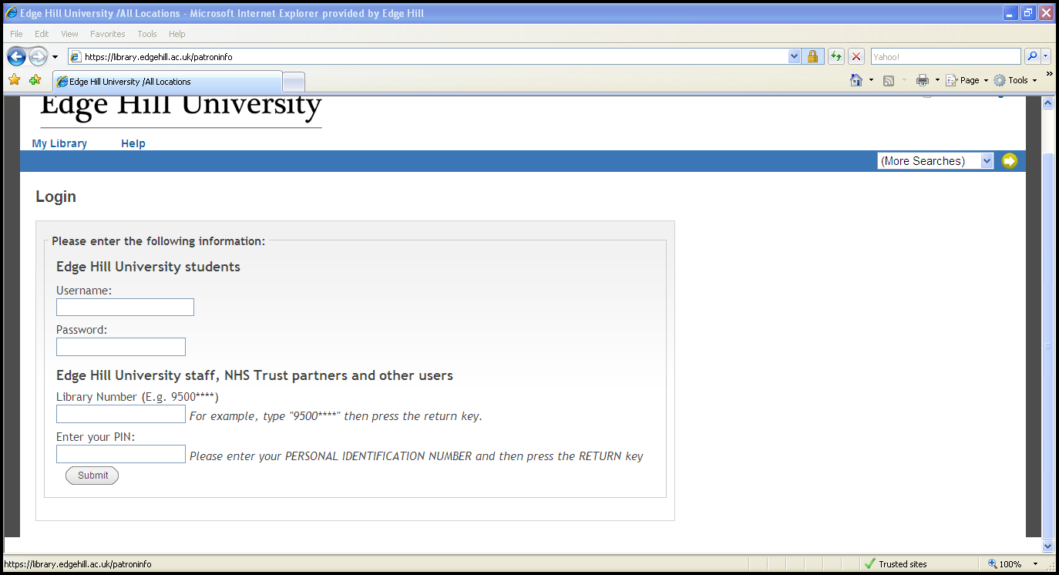
Log in to the Library Catalogue
Log into My Account
Click on ‘Request’
SCREEN SHOT

Slide 7
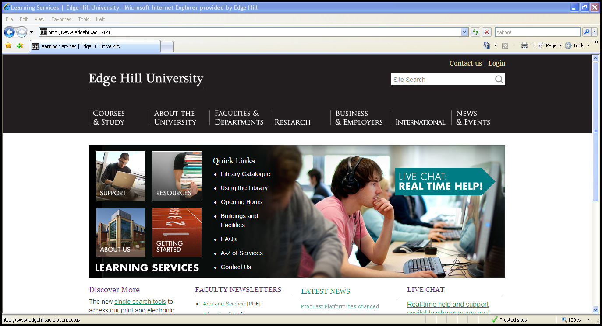
Learning Services
Notes:
Happy to help.

