Slide 1

Learning Edge
A guide to your Virtual Learning Environment (VLE)
Notes:
A concise guide to your online/virtual learning environment

Slide 2
Learning Edge
What is it used for?
Learning Edge is an online environment which contains a wide variety of teaching and learning material and interaction including:
Module information
Lecture notes
Online assignment submission
Notes:
Learning Edge is used to contain, display and interact with your modules and teaching and learning materials in a variety of different ways. This may be text or may be audio, video or other multimedia, web links, slideshows, presentations, forms, files plus much much more. Your tutor has used a number of tools to help you interact with your study material and make it easier to access wherever you may be in the world! A concise guide to your online/virtual learning environment

Slide 3
What else is in Learning Edge?
Learning Edge also encompasses:
eShare – Teaching and Learning Materials
Turnitin – Plagiarism Detection
Campus Pack – ePortfolios
Mobile – access your modules on your mobile
Pebble Pad – ePortfolios (until November 2011)
Notes:
eShare is a Teaching and Learning repository that will continue to grow as more material is added. Your tutors use this material to enrich your courses and help bring together their own knowledge with that of the wealth of knowledge available on the web and in other connected services (such as the library catalogue)
Turnitin helps you check your own work to ensure you have referenced correctly. This is a good skill to master and Turnitin helps you identify mistakes when you reference. It is not intended to catch you out!
Campus Pack is a new e-Portfolio solution for the university. You will hear more about it if your course decides to implement e-Portfolios.
Blackboard Mobile is a new tool for this year. It allows Blackboard to be displayed in a mobile friendly way, so you can interact and view your course whilst on-the-go. See Learning Services for further information on how to install the app.

Slide 4
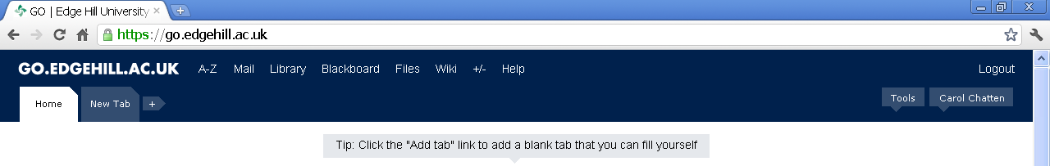
How do I access Learning Edge?
Learning Edge
When you have logged in to GO, click on ‘Learning Edge in the bar across the top of the page
Notes:
Learning Edge is accessible once you have logged into the Student Go Portal. Click on ‘Learning Edge’ in the top panel
(It may be that Learning Edge is still referred to as Blackboard, this will shortly change if so). Learning Edge is used to contain, display and interact with your modules and teaching and learning materials in a variety of different ways. This may be text or may be audio, video or other multimedia, web links, slideshows, presentations, forms, files plus much much more. Your tutor has used a number of tools to help you interact with your study material and make it easier to access wherever you may be in the world! A concise guide to your online/virtual learning environment

Slide 5
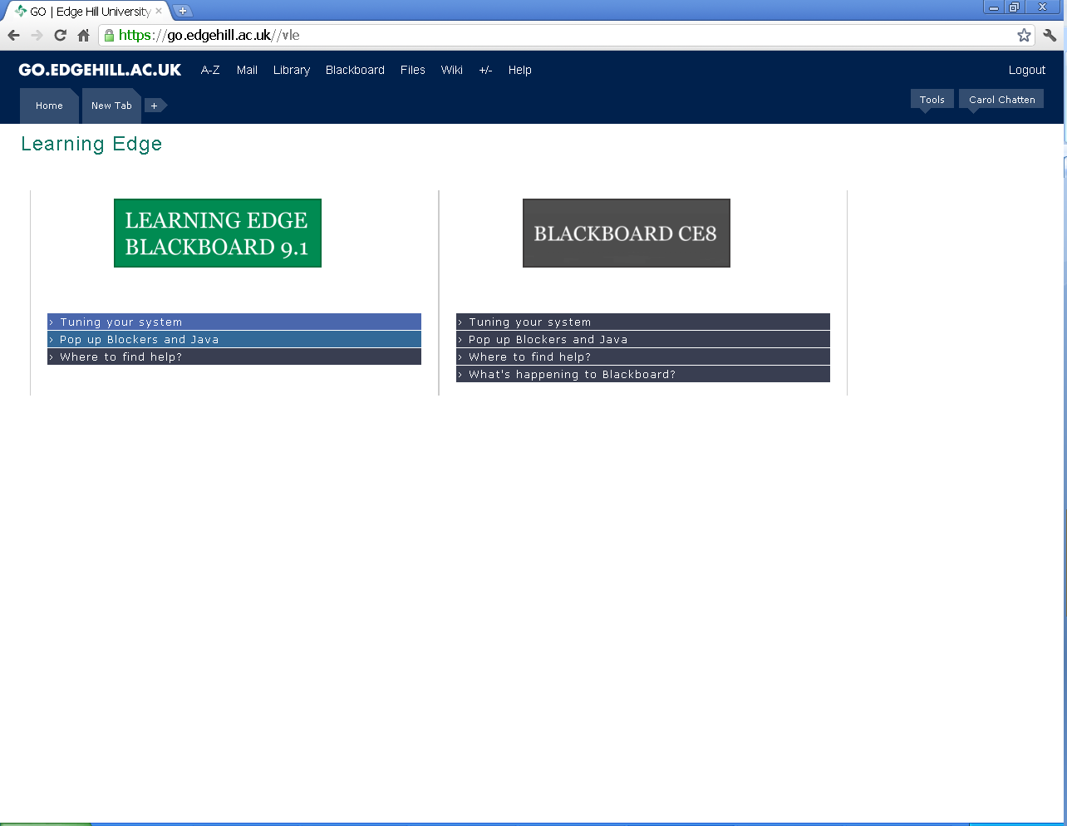
The ‘holding page’
The majority of courses will be using Learning Edge Blackboard 9.1 as of September 2011
Notes:
If you are a first year student your course will be delivered in the ‘new’ version of Blackboard – 9.1 Click on the green logo to get access to your courses

Slide 6
The ‘holding page’
Only a few courses will continue to use our old system until August 2012 at the latest.
Notes:
If you are doing certain courses, you may still have to use the ‘old’ version for now. If so, click on ‘Blackboard CE8’

Slide 7
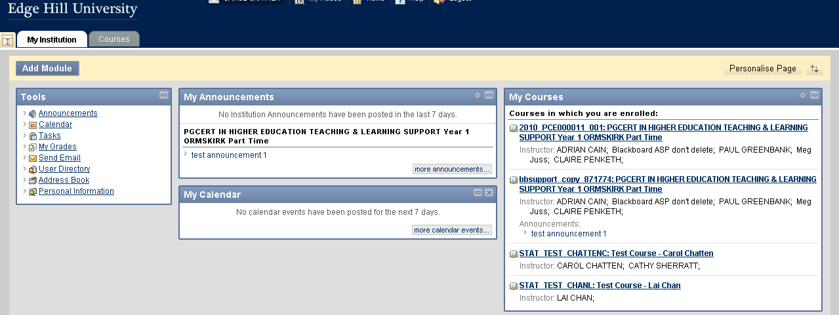
Navigating
From ‘My Courses’ you can enter one of the courses or modules you are enrolled on.
Notes:
Once you have logged in you will see your courses on the right hand side of the page. If you can’t see all of your modules, it may be that your tutor isn’t quite ready for you to see them yet. If you are concerned and believe you should see a module in the list, speak to your tutor.
Click on one of the names of your courses to enter it.

Slide 8
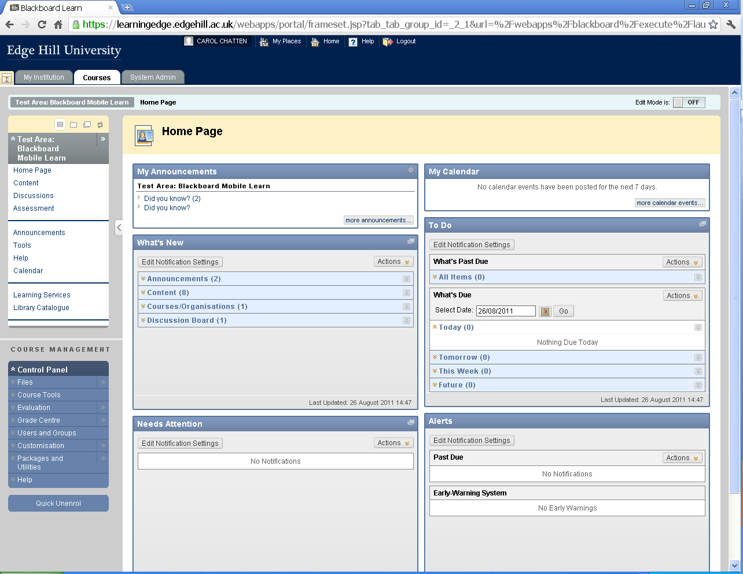
Modules or Courses
You navigate around your courses or modules from the left hand side menu. Depending on how your tutor wishes to teach, this menu may vary.
Notes:
The navigation menu is on the left of the page. The content or interactive content will appear on the right of the page. Remember to make use of all the content and tools in your course areas – they are designed to help your studying and learning!

Slide 9
Modules or Courses
Typical content may include:
  Module content
  Discussion Boards
  Online Assessments
  Calendar
  Web links
Notes:
Depending on how your tutor has set up your course, it may look something like this. You may have more or less options than this though. Discover what is available and become familiar with your course. It can be updated at any time by your tutor with more content to help you. Check back often!
It acts just like a web page, so don’t be scared to explore, get acquainted and familiar with how to use the tools so you know what to do when required.

