Slide 1
Using the GO Portal
A guide to the resources you can access through the GO Portal

Slide 2
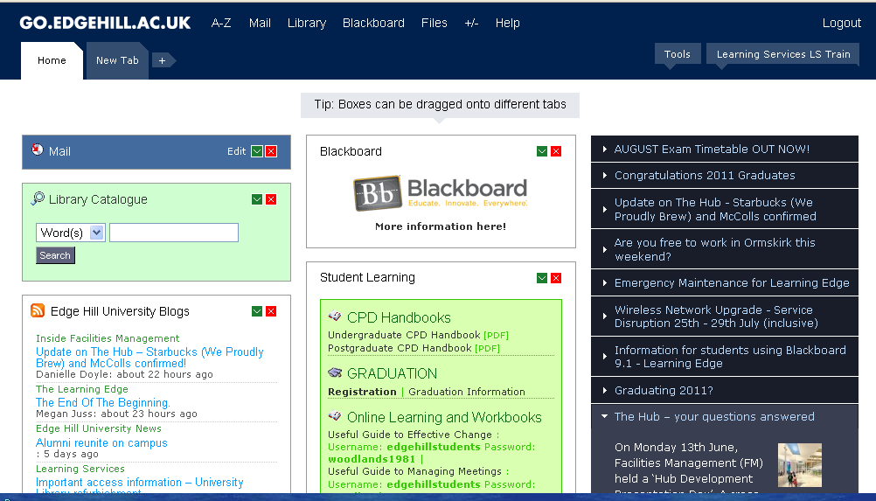

The GO Portal
Your University email account
Library Catalogue
Learning Edge
Your network file storage area
Notes:
When you login to the network you will be taken to the Go Portal. This gives you access to a file storage area, your University email account, Learning Edge, the Library Catalogue and much more.

Slide 3
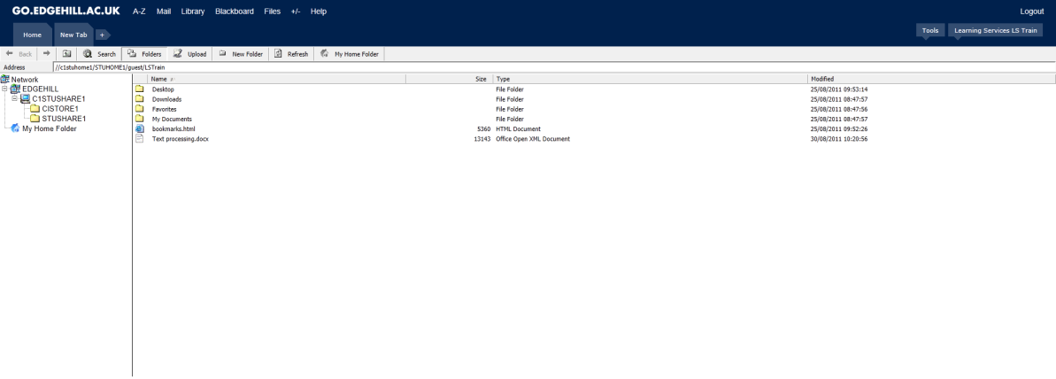
File Storage Area
You have 250MB of network space to store your work
This is space is secure and regularly backed up
Notes:
As a part of your account you are allocated a file storage area for saving your work, which is secure and regularly backed up. You are given 250MB of space which you can access by clicking on the Files link at the top of the Go Portal.

Slide 4
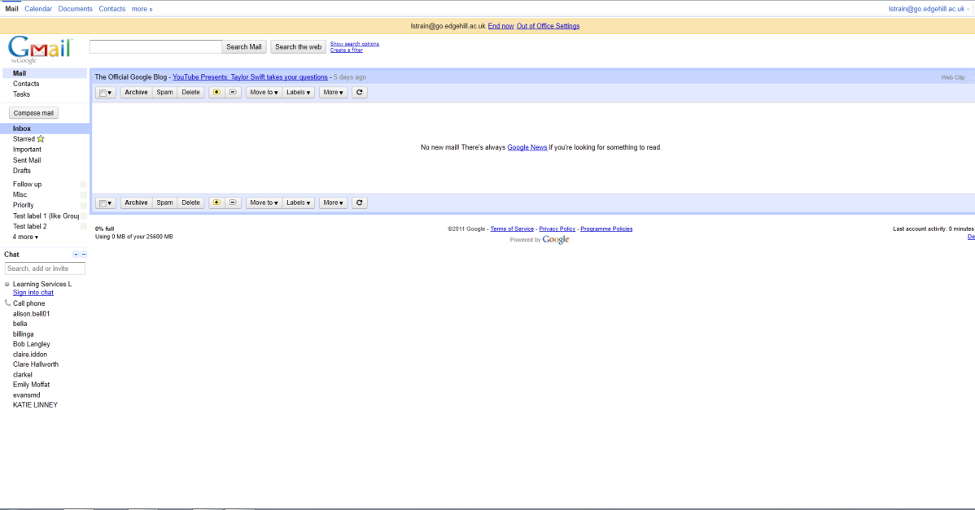
Your University Email Account
Your email address is on your enrolment letter
Check your account regularly
Notes:
To access your University email account, click on the Email link at the top of the Go Portal page or in the Email panel. The email system in use is Google Mail and the format of your email address is on your enrolment letter. Please check your inbox regularly as Learning Services and your tutors will use this address to contact you if necessary.

Slide 5
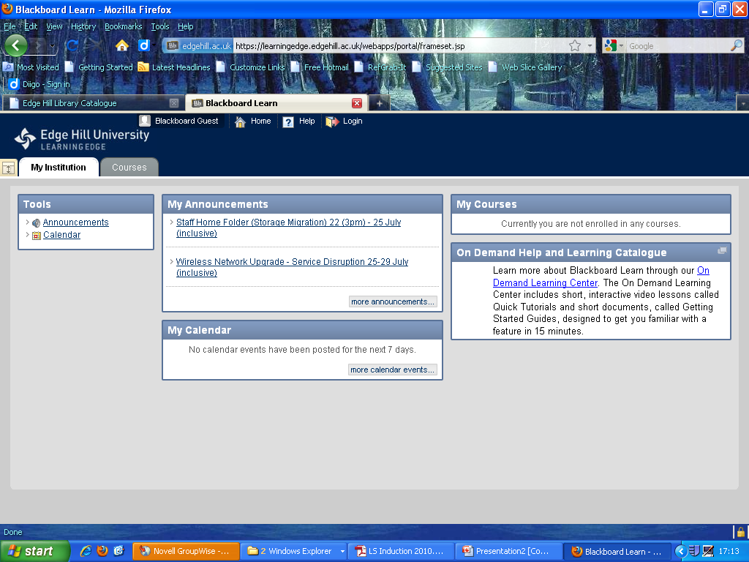
Learning Edge/Blackboard
Module information
Reading lists
Lecture notes
Online assignment submission
Notes:
Learning Edge is the name of the University’s Virtual Learning Environment. You can access it by clicking in the Blackboard panel on the Blackboard link at the top of the Go Portal. Learning Edge gives you access to information about your modules provided by your tutors, notes from lectures, reading lists for your modules, and the facility to submit assignments online, as well as much more.

Slide 6
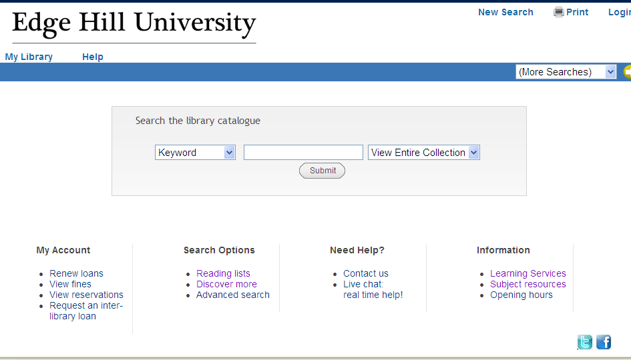
The Library Catalogue
Find the books you need
Access online resources
You can also access the Library Catalogue from:
edgehill.ac.uk/ls
Notes:
The Library Catalogue can be accessed by clicking in the panel or the Library link at the top of the Go Portal. Through the Library Catalogue you can access information about books which are shelved in the University library. You can also access our extensive collection of electronic resources, which includes electronic books, journals, and newspapers. You can also access the Library Catalogue from the Learning Services website, edgehill.ac.uk/ls.

