Slide 1
Logging in
How to log in to the Edge Hill Network

Slide 2
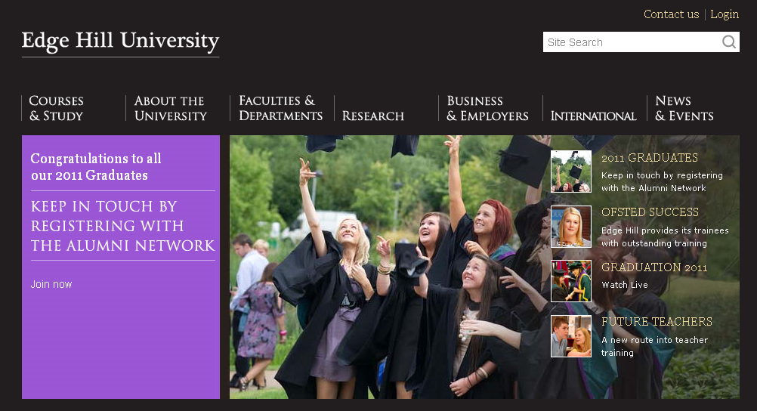

If you are off campus go to edgehill.ac.uk…
…and click on ‘Login’
Notes:
To login if you are off campus go to Edge Hill’s homepage at edgehill.ac.uk and click on the login link at the top right hand side of the page

Slide 3
Note your student number and temporary password on your enrolment letter…
Notes:
When you enrolled on your course you will have received an enrolment letter. This contains your student number, temporary password and email address. Make a note of your student number and password.

Slide 4
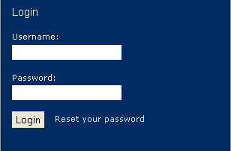
… and enter them in the login boxes
Notes:
Enter your username and password into the login box

Slide 5
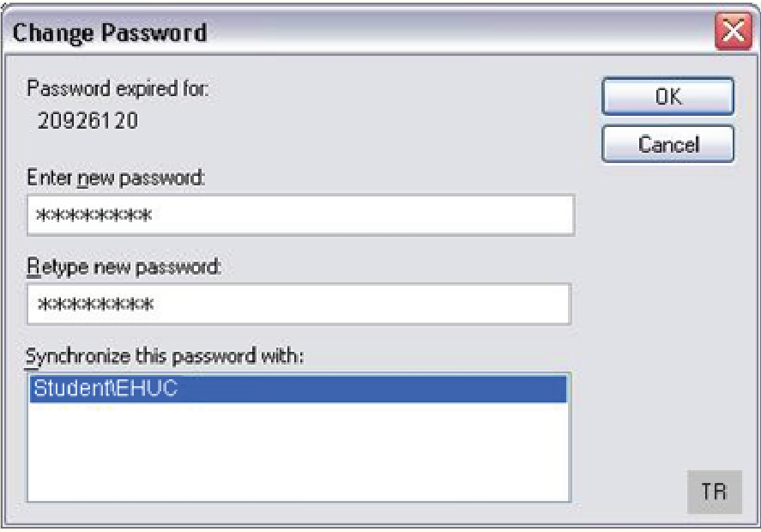
Change your password when prompted…
Notes:
You will be prompted to change your password to something more memorable for you. You will then have to change your password every 90 days.

Slide 6
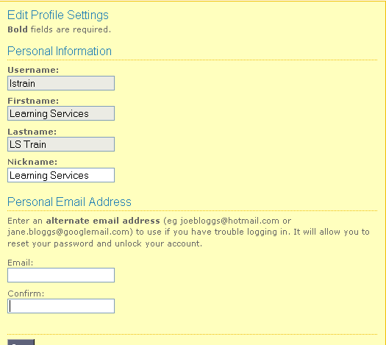
… and enter an alternative email address
Notes:
You will also be prompted to enter a personal email address as an alternative to your University email account. Entering an alternative email address will allow you to reset your password and unlock your account if you are having problems logging in.

Slide 7
Acceptable Use Policy
  The University has an Acceptable Use Policy covering use of the internet and email
  Make sure you read and understand this policy before using the Edge Hill network
  You can find the AUP in your student handbook
Notes:
Make sure that you have read and understood the Acceptable Use Policy. This covers the use of email and the internet by staff and students and you will find a copy in your student handbook.

