Slide 1
Notes:
This session is being offered as part of Learning At Work Week.
Attendees - please feel free to tweet during the session – you can tag @EHULearnService and use the hashtag #learningatworkweek

Slide 2
“Finding Bargains Online”
David Callaghan
May 2016

Slide 3
Objectives
Know some more places / techniques
Know who to network with about online bargains
Have had a go at a new site / technique.

Slide 4
Outline of session
Presentation
Discussion
Have a go …
Plenary

Slide 5
Topics
General:
Amazon
eBay & similar (baycrazy.com)
  Auctionsniper.com
HotUKDeals
Metasites
  Google, Kelkoo, Pricerunner, Shopping & Megashopbot
  Hot UK Deals
Group buying
Groupon
LivingSocial
Forums
www.moneysavingexpert.com
Insurance / Money / Fuel
Try direct too – like Direct Line
Holidays
Air BNB, HotWire,
Meta sites vs Direct
Food
Lots of offers
Free
Warranties
Pricing Glitches
Sale of Goods Act

Slide 6
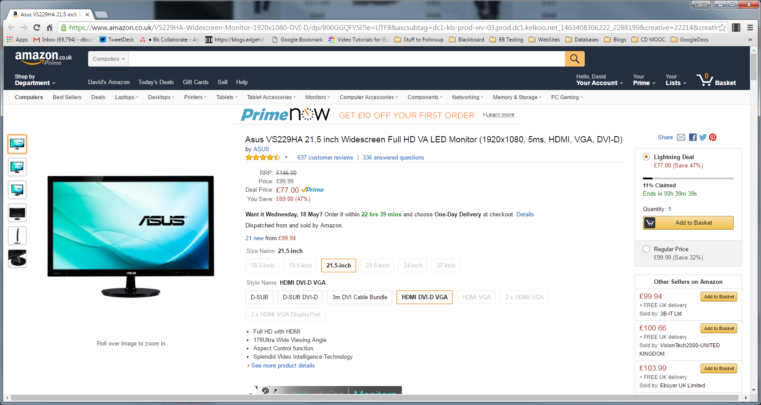
Amazon – often the cheapest:
https://www.amazon.co.uk/VS229HA-Widescreen-Monitor-1920x1080-DVI-D/dp/B00GGQFY5I/ref=sr_1_1?ie=UTF8&qid=1463483394&sr=8-1&keywords=vs229ha

Slide 7
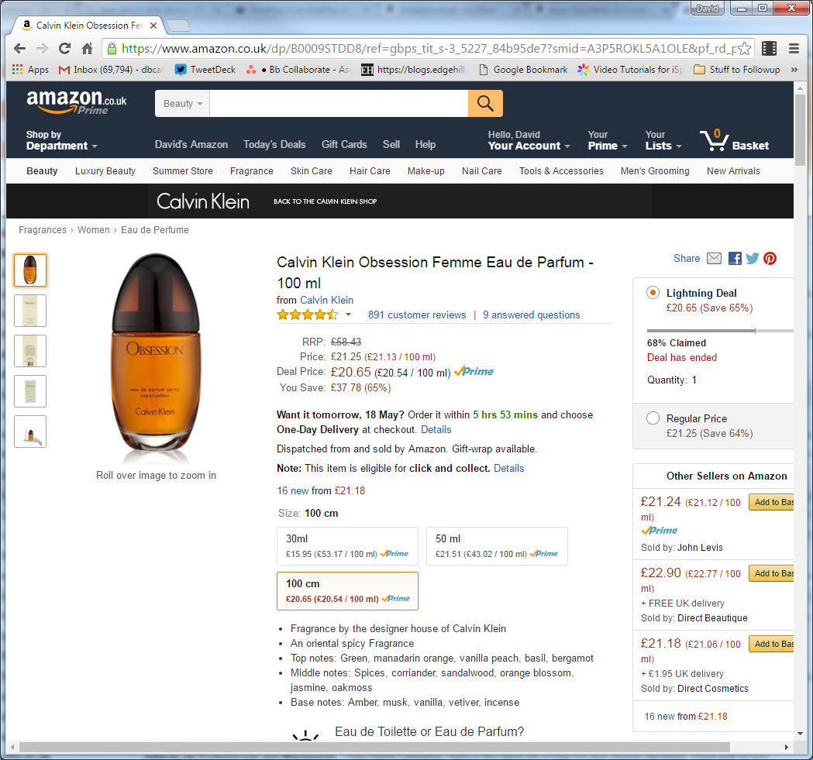
Save 59p

Slide 8
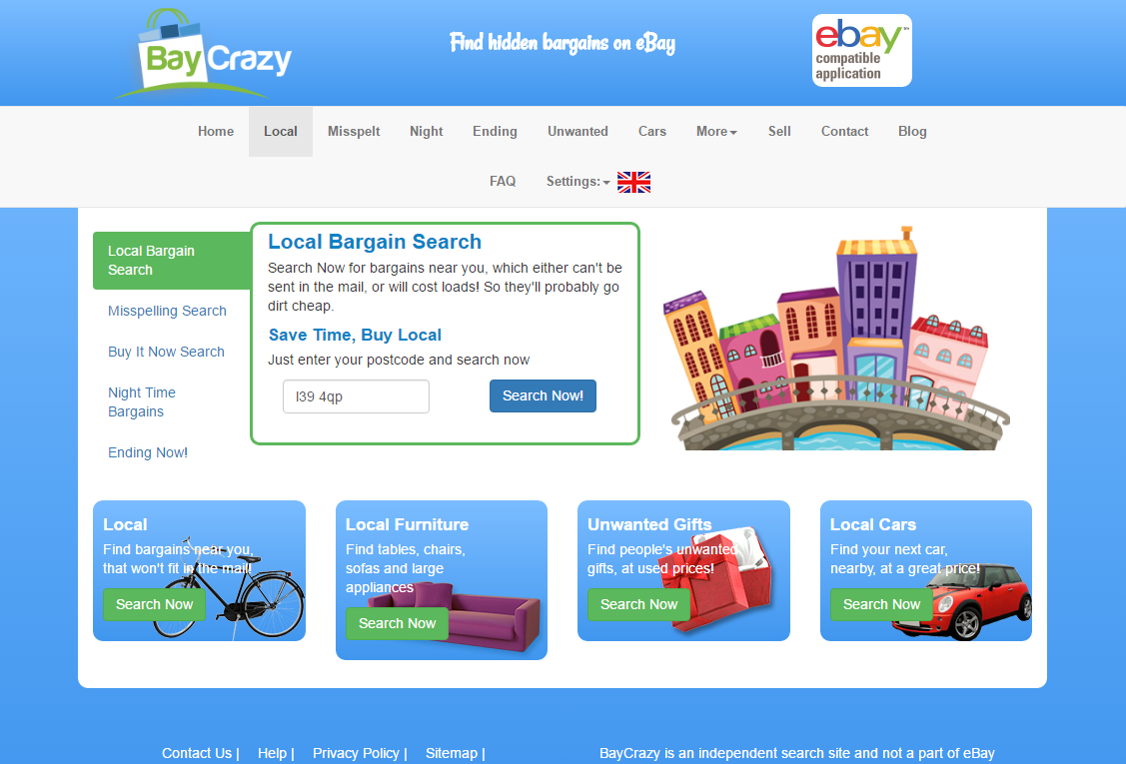
… baycrazy.com
Local
Misspelt
Night

Slide 9
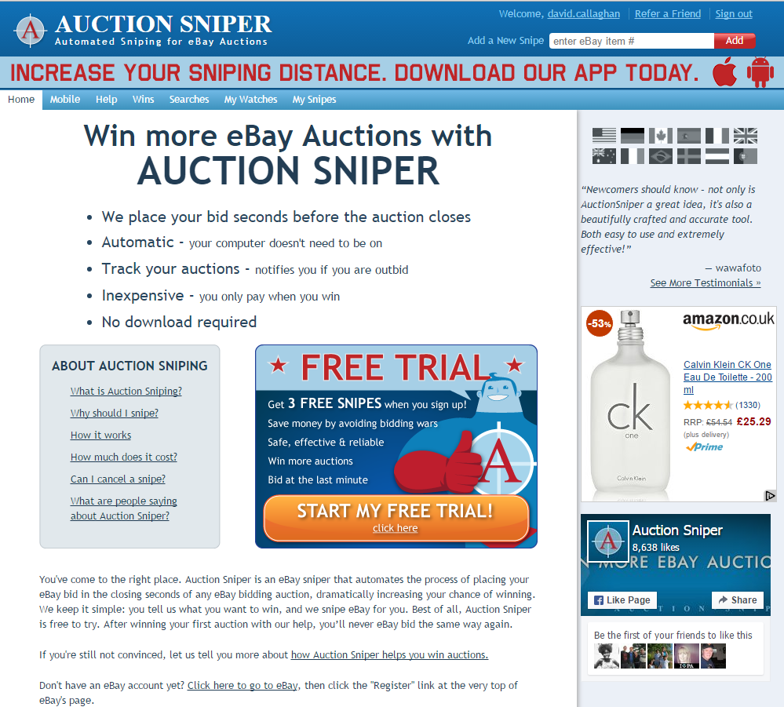
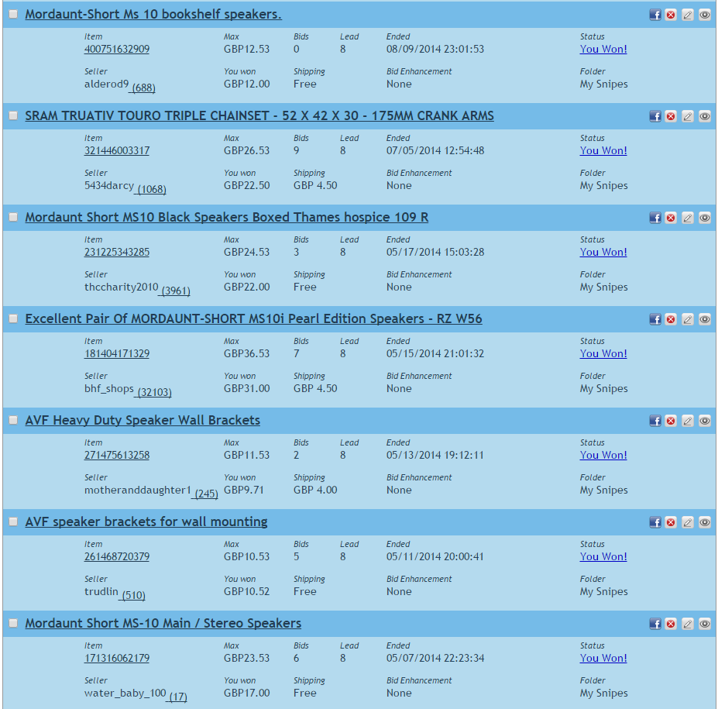
Auctionsniper.com
http://www.auctionsniper.com/?who=david.callaghan
http://www.ebay.co.uk/sch/i.html?_from=R40&_sacat=0&_nkw=ms10%20speakers&LH_Complete=1&rt=nc&_trksid=p2045573.m1684

Slide 10
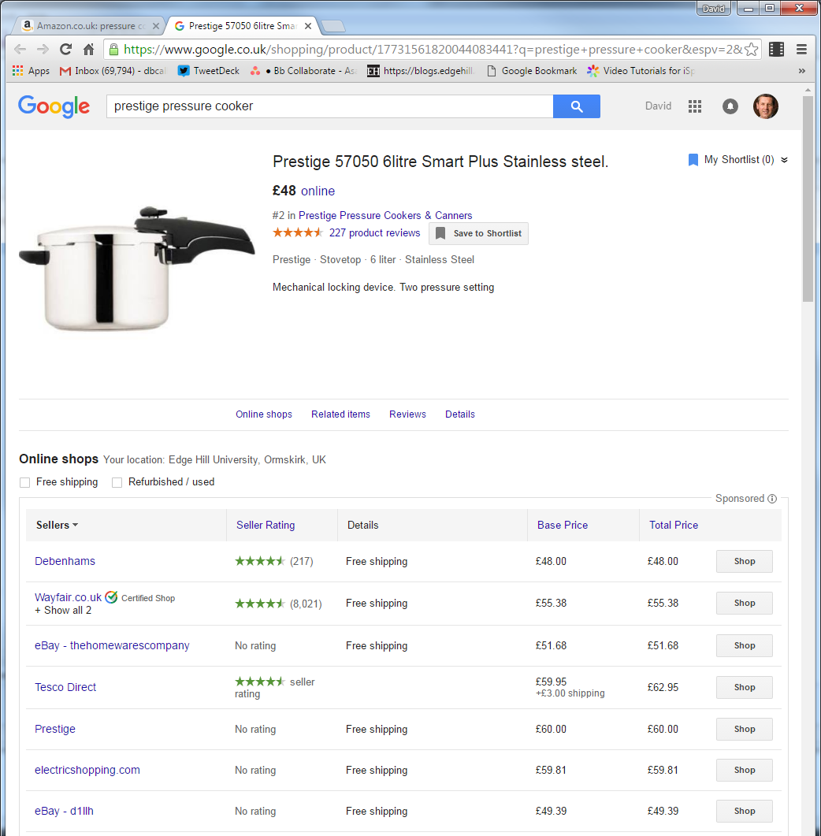
Metasites
Google
Kelkoo
PriceRunner
Shopping.com
Megashopbot.com

Slide 11
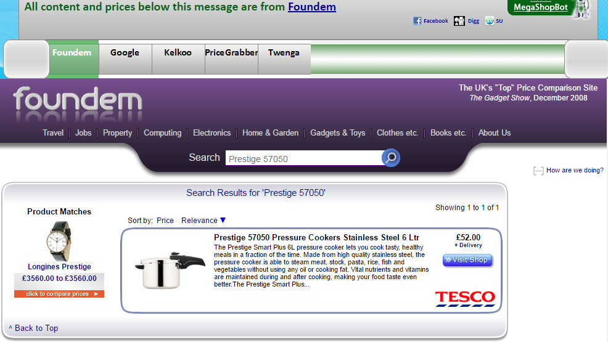
Megashopbot.com

Slide 12
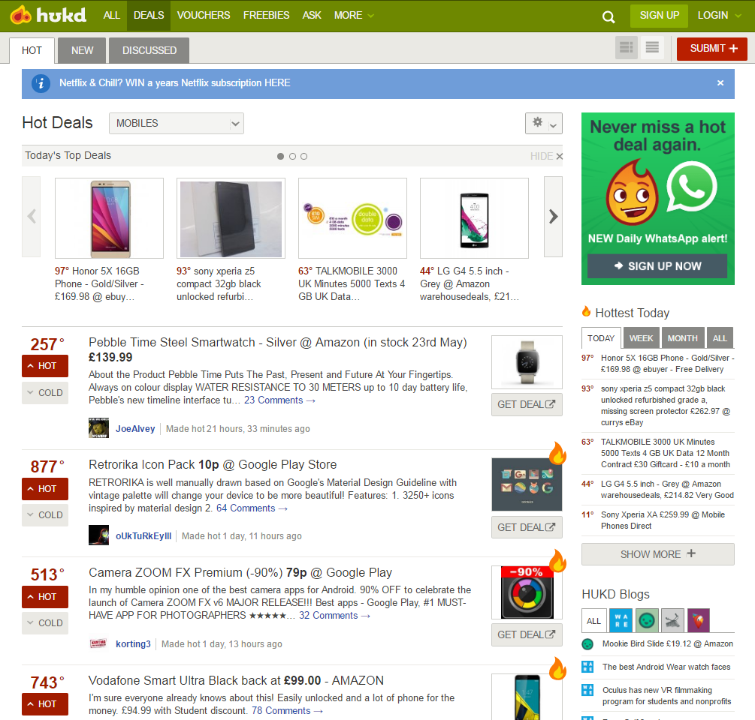
HotUKDeals

Slide 13
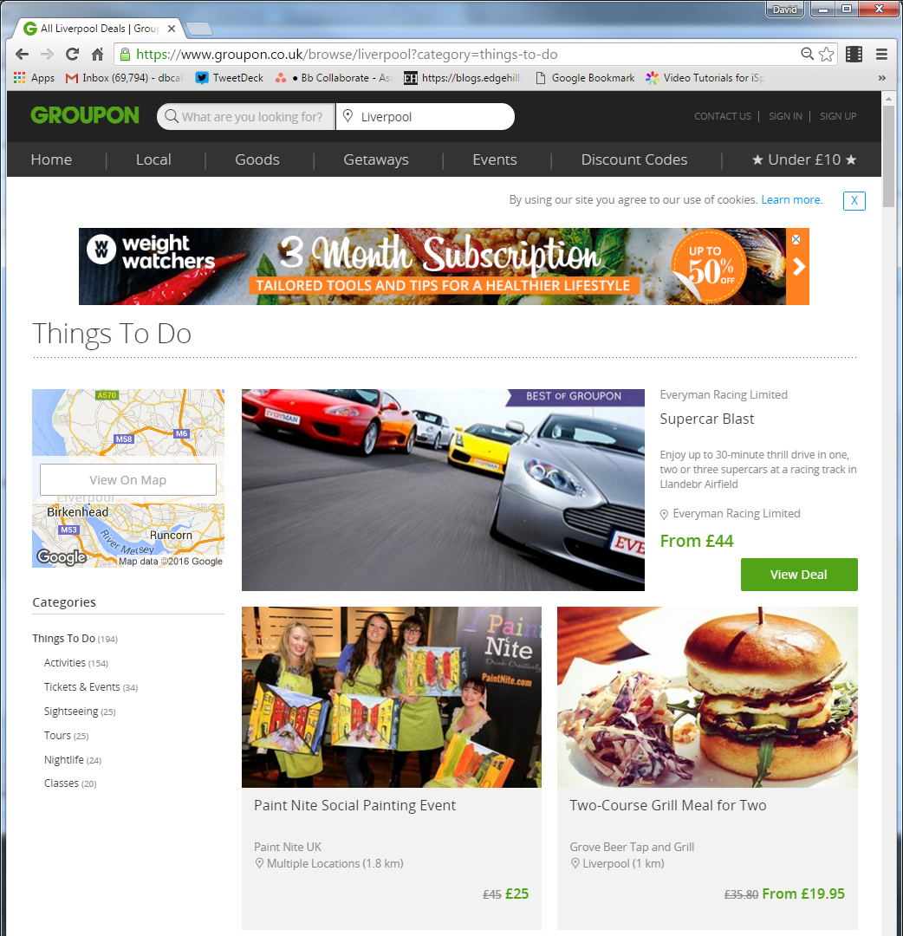
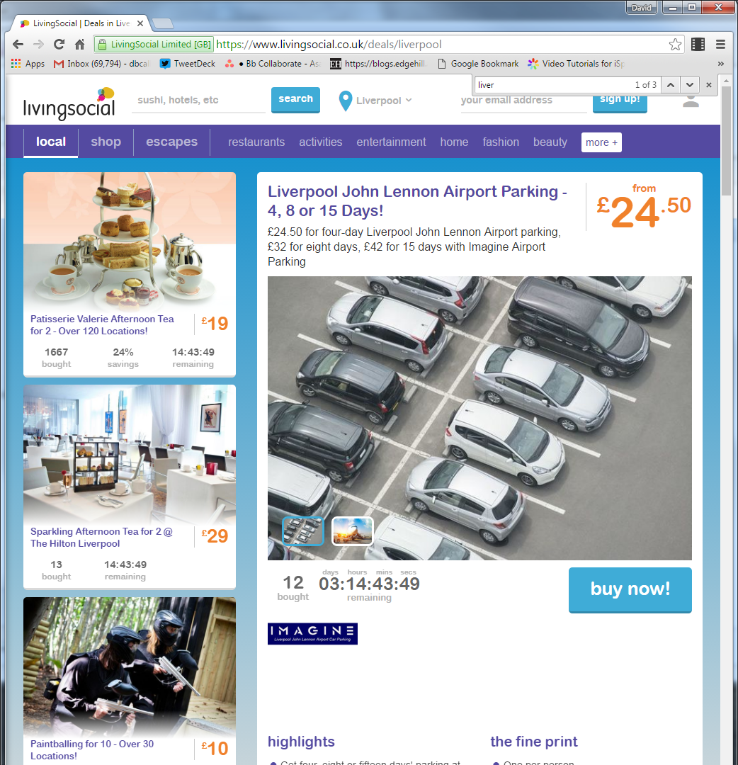
Group buying

Slide 14
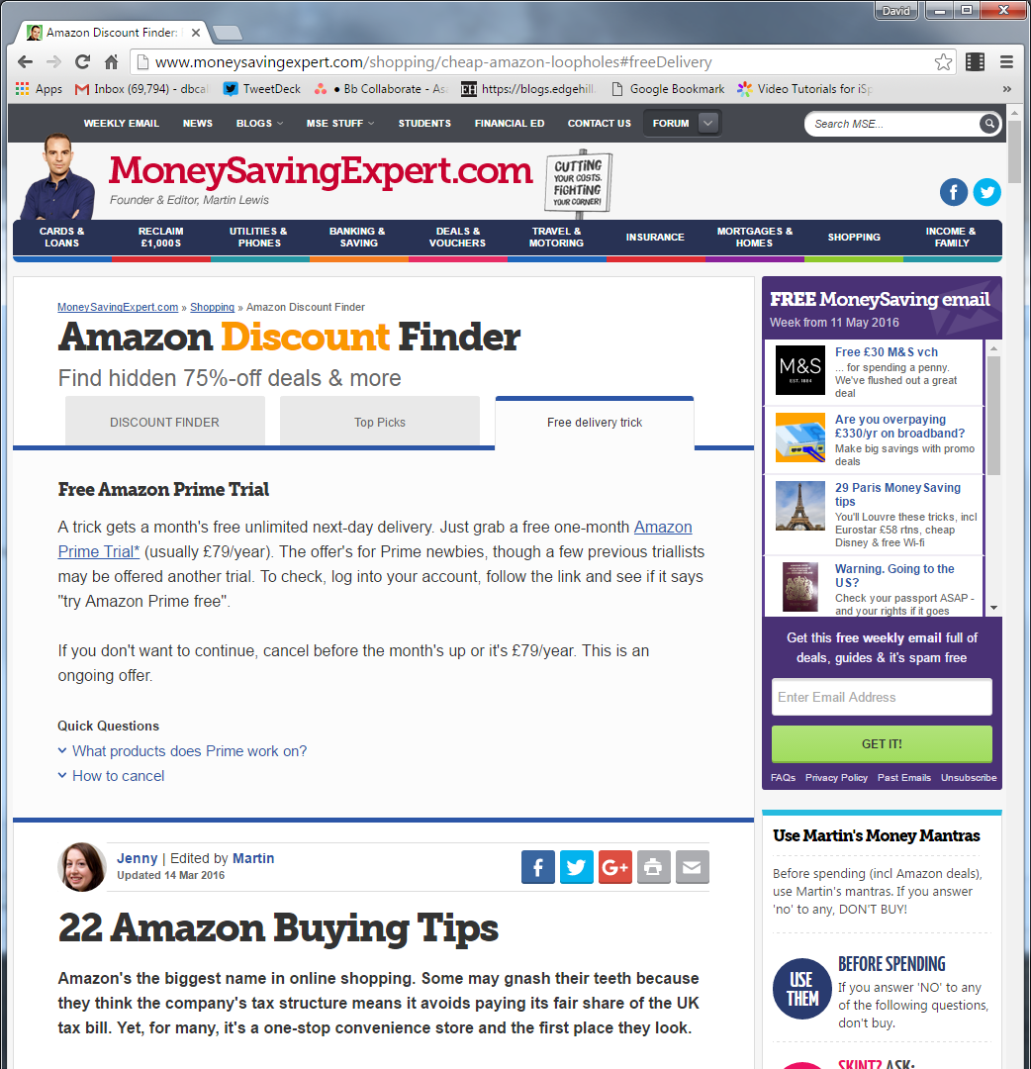
Forums
http://www.moneysavingexpert.com/shopping/cheap-amazon-loopholes#freeDelivery

Slide 15
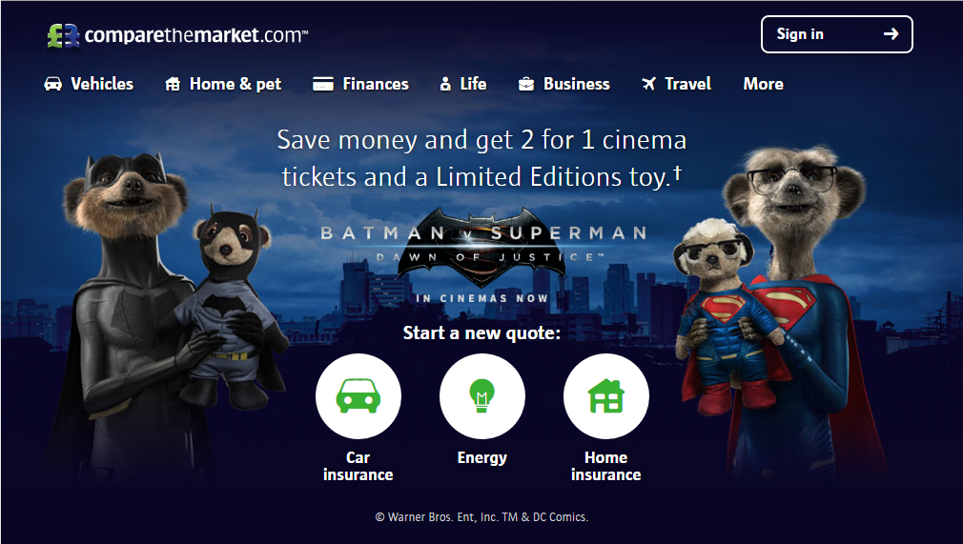
Insurance / Money / Fuel
Compare the market
Go Compare
Money Supermarket

Slide 16
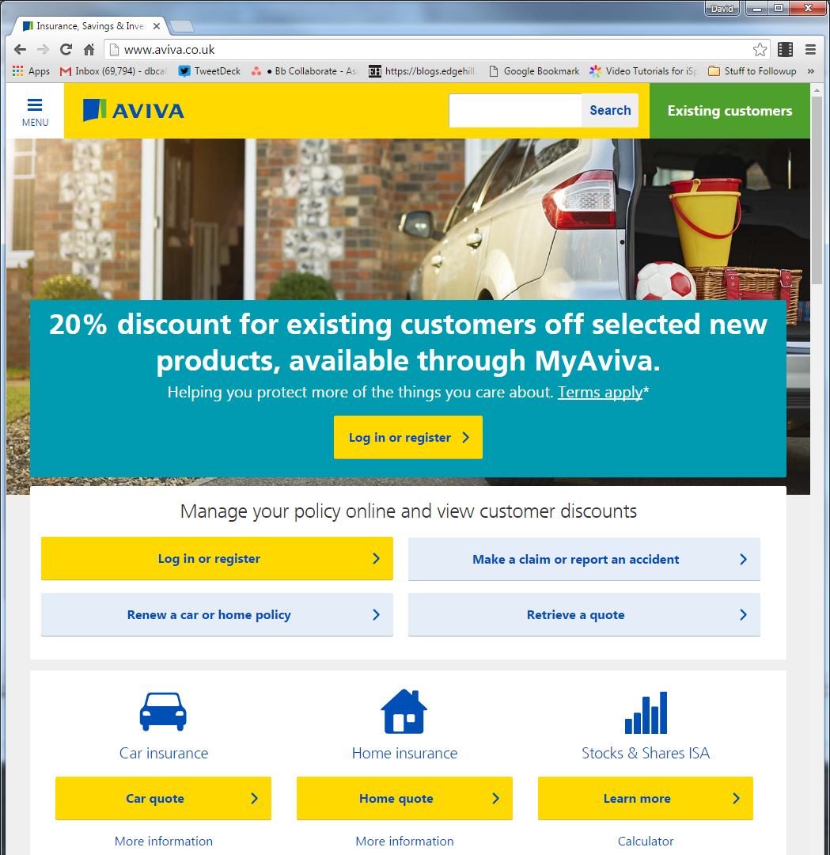
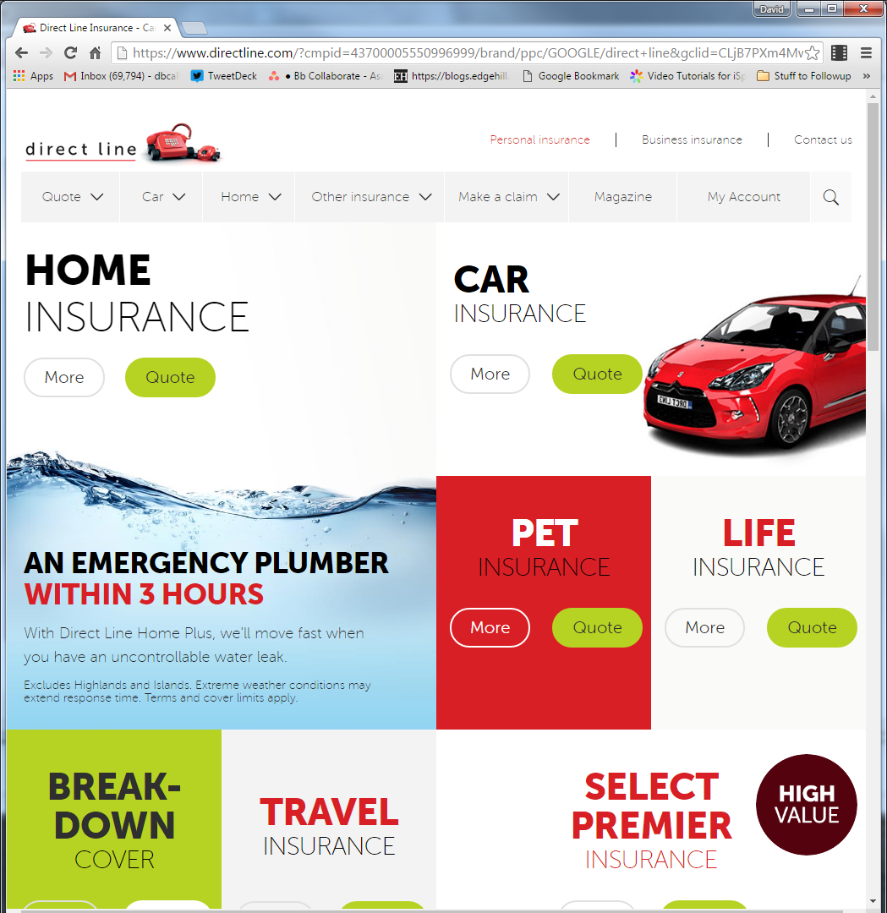
But …

Slide 17
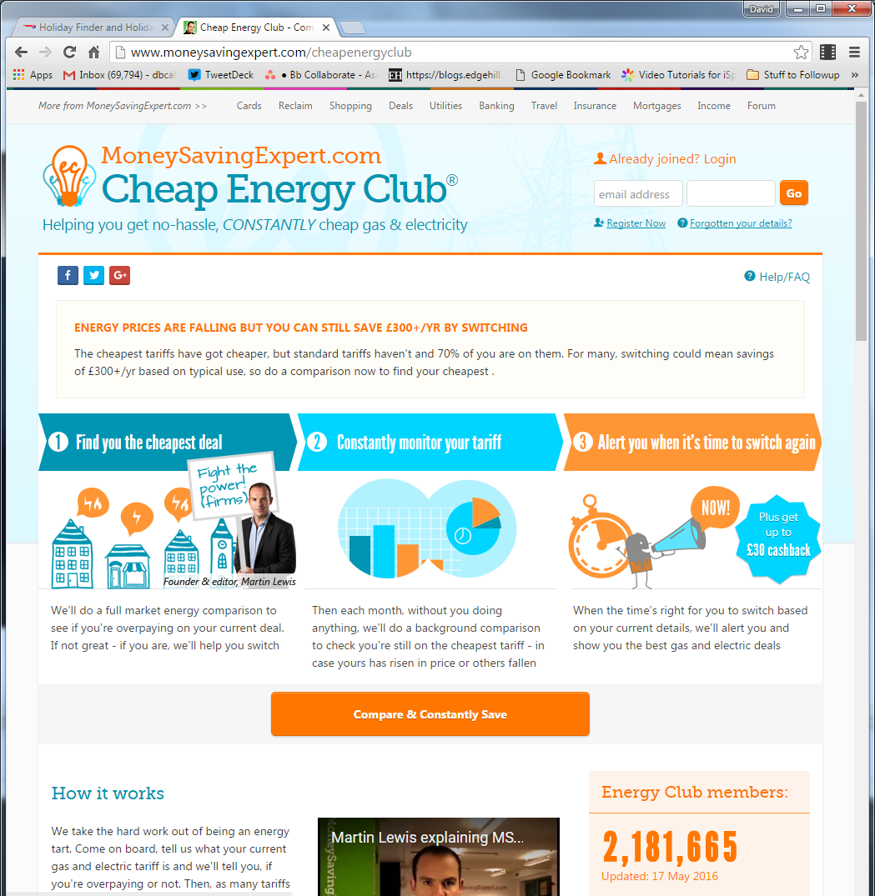
Engery
Group Deals
E.g., MSE:

Slide 18
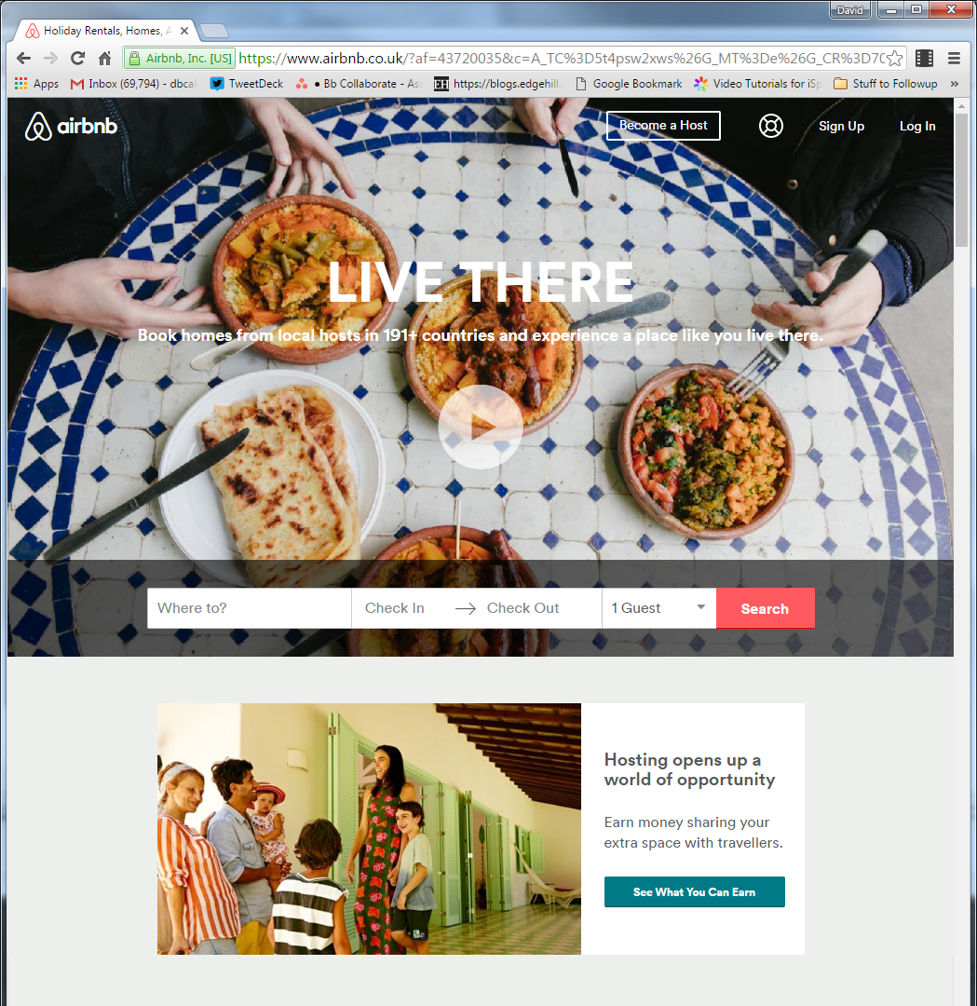
Holidays
Air BNB
HotWire

Slide 19
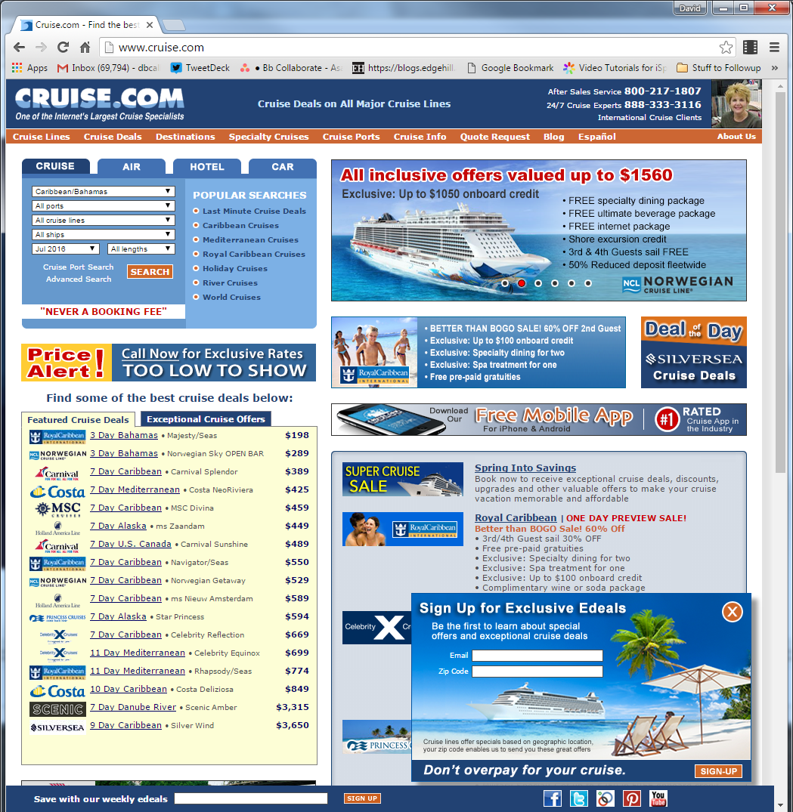
Holiday Meta sites
Holiday Hypermarket
Last Minute
Thomas Cook
eBookers
Cruising:
Cruise.com
Thomas Cook
VivaVoyage

Slide 20
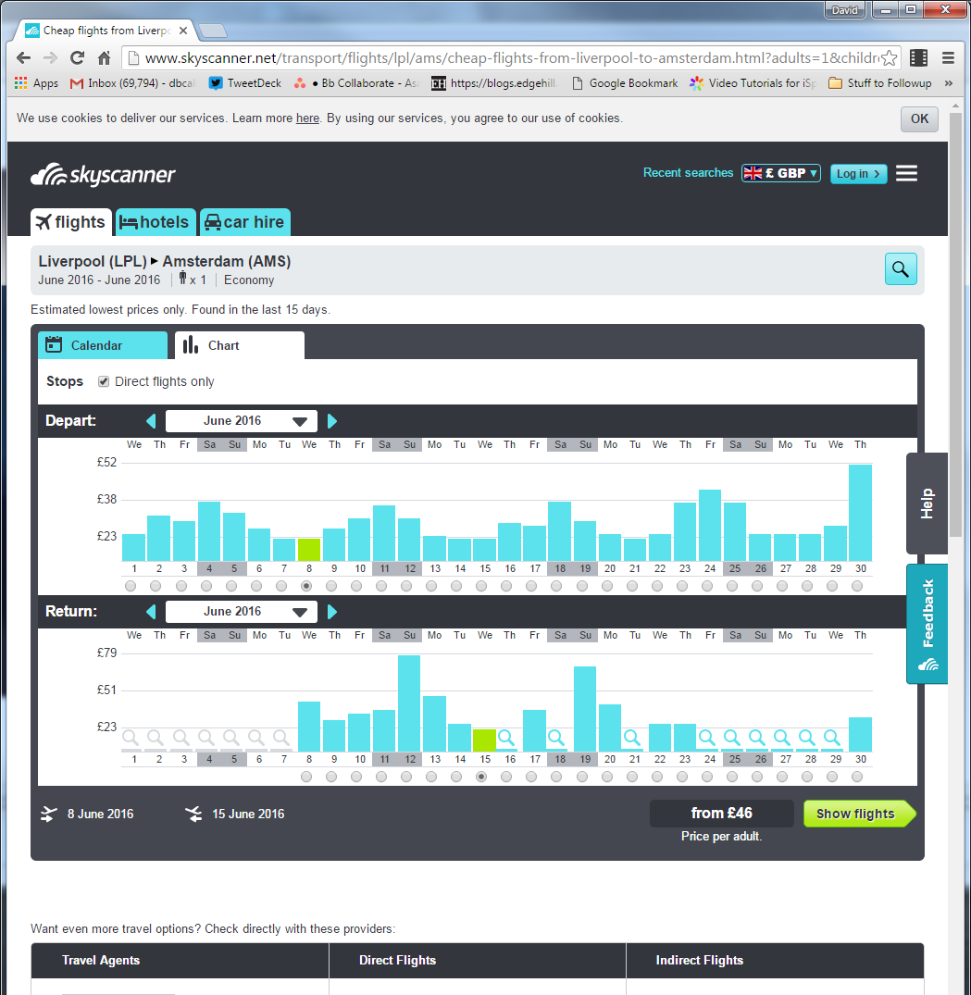
SkyScanner
Brilliant tool
… but

Slide 21
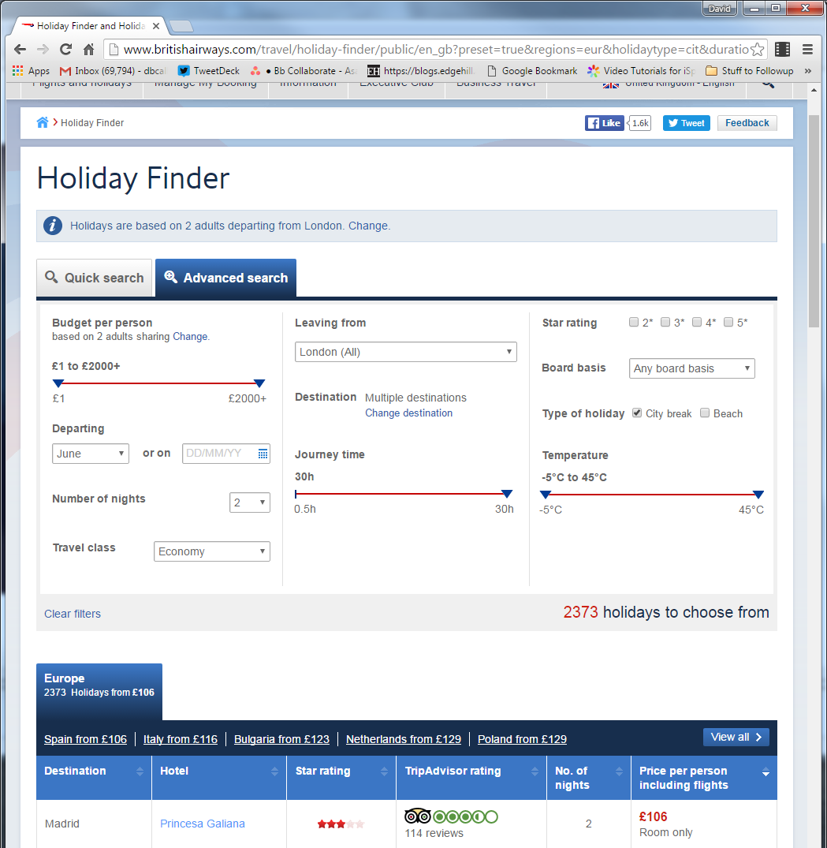
vs Direct
E.g.
British Airways:

Slide 22
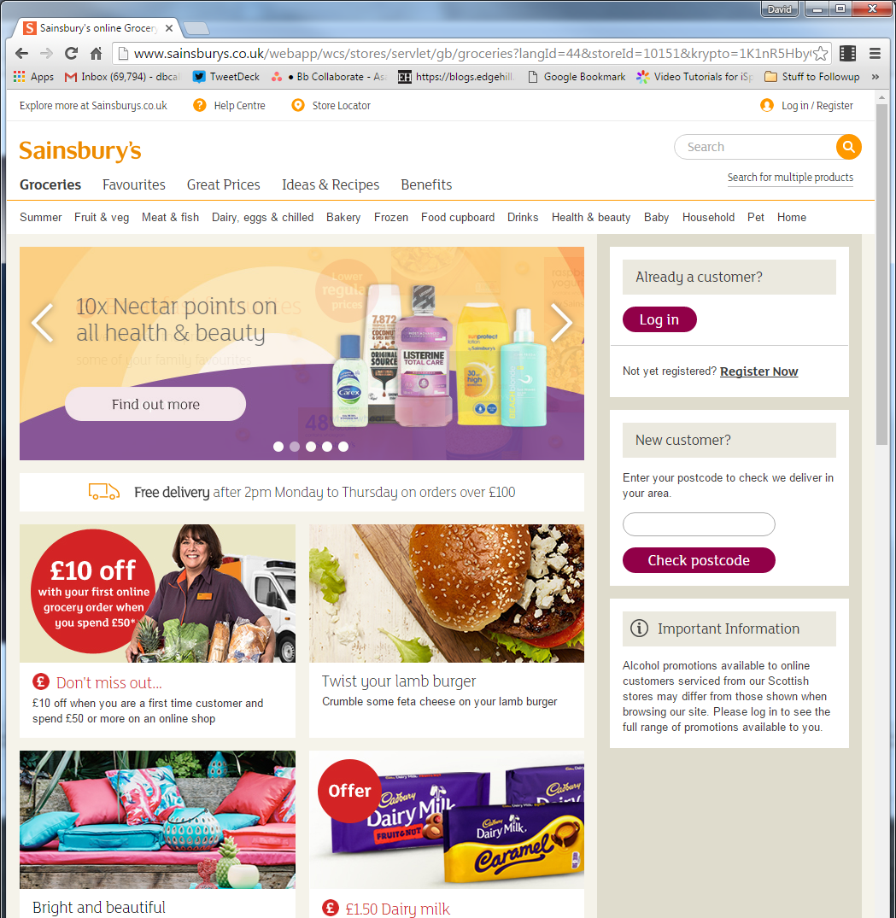
Food
Lots of offers

Slide 23
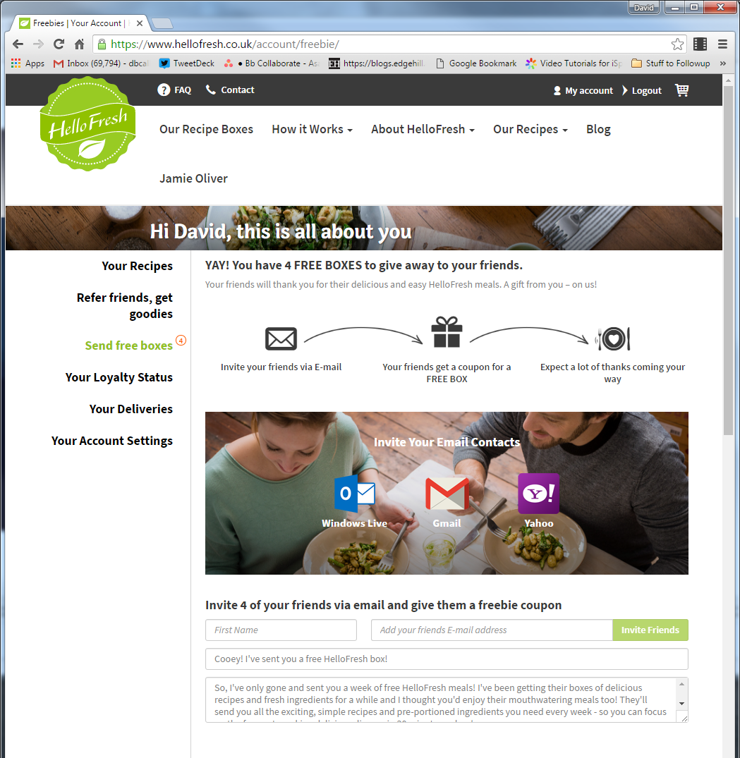
Free
HelloFresh.co.uk
Great food
Fab ideas
A little expensive
Remember to cancel!

Slide 24


Warranties
Koss

Slide 25
Sale of Goods act
From: "dbcallaghan@gmail.com" <dbcallaghan@gmail.com>
Date: 11 March 2010
Subject: Customer Enquiry
Reason for enquiry (header) - General
Reason for enquiry (specific) - Other
Comments - Hi
I bought a PSP from you around 2008 (slim & lite version - it had been out a few months). It has developed a fault that prevents it from turning on.
As the unit is around 2 years old I suggest that, under the Sale of Goods act, you should offer to replace, repair or refund.
I look forward to your response.
Kindest regards
David Callaghan

Slide 26

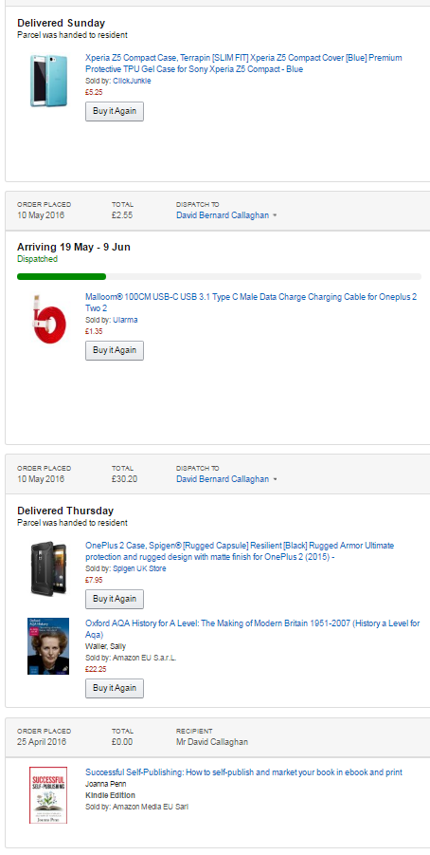
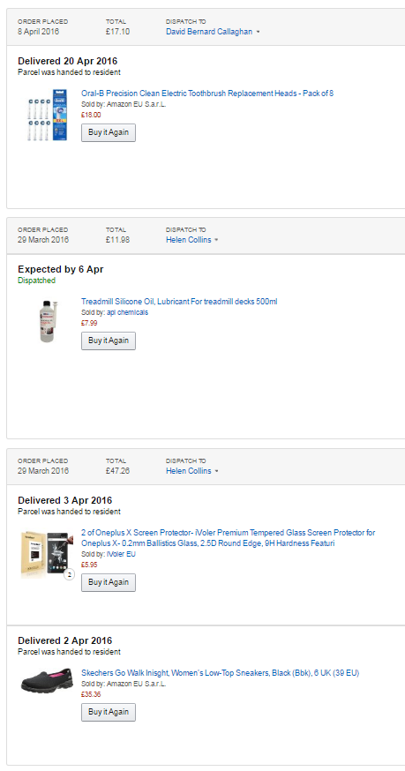
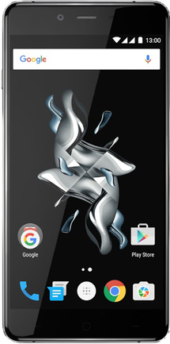

Recent Purchases

Slide 27
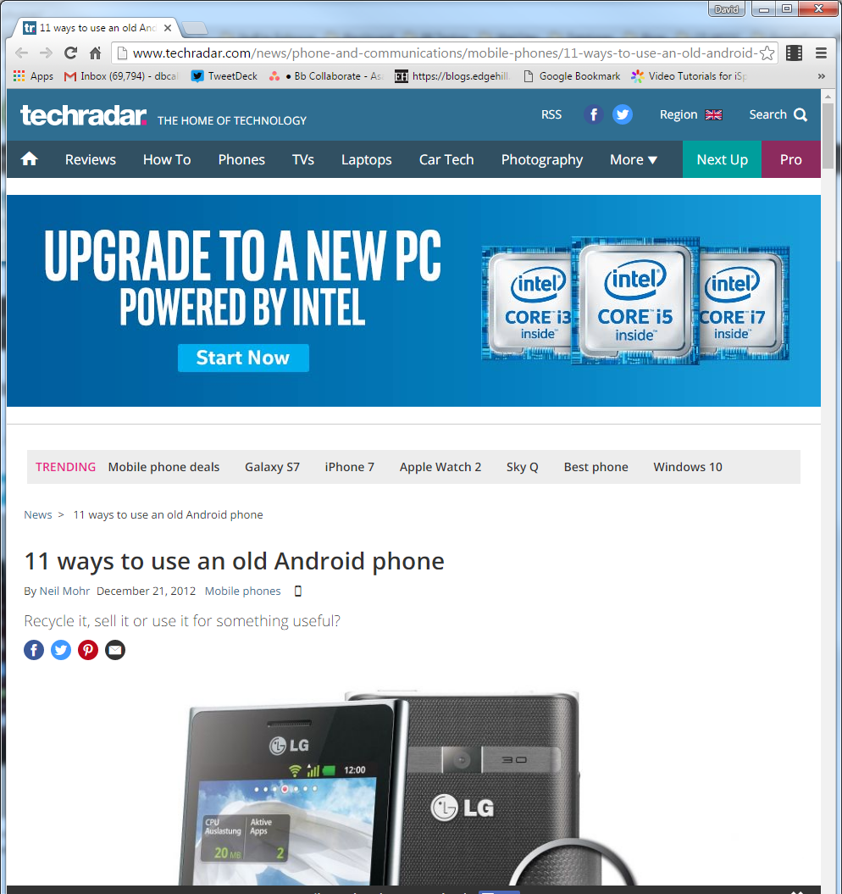
A little off topic:
Repurposing an old phone:
Security or nursery monitor
AirPlay audio streamer
Kids toy
Smart remote
Kitchen assistant
Ultra low-powered server
Portable media player
Portable games console
Remote IP web camera
Video camera
Sat nav

Slide 28

Take away messages
Plan – What will YOU do now?

