Slide 1
Dissertations Some basic pointers
Dissertations
Home
Getting Started
Focusing your research topic
Introductions and Conclusions
Literature Reviews

Slide 2
Before you begin
Check with your lecturer or tutor about specific requirements around the organisation, structure and writing of your dissertation as these may vary.

Slide 3
What is a dissertation?
A dissertation is a piece of research on a very specific and narrow focus.
It may take a number of forms depending on the topic or problem which the researcher is focussing on.

Slide 4
Getting started
A key factor of being organised is the ability to manage your time effectively.
Make time to plan, draft, write and proof read your work and of course submit on time.
Record submission dates and set yourself targets and deadlines each week leading up to the submission date.

Slide 5
Plan to succeed
STEP 1: Provisional reading / research background material (textbooks etc.)
First draft
STEP 2: More specific tailored reading / research on research parameters (journal articles etc.)
Second draft
STEP 3: Primary research (data collection / interviews.)
Third draft
Ensure that your research question is simple and clear.
Consider the main concepts of the research question when you are searching for relevant literature.

Slide 6
Focusing your research topic
This part includes the following:
Narrow and clear focus
Examples of dissertation titles that are too broad
How to develop your topic focus
An example of a good dissertation title

Slide 7
Narrow and clear focus
Focus on an area in the literature which has little written about it.
Avoid areas which are
too broad.

Slide 8
Dissertation titles that are too broad
Here are some dissertation titles, all of which are too broad to be feasible.
1. ‘Unemployment and Poverty in the UK’
2. ‘Special Educational Needs in Secondary Schools’
3. ‘Representations of Disability in the Media in the Twentieth Century’

Slide 9
What is wrong with these titles?
Unemployment and Poverty in the United Kingdom
Representations of Disability in the Media in the Twentieth Century
All three titles have a broad topic area and none are specific enough. The literature available on these topics would be too large.
You could never read the literature in the time allotted let alone produce a decent set of research questions or a workable literature review.
Special Educational Needs in Secondary Schools

Slide 10
Dissertation titles that are too broad
For example ‘Representations of Disability in the Media in the Twentieth Century’ is an unfeasible topic because:
The dissertation title has two topic areas; disability and media which are both too broad.
Both these broad topics cover a time frame that is too long; an entire century.

Slide 11
Developing your topic focus
Topic 1
Disability
Adding another topic area narrows the focus
Topic 3
Media
Topic 2
Law

Slide 12
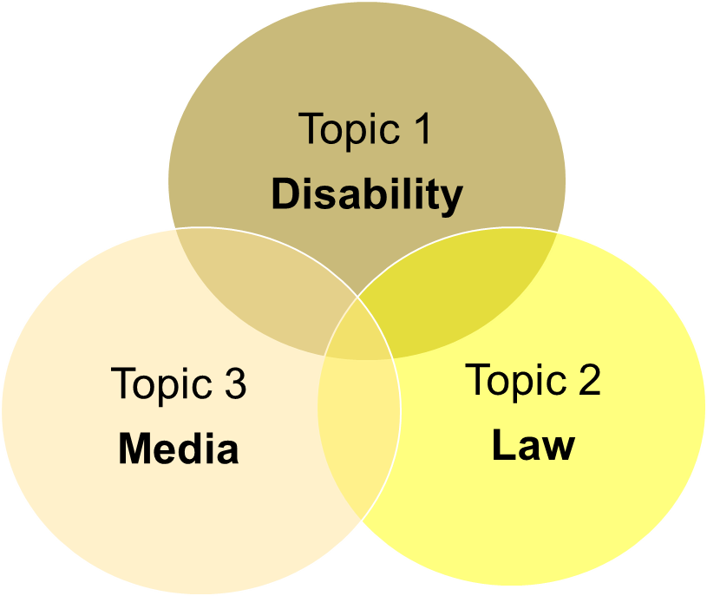
How to develop your topic focus
Initial reading of the literature might look at where subject areas overlap, rather than disability, media and law as separate subjects.
For example:
laws relating to the media
disability law
discussions of disability in the media

Slide 13
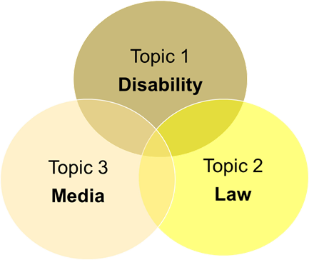
How to develop your topic focus
To refine your reading further consider where all three subject areas overlap.
For example:
Laws that relate to both disability and the media
Media discussions of disability laws
However, this is still too broad.
Now you need to narrow your topic focus further.

Slide 14
Narrowing your topic focus
Topic 2
Disability Discrimination Act
Topic 3
Radio 4 News Coverage
Topic 1
Parliament Debates on Disability
The Venn diagrams show how this topic has been narrowed further.
Notes:
a particular form of media, was selected, radio.
a specific radio station provides a further and tighter focus.
‘Law’ was narrowed down further to a particular Act related to disability.
‘Disability’ was narrowed to parliamentary debates on disability.
The narrowing of the time frame is not represented, however, it is implied to be the period in which the Disability Discrimination Bill was debated in Parliament before its passing into law and becoming an Act of Parliament.

Slide 15
An example of a good dissertation title
‘BBC Radio 4 News coverage of Parliamentary discussions of the Disability Discrimination Act’.
The dissertation title is now so tightly focused that there should be little previous literature on this specific topic.
However, there should be enough literature around this topic to provide context and material for discussion within a literature review.

Slide 16
Part 3: Introductions & Conclusions
This part includes the following:
Introductions and conclusions, what they should include.
A good example of an introduction.

Slide 17
Introductions, what they should include
What
Your focus, explain the specific question or topic you are examining.
Why
Your rationale explains how this research is important or significant. Does it tell us something that we don’t know and why we need to know this?
How
Say what your methodology, methods of gathering evidence etc. will be.
Notes:
What: Clearly state what your principal argument or findings are.
Why: (Note your What and Why will be discussed at length in your Literature Review.)
How: (Note: Your How will be discussed at length in your Methodology.) For example; semi structured interviews or questionnaires.

Slide 18
Conclusions what they should include
What
Restate your principal findings.
Why
What is the relevancy of your findings to wider debates in your area of research.
How
Explain how your research question/s have been answered by the methods you employed and the evidence you have found.

Slide 19
A Good example of an introduction
As an example, let us presume that the dissertation title is:
‘The role of a Special Educational Needs co-ordinator in primary school management structures’.

Slide 20
A Good example of an introduction
The What, Why and How outlined in the first paragraph would be something like this:

Slide 21
A Good example of an introduction
This introduction is now broken down into its three component parts: and each is examined in turn.
Let’s start with ‘What’
Focus:
This dissertation examines the Special Educational Needs Co-ordinator’s (SENCO) role within a primary school management structure in one school in the North West of England. This dissertation will seek to interrogate to what extent the limitations of the SENCO role in the management structure of the school aid or hinder the following of Government SEN agendas and policies.
Principal Argument:
It will argue that though this is a single case it is indicative of the role of the SENCO: its limitations and opportunities for supporting children with a Special Educational Need (SEN).
Here the focus and principal argument are stated first so the reader knows what the dissertation research is on and what the argument is that will be made throughout the dissertation. As this dissertation is a case study this could have been mentioned in the first sentence as well.

Slide 22
A Good example of an introduction
The ‘Why’ can now be considered.
Importance or significance:
The significance of the SENCO role is that it is often deemed as one of the key actors with responsibility for children with an SEN in a school.
This highlights the importance of the SENCO role.
To improve this sentence further, if this role is under researched it would be useful to mention this here.
Alternatively, there may be disagreements about the usefulness of this role, again it would improve the sentence further to acknowledge this.
To a certain extent this will highlight and emphasise further the rationale (reason for doing) your research.

Slide 23
A Good example of an introduction
The ‘How’ can now be considered.
Methodology:
This dissertation will use a case-study methodology to examine the role of one SENCO in one school. It will use open ended interviews with the SENCO and the other senior managers within the school to assess the limitations and strengths of the SENCO’s role (rather than the individual who fulfils that role) in delivering government policy at the local school level.
The ‘How’ should be a very simple summary of the methodology adopted and the basic method you are using to gather your primary evidence.

Slide 24
Part 4: Literature Reviews
This Part includes the following:
Purpose of a literature review
Different types of literature reviews
Writing tips
Successful searching
Recording your search
Managing your references

Slide 25
Before you begin
Check with your lecturer or tutor about specific requirements around the organisation, structure and writing of your literature review as these may vary.

Slide 26
Purposes of a literature review
Literature reviews do not answer research questions they pose research questions.
Identify key themes, authors and ideas for your specific topic.
Does not need to capture every detail of the debate.
Explains how the topic is to be investigated further as a research project, including design and methodology.

Slide 27
Literature review research question examples.
You have your topic.
“Parenting children with severe learning difficulties”
Now you need your research question.
“What is the experience of parents looking after a child with severe learning difficulties?”
OR
“Are parents able to access the help they need when looking after a child with severe learning difficulties?”

Slide 28
Literature reviews
Academic Rationale
Identify and analyse what is NOT known and NOT agreed on and why
Identify a specific focus in the literature which has been under researched or is problematic
Identify why this specific focus should be researched further
DO NOT describe every piece of academic work in your chosen field. Keep factual information to a minimum.

Slide 29
Systematic Review
Narrative Review
Critical Review
Types of Literature Reviews
Tip!
Search for literature reviews in your discipline and read them to get an idea of the themes you might want to look for in your own reading or research.

Slide 30
Systematic Review
Undertaken according to a defined and systematic approach.
Critical Review
A writing task that asks you to summarise and evaluate a text.
Requires you to read the selected text in detail and to also read other related texts so that you can present a fair and reasonable evaluation of the selected text.
Narrative Review
Summarises different primary studies from which conclusions may be drawn into a holistic interpretation contributed to by the reviewers’ own experience, existing theories and models.
Identify, appraise and synthesize research evidence from individual studies based on a strict protocol.
Notes:
Glossary slide
Review definitions and simplify

Slide 31
Literature review: Writing tips
Avoid long quotations unless you are going to discuss them at length
Group authors and link ideas
Paraphrase or quote single authors sparingly

Slide 32
Literature review: Writing tips
On occasion it is better to paraphrase multiple authors: for example,
‘Numerous authors have argued x (see for example Smith, 2010, Jones, 2009 and Bloggs, 2001).
Then acknowledge the counter arguments: for example
‘However other authors have suggested y (see for example Cooper, 2011, Johnson, 2005 and Butcher, 2000).
Then give your position on this – your arguments for x as against y.

Slide 33
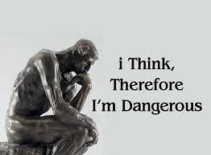
A Synthesis Matrix
Synthesising information is closely connected to determining importance.
Determine what is important in the text.
Organizing, recall and recreate the information and fit it in with what is already known.
A synthesis matrix presented in a chart may help you to think/write in sub-topics.
Work vertically in a chart column belonging to a source, recording as much information as possible about each significant idea presented in the work.
Example Chart
Notes:
After you have determined what is important in the text, go through the process of organizing, recalling and recreating the information and fitting it in with what is already known.
A synthesis matrix presented in a chart may help you to think/write in sub-topics, comparing and contrasting the different researchers and their arguments.
As you examine your first information source, you will work vertically in the chart column belonging to that source, recording as much information as possible about each significant idea presented in the work.

Slide 34
A Synthesis Matrix
Research topic Burnout syndrome amongst ICU nurses | Author A Peterson, A. | Author B Bannerman, J. | Author C Allan,S. and White, M. | Points to note/comments
Article title/details
Research aims
Methods | qualitative: case study : 6 ICU nurses over 9 months | qualitative: questionnaire: 572 general ward nurses | qualitative: cross-sectional survey of 5956 staff nurses | A = case study over longer research period than B and C (only questionnaires) – significant?
Findings: main ideas/themes
Discussion/analysis
Conclusions
Queen Margaret University, Edinburgh

Slide 35
Successful literature searching
Remember!
Planning a search strategy gives you a predefined plan for searching for information or research on a topic. It is the most efficient way to find your information.
Planning
Preparation
Efficiency

Slide 36
Using relevant journals
Reference list searching
Search
Author searching
New publication alerts
Additional
Grey literature
Citation searching
Strategies
Carefully executed electronic search strategies will need to be supplemented using additional searching methods to ensure relevant pieces of research are not omitted.

Slide 37
Reference list searching
Identify the key journal articles relating to your research question
Examine the reference lists for further references that may be useful to you
Using relevant journals
Where key articles are located in one or two journals search these journals to see if other relevant articles can be identified.
Author searching
If you find many of your key articles are by the same author(s), carry out additional searches by author
Notes:
Review definition for Grey Literature

Slide 38
New publication alerts
Online databases provide options to sign up for an account, save searches and set up email alerts to let you know when new research is published on your saved search strategy
Citation searching
Allows you to track research. Search for specific books or journals to see who has used them in their research.
Grey literature
For example; conference papers on websites, official reports, government publications etc. Try Open Grey or BASE
See help links
Try Web of Science, Google Scholar or Academic Search Premier. Look for links in the results like, cited by or find similar results or search options like Cited Reference Search.

Slide 39
Recording your search
Organising your information at the beginning will save you from the overwhelming task of trying to organise at the end when you have a lot of material.
Keep a record of your searches, perhaps as a spreadsheet.
prevents duplication of effort
prevents missing out on a significant and relevant sector of literature
Database/Catalogue/Resource | Supplier: e.g. Science Direct or Wiley | Date searched | Keywords /limits / filters | Number of results
Notes:
Keeping a record of your search is useful, to prevent you duplicating effort by doing the same search twice, or missing out a significant and relevant sector of literature because you think you have already done that search.

Slide 40
Managing your references
It is worth investing time in learning to use reference management software.
You can collect references from a wide variety of sources and keep them in one place.
When you download them from databases or online, you know they are complete and accurate.
Always check your referencing meets the standard set by your lecturer or marker.

