Slide 1
Literacy at Silverstone UTC
Driving home the need to read

Slide 2
Let’s read

Slide 3
Literacy Policy
Always begin the lesson with 10 minutes private reading.
Black vocabulary books are used to extend language choices.
Circle is displayed with the lesson’s literacy objective.

Slide 4
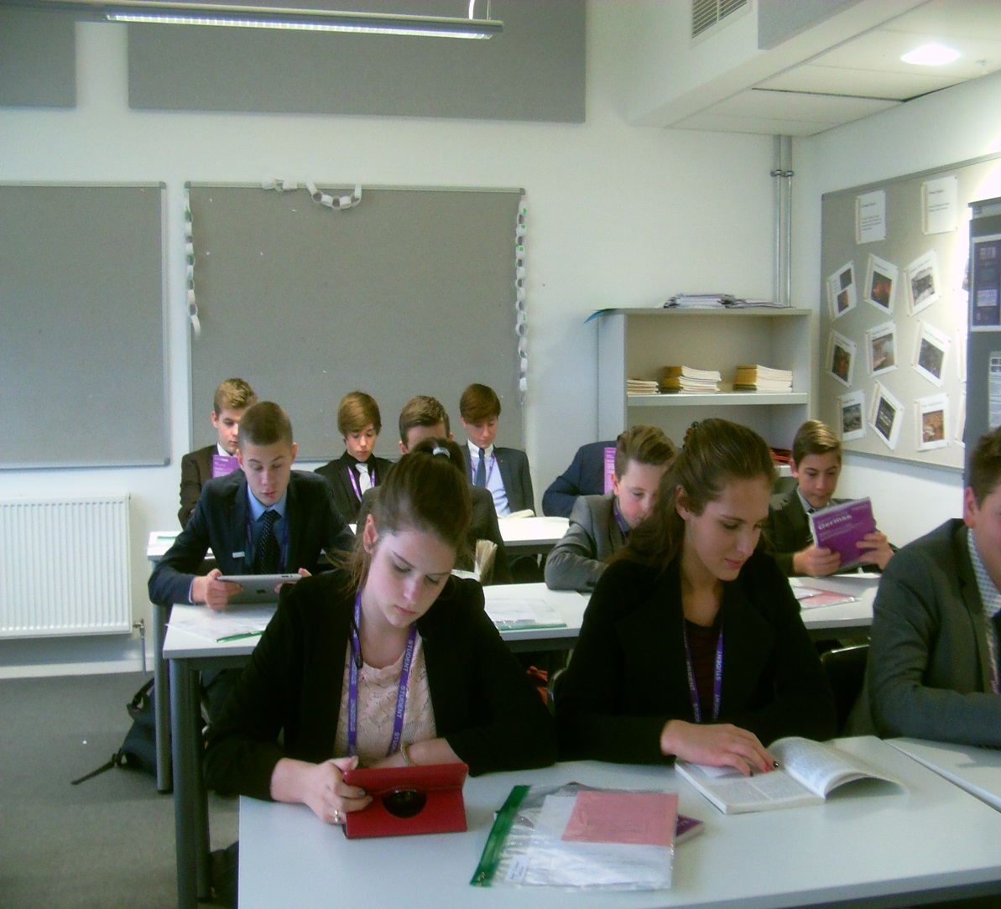
Let’s read

Slide 5
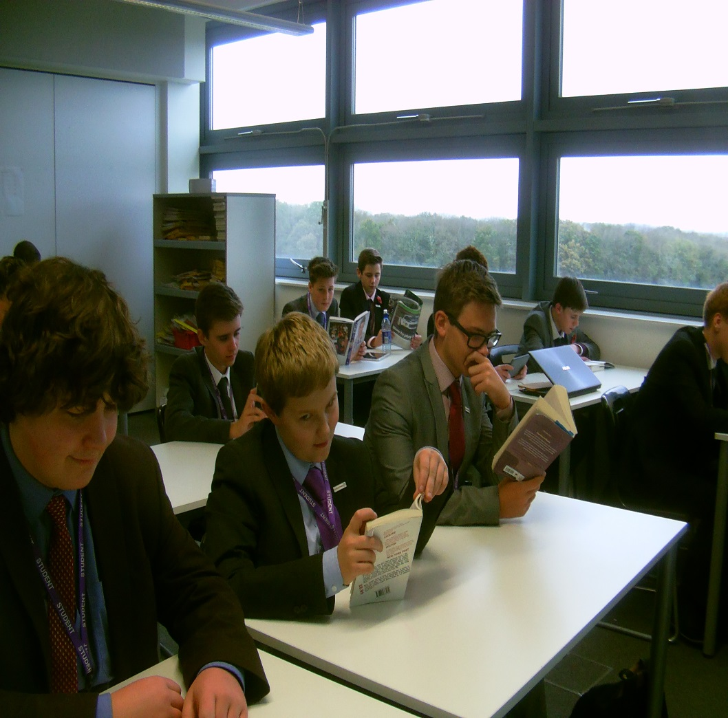
Let’s read

Slide 6
WORD OF THE WEEK
Succumb- verb (doing word)
Meaning: fail to resist….pressure, temptation.
Dr Jekyll could not resist the temptation to become Mr Hyde, he succumbed to the drugs to change into his alter ego.

Slide 7
Little black book

Slide 8
Little black vocab book

Slide 9
Vocabulary book

Slide 10
Literacy yellow dot

Slide 11
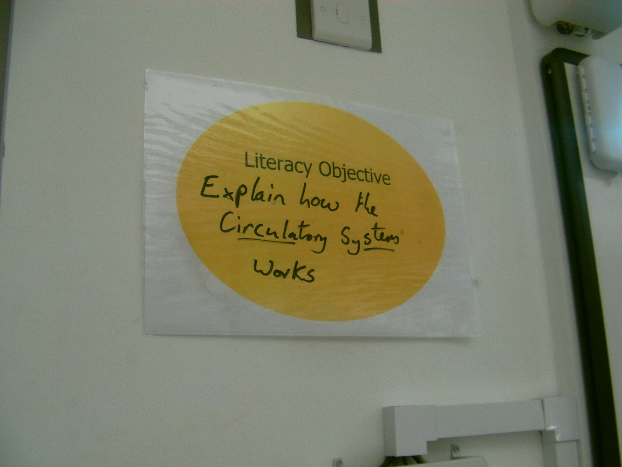

Slide 12
Student of the week- 10 reward points. Making students proud of their success.

Slide 13
Reading Buddy interview- Year 10 student

Slide 14
Year 10 and Year 12 interview: the buddies

Slide 15
Reading Buddy- Year 11 student

Slide 16
Year 11- interview

Slide 17
Buddy pack

Slide 18
Literacy leaders- interview

Slide 19
Lesson dipping by the leaders
Lesson Dipping: What to look for
Is the literacy objective displayed up on the wall?
What is the objective?
Are students aware of this? Can they tell you about what it means?
Can students tell you about where it has formed a part of their learning?
Do students receive feedback when they have tried to meet this objective? What form has this taken (written/verbal/peer/self-assessment)?

Slide 20
Weekly literacy spot in the staff bulletin
LITERACY
All Year 10 and Year 11 students have been issued with their little black vocabulary book. Please remember when you introduce a new word or key term in your subject, allow students time to write it in their book.
Thank you
‘It’s a handy little book to have, because it helps with my vocabulary and it’s there when I need it.’
Dean Martin Year 10

Slide 21
Weekly literacy spot in the staff bulletin
Literacy spot
The root of the matter
Being aware of the origin of the word can help enormously with vocabulary and spelling.
Here are a few examples of everyday words with Greek roots:
Biology= bios (life) logia (study)
Democracy= demos (people) kratos (rule)
Dyslexia= dys (impaired) lexis (word)
Geography= ge (earth) graphein (to write)
Now you can say, ‘it’s all Greek to me.’

Slide 22
Whole school marking for literacy

Slide 23
Primary school visit
A group of students went in role as fictional characters and worked with groups of Year 6 students at the local primary school.
Focus: creative writing.

Slide 24
Moving forward
Next year I have asked SLT to try and timetable five English lessons over a fortnight; increasing hours from eight to ten.
Year 10 and 11 students working as leaders.
Competitions

