Slide 1
Creating a Banner Image for Blackboard 9.1
PowerPoint allows you to create effective banners easily (Banner template size: 16 x 4 cm).
There is no specific limit to the banner size. However, large banner sizes may require the viewer to use a scroll bar to see the whole image, depending on the size of their browser window and their screen resolution. Use these template to help you create well sized banners
Want to know how to create a banner from scratch using ‘Custom Slide Size? Go to eShare for the following LTD guide: LTD3069.
Following this slide - for an improved viewing experience (not in Show mode), click View tab, followed by ‘Zoom’ then select 100% or use the -/+ (%) slider (bottom right) to refine the adjustment.

Slide 2
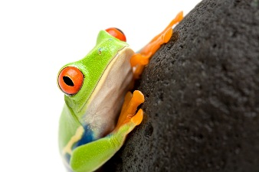
Biodiversity SCI1404 Biology Department September 2014
Deleting unwanted thumbnail helps to avoid creating unwanted banners
01 Banner Template
Text box
Banner/slide (16 x 4 cm)
Clipart/photo /graphic image
Use these templates to create your own design. Click to the next slide to view the basic features. Click and remove unwanted items, replacing images, adding text (module/course/organisation ID, Name and Date) as required.
When complete save the banner as a JPEG or PNG file on your PC.

Slide 3
Biodiversity SCI1404 Biology Department September 2014
Deleting unwanted thumbnail helps to avoid creating unwanted banners
01 Banner Template

Slide 4
Deleting unwanted thumbnail helps to avoid creating unwanted banners
02 Banner Template
Banner/slide (16 x 4 cm)
Clipart/photo /graphic image (send to back of text box).
Text boxes
Use these templates to create your own design. Click to the next slide to view the basic features. Click and remove unwanted items, replacing images, adding text (module/course/organisation ID, Name and Date) as required.
When complete save the banner as a JPEG or PNG file on your PC.

Slide 5
Deleting unwanted thumbnail helps to avoid creating unwanted banners
02 Banner Template

Slide 6
Deleting unwanted thumbnail helps to avoid creating unwanted banners
03 Banner Template
Clipart/photo /graphic image (send to back of text box)
Banner/slide (16 x 4cm)
Text boxes
Use these templates to create your own design. Click to the next slide to view the basic features. Click and remove unwanted items, replacing images, adding text (module/course/organisation ID, Name and Date) as required.
When complete save the banner as a JPEG or PNG file on your PC.

Slide 7
Deleting unwanted thumbnail helps to avoid creating unwanted banners
03 Banner Template

Slide 8
Deleting unwanted thumbnail helps to avoid creating unwanted banners
03 Banner Template

