Slide 1
Anthony Burgess, Tremor of Intent
LIT 3024
Sense of an Ending

Slide 2
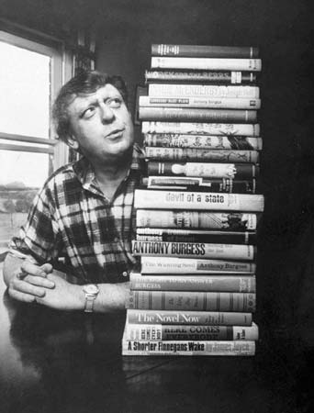
Overview
Burgess as novelist
The sixties scene
The spy genre
Key characteristics of Burgess’s novel

Slide 3

Burgess as novelist
Long and prolific career
Malayan trilogy late 50s
Terminal year – five novels
A Clockwork Orange (1962)
Enderby novels
Earthly Powers (1980)
A Dead Man in Deptford (1992)

Slide 4

The sixties
‘Sexual intercourse began in 1963’ (Philip Larkin)
Relative prosperity
Youth cultures and sub-cultures
Cold war tensions (Cuban missile crisis, Kim Philby)
Notes:
Annus Mirabilis
Sexual intercourse began
In nineteen sixty-three
(which was rather late for me) -
Between the end of the "Chatterley" ban
And the Beatles' first LP.
Up to then there'd only been
A sort of bargaining,
A wrangle for the ring,
A shame that started at sixteen
And spread to everything.
Then all at once the quarrel sank:
Everyone felt the same,
And every life became
A brilliant breaking of the bank,
A quite unlosable game.
So life was never better than
In nineteen sixty-three
(Though just too late for me) -
Between the end of the "Chatterley" ban
And the Beatles' first LP.

Slide 5

cultural context of the sixties
Growth of pop music
Pirate radio stations, leading to BBC reorganisation
Pop art (Warhol, Lichtenstein)
End of theatrical censorship
Much greater frankness in literature
Decriminalisation of homosexuality, 1967

Slide 6
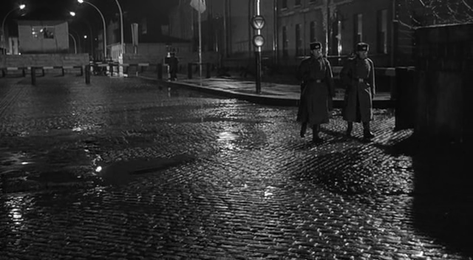
Espionage and fiction
Already established genre (Conrad, The Secret Agent, 1907)
Eric Ambler, 1930s
Ian Fleming, James Bond 1953 on
New resonance in Cold-War era
John le Carre, The Spy Who Came in From the Cold (1963)

Slide 7

Burgess and espionage
Honey for the Bears (1963) – comic novel involving character trapped in Leningrad by Russian spies
Produced script for James Bond film
Espionage features in several later novels, e,g, Earthly Powers, Any Old Iron, A Dead Man in Deptford.
No evidence AB himself a spy
Notes:
Burgess completed a script for the Bond film The Spy Who Loved Me in 1977. Cubby Broccoli turned it down, though Burgess claimed that the finished film retained his idea for a floating seaborne lair for the villain. Burgess’s plot begins with Bond ‘fighting a Chinese musical gong society and drowning one of its thugs in a tub of shark’s fin soup, seasoning it with soy sauce’

Slide 8
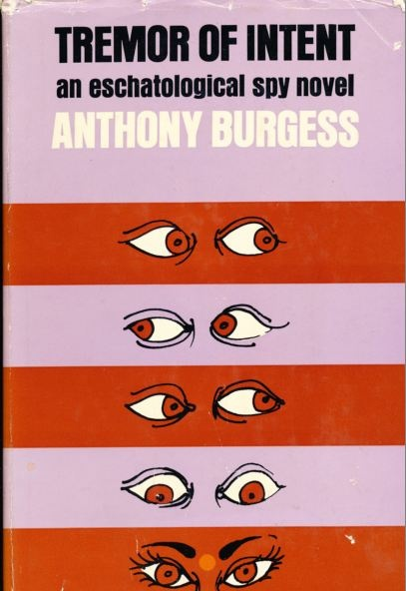
Tremor of intent
Published 1966
Biswell: blend of Ian Fleming-style spy fiction, Graham Greene-style examination of the human condition, and some literary experimentation, owing something to James Joyce
“An eschatological spy novel.”
Connotations of the title
Notes:
Eschatology-the branch of theology or Biblical exegesis concerned with the end of the world.

Slide 9

Structure and style
Part 1: First person narrative by Hillier begins in medias res on the Polyolbion crusie ship
Account of his and Roper’s Catholic upbringing, and war experience, post-war meeting – Brigitte
Hillier’s position as spy on final job before retirement
His self-loathing (p.47)
Notes:
Polyolbion: Poly-Olbion, by Michael Drayton, is an early modern epic of national description, is comprised of topographical descriptions of the counties of England and Wales, with digressions on national and local traditions, legends and histories. 15,000 lines, published in two parts, 1612 and 1622.

Slide 10
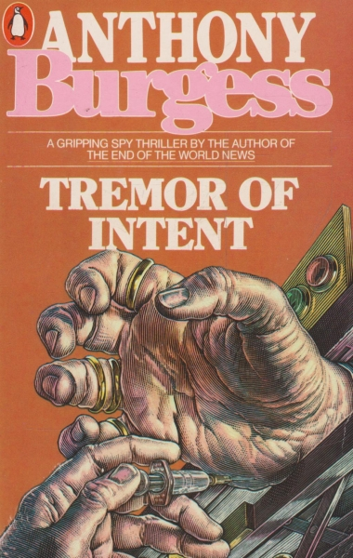
Structure and style
Part 2: Third-person omniscient narrator
Early indications of Fleming-style spy genre (p.49)
Closed environment of the ship recalls Greene, Stamboul Train
Set piece scenes of excess ( sex, gluttony)
Ending: “Everything he’s told us is religious.” (p.112)

Slide 11
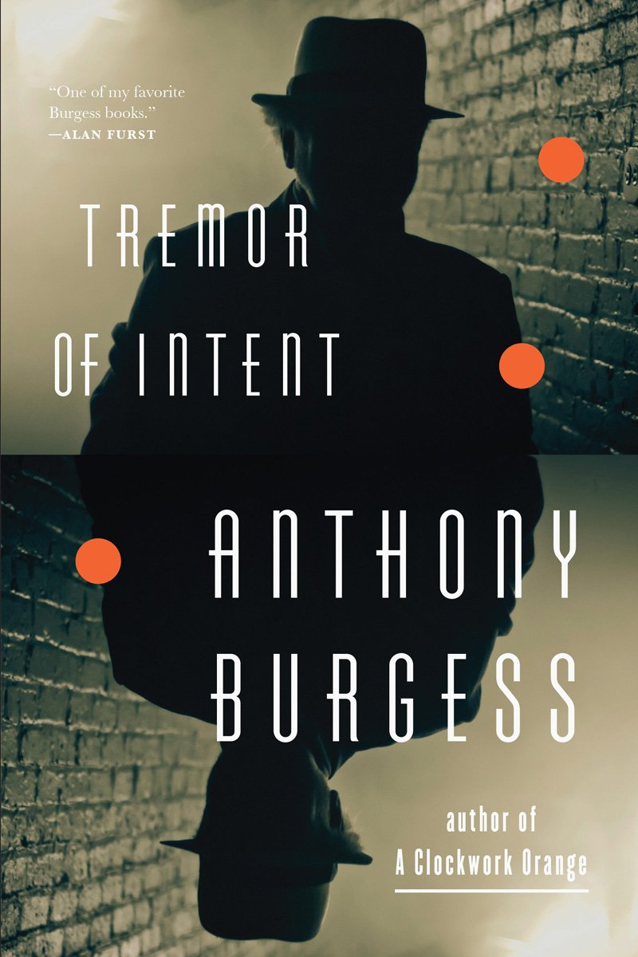
Structure and style
Part 3: Joycean stream of consciousness / internal monologue
Third-person omniscient narrative, with the Roper memoir interpolated
Part 4: The most conventional section – straightforward third-person narration.

Slide 12
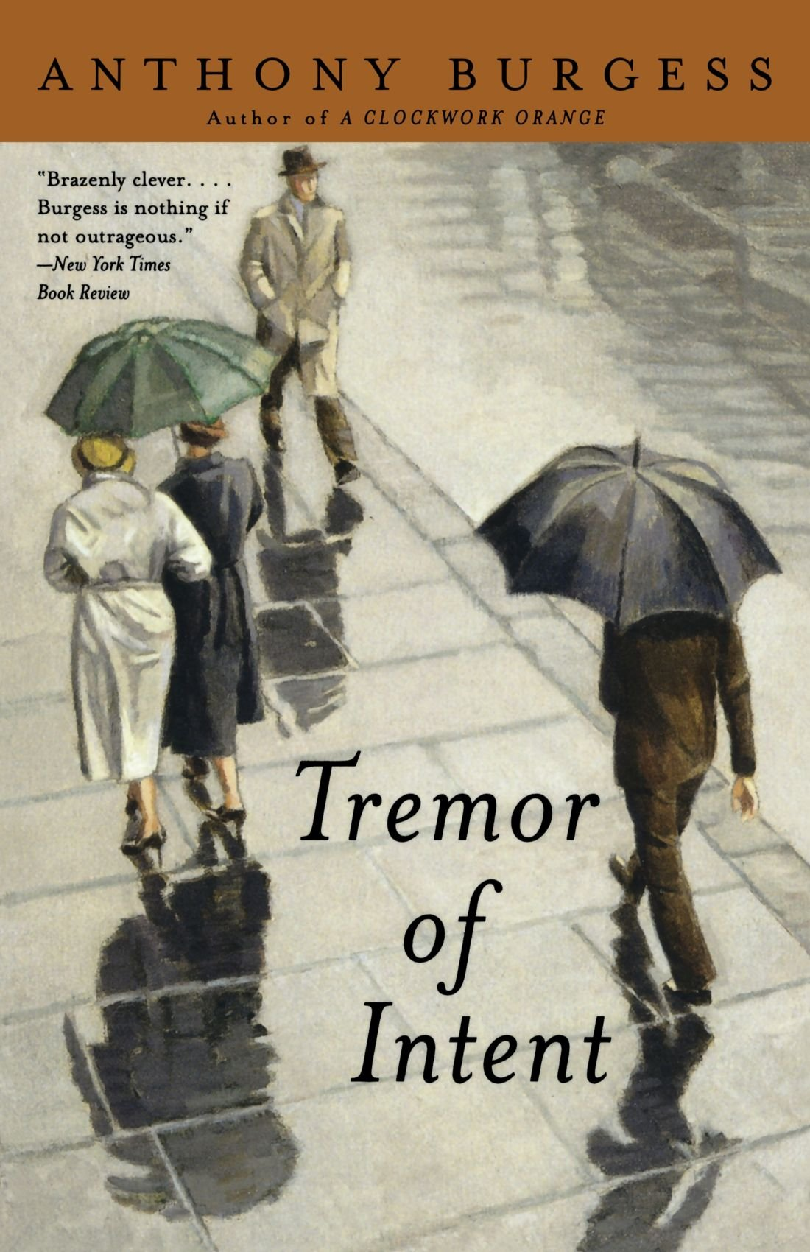
Themes and issues
Manichean universe
“Ah, what a bloody Manichean mess life is.” (p. 21)
Manicheanism – doctrine of primordial battle between light and darkness, good vs. evil
“You can’t get away from the great opposition.” (p.219)
Notes:
Frequent Burgess theme. Hillier’s vision of the world based on this – but see his final summation of the position at the end.

Slide 13
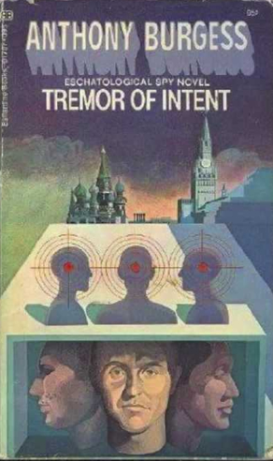
Themes and issues
Hillier’s regeneration foreshadowed from the start – belief in Original Sin, the schooldays at a school whose patron saint is Augustine.
Roper’s rationalism undone by observation of reality of evil in the world.
Overtly religious language, particularly at the end – God and Not-god. (p.219)
Notes:
Augustine v Pelagius: key difference is P’s denial of original sin.

Slide 14
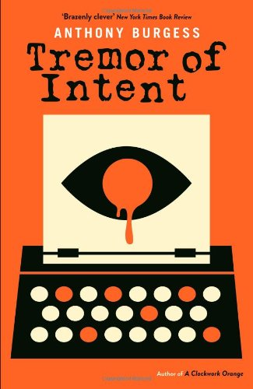
conclusions
Strange mix of genres
Spy novel, thriller, philosophical treatise
Mix of styles – some conventional realist segments, others more experimental.
Allusion, symbolism, puzzles – text is awash with traps for the unwary reader.

