Slide 1
Muriel Spark:
The Ballad of Peckham Rye
LIT 3024
The Sense of an Ending

Slide 2
Overview
Spark as novelist
The context of the times
Style and structure
Comic technique

Slide 3
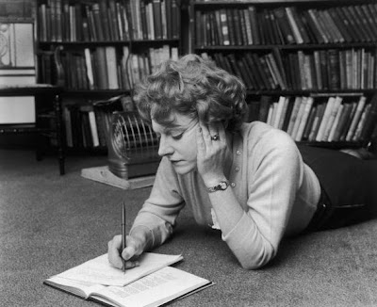
Muriel Spark
1918 – 2006
Edinburgh upbringing
1937: Aged 19, marries S.O. Spark and leaves for Rhodesia.
Unhappy marriage ends in 1940 and Spark returns to Britain in 1944
War work - propaganda
Notes:
Sidney Spark – manic depressive, violent.

Slide 4
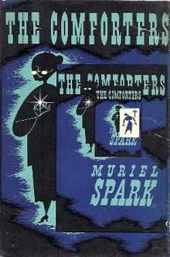
Early career
Editor of Poetry Review 1947-49
Writing and publishing poetry
Some short lit.crit. works
1954: Breakdown / conversion to Catholicism
Starts writing novels – 1957 The Comforters
Notes:
Comforters was published on advice of Evelyn Waugh and Graham Greene – Catholic connection. Obviously based on own experience – novelist who hears voices as a result of dexedrine. Typing Ghost – element of the supernatural that we also find in BPR and other Spark novels. Playful, self-reflexive style – even postmodern.

Slide 5
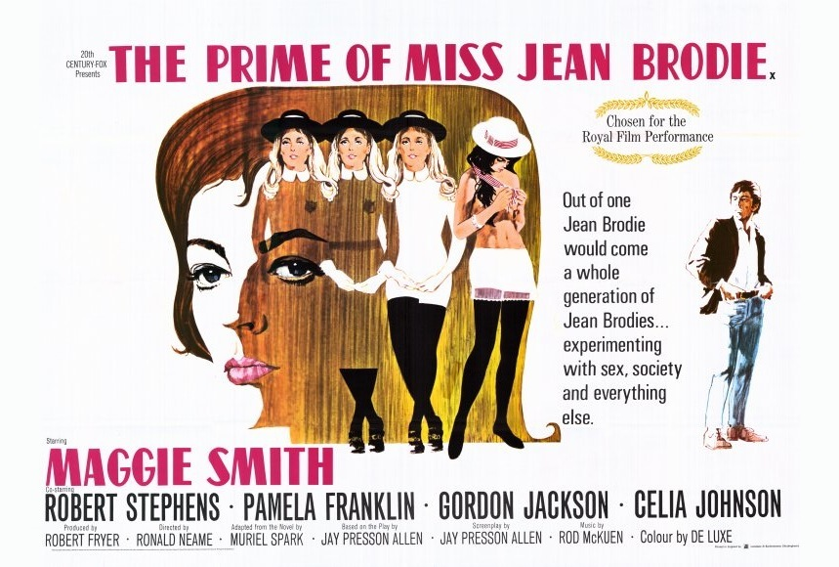
Later career
22 novels in a fifty-year career
Best known for The Prime of Miss Jean Brodie (1963) – made into a successful film
1967 on – exile in Italy

Slide 6
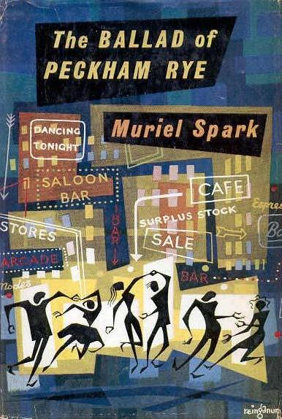
The Ballad of Peckham Rye
Published 1960
Set in contemporary London of the fifties
Supernatural overtones
‘Ballad’ is significant

Slide 7
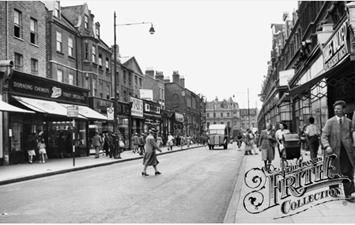
Peckham
Working-class district of south London
Social deprivation beginning to increase after the war
Nineteenth century housing, general air of decay.

Slide 8
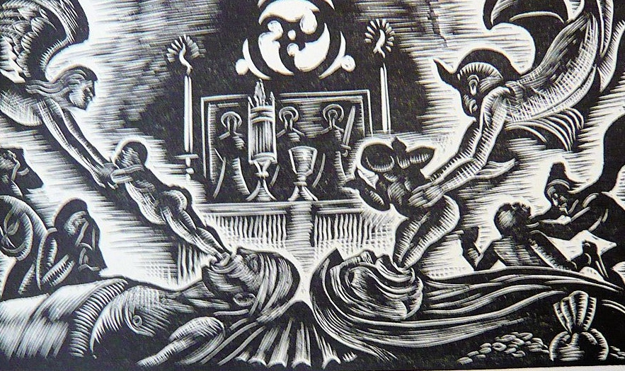
The Ballad and the Devil
Spark’s Scottish background
Initial vocation as poet
‘The Ballad of Fanfarlo’
Border ballads
Hogg’s Justified Sinner – representation of evil in the form of the doppelgänger
Notes:
Fanfarlo – from Baudelaire’s story about the dreamer poet and his love for the dancer Fanfarlo. Cramer. Spark transposes him to the present day in London, where he encounters, and has dialogue with, a series of people and inanimate objects – such as traffic lights and a steel chair, and finally Death. Written in ballad form, with peculiarly modernist touches (The new moon like a pair of surgical forceps /With the old moon in its jaws) cp Prufrock and Sir Patrick Spens. See opening exchange in BPR
Border Ballads – ‘concerned with the lyrical winding in and out of a situation; for all their repetitiveness and length, they are models of narrative economy.’ (in John Masefield (London: Peter Nevill, 1953) p.104
Image – Douglas Bliss, illustration from The Border Ballads (Oxford, 1925)

Slide 9
Dougal Douglas
Name is a kind of doubling
A “de-Picted Scot” (Maley)
Shapeshifter (cp Gilmartin in Hogg)
“Dougal changed his shape and became a professor” (p.16)
Dance of death (p.60)
Witch-like – can’t cross running water (p.87)
Becomes death (p. 173)
Notes:
Maley – in McQillan, M (ed) Theorizing Muriel Spark (London: Palgrave, 2002) p.181

Slide 10
Dougal Douglas
Radically disrupts the realism of the plot
Source of sexual confusion – both hetero and homo (Mr Druce)
Plays with ideas of fiction / reality (e.g. introducing events from his ‘research’ into the ghost-written autobiography of Maria Cheeseman
Dougal turns experience into “a lot of cockeyed books” (p.142)

Slide 11
Structure and style
Chapter 1 chronologically late in narrative
Central chapters work as analeptic account of events leading to the marriage scene
Final chapter ‘corrects’ versions of the narrative mentioned in chapter 1
Cinematic style – scenes are presented without linkage

Slide 12
Role of the supernatural
Elements of supernatural presented as unremarkable: e.g. Dougal with Merle Coverdale in the cemetery (p.30)
DD’s tale of his dream as the devil (p.77)
Battle with Trevor Lomas uses the bones of nuns as weapons (p.139)

Slide 13
Conclusions
Deals with major issues (death, morality, relationships) in comic form
Mixes realist and modernist technique
Blurring of fact and fiction
Boyd disbars supernatural interpretation: “…it is situated so fixedly in the grime and petit-bourgeois mundanity of post-war London” (p.ix)

