Slide 1
The Post-War Scene
LIT 3024

Slide 2
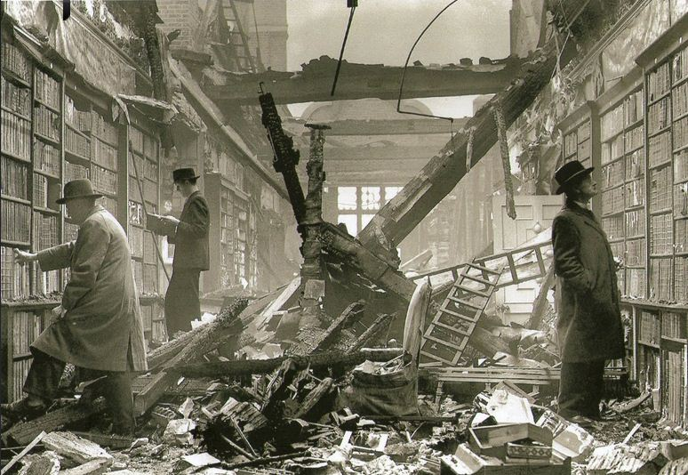
Britain in 1945
Notes:
The London Library during the Blitz

Slide 3
New start
1945 election – Labour landslide
Atlee’s government: NHS, nationalisation of railways, coal mines, steel, etc.
Education Act of 1944 fully implemented
Huge rebuilding programme
Post-war consensus established – lasting until Thatcher era.

Slide 4
Literary developments
Decline of modernism – Joyce and Woolf both dead in 1941, Pound incarcerated 1945-58.
Strongly political novels – e.g. Orwell’s Animal Farm (1945) and Nineteen Eighty-Four (1948)
Fifties in poetry – the Movement (Larkin, Amis, Davie, Enright, Jennings)
Fifties in the novel – emergence of regional novelists (Sillitoe, Wain, Waterhouse); novels of youth culture (MacInnes) and return to realism.
Fifties in drama – “Kitchen Sink” (e.g. Osborne) Avant-garde (e.g. Beckett)
Post-war cultural developments – 1951 Festival of Britain; 1955 launch of ITV; 1957 Hoggart, The Uses of Literacy.
Notes:
Sillitoe, The Loneliness of the Long-Distance Runner; Saturday Night and Sunday Morning.
Wain, Hurry On Down
Waterhouse, Billy Liar
MacInnes, Absolute Beginners

Slide 5
Cold War anxieties
Realignment of Europe
Iron Curtain (followed by Berlin Wall, 1961)
Overt war replaced by ‘cold’ war
Gives rise to literary genre – spy novel: Eric Ambler, Graham Greene, Ian Fleming, John le Carré

Slide 6
End of Empire
India partitioned / formation of Pakistan 1947
Independence granted to many colonial states by Macmillan’s government: “winds of change” speech 1960
‘Decolonisation’.

Slide 7
Growth of youth culture
Full employment
Growing affluence
Distinctive teenage / youth culture emerges
Pop music / fashion
Teenage subcultures – e.g. Teddy Boys

Slide 8
Our texts
Malcolm Lowry, Under the Volcano (1947)
Muriel Spark, The Ballad of Peckham Rye (1960)
Anthony Burgess, Tremor of Intent (1966)
Basil Bunting, Briggflatts (1965)
Anita Desai, Clear Light of Day (1980)
Tom Stoppard, Arcadia (1993)
+ poems by a selection of significant figures from the fifties to the present day.

