Slide 1
Notes:
Standard in all slides

Slide 2
UniSkills
Develop your Proofreading and Editing Strategies
ehu.ac.uk/ls
ehu.ac.uk/uniskills
Notes:
Standard in all slides – update title

Slide 3
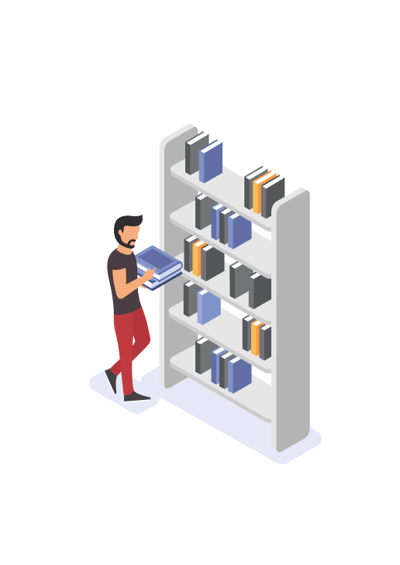
Overview of Session
The difference between ‘editing’ and ‘proofreading’.
Why it is important to proofread.
Strategies, tools, and techniques to use when proofreading.
Assistive technologies to support proofreading
Locating and accessing further support.
Notes:
Standard in all slides

Slide 4
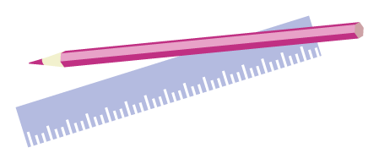
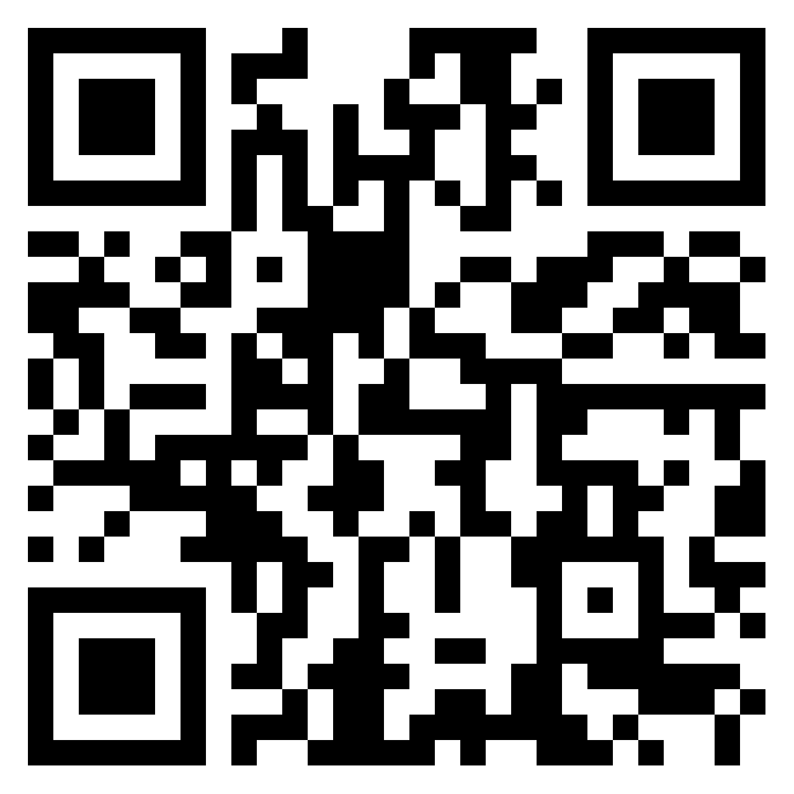
Self-Evaluation
Use Padlet to answer these questions:
How confident do you currently feel about proofreading your own work? Give yourself a score from 1 (not confident) to 10 (very confident).
How would you define editing?
How would you define proofreading?
https://edgehill.padlet.org/uniskills/lmlceei651yqwvdz
Notes:
QR code hyperlinked to Padlet.
Link to Padlet: https://edgehill.padlet.org/uniskills/lmlceei651yqwvdz
Editing is an important part of the writing process. It is the stage in which you try to make words and sentences clearer, more precise, and as effective as possible. It can also involve re-ordering your work and ensuring that there is fluidity between the different sections. This can be a lengthy process – almost like completing a jigsaw puzzle!
Proofreading comes after all of the editing is completed. It is less about checking content, and more about checking consistency – in spelling; punctuation and capitalisation; grammar; references; and presentation and layout. It is the final piece in the puzzle that ensures your work is as accurate and professional as it can possibly be.

Slide 5
Self-Evaluation
Editing is part of the writing process and comes before the proofreading.
Proofreading is reading and checking spelling; punctuation and capitalization; grammar; references; and presentation, layout, and consistency.
Notes:
QR code hyperlinked to Padlet.
Link to Padlet: https://edgehill.padlet.org/uniskills/lmlceei651yqwvdz
Editing is an important part of the writing process. It is the stage in which you try to make words and sentences clearer, more precise, and as effective as possible. It can also involve re-ordering your work and ensuring that there is fluidity between the different sections. This can be a lengthy process – almost like completing a jigsaw puzzle!
Proofreading comes after all of the editing is completed. It is less about checking content, and more about checking consistency – in spelling; punctuation and capitalisation; grammar; references; and presentation and layout. It is the final piece in the puzzle that ensures your work is as accurate and professional as it can possibly be.

Slide 6
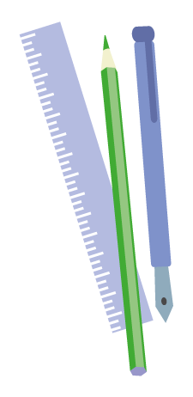
Why Proofread?
Transferable and lifelong skill…
‘Many jobs, and nearly all educational courses, require people to proofread material written by themselves and others for various errors and omissions.'(Furnham, 2010: 735).
Errors are easily overlooked, for example:
Use of contractions: didn’t, doesn’t, wouldn’t.
Commonly confused words: addition vs. edition; allusion vs. illusion; lose vs. loose.
What errors do you know you make?
https://edgehill.padlet.org/uniskills/lmlceei651yqwvdz
Notes:
QR code hyperlinked to Padlet.
https://edgehill.padlet.org/uniskills/lmlceei651yqwvdz
Employers want to see that you can write to a high standard, and are able to communicate your ideas with clarity and precision. Taking the time during your course to hone these skills can only increase your postgraduate employment opportunities.
Reminder of academic tone:
Academic writing avoids contractions and colloquialisms, as it is ‘professional’ in nature. Most academic writing also requires the use of the ‘third person’ academic voice. This helps to achieve some distance from the arguments/points being developed, and to maintain a cautious stance, i.e. the objective viewpoint: ​
​
It could be argued that…​
The following section of this essay will explore…​
Mead’s research indicates…​
​
However your subject area (health/education) may also require reflective writing in your assessments, so these will be in 1st person. Unless specifically stated, assume that you should be writing in 3rd person.​
​
Academic writing also uses evidence. So, no unsubstantiated opinions – what that means is, do not state something without providing the evidence from the literature. Remembering to reference throughout!
These are all things that you should be picking up on in your proofreading.

Slide 7
Why Edit?
Editing is a positive process of checking and changing written content, in order to perfect and produce a strong submission. When you edit your work, ask yourself:
Have I answered my question and covered my learning outcomes?
Is the content focused, well argued and presented?
Is my content clear and readable for my marking tutor?
Does it make sense?
Am I within my allocated word count?
Do I need to make my work and ideas more succinct?
Are my sentences varied and presented in a logical order and Hhave I used signposting between paragraphs and ideas to present my arguments?
Am I writing in an appropriate academic style and voice?
Notes:
QR code hyperlinked to Padlet.
https://edgehill.padlet.org/uniskills/lmlceei651yqwvdz
Employers want to see that you can write to a high standard, and are able to communicate your ideas with clarity and precision. Taking the time during your course to hone these skills can only increase your postgraduate employment opportunities.
Reminder of academic tone:
Academic writing avoids contractions and colloquialisms, as it is ‘professional’ in nature. Most academic writing also requires the use of the ‘third person’ academic voice. This helps to achieve some distance from the arguments/points being developed, and to maintain a cautious stance, i.e. the objective viewpoint: ​
​
It could be argued that…​
The following section of this essay will explore…​
Mead’s research indicates…​
​
However your subject area (health/education) may also require reflective writing in your assessments, so these will be in 1st person. Unless specifically stated, assume that you should be writing in 3rd person.​
​
Academic writing also uses evidence. So, no unsubstantiated opinions – what that means is, do not state something without providing the evidence from the literature. Remembering to reference throughout!
These are all things that you should be picking up on in your proofreading.

Slide 8
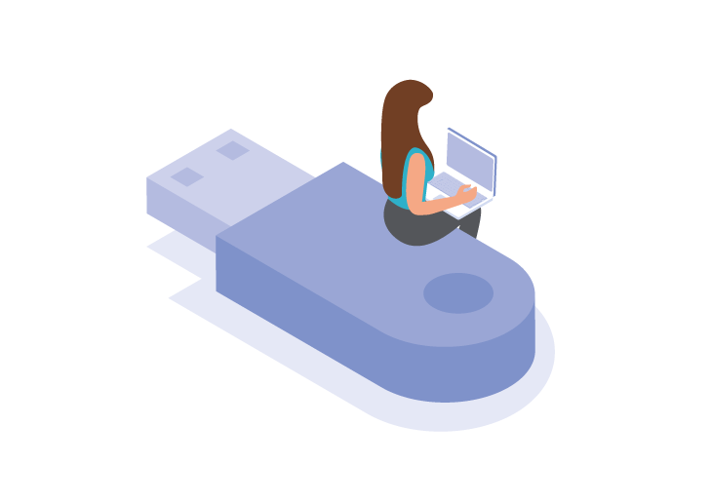
Activity
What errors can you spot in this excerpt?
Writing can be really quiet difficult. its not that that we don’t know what to say, but getting are words down on paper can be a challenge. It feels like everyone else knows what there doing but really we’re all learning and struggling and should make sure we ask for help and keep practicing and keep trying to get it right. Proofreading is an important part of this process, and some argue that it is required in many jobs (Furnham 2010). Proofreading helps us check for errors in are grammar, spilling, and punctuation, and also to make sure our format and referencing is correct.
Notes:
Suggest not to read aloud to students, as errors will be more evident then – let the students have a go on their own. Can discuss amongst peers, or whole class discussion depending on size.
Students might be encouraged to screenshot the image (if F2F) so they can engage with it more directly.

Slide 9
Activity
What errors can you spot in this excerpt?
Writing can be really quiet difficult. its not that that we don’t know what to say, but getting are words down on paper can be a challenge. It feels like everyone else knows what there doing but really we’re all learning and struggling and should make sure we ask for help and keep practicing and keep trying to get it right. Proofreading is an important part of this process, and some argue that it is required in many jobs (Furnham 2010). Proofreading helps us check for errors in our grammar, spilling, and punctuation, and also to make sure our format and referencing is correct.
Notes:
Text is also justified; can mention spacing too.
Highlight:
Contractions.
Malapropisms.
Run-on sentences.
Referencing.
Confusing singular and plural.

Slide 10
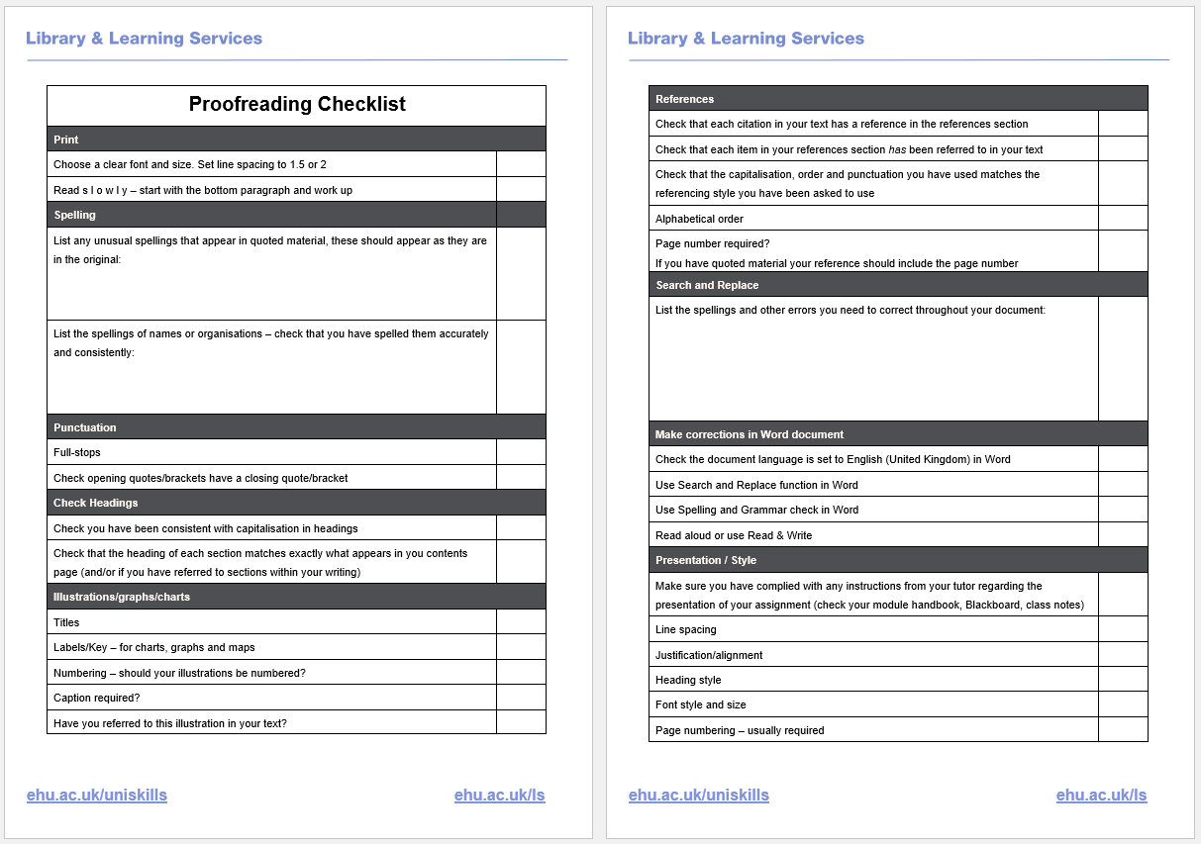
Proofreading Checklist
Crucial!
Notes:
Image hyperlinked to checklist.
Link to checklist: http://eshare.edgehill.ac.uk/14291/1/Proofreading%20Checklist%20%28Accessible%29.pdf

Slide 11
Top Techniques
Print out – double line spacing minimum
Zoom out to check layout
Make pages fit width of screen
Read S L O W L Y
Read in sections from the bottom up
Read backwards, by word or by sentence
Use a printer, pen, highlighter, post it notes – whatever works for you.
Focus on one aspect at a time, e.g. referencing, spelling, grammar.
Allow yourself time away from your work; return to it with a fresh set of eyes
Read out aloud…
Notes:
Suggested that reading in sections/backwards distracts the reader from content/context and helps focus on spelling and grammar (https://www.eiu.edu/fycomp/Tips.pdf).

Slide 12
Top Techniques
Use each other: friends/family – a different pair of eyes.
Avoid using third-party, paid-for services.
Give yourself time – be in the right mindset.
Use English grammar book or websites
Notes:
Turner notes concerns about the ethics of using third-party services for proofreading. Issues arise over academic integrity (‘whose work is it?’), potential loss of learning opportunities (correcting students mistakes for them, leading to passive learning), and the inequity that arises due to finances or lack thereof (2011; cf. Conrad, 2020).
Can suggest using different coloured highlighters/pens for each aspect.

Slide 13
Technologies for Proofreading
Help students read more effectively (cloudguides.com)
This resource explains how to use to reduce distraction and simplify the interface so you can focus better on reading your writing.
Notes:
Should note here that read aloud software may not be useful for EAL students. Citing Harris (1987), Salter-Dvorak explains that ‘reading one’s work aloud is a strategy associated with experienced native-speaker writers’ (2020: 126). In this instance, we can refer students to the EHU Language Centre and their Academic English Language Support sessions: https://www.edgehill.ac.uk/departments/academic/efl/academic-and-english-language-support/

Slide 14
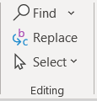
Technologies for Proofreading
Hear web pages and documents read aloud. | Use Read Aloud to hear your work read back to you with simultaneous highlighting. | Use find and replace for any contractions | Use Editor to check for formality
Understand unfamiliar words with text and picture dictionaries. | Breaks words into syllables to promote concentration. | Helps to remove informality. | Use Editor to check for spelling and grammar errors
Develop writing skills with word prediction. | Helps you to check the fluency of your work. | Helps you to establish a more academic tone. | Use Editor to check for clarity and conciseness
Supports spelling with similar word checker for homophones. | Makes editing much easier. | Saves time in long documents. | Use Editor to check for punctuation conventions
Notes:
Should note here that read aloud software may not be useful for EAL students. Citing Harris (1987), Salter-Dvorak explains that ‘reading one’s work aloud is a strategy associated with experienced native-speaker writers’ (2020: 126). In this instance, we can refer students to the EHU Language Centre and their Academic English Language Support sessions: https://www.edgehill.ac.uk/departments/academic/efl/academic-and-english-language-support/

Slide 15
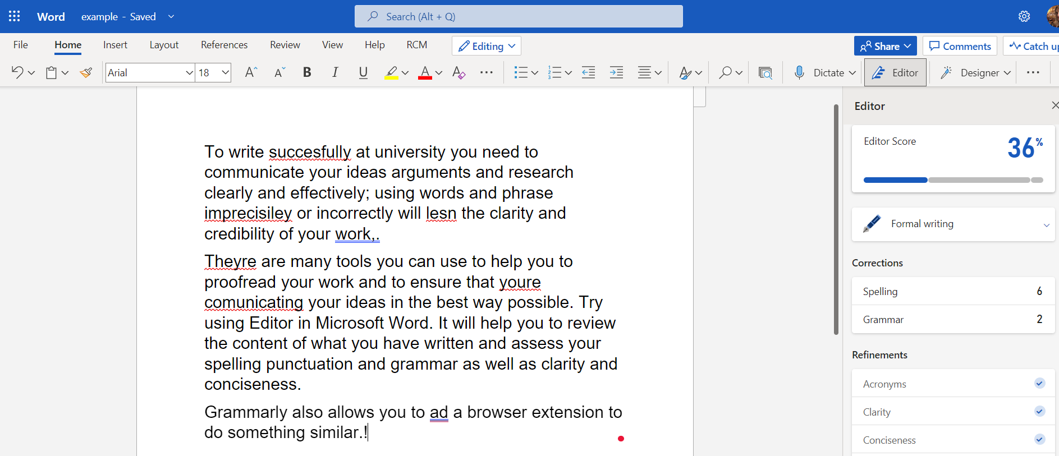
Explore Editor on Microsoft Word
Notes:
Example of this provided in Teams, but might need to ensure version of word has Editor.
NB. Some errors are not highlighted (links to next slide), e.g. ‘phrase’ instead of ‘phrases’; and commas between spelling, punctuation, and grammar.

Slide 16
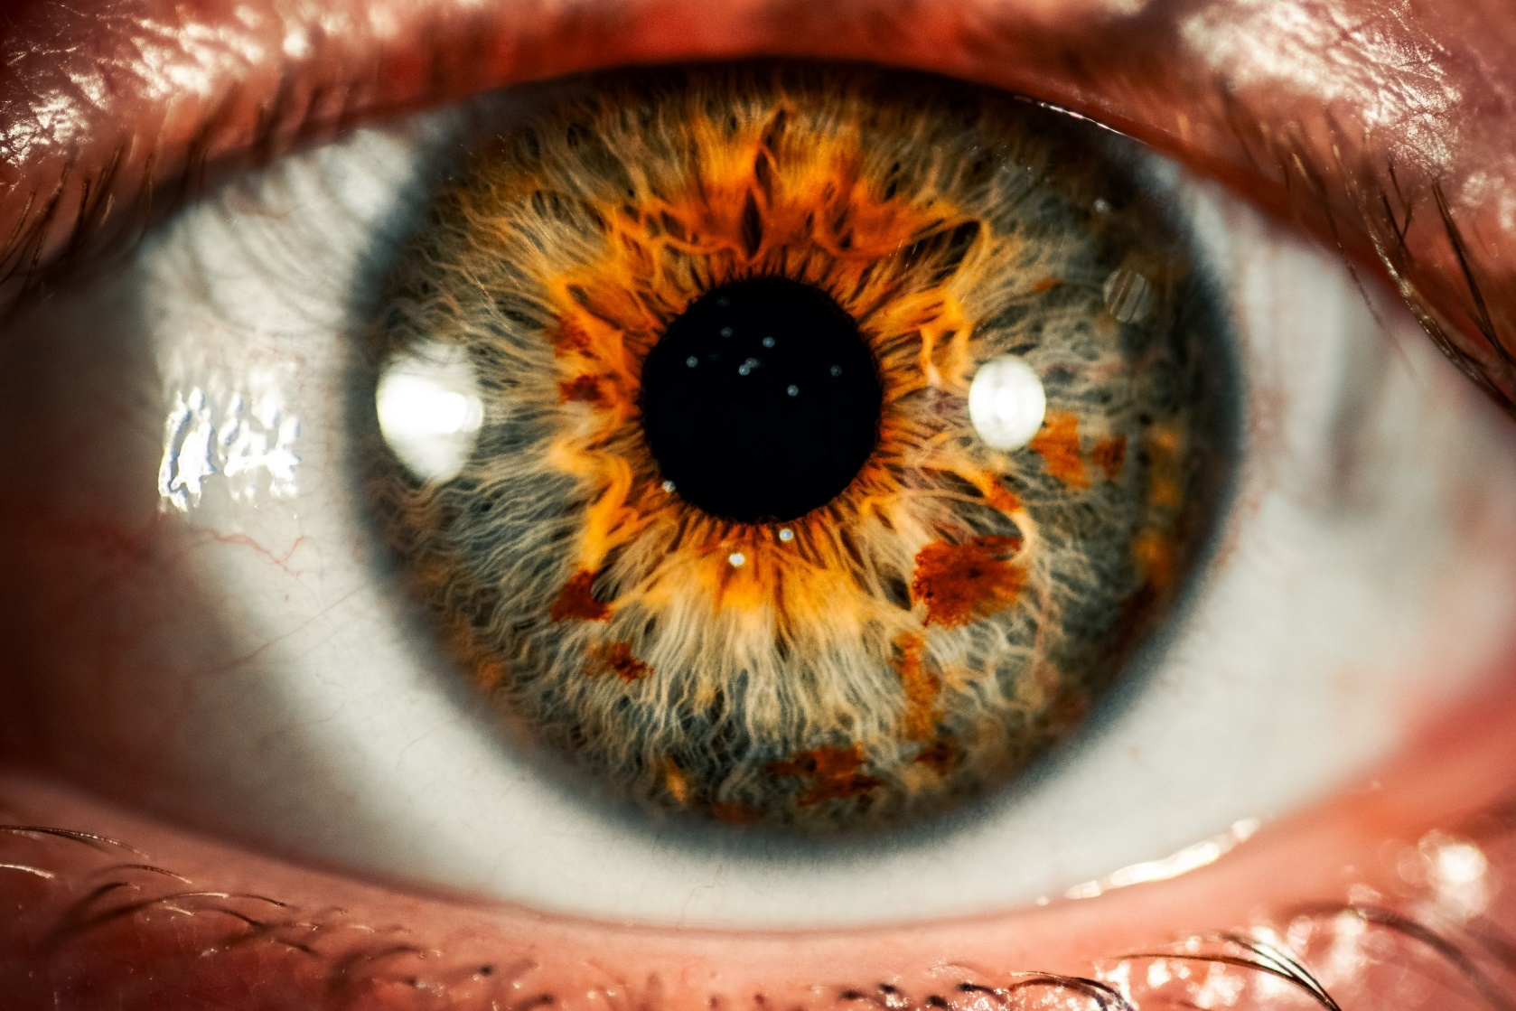
Remember…
There may still be things assistive technologies might not pick up.
Use the tools, but a ‘human eye’ is still always recommended when proofreading your work.
Notes:
Whilst the plethora of assistive technologies available are certainly useful, it is important to remember that these too can overlook mistakes.
For example, words spelled correctly but misused in your particular context may be overlooked.
It is important, then, to give your work a final double-check even if you have used all of the tools available to you.

Slide 17
Things to Take Away
Editing is part of the writing stage; proofreading is your final checkpoint.
Proofreading checks for errors and inconsistencies in your spelling; punctuation and capitalization; grammar; references; and presentation and layout.
Being a good proof-reader -> being a good student and, ultimately, a good employee.
Make use of all of the tools, tips, and technologies available to you…but always make that final check yourself!

Slide 18
Self-Evaluation
How confident do you now feel about proofreading your own work? Give yourself a score from 1 (not confident) to 10 (very confident).
What tips have you found most helpful in this session?
https://edgehill.padlet.org/uniskills/lmlceei651yqwvdz
Notes:
QR code hyperlinked to Padlet.
https://edgehill.padlet.org/uniskills/lmlceei651yqwvdz

Slide 19
Interactive Online Toolkit
Notes:
Image hyperlinked to Toolkit.
Link to Toolkit: http://eshare.edgehill.ac.uk/16349/3/story.html

Slide 20
Further support
Discover information, guides, videos and toolkits on our webpages
Book your place on a UniSkills webinar or workshop running throughout the year
Book an appointment with UniSkills for 121 support
Contact the Catalyst Helpdesk via email at CatalystEnquiries@edgehill.ac.uk, search our FAQs or Ask a Question online
Explore LinkedIn Learning to access online courses and video tutorials, written by industry experts, to help develop your skills and boost your employability
Attend 3 UniSkills workshops and/or webinars to gain 10 activity points towards the Extra Edge Award
Notes:
Standard in all slides

Slide 21
Keep in touch
@EHULibrary
@EHULearnService
edgehill.ac.uk/uniskills
blogs.edgehill.ac.uk/ls
Notes:
Standard in all slides

Slide 22
Notes:
Standard in all slides

