Slide 1
Research Laboratory
Dr Rachel Marsden and Dr Shaun Thompson

Slide 2
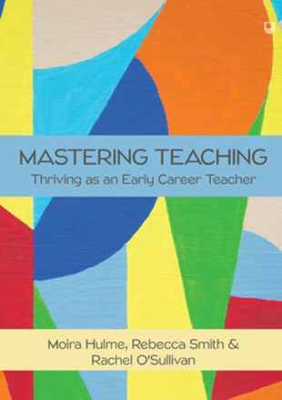
Who?
Dr Rachel Marsden
Teacher
Teacher-researcher
Researcher of teacher-researchers
Teacher of teachers

Slide 3
Who?
Teacher
Mixed methods
Teacher Educator
Autism
Special Educational Needs
Well-being
Dr Shaun Thompson

Slide 4
What?
A forum for academics at the university and teachers in our Partner schools and colleges to meet up and discuss research.
20 minute presentation, followed by questions, then a general discussion about research.
We have had colleagues talking about their doctoral research, projects they’ve been involved in that they’d like to roll out further, and showcasing what could be achieved by academic-teacher collaboration.
Teachers from Rainford High have also presented about their longitudinal research project.

Slide 5
When?
Once per month
A different day each month to avoid fixed commitments
4pm to fit around the school day
On Teams, then hybrid in May and June

Slide 6
Future Ideas
Vlogs of academics talking about how their research might be of interest to teachers.
‘Match-making’ service where teachers can input their interests, and we can match them to an academic
ResearchLab@edgehill.ac.uk

Slide 7
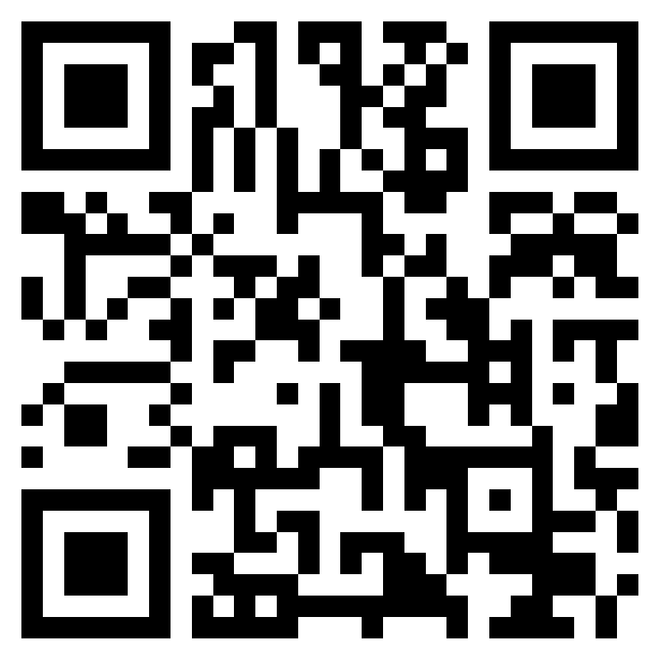
Interested?
Register here: https://forms.office.com/e/8qUKnuwn7k

