Slide 1
Education for Social Justice
Professor Vicky Duckworth

Slide 2
Vision Statement
To develop and sustain a critical, positive and praxis-driven environment which engages at a local, national and international level. It will be dialogic, intellectually thought-provoking and inclusive in its desire to unite those who have an interest in engaging with research-related activities that inform policy and practice in the field of social justice

Slide 3
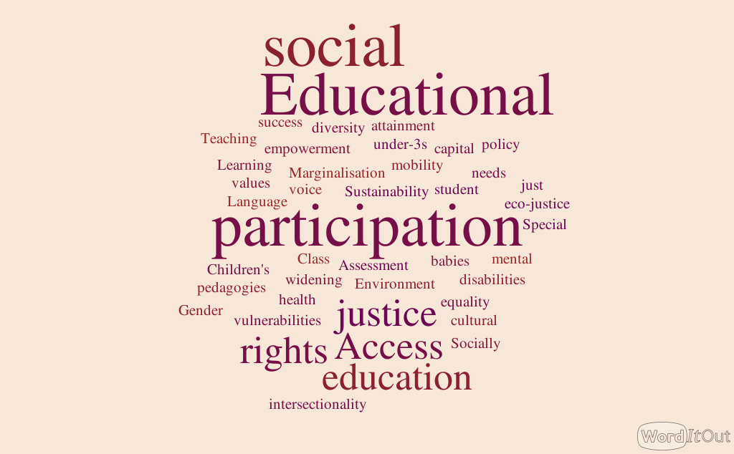

Slide 4
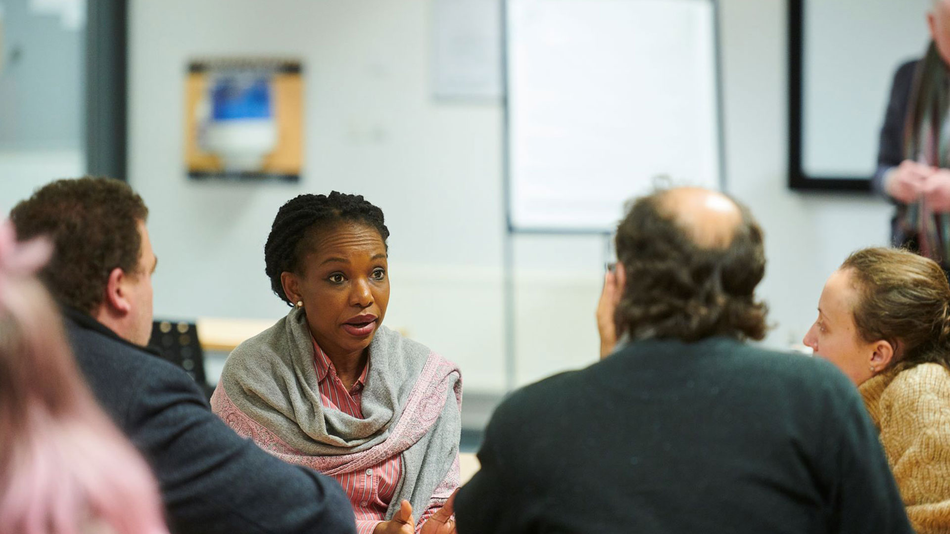
Launch and Day Workshop with Graeme Tiffany

Slide 5
Special Edition of the journal, PRISM

Slide 6
Screening of the award-winning documentary, ‘Young Plato’

