Slide 1
Step by step author instructions for institutional accounts
institutionalaccounts@plos.org

Slide 2
Explainers:
1-page explainer
Step by step multi-screenshot walk through
Summary of four-step check process

Slide 3
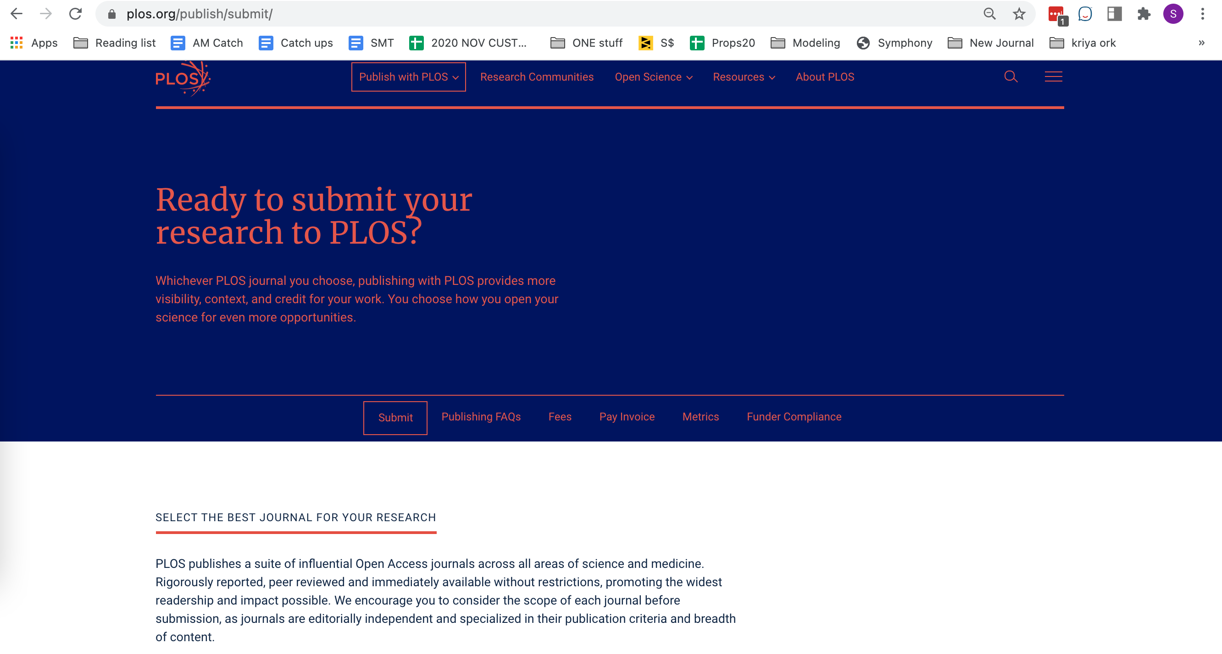
To submit to PLOS journals visit: https://plos.org/publish/submit/

Slide 4
To take advantage of your institutional agreement: authors must correctly identify their institutions in two places during submission
”Additional information” and “Manuscript Data” both require correct institutional affiliation selections.
Authors can skip to any section in any order during manuscript submission process. The submission portal will alert authors when they have missed a required field. Both their payment and author personal information are required for submission.
https://plos.org/publish/submit/

Slide 5
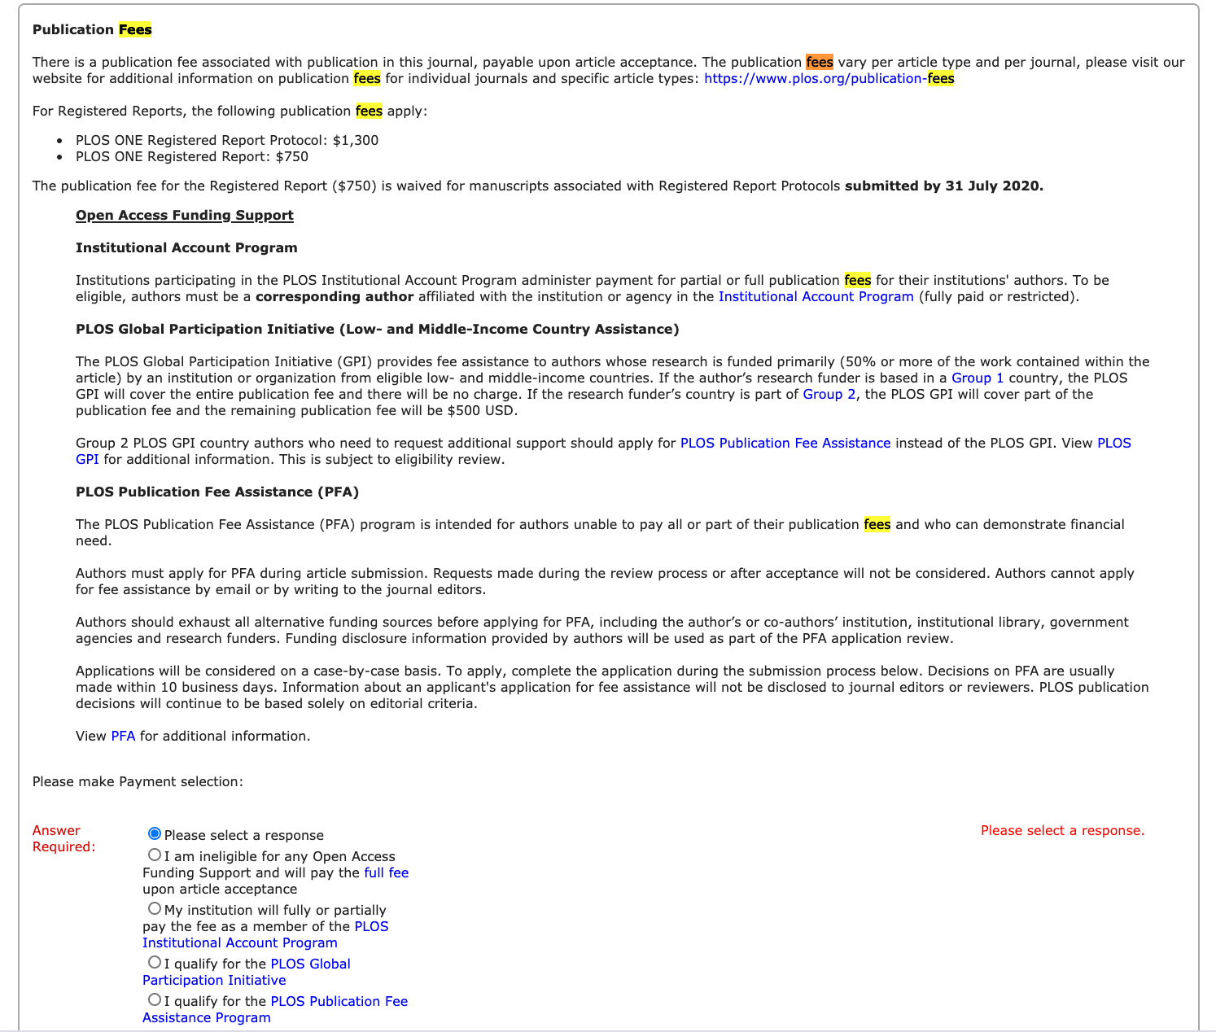
1. Within the “Additional Information” page, scroll to “Publication Fees” 2. Select second radio button “My institution will fully or partially pay the fee..”
Steps to select your correctly select your institution

Slide 6
4. Select your institution from the drop down.
Select your institution’s name from the drop down menu. Once you make a selection, no further action is required.
No more drop downs or text boxes will appear*.
Complete the rest of the sections in this portion of the submission process.
*Except for University of California authors

Slide 7
To take advantage of your institutional agreement: authors must correctly identify their institutions in two places during submission
After completing your “Additional Information” Publication Fees selection, you will have to complete your “Manuscript Data” section prior to submission. This is where you provide all the metadata associated with your manuscript for reporting, billing, and invoicing purposes.

Slide 8
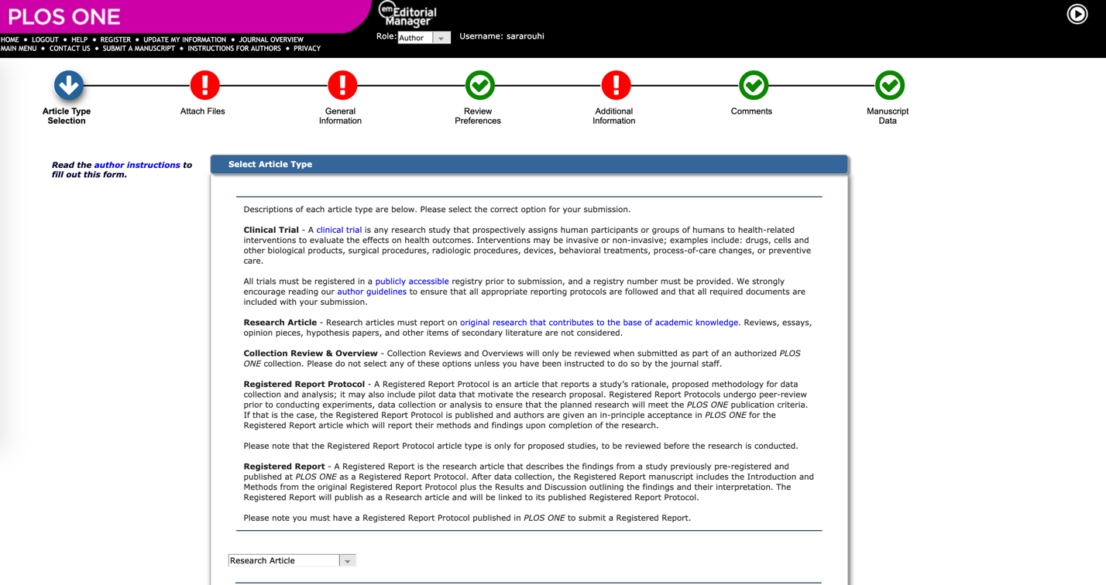
Jump to “Manuscript Data” from top-level navigation.

Slide 9
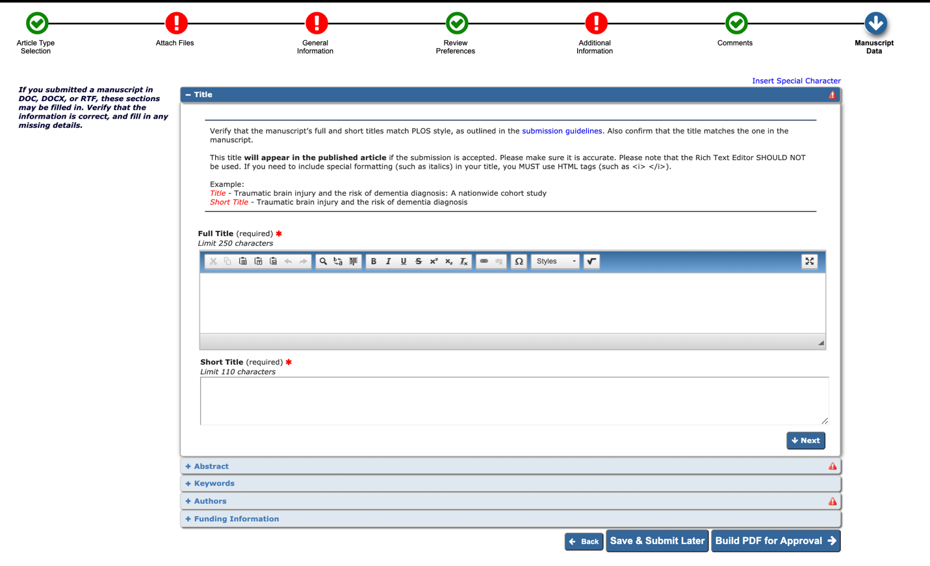
Click on the “Authors” drop down and edit your contact information

Slide 10
Click on the pencil to edit your contact information

Slide 11
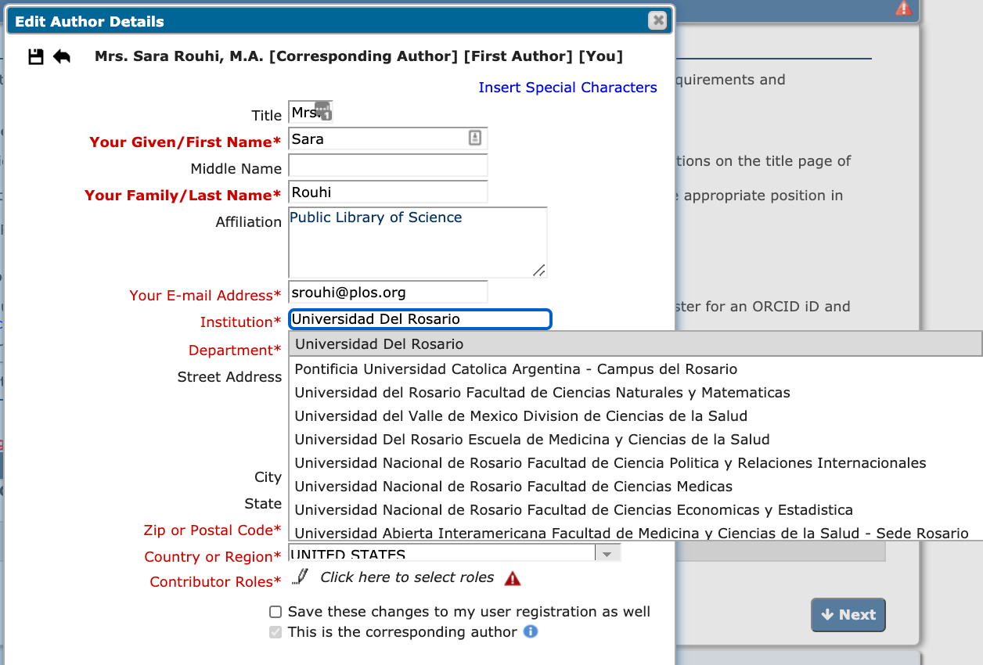
Begin typing your institutional affiliation to prompt the dropdown menu and select from drop down. DO NOT override and type a different institution name.

Slide 12
When finished, click next and move on to providing next section.

Slide 13
To summarize: 4 checks
Additional Information → Publication Fees → Institution Account Program → Institution Name
Manuscript Data → Authors --> Click on Pencil → Type name in institution → Click on appropriate org in drop down
There is a final institutional affiliation check done manually during the accounting/invoicing process.
The library will receive a monthly publications report where librarians can review published papers to ensure they are eligible for the library’s agreement

Slide 14
Questions?
For all journals: https://plos.org/publish/submit/
For PLOS ONE:
https://journals.plos.org/plosone/s/submission-guidelines
FAQs:
https://plos.org/publish/publishing-faqs/

